Slide 1
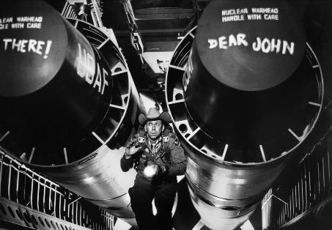
MIGS Brain Dump 2019
What Didn’t Kill Me
Oscar Clark
Samantha Cook
Amy Dallas
Henrik Jonsson
Bahiyya Khan
Richard Rouse III
Jesse Scoble
Matthew Weise
@Athaneteus
@cookthesam
@amydallas
@IonSwitz
@BreakinBahiyaa
@richardrouseiii
@jscoble
@sajon77
Montréal International Game Summit
Tuesday, November 19th, 5PM
Notes:
Welcome.

Slide 2
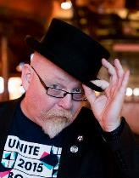
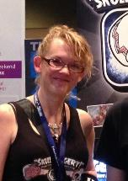
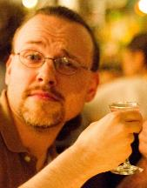
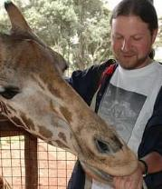
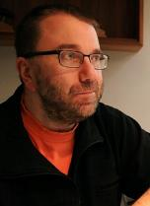
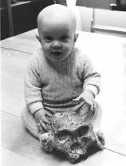
Notes:
Our format is simple
We round up a bunch of cool speakers

Slide 3
5 MINUTES
Notes:
And invite them to talk on a theme for five minutes

Slide 4
WHAT DIDN’T KILL ME
Notes:
And we invite them to talk on a theme
So this is a term you’ve heard before

Slide 5
“Was mich nicht umbringt, macht mich stärker. - Nietzsche
Notes:
It’s tied to...
5

Slide 6
“That which does not kill me makes me stronger.” - Nietzsche
Notes:
Which is...
There’s all sorts of reasons this isn’t actually true – things can really hurt us without killing us, and they don’t always make us stronger.
For our purposes, think of it more as “That which leaves me functional to make ore games”... But I’ll get back to that at the end of the talk.
But we’re on a tight schedule so let’s get to our first speaker.
6

Slide 7
Co-Founder
Fundamentally Games
@Athanateus
OSCAR
CLARK
Notes:
Oscar Clark is co-founder of Fundamentally Games and a pioneer in games services since 1998. And he recently told me he’s the person who figured out how to make PlayStation Home work...
Bio:
He helps developers and investor design, deliver and monetize games and literally wrote the book “Games As A Service” published by Focal Press. Over his career he has planned, delivered and helped manage pioneering games services including BT Wireplay, Three and Playstation Home as well as consulting on more games projects that he can recall. He is best known as an evangelist for Unity Technologies, and prior to that NVIDIA, Papaya Mobile and Applifier.
Past projects:
Major highlights include Playstation Home (Sony’s groundbreaking virtual world as Home Architect), Three UK’s Games Platform (Worlds highest revenue/user Java games platform), BT Wireplay (one of the first Online Gaming Service ever), numerous games projects with a diverse range of clients including (but not limited to) Jagex, Kiloo, Team17, Deepmind, Reality Gaming, Internet of Elephants, India Games, Proper Games, Copenhagen Creators, Games Faction, Exient, Iomo Studios, Thumbstar Games, Biodroid Entertainment, Magmic, EA, AMA, Soccer Manager, Virtrade, No Yetis Allowed, Dreamharvest, Atom Universe, etc (in no particular order).

Slide 8
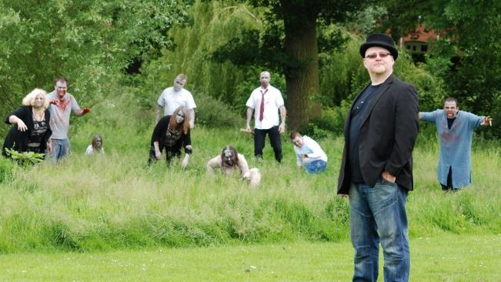

Slide 9
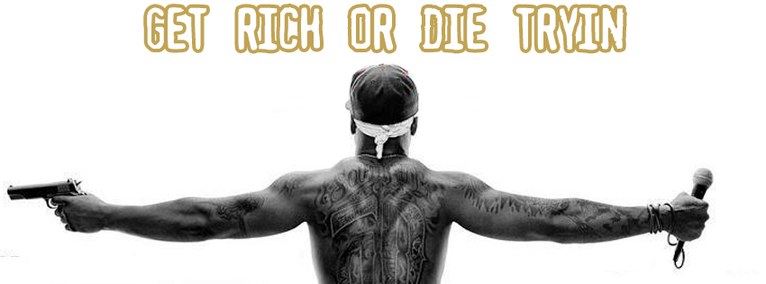

Slide 10
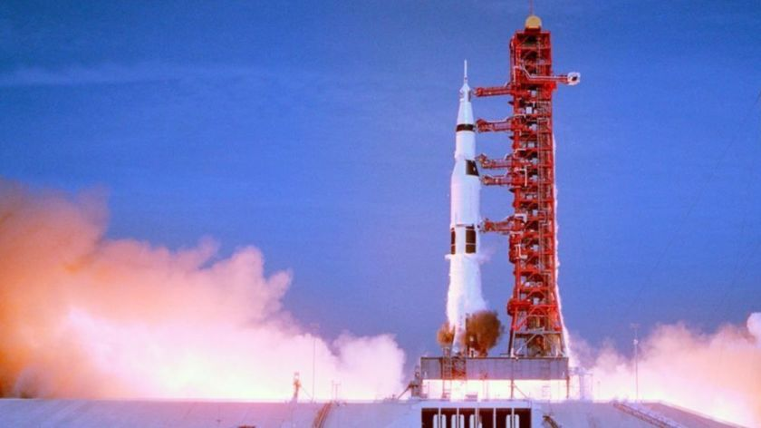

Slide 11
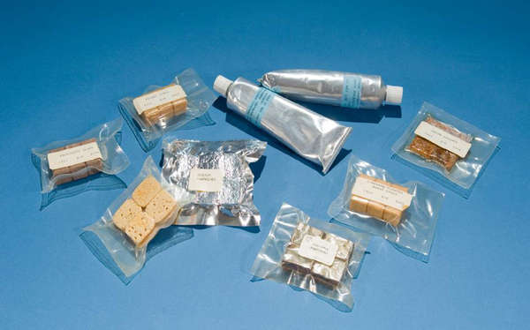

Slide 13
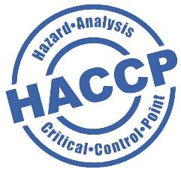
DEFINE “HAZARDS”
IDENTIFY CONTROL POINTS
IDENTIFY NORMAL LIMITS
MONITOR & CORRECT
REVIEW

Slide 14
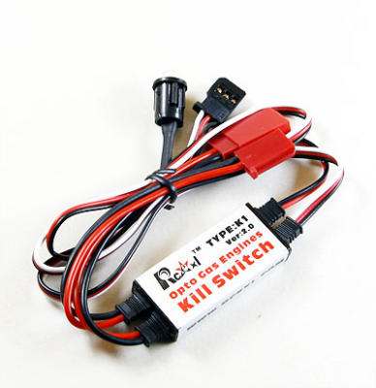

Slide 15
VISION
GAP ANALYSIS
MECHANIC
CONTEXT
CORE DEVELOPMENT
PLAYER PERSONAS
TEST STORE PAGE
30s VIDEO
PROTOTYPE CONTEXT
ALPHA TESTING
METAGAME
MVP DEVELOPMENT
PROTOTYPE METAGAME
LIVE OPS PROCESS
RELEASE CANDIDATE
CLOSED BETA
OPEN BETA
SOFT LAUNCH
USER AQUISITION
SCALE
LIVE OPERATIONS
LAUNCH
PROTOTYPE
FIND THE FUN

Slide 17
Oscar Clark
Chief of Curiosity
@Athanateus
Oscar@fundamentallygames.com

Slide 19
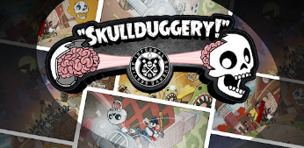
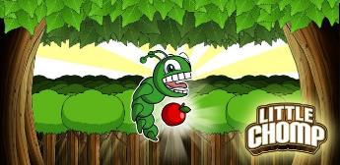
CEO/Co-Founder
ClutchPlay Games
@AmyDallas
AMY
DALLAS
Notes:
Amy Dallas has a background everywhere from EA Maxis to ngmoco
She the one of the four founding partners of ClutchPlay Games, a small but scrappy game studio in Portland, Oregon.
PAX 10 Award winning game Skullduggery
Full bio:
Founded in 2012, the ClutchPlay team has worked on several indie and work-for-hire titles for larger companies such as ILMxLAB, Endless Entertainment, KIXEYE, Inc., Telltale Games, Glu Mobile, and Intel to name a few.
ClutchPlay’s first game Little Chomp, was selected as one of six titles featured at the 2013 PAX East Indie Showcase, and their second title, “Skullduggery!” was selected for the PAX 10 Indie Showcase at PAX Prime 2014.
As the CEO, Amy wears a lot of hats at ClutchPlay, and divides her time between being a tireless organizer, an accomplished cat-herder, a skilled bomb-diffuser, a fearless lion-tamer, a compassionate hand-holder, an experienced whip-cracker, a relentless team-builder, and a producer of some pretty badass projects. Before starting ClutchPlay, Amy worked at several game companies, including EA Maxis, ngmoco:) and DeNA.

Slide 20
Notes:
I’m Amy Dallas. Welcome to my personal edition of “shit that didn’t kill me.”
20

Slide 21
Notes:
…is fear. Fear is kind of a weird and uncomfortable thing to talk about in this industry. This is a competitive ‘survival of the fittest gig.
which makes admitting anything other than pure confidence seem like a bad life choice.
Fear comes in small quiet moments disguised as something other than what it is.
Perfectionism. Self Doubt. Pessimism. Procrastination.
21

Slide 22
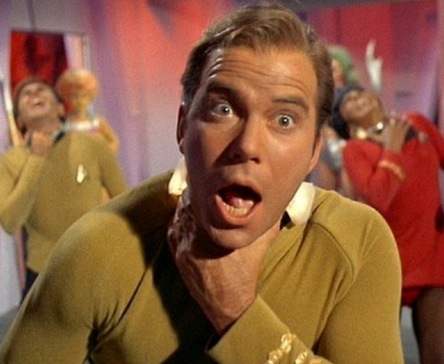
Notes:
So even when you feel like this…
22

Slide 23
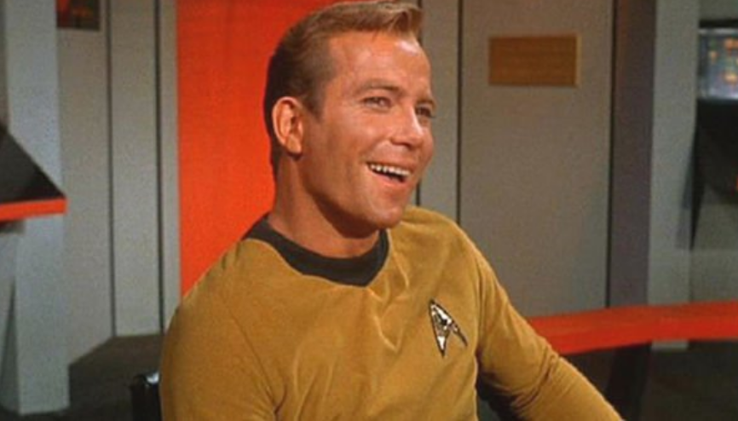
Notes:
You’ve got to look like this
23

Slide 24
Self Doubt
Notes:
Not too long ago, Gallop did a poll of the top 10 human fears and fear of failure ranked just below death in that list.
24

Slide 25
Self Doubt
Perfectionism
Notes:
Not too long ago, Gallop did a poll of the top 10 human fears and fear of failure ranked just below death in that list.
25

Slide 26
Self Doubt
Perfectionism
Pessimism
Notes:
Not too long ago, Gallop did a poll of the top 10 human fears and fear of failure ranked just below death in that list.
26

Slide 27
Self Doubt
Perfectionism
Pessimism
Procrastination
Notes:
Not too long ago, Gallop did a poll of the top 10 human fears and fear of failure ranked just below death in that list.
27

Slide 28
Gallop Poll: Top 10 Human Fears
Fear of flying
Fear of public speaking
Fear of heights
Fear of the dark
Fear of intimacy
Fear of death
Fear of failure
Fear of rejection
Fear of spiders
Fear of commitment
Notes:
Not too long ago, Gallop did a poll of the top 10 human fears and fear of failure ranked just below death in that list.
28

Slide 29
Notes:
The way you battle fear of failure is by recognizing that it’s better to try and fail and go down swinging than it is to fail because you didn’t try.
In many ways, we in the games industry are unequipped with resilience to failure.
When you get killed in a game, you don’t quit. You reset the level and start again, with a little more information on how to get through it.
29

Slide 31
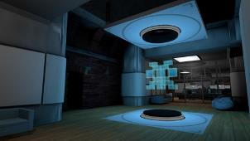
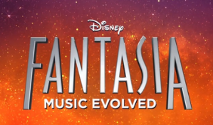
Co-Founder/Creative Director
Fiction Control
@sajon77
MATTHEW WEISE
Notes:
Watthew Weise is a game designer, writer and educator who has worked on everything from Fantasia Music Evolved to his current passion project and something I like a lot, The Myth Machine

Slide 32
Abandon Your Vision
Matthew Weise
Notes:
32

Slide 33
Notes:
33
10 years ago I was here, doing experimental game design work.
It was a lot of fun, but really I had this burning desire to make “my game”.

Slide 34
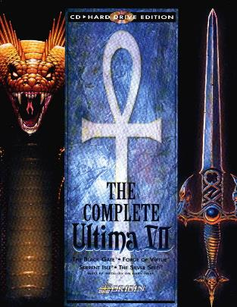
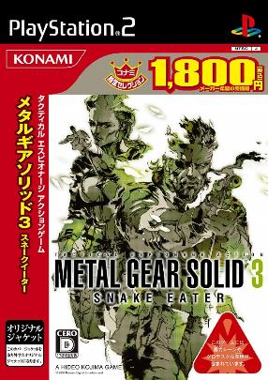
Notes:
34
“My game” was some sort of hyper-specific emergent narrative simulation.
Inspired by my (apparently) eclectic taste.

Slide 35
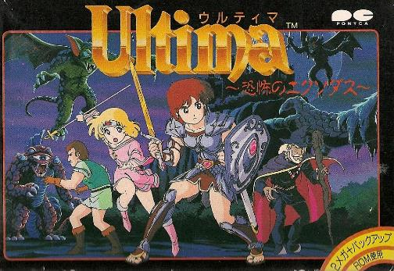
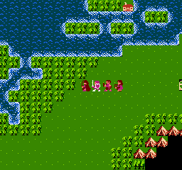
Notes:
35
It was all because of this nonsense.
The idea was to make a mechanics-heavy, systems-heavy simulation within a highly constrained scenario that naturally lent itself to drama.
I imagined it would be pixel art.

Slide 36
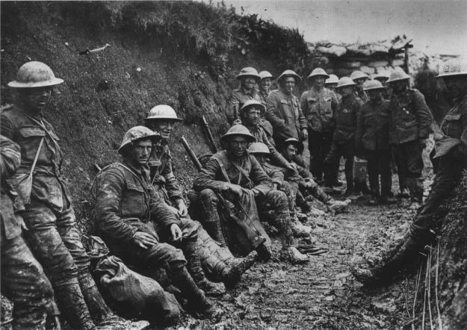
Notes:
36
The limited nature of a pressure-cooker scenario that promotes drama was key.
The team came up with two possibilities: a whimsical dream inspired by The Little Prince... or World War I.
We forced them to choose World War I.

Slide 37
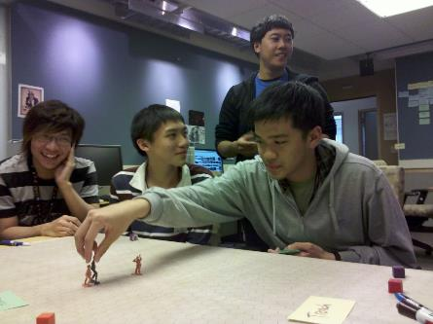
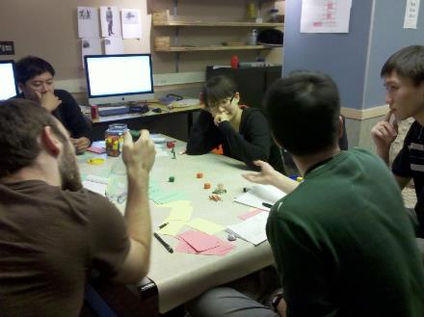
Notes:
37
We prototyped it for weeks.
Literally weeks, to develop scenarios.

Slide 38
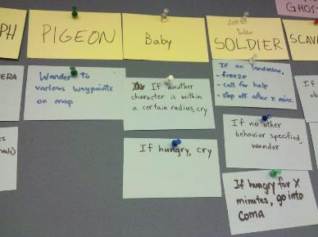
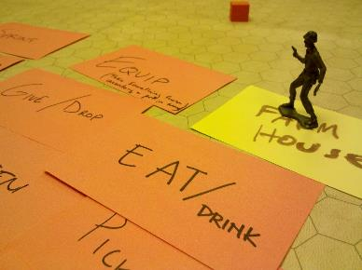
Notes:
38
It was full of all sorts of A.I. actors in a simulated world.
I had a solider, a baby, a pigeon, a hungry dude, a woman defending her house. It had hunger, madness, cold, and fear as systems.

Slide 39
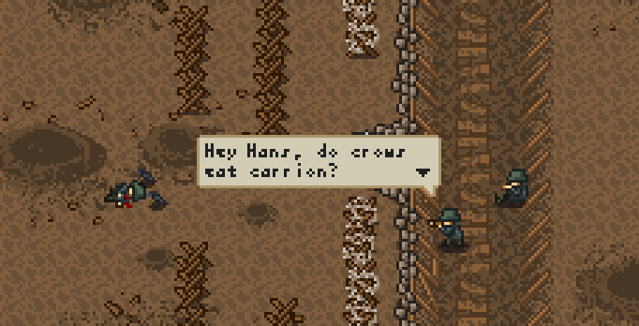
Notes:
39
I thought it needed to be fairly abstract for all this to work, like a pixel art game.

Slide 40
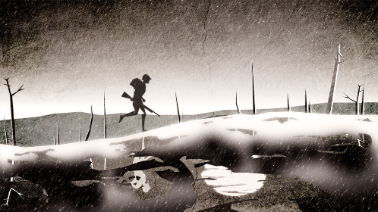
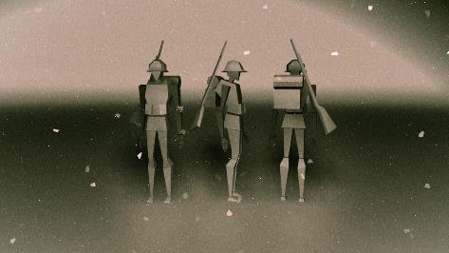
Notes:
40
But our art team got obsessed with 3D.
The project co-lead, our Art Director, supported this over my skepticism.

Slide 41
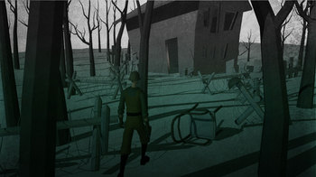
Notes:
41
I was assured we’d still be able to do all the stuff I wanted, because we’d do deliberately abstract 3D and it wouldn’t be the same time-sink as realistic 3D.
Ha!

Slide 42
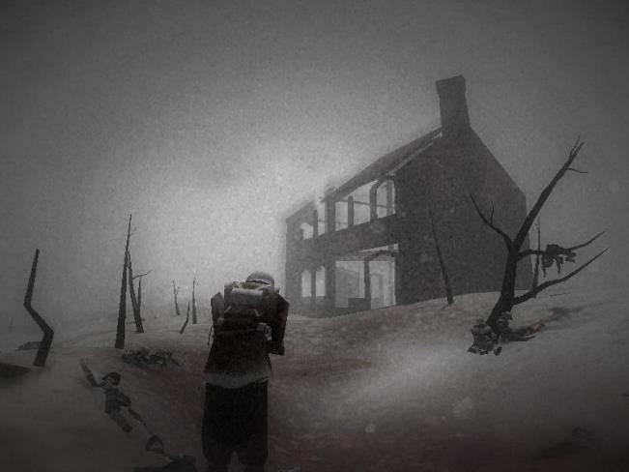
Notes:
42
When we had just a few weeks left, we had something atmospheric and wonderful.
It made people feel sad and cold.

Slide 43
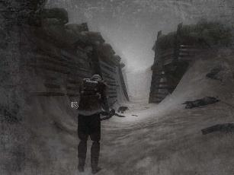
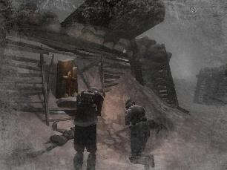
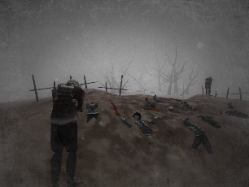
Notes:
43
But basically all you could do is walk around and die.
It had the cold system and pathfinding, and that was it.
That was 5% of the planned design.

Slide 44
Notes:
44
This isn’t what I wanted.
My art team was happy, but the narrative designer in me was bitterly disappointed at letting them talk me out of my vision.

Slide 45
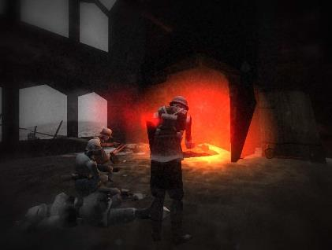
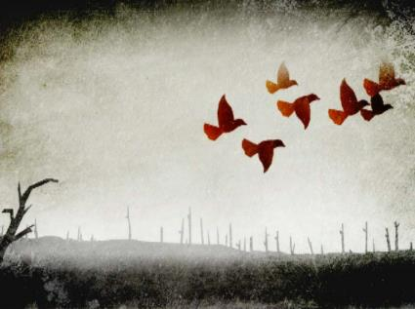
Notes:
45
I just abandoned my ambition and had an 11 hour hail mary pass on the design with the team.
We decided leading everyone to the fire to die together was the goal. Done. Ship it.

Slide 46
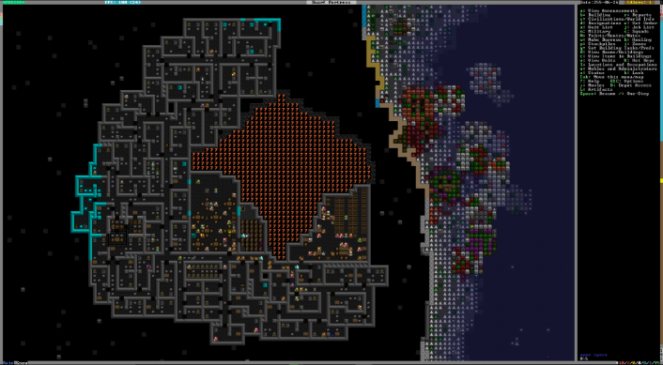
Notes:
46
I was bitter for months afterward.
I’d wanted a smaller-scale Dwarf Fortress.
Instead I got a walking sim where you die in 10 minutes.

Slide 47
Notes:
47
We did get an IGF nomination, and several publications said the game moved them.
While this didn’t help my mood right away, it made me realize people had connected with what the game was, regardless of what I wanted it to be.

Slide 48
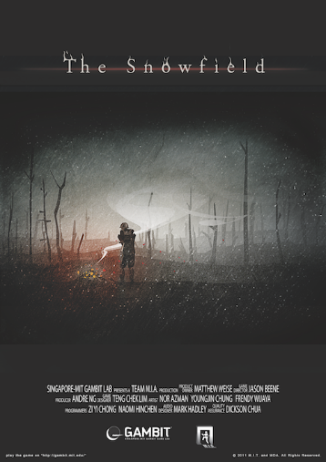
Notes:
48
Years later, this is now one of the things I’ve done that I’m the most proud of. I’m not convinced my original vision would have affected people as much. While we always seek creative satisfaction, and sometimes get it, it’s important to remember that’s not the only metric of success.
You can disappoint yourself, but make the audience happy, and vice versa. Is that glass half empty or half full?

Slide 49
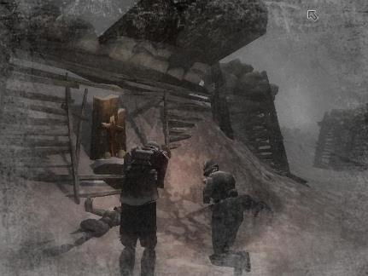
Notes:
49
I did feel like I learned a lesson from it.
What you want to make and what you do make might be different.
You might have to abandon your vision to let the game be what it wants to be.

Slide 50
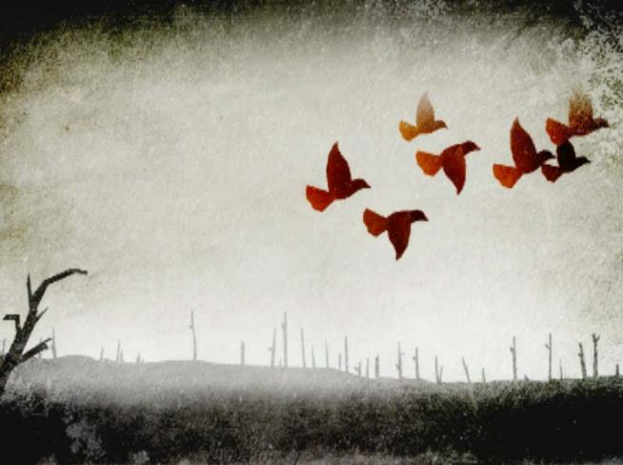
Notes:
50
You tell yourself nothing is worse than abandoning your vision. But… it didn’t kill me.
The audience never knows what you wanted. Know that and use it.
You will carry that disappointment forever. But that’s the curse of being the maker.

Slide 51
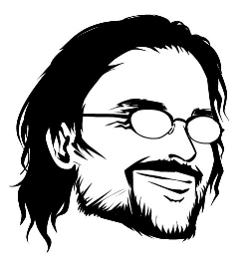
Thank You
www.matthewweise.com
www.empathy-box.com
matthew.weise@gmail.com
@sajon77
Notes:
51
You tell yourself nothing is worse than abandoning your vision. But… it didn’t kill me.
The audience never knows what you wanted. Know that and use it.
You will carry that disappointment forever. But that’s the curse of being the maker.

Slide 53
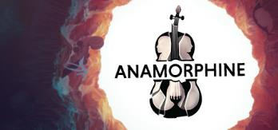
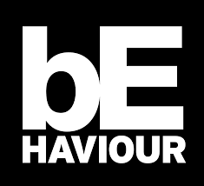
Co-Founder & Executive Producer
Artifact 5
@CookTheSam
SAMANTHA
COOK
Notes:
Samantha started her game career in production at Behavior Interactive before co-founding the studio Artifact 5, where she is producer, narrative and does whatever needs to get done.
And she’s here to tell you about their very beautiful game Anamorphine.

Slide 54
What Didn’t Kill Me, Though It Killed Our Game
A Wake for Anamorphine
@artifact_5
@cookthesam

Slide 55
Me:
Co-founder
Producer
Business development
Bookkeeper
Narrative director
Chocolate buyer
Agony aunt
Dad joke director
Notes:
Hi! My name is Samantha, and I'm co-founder, producer, business development, bookkeeper, narrative director, chocolate buyer, agony aunt, and dad joke director at Artifact 5.

Slide 56
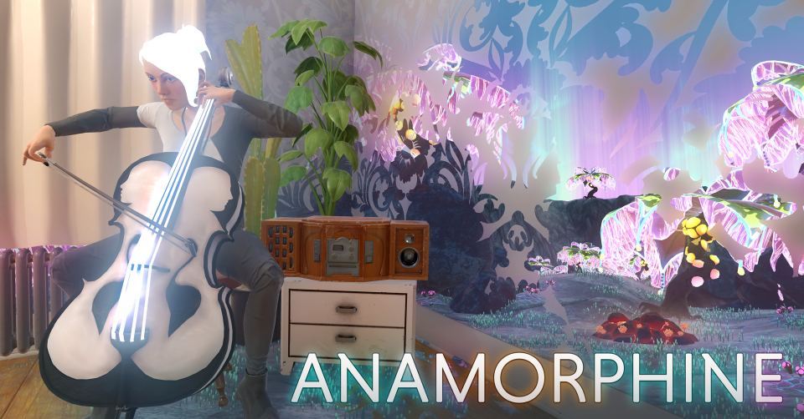
Notes:
In 2015, I co-founded Artifact 5 with Ramy Daghstani and Mohannad Al-Khatib. We came together to make a game called Anamorphine.

Slide 57
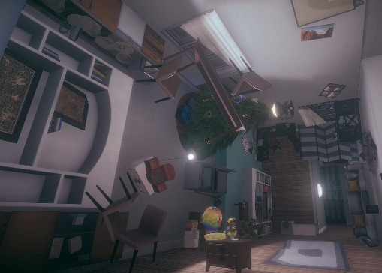
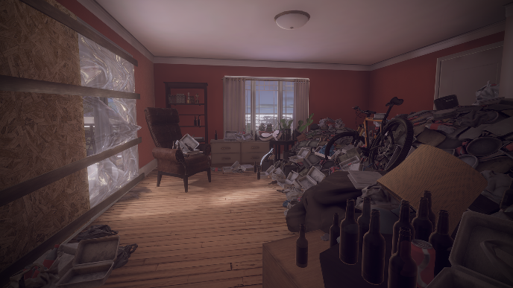
Mental Health
Notes:
It's a surreal exploration game centered around themes of mental health and post-traumatic stress. It’s told purely through environmental storytelling - no text, no voice-over

Slide 58
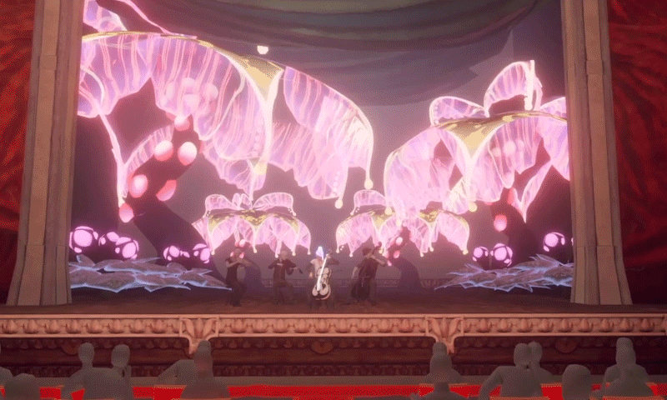
Notes:
Aaaaand without an action button. Your camera is your only navigation tool. It was highly experimental, meant to move peoples' hearts and minds, give folks a window into the lives of people struggling with relationship issues and mental health, and we imagined it joining the ranks of...

Slide 59
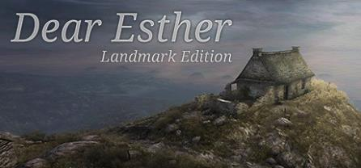
The simple world of 2015
Notes:
these amazing games. We were so excited by this new, unusual game genre called, so often derogatorily, “The Walking Simulator. We could bring something new to the genre, combine exciting elements from the games that had spoken to us, and chart our own course through this relatively blue-ocean space.

Slide 60
56% over time
43% over budget
Notes:
We were a motivated, six-person, full-time team. With Canada Media Fund funding secured, we had about a year to a year and a half to make the game before the budget ran out. How hard could it be? Well... A walking simulator is like a movie; you can't just make half of it. And we were green. And we had promised to ship it for not just PC, but also consoles, and, of course, in VR, too! (Hit black)
At the end of the day, we thought Anamorphine would take about 16 months. It took 37. This resulted in us scrounging for more funds to keep the lights on and finish development.

Slide 61
56% over time
43% over budget
Uh… almost...
Notes:
All of this less to us announcing our launch too early! Gosh, were we optimistic game devs.
What we didn’t realize was that it would take another ***6 months*** to finally get the game out on PS4. 6 months. Some things you can’t scope for until you’ve experienced them personally.

Slide 62
56% over time
Notes:
After all of that - running out of money twice and pushing our launch date back multiple times, we were able to announce a launch date, and stick to it! People were happy for us and excited to play our game! The problem was...

Slide 63
Everything had changed
Holy budgets & production value!
Notes:
The ecosystem had entirely changed. Firewatch, Everybody’s Gone to the Rapture, Virginia, and What Remains of Edith Finch came out between 2015 and 2018, taking our blue-ocean under-served market and serving it incredibly well. Not only that, but the way we consumed games had changed.

Slide 64
Notes:
… we put a movie on Twitch.

Slide 65
(Thank you, Washington Post)
(No thank you, Metacritic)
Critically OK, commercially a flop
Notes:
Our game impacted many in the ways we hoped it would. We are proud of the story we told. However, the game needed another month or two to fix glaring technical issues, which resulted in negative reviews.

Slide 66
What do you do when your game fails commercially?
Notes:
So, what do you do when your game fails commercially?

Slide 67
Notes:
LET IT GO!
Well, you try, but that’s actually really hard. It’s depressing when your game goes nowhere -almost depressing as the game itself!

Slide 68
“Yeah, no, but what do you actually do?”
Notes:
Fair question!
We patched a little bit after launch, but we were absolutely out of money and energy by then.
The good news is that we were able to keep the lights on using our hard-earned gamedev, VR, and shader skills. Work for hire tided us through for 11 months until we were able to convince the CMF to give us money to start new prototypes. Thank you, CMF!

Slide 69
We had a wake
Held it at a goth club
Invited our friends and colleagues
Had a condolence/memory book people could sign
Celebrated the life and death of Anamorphine
AND
Making it 4 years as a company
Notes:
And then, we admitted defeat. After a year, we realized we were never really going to patch this game. We couldn’t save it. We were not going to find the time, money, or emotional energy to try to change the past or the future. So, we send it off into the sunset with a party.
Because we made it, kind of. After four years, we still had our jobs!

Slide 70
Thank you!
The final takeaway:
Accepting failure is part of life
We were very lucky we were allowed to fail
@artifact_5
@cookthesam
Notes:
Here's the final takeaway:
Acknowledge and celebrate your death. Most games die in this ecosystem. We probably would have moved on faster if we had allowed ourselves to digest this sooner.
At the end of the day, we’re still here thanks to the support of the Canadian model - one that allows for innovation in games the same way it does tech. It allows us to experiment, grow, fail, and come back stronger. We’re a much better company for all that we’ve survived. But while the game didn’t kill us, it is definitely, definitely dead. Thank you!

Slide 72
Scriptwriter
Ubisoft Montreal
@jscoble
JESSE
SCOBLE
Notes:
Jesse Scoble started his career in role playing games before moving to the digital world working on games like Wizard 101.
He’s now a writer at Ubisoft where he’s worked on everything from Watch Dogs to Assassin’s Creed

Slide 73
What Didn’t kill me… (Made me stronger)
Jesse scoble edition
@jscoble

Slide 74
First professional near-death experience
Notes:
Hi, I’m Jesse Scoble. And I’m hear to tell you about my first (professional) near-death-experience…

Slide 75
We were so young
Notes:
This happened a lifetime ago, at one of my first opportunities to have responsibility on a project.

Slide 76
Notes:
Company sounded great. Projects sounded challenging and cool.
They loved my pen&paper background, and hobby game industry experience. The town was not “awash” in game dev at the time, and I suspect I had more pro qualifications than many who were applying.
Up to this point, I had led some major RPG publications as a creative director, but had not been given a chance to “step up” in the video game world.

Slide 77
Shape and develop the vision
Notes:
I was brought in to help shape and develop the Creative Director’s vision.
On his pet project.
Amazing opportunity. Felt I really had a chance to prove myself. And to shine if I pulled it off.
Only one problem.
Well, more than one problem – or this wouldn’t be a “what didn’t kill me” talk.

Slide 78
Small problem
Notes:
But first problem was that there was already a lead narrative designer on it, but the project wasn’t making much progress, so the CD tapped me to take it over.

Slide 79
Small problem
Notes:
But the trick was that the former lead was now going to be working for me. So… that was a curveball.
How could I do the job, learn from him, keep him on my side, but also “do everything differently” to move the project along and please the CD.

Slide 80
Notes:
First step was getting his take on the project.
What was the history, what worked, what didn’t. What, if any, solutions had been tried and failed?

Slide 81
Notes:
Then second step was keeping my new partner in the loop – bouncing my ideas off him and soliciting feedback. Also trying to keep and protect the best of his ideas, while simultaneously showing enough change / new direction to keep the CD happy.

Slide 82
Notes:
Then it was trying to figure out all the problem points – and come up with a variety of solutions – to present to the CD, rather than just point out the flaws.
Old axiom, “don’t just come with problems, but bring solutions.”
Worked with the team – inc art team and designers - to develop and present bold suggestions for how we could move forward. And when I felt I was ready for a leap of faith, I booked a meeting with the CD.

Slide 83
Notes:
During the presentation to the CD, I was 5 slides into a 30 slide presentation when I realized I had miscalculated – while I had come up with a whole host of solutions, I suddenly realized he didn’t think ANY of the old design was a problem, per se (at least not in HIS mind) and that he felt I was ambushing him / trying to take over the project. (And that I had wasted 2 weeks of my time – and the team’s time - on something that I thought was important but he didn’t value).

Slide 84
Notes:
I didn’t get fired, but I did get a pretty good “talking to.”
And I realize my star was… falling.

Slide 85
Carry forward
Notes:
What did I carry forward?
I learned a pretty important lesson in communicating and telegraphing my intentions.
What I had done right – was make the old narrative lead an ally. I didn’t know it at the time, but he had had two junior designers under him that had landed their spots due to personal ties, and didn’t really know what they were to be doing.
I wasn’t old – certainly not as old as I am now – but I had been working for enough years to have developed a bit of professionalism.

Slide 86
Notes:
I also didn’t come in all Godzilla about it. The old “you screwed up or I wouldn’t be here” routine.
But I hadn’t figured out how to establish a rapport with The Powers That Be, as it were – and that’s something I would take forward to every subsequent project.

Slide 87
Thank You! / Merci!
Twitter: @jscoble
Email: jscoble11@gmail.com

Slide 89
Game Desiger & Writer
Emo Alien Cult
@BreakinBahiyya
BAHIYYA
KHAN
Notes:
Bahiyya Khan is a multiple award-winning game designer and writer from Johannesburg, South Africa.
She worked on the IGF award winning game, after HOURS, and in researching her I found that every time she writes a bio it is unique.

Slide 91
Notes:
Hey watsup I’m Bahiyya Khan and I make video games and awful art that is very good actually. This talk is about trusting your instincts as opposed to going along with what you think you’re ‘supposed’ to you because you owe it to yourself or some social construct. I’ll be speaking about what happened when I went to a punk show last year to see Joyce Manor play and got destroyed in the pit and how that relates to the game I made, after HOURS. Quick background into Joyce Manor, they’re a pop-punk band from California. They make short and fast music that makes you feel like smashing things. After HOURS is a fmv about sexual assault and BPD that scooped up an IGF at this years awards and it was developed by a punk rock band (me) and the women I worked with on it from South Africa so that instantly makes us cooler than Joyce Manor.

Slide 92
Notes:
So the thing about punk shows is that there’s a certain mentality that you have to accept or integrate into, or it’s taken for granted that because you love the music, you’d love and accept the culture that comes along with it. And if you don’t, you’re a fake fan. You’re not really punk. And the thing about making a video game about a social issue that you’re so passionate about bringing awareness to and is so intimately tied into who you are as a person, which means that if you stopped working on this game, if you walked away, that means that you didn’t care enough. Or you weren’t enough to handle it. And you have to handle it. So you have to be enough. Both of these scenarios are tied into feeling like an imposter. Like if you don’t follow through with what you ‘subscribed’ to, you’re kind of a poser you weak ass bitch.

Slide 93
Notes:
With most alternative shows, moshing is a given during heavy songs. Whatever man I’m chilled with that like I generally enjoy aggressive dancing to hard music. But there’s a designated space for it. When I saw JM last year, the moshing got so out of control that there were no boundaries as to where the pit started and ended. I didn’t go into the pit at their show from the beginning cos But the pit spilled over and I was getting fucked up properly. My ribs felt like they were being crushed. People were ramming into each other and I properly thought I was gonna die. Struggle with should I get out or not and then asled security to take me out and saw the rest of the show much further away but calmer but fuckin angry that the experience was spoiled. Imposter behaviour.

Slide 94
Notes:
After HOURS: the trauma was less immediate and way more spread out. Not a 1 hour show but a 1.5 year long experience and then the after effects Trauma is a lot less clear when you don’t immediatly recognise that ur life is being thretaened. There’s no adrenaline kikcking in saying bitch u are going to die if you don’t get out right now. There’s someone that looks like you sitting in your room at the end of the bed or skulking in the corner looking at you all the time with an expression you can never quite figure out. She never cheers for you, just points out every fucking thing you’re doing wrong. Everything that makes you less or pathetic or like you don’t really care about what you’re making bevause if u did you would get up you wouldn’t be crying in bed because you can’t face it you wouldn’t feel like killing yourself because it’s all too much. A punk show has nothing on this sort of trauma but both experiences are rooted in different forms of terror. Terror is hard to recognise when you enter something already terrified. I had existing sexual assault and bpd trauma. I needed to heal. I don’t think making games about your traumas are a form of therapy. RIP to other devs but I’m different.

Slide 95
Was mich nicht umbringt, macht mich stärker.
Notes:
You feel like a fraud leaving something ur ‘supposed’ to be able to handle. Boundaries and self care and mental health. It doesn’t make you less. You need you. Your responsibility to yourself. WHO do I owe it to? The most punk rock thing you can do is be kind to yourself. I don’t want my work and my life to hurt my heart. Sometimes the best thing is to sit it out until you can or even if you never can that’s okay.your game is not leaving you. Even if ayone else does it, it’ll never be the way you do it. Dancing alone away frm everything or sitting something out doesn’t mean you weren’t present. You know who you are. And you should protect that
Now I would say ‘no fuck that’ I think I needed to have those experiences to know how I should better respond to those situations.
The most punk rock thing you can do is be kind to yourself.

Slide 97
Executive Producer
Goodbye Kansas Game Invest
@IonSwitz
HENRIK
JONSSON
Notes:
Henrik Jonsson currently works at the Goodbye Kansas Investment fund, but in a past life had a long career as a games and graphics programmer.
And I was happy to learn he is the second member of the Anachronox dev team to ever do this session.
Full bio:
Henrik likes Game Developers more than he likes making Games. After working 22 years as a Games and Graphics Programmer, making everything from AAA-games and Casino games to Industrial Robotics Simulations, he became an Game Company Equity Investor at Goodbye Kansas Game Invest.
By helping seasoned experts and rising stars get funded to build their dreams, Henrik is finally in a position to help Game Developers build their own games, rather than building games himself.

Slide 98
BEING KIND
Notes:
98

Slide 99
“Online Angel of the Year – Gaming”
Notes:
The Online climate has grown very cold over the years, threats, hate and abuse is hurled the way people used to throw rocks at each other – way too frequently
In Sweden, there’s an award being handed out for the Online Angel of the Year, each year people or organizations get an award for helping others – basically , for being kind. The award for Gaming is handed out by a jury of people very active in the gaming sector, and some recipients have been the Dreamhack organization, and a Female E-sport organization, etc.. So it’s a big thing.
99

Slide 100
“Online Angel of the Year – Gaming”
MEEE!
Notes:
And I think this is a pretty cool award to have..
100

Slide 101
“Online Angel of the Year – Gaming”
MEEE! MEE!
Notes:
The people receiving this award are obviously very kind people
101

Slide 102
“Online Angel of the Year – Gaming”
MEEE! MEE!
IT WAS MEEE!!
Notes:
But the most important aspect is not who receives the award, but.. In what ways they help others.
102

Slide 103
“Online Angel of the Year – Gaming”
MEEE! MEE!
IT WAS MEEE!!
I WON AN AWARD!!!
Notes:
These people do nice things because other people deserve nice things. They don’t do this to win awards,
103

Slide 104
“Online Angel of the Year – Gaming”
MEEE! MEE!
IT WAS MEEE!!
I WON AN AWARD!!! A FREAKING AWARD!!! FOR BEING KIND!!
Notes:
and obviously none of these wonderful people would use this for boasting or for public recognition..
104

Slide 105
“Online Angel of the Year – Gaming”
Notes:
Since I’m here for MIGS, I don’t know who won this year, but I hope it was someone nice…
105

Slide 106
Notes:
Another award was handed out last week in the US, and Megan Rapinoe won a “Women of the Year” award. In her speech, she said a ton of great things… Amongst others
106

Slide 107
“You ain’t sh*t coz you’re good at sports.
You ain’t sh*t coz you’re Popular.
You’re gonna be a Good Person”
- Megan Rapinoe
Notes:
You ain’t sh*t coz you’re good at sports.
You ain’t sh*t coz you’re Popular.
You’re gonna be a Good Person
107

Slide 108
(Daphne Rapinoe)
“You ain’t sh*t coz you’re good at sports.
You ain’t sh*t coz you’re Popular.
You’re gonna be a Good Person”
- Megan Rapinoe’s Mom
Notes:
Megan Rapinoe’s Mom – Daphne Rapinoe
108

Slide 109
Caring is cool
Doing more is cool
Giving all the f*cks is cool
Lending your platform to others is cool
Notes:
109

Slide 110
“I’m busy, I ain’t got time to Kind”
Notes:
Employers: You need experienced people who aren’t
embarrassed to work for you. Be Cool. Be kind
Everyone: Aim to be someone people asks to work with.
Word of Mouth is fast and strong.
Kindness is a force multiplier.
110

Slide 111
“How can I Kind?”
Retweet some strangers game
Get coffee for someone who’s struggling
Include the new(old) person for lunch
Learn to give feedback
Ask for their opinion - and Listen
Connect people with each other – and walk away
No “Quid Pro Quo” – No Guilt – No keeping score
Notes:
111

Slide 112
“How can I Kind?”
Retweet some strangers game
Get coffee for someone who’s struggling
Include the new(old) person for lunch
Learn to give feedback
Ask for their opinion - and Listen
Connect people with each other – and walk away
No “Quid Pro Quo” – No Guilt – No keeping score
When in doubt – What would Osama Dorias do?
Notes:
112

Slide 113
BEING KIND
DIDN’T KILL ME
Notes:
113

Slide 114
BEING KIND
DIDN’T KILL ME
(but it did make me an Angel)
Notes:
114

Slide 116
Director/Designer/Writer
Paranoid Productions
@richardrouseiii
RICHARD
ROUSE III
Notes:
And who’s this next speaker? Oh, it’s me!

Slide 117
Many Games are About Dying
Notes:
117

Slide 118
Notes:
The classic arcade game, which is unwinnable – no matter what you do, every game ends in your death.

Slide 119
Death is Inevitable
Notes:
So it leaves us with the lesson that...

Slide 120
Notes:
The Modern action game, that restores you to a checkpoint
In games it isn’t “What Didn’t Kill Me Makes Me Strong”
It’s “What did Kill Me Can be beaten if I just try again and get better die rolls or wait for a patch to make it a bit easier”

Slide 121
Notes:
The Modern action game, that restores you to a checkpoint
In games it isn’t “What Didn’t Kill Me Makes Me Strong”
It’s “What did Kill Me Can be beaten if I just try again and get better die rolls or wait for a patch to make it a bit easier”

Slide 122
Death is Irritating But You Can Just Keep Trying
Notes:
So it leaves us with this lesson...

Slide 123
Notes:
Over time, some games went one way with death. Some just removed it entirely.
And don’t get me wrong, I love Journey, I love many games that don’t have death...

Slide 124
Death Does Not Exist
Notes:
But the lesson here is...

Slide 125
Notes:
But modern games have re-affirmed death.
Indie rogue-ish games went another direction... Where death becomes more meaningful again because it’s permanent, and makes you restart.
Like the Binding of Isaac

Slide 126
Notes:
Or the game I just recently shipped, The Church in the Darkness
The game is set inside a religious cult where you are trying to find your nephew and see if he’s OK

Slide 127
Notes:
In Church in the Darkness we tried to combine quite a ew things – infiltration/stealth gameplay, procedural narrative, rogue-likey permadeath
It’s not a mixture that’s immediately familiar, but some people definitely like it.

Slide 128
Notes:
And it’s not just a quick death
When you get taken down the first few times, you get captured, so death wasn’t exactly death
But get captured enough times, you have to restart, and things will be different.
People did find the game difficult, so much so that we recently patched the game to take the permadeath out of the easiest difficulty. People who come to the game for the narrative, don’t necessarily want death to be such a setback.

Slide 129
Notes:
But in true rogue-like fashion, we also added unlocks on replays. So each time you restart, you can bring more gear with you, based on what you found in previous playthroughs. So that makes things quite a bit easier, and takes some of the sting out of the death. But the death is still meaningful.

Slide 130
Death is a Big Setback but You Get Cool New Unlocks
Notes:
So if there was a lesson from games like The Binding of Isaac or the Church in the Darkness, it’s that...

Slide 131
Death is Inevitable
Death is Irritating But You Can Just Keep Trying
Death Does Not Exist
Death is a Big Setback But You Get Cool New Unlocks
Notes:
So these are some of the lessons video games have taught us about death.
But as we are game developers, we grew up with games, learned a lot from them whether we new it or not.
So how do we apply these lessons to game development? How do each of these lessons change the way we make games?
131

Slide 132
Death Does Not Exist
Notes:
I’m going to take these out of order, and start with this...
Now first, we don’t need to be so dramatic about this.
It is inherently silly to call making entertainment/art life and death
But if you believe in something enough and want it to be good it can feel like a matter of life and death, even when you sometimes need to take a moment to breath and put things back in perspective.
132

Slide 133
Not Shipping?
Shipping a bad game?
Not getting to make another game?
Burn out?
Notes:
But short of self-injury, what are the many ways you can “die” metaphorically in game development?
We know all of these...
133

Slide 134
Notes:
There’s enough stages to failure in gamedev...
134

Slide 135
Notes:
It can push you over the edge...
135

Slide 136
Notes:
And turn you into an axe murderer.
136

Slide 137
Death Does Not Exist
Notes:
So clearly “Death Does Not Exist” is not true for game development.

Slide 138
Death is Irritating But You Can Just Keep Trying
Notes:
So now this one... Is especially not true.
There’s no restoring to a checkpoint in gamedev – you can’t go back.

Slide 139
Notes:
(though restoring to a Perforce backup comes close)

Slide 140
Notes:
Because the clock keeps ticking and the money keeps being spent and your team is becoming more exhausted and there’s no “What if we had taken the other path?”

Slide 141
Notes:
Indeed, this way of thinking may lead to some of the worst examples of crunch culture.
If we just keep banging our head against this eventually we will finish – but maybe kill our teams in the process.

Slide 142
Death is Irritating But You Can Just Keep Trying
Notes:
So this is not a lesson that feels true to game development either.

Slide 143
Death is a Big Setback but you Get Cool New Unlocks
Notes:
Strangely enough, I think this is probably what comes the closest.
143

Slide 144
“That which does not kill me makes me stronger.” - Nietzsche
Notes:
This is where our talk theme of “What doesn’t kill me makes me stronger” comes into play.
For all the ways this saying is incomplete and not perfect, we do want there to be a truth to it, and there can be.
144

Slide 145
Notes:
Because we want to look back on something that “almost killed” us, reflecting on what went wrong so we don’t make the mistakes again. And in turn, make something good out of a not-perfect experience.
But it’s only through your choice to do something with that experience that you can actually make it not a waste of time.
What didn’t kill you makes you stronger only if you take the time to get stronger from it.

Slide 146
Death is a Big Setback but You Get Cool New Unlocks
Notes:
So if you take one lesson from video games, its that you may have died, but you can do new stuff now... The lessons you got from what didn’t kill you.

Slide 147
Death is Inevitable
Notes:
But now, for the last lesson, we’ll get a little dark.
Sometimes I wonder if the way those old, hard arcade games taught us – that no matter how good we were, we’d die eventually...
Because the reality is, there’s no getting around death, and the trick is figuring out what to do with the time before it
Many of the people in this room love games so much, we’re willing to spend our lives on it.
I’ve recently reached the point I’ve spend more of my life working on games than not working on them.
147

Slide 148
“I’m doing this even if it kills me.” – Me
Notes:
When I set out making The Church in the Darkness, I remember saying...
148

Slide 149
Shipping church
Notes:
And indeed, shipping an experimental game that tries to do something new while also something familiar – with stealth and permadeath and procedural narrative
And then ship it on a bunch of platforms in a bunch of languages, that was pretty crazy.

Slide 150
Notes:
At its most intense, I thought about how long I had worked on this game – twice as long as I had worked on anything else – and how working on something for a long time makes
It even more deadly.
Stress was so bad I wondered if it would kill me – I thought “That's it, this game is shortening my life...”

Slide 151
Notes:
And yet, here I am on the other side, glad I did it, riding that fatal bomb all the way down.

Slide 152
Notes:
Now astute viewers may have noticed that I’ve been using images from Kubrick movies throughout this talk
And there’s a reason for that
One of my favorite Kubrick films was his last, Eyes Wide Shut

Slide 153
Notes:
Some of you may remember that Kubrick died one week after delivering the near-final cut of this film. He was 70.
Now I think there’s two ways to read that
One is that his obsession and overwork led to his death, and that may well be true, and I wouldn’t recommend overwork to anybody.
Another is that, having made what was probably going to be his last movie, it may be that his body just said that’s it, I’m done. If I don’t get to make another movie... It’s not worth it. And for people who love what they do, there’s something we can relate to in that. But if we couldn’t do that thing we love anymore?

Slide 154
Notes:
I’m not saying that there’s one right way to live – to use up your life up until the bitter end doing making these games we love – but you have to understand there’s something to it.
Or maybe we should be careful, balance our lives, so there’s more to it than just the games.
That’s a decision you all have to make, even if you’re not making it consciously. So think about it, and decide how you want to proceed.

Slide 155
Games Didn’t Kill Me...
Notes:
But for the time being I am please to report

Slide 156
Games Didn’t Kill Me...
Yet
Notes:
That games didn’t kill me... Yet.

Slide 157
THE BRAIN DUMP THANKS EVERYONE
@Athaneteus @amydallas @sajon77 @cookthesam
@jscoble @BreakinBahiyaa @IonSwitz @richardrouseiii
Notes:
Thanks everyone!

