Slide 1
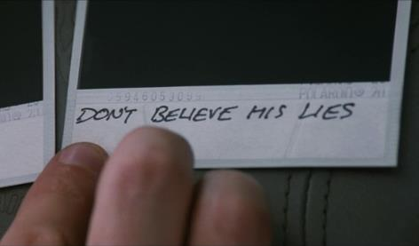
MIGS Brain Dump 2016
What No One Tells You
Adam Boyes
David Calvo
Richard Dansky
Steve Escalante
Jason Kim
Anna Kipnis
Aleissia Laidacker
Jill Murray
Richard Rouse III
@amboyes
@metagaming
@RDansky
@IndieEski
@LeSaucierKim
@DoubleAnna
@Aleissia
@CodeJill
@richardrouseiii
with your host
Montréal International Game Summit
Tuesday, November 15th, 5PM
Notes:
Welcome to this year’s Brain Dump.

Slide 2
5 MINUTES
Notes:
Our format is simple – we invite a bunch of speakers and they each talk for 5 minutes.

Slide 3
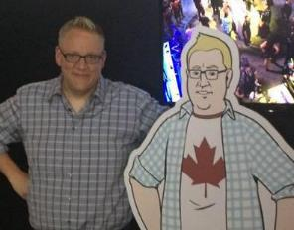
Notes:
We round up a bunch of speakers – some of whom are talking at MIGS already, and some who we grab from wherever we can find them.

Slide 4
WHAT NO ONE TELLS YOU
Notes:
And this year’s theme is “What No One Tells You” about game development.

Slide 5
Notes:
Now, I’m going to tell you how I’m interpreting this theme right now.
I had a different opening planned for this talk.

Slide 6
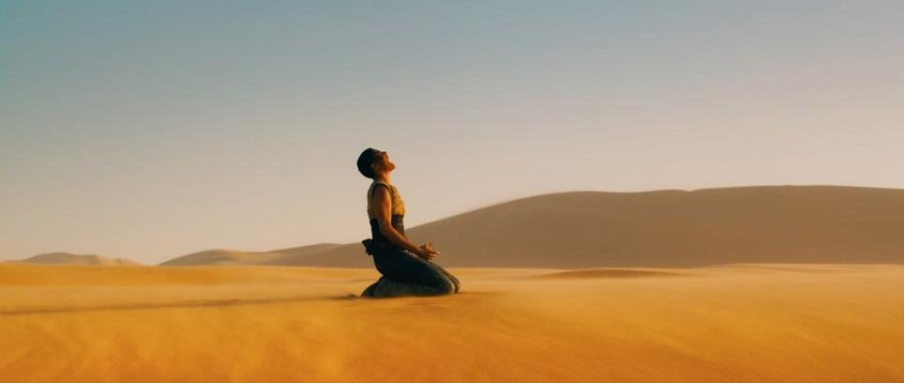
Notes:
But then the election happened.
So I don’t know about you guys, but that pretty much wrecked the rest of the week for me and my wife and so many people I know.
I feel bad even complaining, because I’m lucky. I’m not the one worried about being harassed or assaulted or having my rights taken away.
Just people I know and care about.
Though, selfishly, I am also worried about the planet looking more like the desolate dystopia of Mad Max a whole lot sooner.

Slide 7
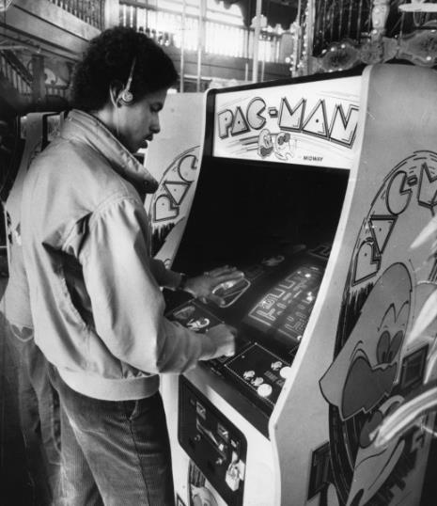
Notes:
Getting back to work was hard for some of us last week – I know a lot of game developers that felt this way.
We make videogames – these things are fun, right?
Hardly seemed important at a time like this.
When big things are happening in the world that appear to be catastrophic, I think it’s natural to question the real value of what we do. Of any entertainer.

Slide 8
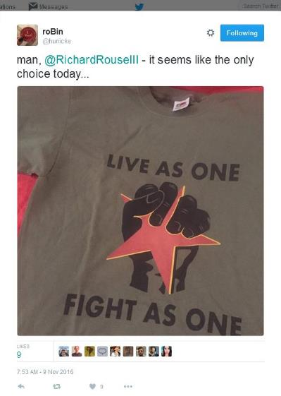
Notes:
Then something kinda nice happened to me.
Robin, a friend of mine, tweeted this out the day after,
This is a shirt from my game, that she got from me just days earlier at Day of the Devs in San Fran.
And it was funny, this tweet actually gave me some hope.
It reminded me, that the work we do, can sometimes have great effects on people.

Slide 9
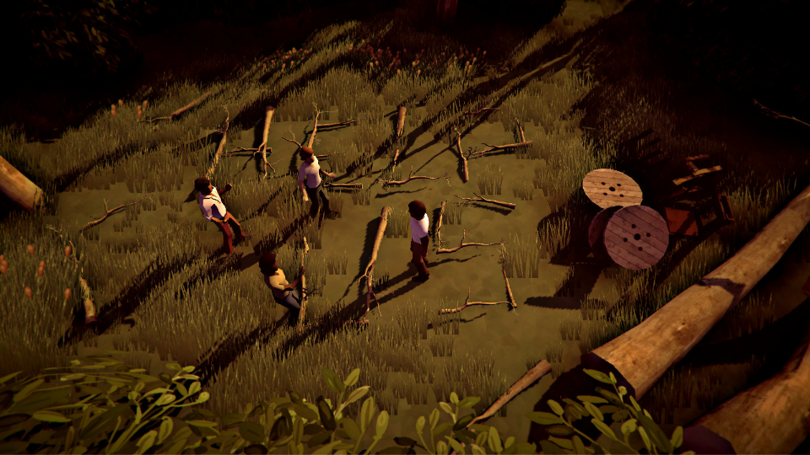
Notes:
And then I thought some more about it – and remembered what I already knew about how games can help us deal with the world
The game that shirt is from, The Church in the Darkness - the game I’m working on now, is about religious cults and about why they are so hard to understand and about how good motives can go sooo wrong.
And it’s a game where the antagonists aren’t always the villain and sometimes the player if they’re not paying attention can become the villain themselves.
I am building this game and the game’s narrative as a system to explore and help understand in some small way a complex subject. Because I think good entertainment and good art helps us understand life.

Slide 10
Notes:
It can be tempting to look at the election in stark black and white terms. I sometimes do this myself.
I think it may still be too soon to expect everyone to stop and think deeply about what happened.
But in the fullness of time,

Slide 11
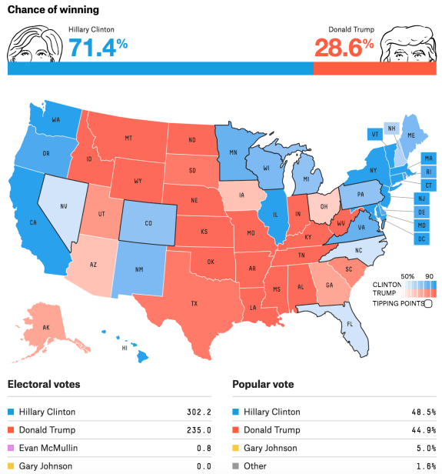
Notes:
If you want to understand why this

Slide 12
Notes:
Turned into this
You’re going to find it’s a system with many moving parts and no easy answers.
If you want to stop it from happening here in Canada, you might want to understand the systems that led to it happening in mine.

Slide 13
Notes:
The way I see it, , most things in life are systems.
And though we can learn about life through books or theater or music or literature, games are really the only art form that can truly tell us about systems.

Slide 14
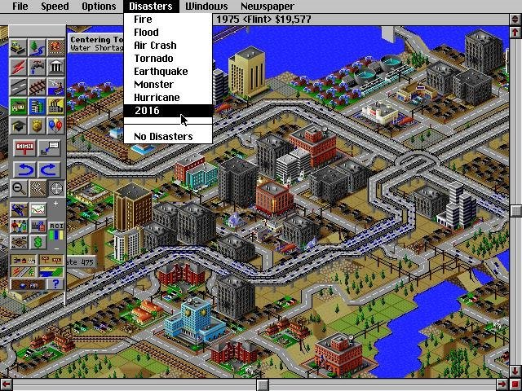
Notes:
A game can help you learn why building superhighways is a bad strategy if you want a thriving inner city

Slide 15
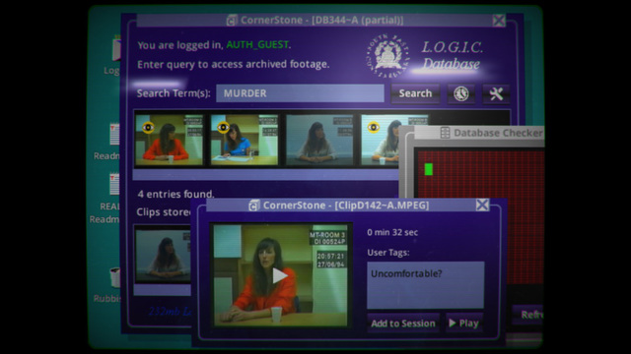
Notes:
Or how a story may completely change the more you look into it.

Slide 16
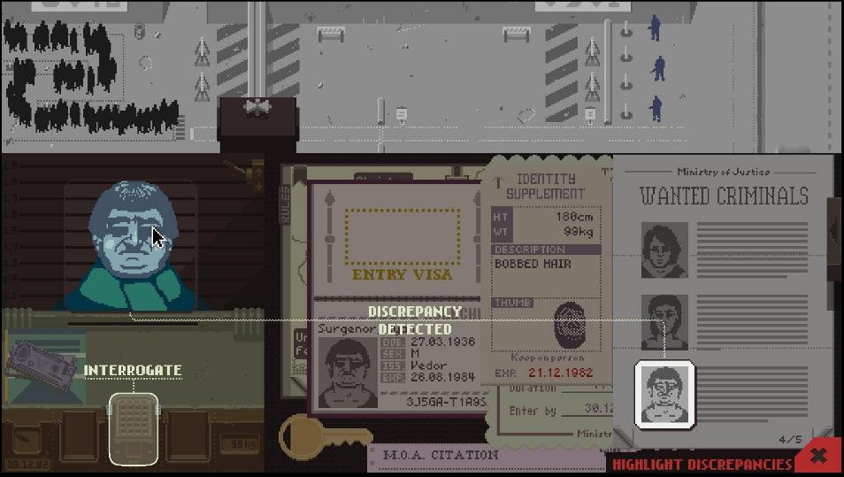
Notes:
Or how horrible and doomed the life of a bureaucratic functionary can truly be

Slide 17
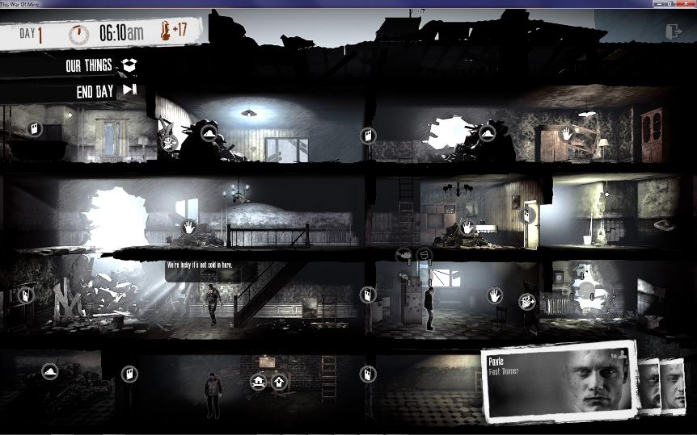
Notes:
Or why good people placed in desperate situations may do horrible things

Slide 18
WHAT NO ONE TELLS YOU
Notes:
So what I eventually decided was, for my definition of this…

Slide 19
WHAT NO ONE TELLS YOU
IS THAT GAMES ARE SYSTEMS
AND LIFE IS SYSTEMS
AND YOU CAN LEARN A LOT
ABOUT THE SYSTEMS OF LIFE
FROM THE SYSTEMS OF A GAME*

Slide 20
WHAT NO ONE TELLS YOU
IS THAT GAMES ARE SYSTEMS
AND LIFE IS SYSTEMS
AND YOU CAN LEARN A LOT
ABOUT THE SYSTEMS OF LIFE
FROM THE SYSTEMS OF A GAME*
*(the right game)

Slide 21
Notes:
So I scraped myself up off the floor last week and I was able to get back to work on these silly video games
because I really do think they can matter.
I still think there’s nothing wrong with escapism and pure entertainment

Slide 22
Notes:
But our games can be very meaningful to people

Slide 23
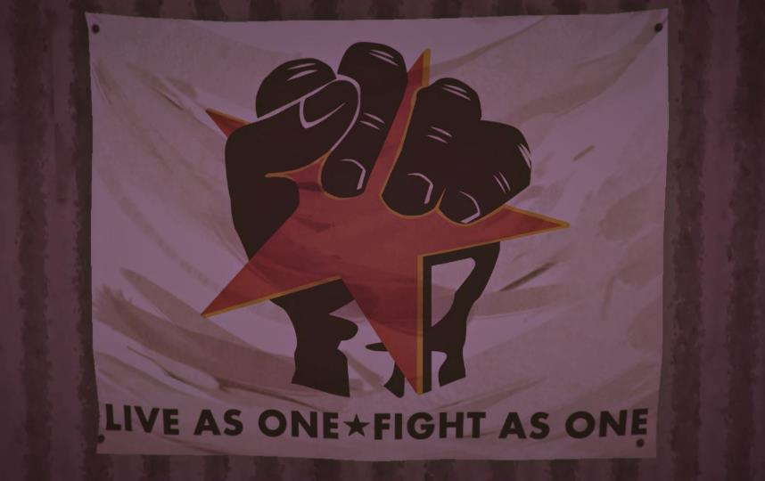
Notes:
And I know that games can be more than pure entertainment
They can help us understand life.
And games are what I know how to make and that’s what motivates me to keep going.

Slide 24
WHAT NO ONE TELLS YOU
Notes:
So now, that’s me. But what about our other speakers? Let’s hear what they have to tell us.

Slide 25
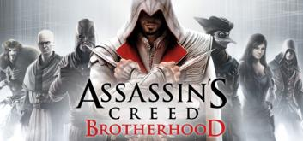
ALEISSIA
LAIDACKER
Lead Gameplay & AI
Ubisoft Montreal
@Aleissia
Notes:
Aleissia Laidacker has been a long time gameplay and AI programmer and team lead at Ubisoft, working on the overlooked game Lost to many entries in the Assassin’s Creed franchise
She’s an advocate for better ways to develop games and I believe speaks at even more conferences than I do.

Slide 26
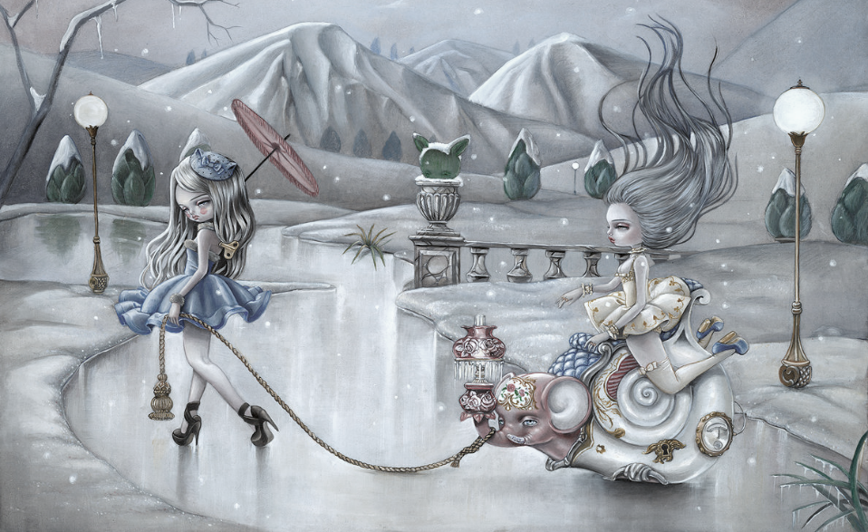
Nobody Told Me…
Aleissia Laidacker – Ubi MTL - @Aleissia
Notes:
We have the coolest jobs in the world. We get to make games that potentially millions of people will play. We get to be creative, technical and innovative in our work. We work with amazing people that challenge and inspire us every day. We love to play games, and we love to make them.
But game dev is not always the world of rainbows and unicorns we wish it to be... So here’s some of the things I’ve learned through the years, that I wish I knew many moons ago…

Slide 27
“Why’d You Have To Go And Make Things So Complicated”
Notes:
1. Things ALWAYS end up getting complicated for nothing! For some reason we love to take the simplest idea and find a way to make it complicated. We code systems that become monsters and crazy to debug. We design complex systems that only one person on the team actually understands. We develop processes that are supposed to help with communication but end up causing more chaos than anything. And in the end, we always end up taking a step back saying Why The Hell did we do this? Maybe we should go back to the version we had a year ago…

Slide 28
Conception … Diving Into the Abyss
Notes:
2. Conception is not the creative walk in the park I expected. In my early years as a game dev, I would work on a project for a year, fix bugs, ship it then repeat. I dreamt of the beautiful calm creative days of Conception! Brainstorming about fun and innovative ideas with a small team! Oh the joys! Boy was I wrong. Conception is basically the time in production, where Nothing is Clear! Everyone thinks everyone is potentially wrong. Blame is thrown around. Fear and mis-trust can spread so easily. Conception is actually the hardest time in production. What I learnt is, having mutual trust and accepting the unknown is SO important. A team can either a) spend years challenging each other, and go no where fast or b) stand together and try to support a common vision, KNOWING that vision will probably change many times and that is totally normal.

Slide 29
I Have No Idea What I’m Doing
Notes:
3. Now this may be stating the obvious but at some point or another, Nobody Knows What the hell they are doing, and I’m looking at you SENIOR DEVELOPERS. It’s funny because we encourage our juniors to ask for help and tell them failure is OK, but as seniors why don’t we do the same? Instead of asking for help, I’ve seen seniors fake it til they break it… Just because we have the experience, doesn’t mean we know how to do everything? We are making video games, not curing cancer, so if we make a mistake, no one’s gonna die. Asking for help and relying on those around us is key. No matter how many years of experience you have.

Slide 30
Social Endeavor
Notes:
4. When I joined the industry, I had no idea how Social a job being a game dev was. As a programmer, I thought I’d be off in my corner, with my headphones on, programming 8hrs a day. But I quickly discovered how much I had to actually interact with people. I would work with designers to come up with new ideas for our gameplays. I would act out things with the animators, jumping off desks, to see how characters should move in the game. Sound, FX, UI and other programmers. These were all people I had to talk to on a daily basis. I couldn’t believe as a gameplay programmer, how social I had to be. And by working with these different departments, I realized how much I was learning and becoming a better well rounded Game Developer. Not just, A Programmer.

Slide 31
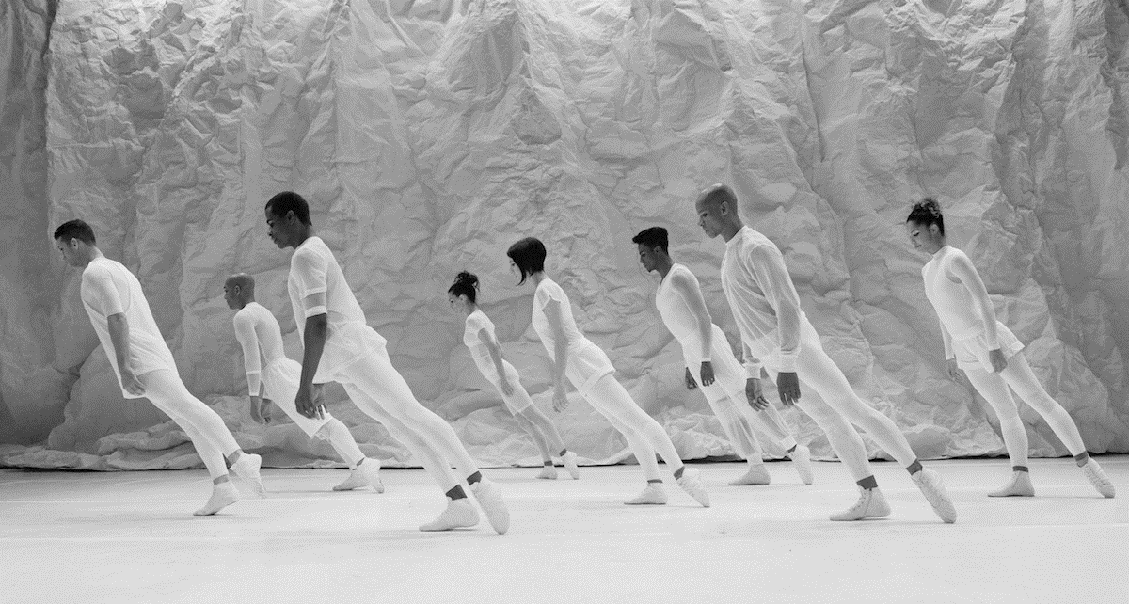
We Are All Artists
Notes:
5. Speaking of programmers, one of the pitfalls I’ve seen over the years, is Programmers thinking, we’re coders, and we aren’t supposed to think about design and art. WRONG! We work in games. It’s a creative industry. We aren’t in the business of making the best software. We are in the business of making the best entertainment. And EVERYONE involved needs to be creative. As devs, we should get inspired by things outside of video games! Interactive Theatre like Sleep No More have inspired my narrative systems. Board games like The Resistance have inspired my game mechanics. TV shows like Black Mirror and Westworld have inspired future AI systems I want to work on. Like true artists, we need to get inspiration from different mediums to develop innovations in our work.

Slide 32
You Don’t Need To Change
Notes:
And finally. When I first joined the games industry I remembered being scared to be myself. I was one of the only women on my team. So I did my best to act like one of the guys. I wore jeans and t-shirts because that was the norm. I didn’t express myself because my ideas were so different.
But what I’ve realized in the past few years is that the only way for me to be happy in my career is for me to be myself. I can be as girly as I want. I can wear extravagant dresses. I can express my ideas and challenge people around me. I can cry if I get angry. I don’t need to act like I have no emotions. I have them, and the best advice I got when I became a lead, was to not feel bad about who I was, or how I acted. But to own it. Will people challenge you on this? HELL YES. But what I realized is, if you are in a good place. With good people. Then you shouldn’t be scared to be yourself. And if you aren’t in an environment like this, then honestly, LEAVE. And for those who luckily haven’t been in situations like this before, well that’s amazing! But that means, there’s room for you to be an Ally. Help those around you by creating a safe space that support uniqueness. A place where people can express themselves without fear. Only then can we truly make amazing, innovative games with amazing people! And bring back a lil of the magic, Unicorns and Rainbows.

Slide 33
Thank You!!
@Aleissia

Slide 34
RICHARD
DANSKY
Central Clancy Writer
Ubisoft / Red Storm
@RDansky
Notes:
Our next speaker has been channeling Tom Clancy for a very long time, going all the way back to a game called Shadow Watch, and he was most recently lead writer on the Division.
But You may not know that he’s also a writer of gothic novels from Firefly Rain to something very pertinent to many people in this room, Vaporware
Richard Dansky!

Slide 35
THEY NEVER TOLD ME GAMEPLAY & NARRATIVE DON’T HAVE TO FIGHT
(And They Don’t! Honest!)

Slide 36
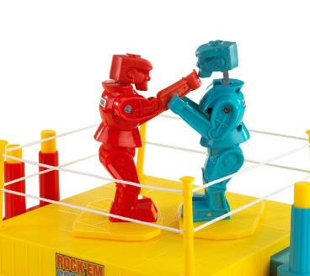
Everyone Swore It Was Like:
(Guess Which One Is Narrative)

Slide 37
Ongoing Struggle For the Soul of a Game
Gameplay
Narrative
Notes:
GAMEPLAY
Duh. It’s a game. Why are we even talking about this.
Why are you bothering me with this?
Are you still here?
NARRATIVE
Provides context for play
Generates emotional investment
Rewards players who view narrative progression as a goal
We’re not trying to be like other media, honest!
What usually happens when these two come in conflict? Hulk beats the Thing’s ass six ways from Sunday.

Slide 38
Notes:
Yeah. Anyway.

Slide 39
This Is…
This is Wool E. Bull.
This…isn’t.

Slide 40
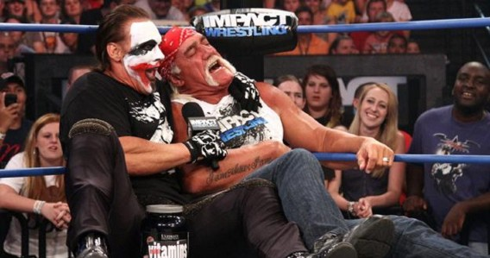
FALSE DICHOTOMY
Not a Collaborative Work Environment
Notes:
Leads to bad decisionmaking
Staking out territory
Opposition, not collaboration
Whoever wins, the game loses
You get gameplay decisions that get made in a vacuum that then need to get papered over by narrative – cf Blacklist computer level What happens then? Bad narrative, and while the temptation is there for HAHAHAHAHA NARRATIVE SUCK IT GAMEPLAY RULEZ, the disruption of the player experience due to badly stitched seams and illogic degrades the entire player experience. Yes, including gameplay. Because once they start looking for nits in one area, they don’t just stop there.

Slide 41
YES, IT WENT THE OTHER WAY TOO
Notes:
Not actually calling out HHGTTG here, but you get the idea. Either way, it was a bad idea, and people seemed entrenched in perpetuating the stalemate. But I learned, much to my pleasant surprise, it doesn’t have to be that way.

Slide 42
Both Elements of Gameplay Experience
The player wins when they work together
So happy, together…
Notes:
Narrative elements that support and contextualize gameplay
Gameplay elements that reinforce character narrative and fantasy
Each allowing space for the other
But this starts on the dev side, and the management side. The resources to do this have to be allocated. The time and labor need to be built into the schedule. And most importantly, there needs to be trust instilled in the idea that NOT EVERYTHING NEEDS TO BE ALL THE SHOOTY McBANG BANG RIGHT NOW. Because when push comes to shove and scenes/levels get looked at in isolation, it’s always easy to go for the WHERE’S THE GAMEPLAY/WHERE’S THE WOW MOMENT argument, and before you know it you look up and every single argument has gone that way. The gestalt is screwed. The cooperation and the resources need to be mandated, remembered and protected or else it all fall apart in a pile of “but it’s just one level” Fortunately, it’s starting to get better in some places. Not everywhere, and not all the time, but….

Slide 43
Case In Point: This…
Awwwww….
Notes:
What happens in this scene? Gameplay pulls back, character takes the fore, and now you have a deeper emotional investment in those characters because you saw them doing something that wasn’t fighting, wasn’t angry, wasn’t loud. [yes, I know this is an old example but you’ll see why in a minute] And you’re seeing that in Titanfall 2. You’re seeing it in Mafia 3. You’re seeing it in the drive for emergent narrative, where the world helps the player tell small stories.
But in a lot of ways, this is moment zero. Because this…

Slide 44
Would Not Have Been Improved By This:
DON’T. EVEN. THINK IT.

Slide 45
Not Talking Hard Fast Rules & Ratios
Notes:
Decisions shouldn’t be made on a “versus” basis
No “It’s my turn now”
No fixed percentages
No sulking
What does this creative choice give the player?
Ideally, the best experience in all circumstances
Unified experience
We have proof this works. Now we need to stop telling the kids that it doesn’t, and we need to remind ourselves.

Slide 46
LEAVING US WITH…
Narrative
Gameplay
Happy Player
Richard Dansky
@rdansky
http://rdansky.tumblr.com/

Slide 47
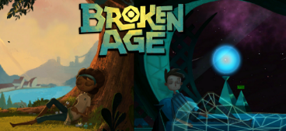
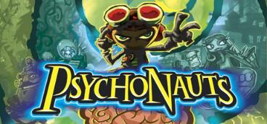
ANNA
KIPNIS
Senior Programmer
Double Fine
@doubleanna
Notes:
Anna Kipnis is a longtime programmer at Double Fine, going all the way back to Psychonauts and including being the lead gameplay programmer on Broken Age.
She also is active in the indie scene, working on games like the charming Wheels of Aurelia, and was one of the founders of Molyjam, a game jam based on fake Peter Molyneux tweets. How cool is that?
Anna Kipnis!

Slide 48
Anna Kipnis
Senior Gameplay Programmer
Double Fine Productions
@doubleanna
Illustration by Michael Firman
Notes:
Hi, my name is Anna Kipnis. I work as a Senior Gameplay Programmer at Double Fine Productions. A little about me and why I got into games.

Slide 49
Notes:
I grew up in the USSR in Kiev, Ukraine. You might have seen it a lot in the news in the past few years,

Slide 50
Notes:
..but this is what it looked like when I was there.

Slide 51
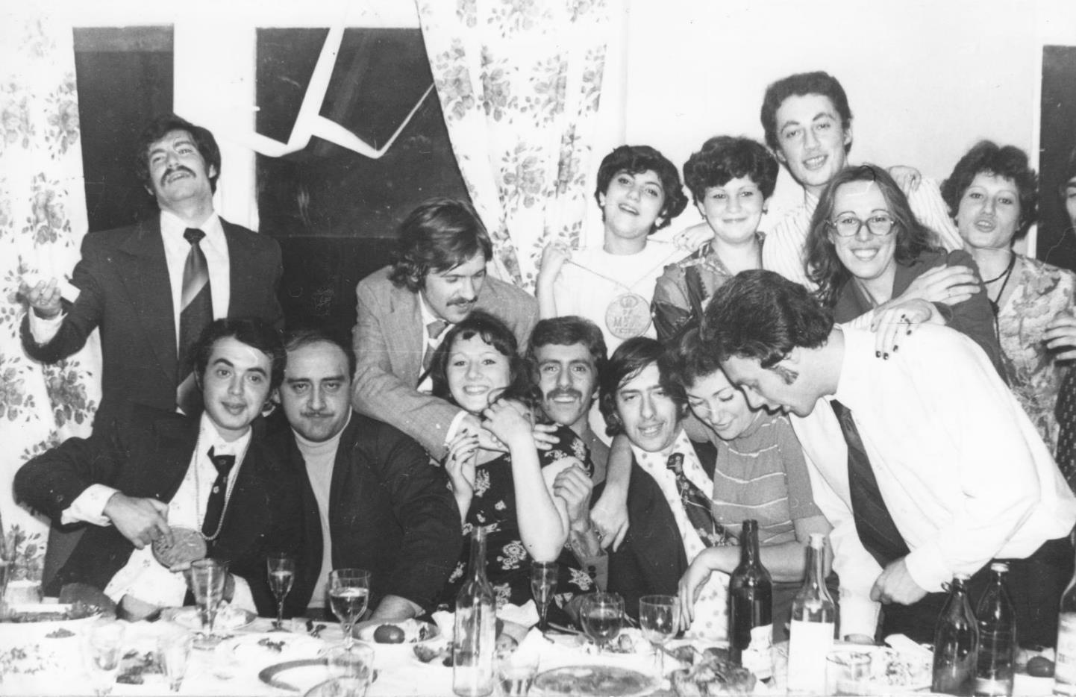
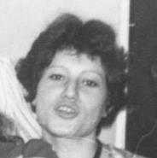
Notes:
Growing up, my parents often had dinner parties…

Slide 52
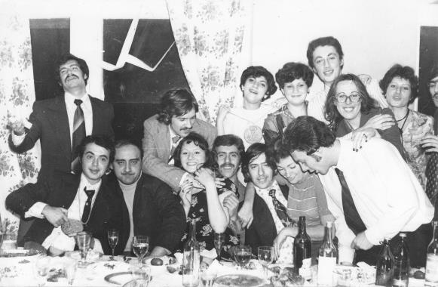
Notes:
..with their friends, who would bring over their kids, and since I was the oldest,

Slide 53
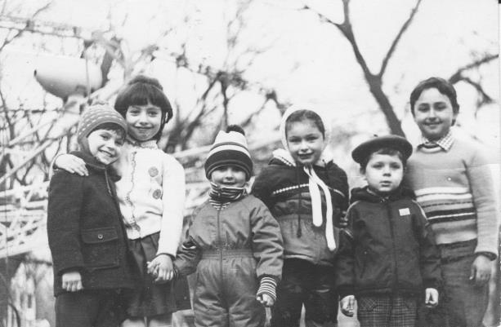
me
Notes:
.. it would fall to me to entertain them all.
There weren't too many board game or toy options for us in the USSR, so I would make up games for us all to play.

Slide 54
Notes:
I remember I found it totally exhilarating when the kids playing my game would start to come up with their own original ideas within that game world. It was as if that universe wasn’t just mine anymore, but suddenly came to life for all of us in a very real way, as soon as we were playing and that was _the best feeling in the world_.

Slide 55
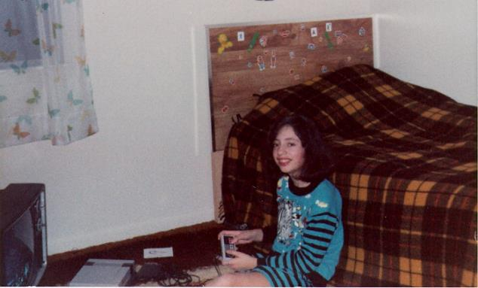
Notes:
In 1989, we moved to the United States and I got to try out Super Mario Brothers on the Nintendo and was blown away.

Slide 56
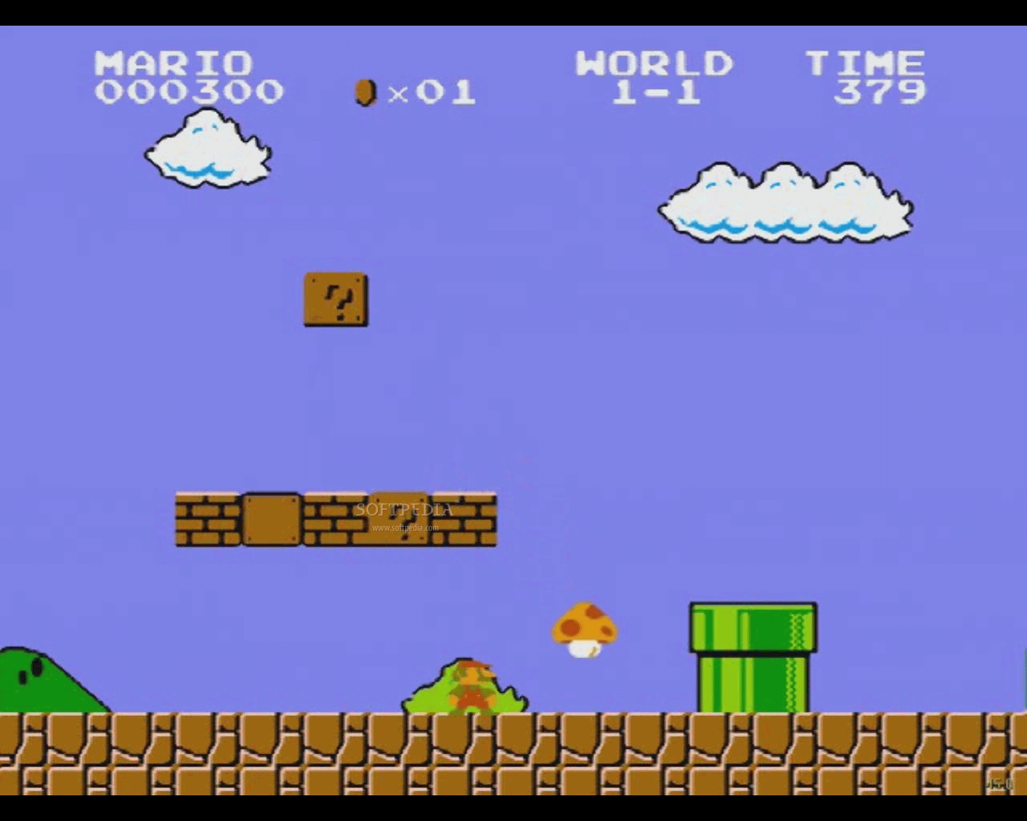
Notes:
Here was someone who made up a world for other people to play with and explore, and he didn't even have to be there. It opened my eyes to what was possible with games for the first time. I wanted to be a part of the process of creating worlds like that.

Slide 57
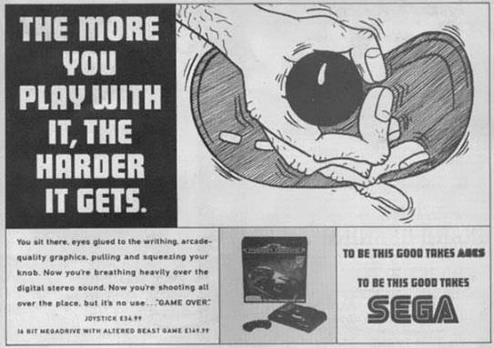
Notes:
And here is where I started hitting some snags. Marketing for video games was pushing girls away. Luckily, when I was going to school to become a game engineer, I could draw inspiration from

Slide 58
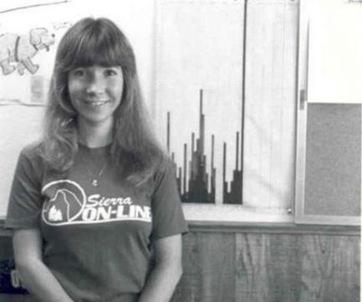
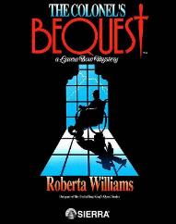
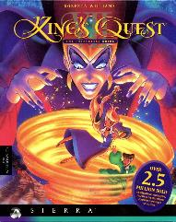
Notes:
women like Roberta Williams,

Slide 59
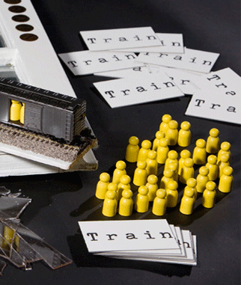
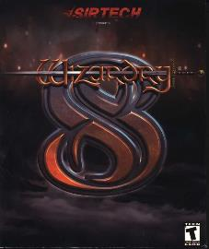
Notes:
Brenda Romero,

Slide 60
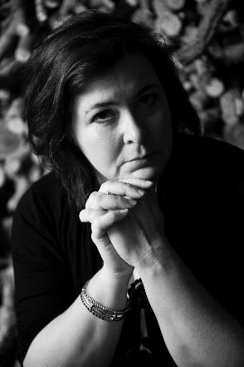
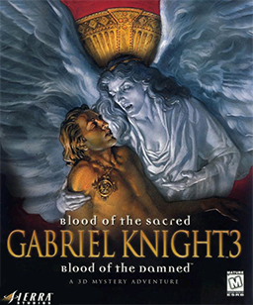
Notes:
Jane Jensen,

Slide 61
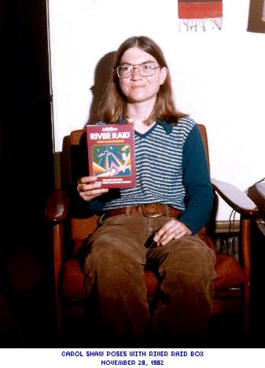
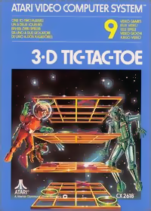
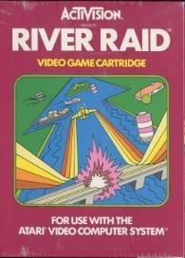
Notes:
Carol Shaw,

Slide 62
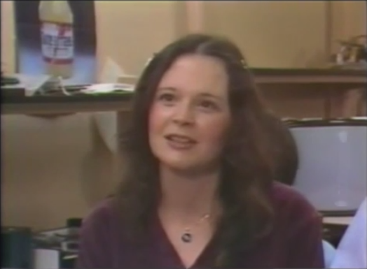
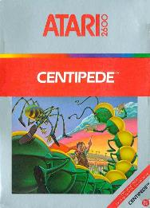
Notes:
Dona Bailey,

Slide 63
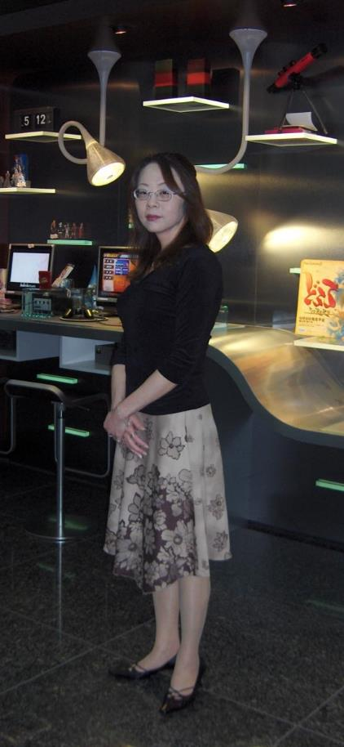
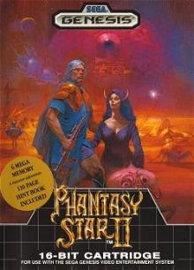
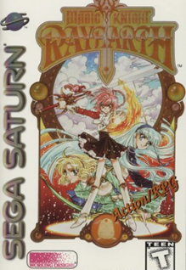
Notes:
Rieko Kodama and others

Slide 64
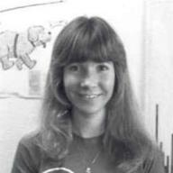
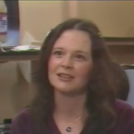
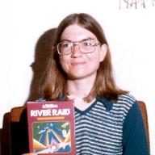
Notes:
who showed that women do great work and lead projects in the games industry. And it made me feel like I belonged there too.

Slide 65
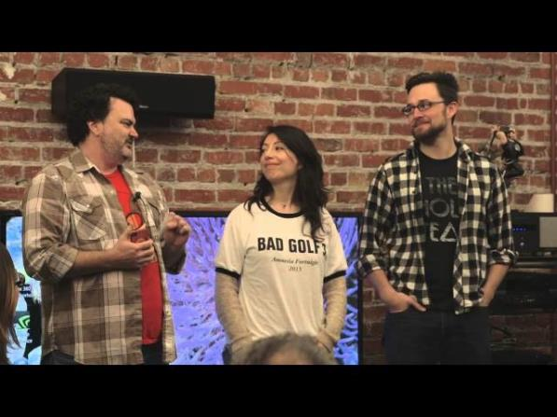
Notes:
Now, 14 years have passed since I started working my dream job at Double Fine and something worries me.

Slide 66
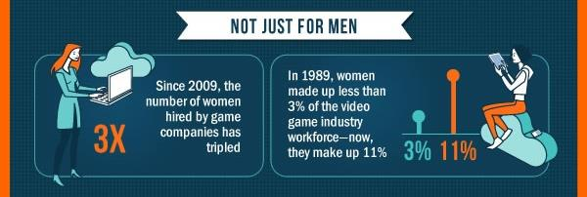
Notes:
There are so many more women in games than there were when I first started, including engineers, but so few games being created by women.

Slide 67
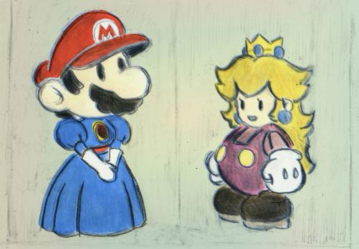
Notes:
We want to see the representation of women in games made more nuanced,

Slide 68
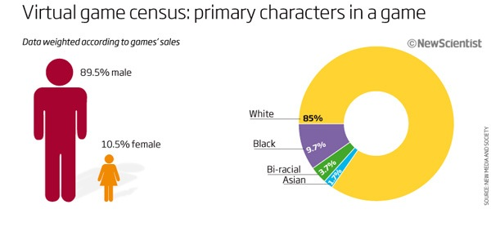
Notes:
We want there to be more creative diversity in games out there, yet it seems like the most obvious solution -- for women to create and lead game projects -- is not being taken up as much as it could be.

Slide 69
Women are capable game creators,
known for masterworks in the games medium.
Notes:
More than anything I feel like it is up to us, the current generation of game developers, to change this trajectory. We need to make it part of the narrative of the game industry that [pause] women are capable game creators, known for masterworks in the games medium. [pause] This is a true statement and I want it to become more true as it becomes a more common idea.

Slide 70
Women are capable game creators,
known for masterworks in the games medium.
Notes:
And even though I have been working in games 14 years, up until exactly 2 years ago, I had not actually tried to create or lead a video game, myself, and I’ve actually had plenty of opportunities.

Slide 71
Notes:
The studio where I work, Double Fine, has done a game jam pretty much every year since 2008, called Amnesia Fortnight.

Slide 72
Amnesia Fortnight
Pitch ideas to Tim
Break into 4 or 5 teams
Make game prototypes for 2 weeks
Notes:
What we do is pitch ideas, break into 4 to 5 teams and take two weeks to create game prototypes based on those ideas.

Slide 73
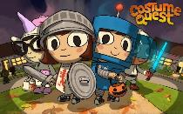
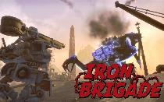
Costume Quest
Iron Brigade
Middle Manager of Justice
Once Upon a Monster
Notes:
Many of the games Double Fine has released were originally prototypes made during Amnesia Fortnight.

Slide 74
Amnesia Fortnight since 2012
Double Fine makes pitch videos
People vote through Humble Bundle
Top-voted games become finalists
Break into 4 or 5 teams
Make game prototypes for 2 weeks
2 Player Productions films the process
Notes:
In 2012, Double Fine opened this process up to the public, so that people on the Internet could actually vote on the prototypes they’d like to see made and even watch a documentary of us making them.

Slide 75
Notes:
In 2014, I pitched a game called Dear Leader, and to my great astonishment, it was voted to be greenlit for the jam by the fine people on the Internet. Ok so why did it take me so damn long to pitch a game?

Slide 76
I have heard this question a few times so I figured I’ll do a post.
It is just a numbers game, in my opinion. Double Fine has about 65 employees, there are 5 fulltime dev women, and 2 part time dev women, and 4 women in administration. One dev woman had a pitch but she later decided against doing it this time around because she needed more time to develop it.
Why didn’t I pitch? Same as probably all the other dudes and ladies who also didn’t pitch: I don’t have a burning desire to lead my own game. That’s not a bad thing, it’s just not what I’m into. I really enjoy being lead artist, and I love working with others who do have a burning desire and vision for their own game. Lucky me there are plenty of those folks here at DF!
Signature
I was DF Jane, now I’m @thatJaneNg!
Notes:
There are legitimate reasons why someone might not want to lead a game project. I remember reading this thoughtful post by my former colleague, Jane Ng, about why someone would not want to pitch a game for Amnesia Fortnight, and thinking that she’s absolutely right. (It is a lot of work and is very stressful, maybe you prefer to work on realizing someone else’s vision rather than creating one).

Slide 77
Reason for not pitching in the back of my mind:
My ideas are half-baked and no one would like them anyway
Notes:
But if I’m honest with myself, there was another reason why I didn’t pitch a game in 2012: I really thought none of my ideas were anywhere near fleshed out enough to be worthy of presenting to anyone, and even if they were, I figured no one would them anyway and I didn’t want to see my worst fears confirmed.

Slide 78
Reason for not pitching in the back of my mind:
My ideas are half-baked and no one would like them anyway
Notes:
This is a terrible reason not to make your own game and if that’s what you’re thinking too, I hope my experience will change your mind. The truth is, many of us got into the industry not just because we wanted to work on games, but because we have a secret fantasy to make a particular game. And if the only thing that’s stopping you, that you think it’s too hard to make it and that no one will like your ideas anyway -- you may be pleasantly surprised that neither of those things is true.

Slide 79
Notes:
What really surprised me about Amnesia Fortnight 2012 was how many in the studio DID pitch a game (more than what is pictured here and they were all men, by the way). I talked to a bunch of them asking them about the details of their games and found that many of their ideas were hardly fleshed out at all!

Slide 80
Notes:
In fact, some told me that they hadn’t planned to do much design until they knew for sure that their idea would be picked! After talking to them, I realized I was more than capable of doing what they did and had actually thought waaaaay more about my little half-baked idea than some of them did about the one they pitched.

Slide 81
Watch the documentary:
youtube.com/user/DoubleFineProd
Try the prototypes:
http://www.doublefine.com/games
Notes:
So like I said, I pitched a game for Amnesia Fortnight 2014, called Dear Leader. You can watch a documentary about how the game was made on youtube and can play the prototype my team made at Humble Bundle.

Slide 82
What’s cool about making your own game?
Notes:
I just want to really quickly share with you a couple of cool things about making your own game:

Slide 83
Great things about making your own game
People are working towards your vision
Notes:
People are working towards your vision, which means if there’s a building in Kiev that you really liked as a little kid, you can ask your artists to draw it for you! If there’s a piece by Chopin you’re crazy about, you can send it to your audio designer, and they’ll put it in the game for you.

Slide 84
Great things about making your own game
People are working towards your vision
Watching your colleagues contribute their own ideas
Notes:
When you come in to work-- you see all the new stuff the people on your team have done for the game and it seriously feels like Christmas morning every day.

Slide 85
Great things about making your own game
People are working towards your vision
Watching your colleagues contribute their own ideas
You never feel helpless
Notes:
When you realize that there’s way more work than there is time for, you don’t feel helpless, because you can actually do something about it: you have the power to cut or make any changes as you see fit!

Slide 86
Great things about making your own game
People are working towards your vision
Watching your colleagues contribute their own ideas
You never feel helpless
It grows you as a game developer
Notes:
It grows you as a person. Of course you learn how to be accountable and responsible for an entire project. But you also realize what you value as a lead in people on your team and it makes you a much better person to work with when you’re on someone else’s project.

Slide 87
Great things about making your own game
People are working towards your vision
Watching your colleagues contribute their own ideas
You never feel helpless
It grows you as a game developer
There is a thrill to seeing people play it
Notes:
Even making a small game prototype, there’s a thrill to seeing people playing it, making let’s play videos and laughing at the jokes and just having fun with the game

Slide 88
What can be done
Notes:
There are people in the audience who would love more than anything to help make this a reality for more women. So what can be done?

Slide 89
Make your studio a place that harbors creativity
Have everyone play and give feedback on games
Notes:
Make your studio a place that harbors creativity. Have a day when everyone at the studio, including your office managers and IT play the games you’re making and have them give feedback and suggestions.

Slide 90
Make your studio a place that harbors creativity
Have everyone play and give feedback on games
Have studio-wide game jams
Notes:
Have studio game jams, where anyone can pitch a game and lead a project.

Slide 91
Make your studio a place that harbors creativity
Have everyone play and give feedback on games
Have studio-wide game jams
Encourage everyone to pitch games
Notes:
Encourage everyone to pitch a game, not just designers. This benefits everyone at your studio, but especially women, who might have needed that extra opportunity to feel like they have it in them to create their own game.

Slide 92
Make your studio a place that harbors creativity
Have everyone play and give feedback on games
Have studio-wide game jams
Encourage everyone to pitch games
Make everyone feel included in the creative process
Notes:
For those running a project, make the other people on the team feel included in the creative process, regardless of their official position.

Slide 93
Women are capable game creators,
known for masterworks in the games medium.
Notes:
And to my fellow women developers, let’s continue the tradition of women game creators and give young girls some more names to think of as they grow into game developers themselves.

Slide 94
Anna Kipnis
@doubleanna
Amnesia Fortnight 2014
@DearLeaderGame
Watch the documentary:
youtube.com/user/DoubleFineProd
Try the prototypes:
http://www.doublefine.com/games
Illustration by Michael Firman
Notes:
Thank you!

Slide 95
STEVE
ESCALANTE
GM/Founder
Versus Evil
@indieeski
Notes:
Steve Escalante has been working in games going way back, when he himself started as an indie.
After working at many big companies including a stint in marketing at Bethesda, he finally left the big companies and founded his own independent games publishing label Versus Evil which had great success with the hit game Banner Saga.
Steve!

Slide 96
From an Indie Publisher Perspective
What No One Tells You

Slide 97
Your Baby is Ugly

Slide 98
Your Baby is Ugly - - and you know it.

Slide 99
But Video Games are an art form

Slide 100
And you know when they are fun

Slide 101
Focus Groups Are Useless

Slide 102
Focus Groups Are Useless

Slide 103
Focus Groups Are Not Taste Tests

Slide 104
Soft Launch – Closed Beta
Friends and Family – Demo Release

Slide 105
Traditional Marketing and Website Take Overs
Struggle to Work Well on Indie Budgets

Slide 106
Traditional Marketing and Website Take Overs
Struggle to Work Well on Indie Budgets
Google’s Rich Media Gallery Benchmark for static media is 0.08% CTR
Purchase 1,000,000 impressions
If you beat that average 1.5% - 0.50% (you can get higher
@ 3% CTR if your budget allows for it)
Delivered Clicks are 15,000 to 5000
Pending you conversion rate depends success.
Pending on the CPM determines
Very little data tracking especially for PC and Console

Slide 107
Regular Content Releases to Build Community
And boost with Social Media

Slide 108
Regular Content Releases to Build Community
And boost with Social Media
Create meaningful releases to build your community and interest (images, videos, developer stories, reviews, etc.)
Support that with your social media and influencer channels
If you can, spend $500 - $1000 to boost a post to reach 150-300,000 people, each time.
Do it over a long period of time.

Slide 109
What No One Tells You
Steve Escalante @IndieEski http://vsevil.net/

Slide 110
DAVID
CALVO
Lead Designer & Writer
Playmind
@metagaming
Notes:
David Calvo has a long history as a designer, writer and builder of worlds.
His diverse past games stretch across many platforms include Islands of Islands of Wakfu, Kwaan and many other games you should seek out
He is currently Lead Designer and Writer at Playmind which specializes in digital environments

Slide 111
Notes:
1. ALL OF THEM WITCHES
1. So, here is something useful that nobody will ever tell you about game developement : it's bogus. It's a scam to make you believe our games are actually worth paying for. Caught in our love for procedure and technocorp newspeak, we parade as engineers of dreams.

Slide 112
Notes:
2. We hear it all the time : games are too expensive, they should be free. But if players knew how really easy it is to make games, they would ask to be paid to play our games. Yet, our industry keeps on charging, expecting people to support its lifestyle, pot of post post-modern postures, stewed in ideologies. Crunch is a mythical sacrifice, we celebrate spring weddings of occult refresh rates, we dance all day round carcasses of useless computers, weaving in our haptic gloves the threads of an invisible song. We’ve scammed the players until now, but, alas, time is running out, and i have to break the prototocols of my coven.

Slide 113
Notes:
3. Since the immanentization of the Eschaton in 1973, and the exploit of the Cosgrove-Mendelbaum bridge in 1982, developers have been tapping a previously unknown source of energy. An energy moving through a threshold, that our primitive computers were taught to access, as keys. This energy is a concentré, puddles of datas, geomantic patterns, threads. Worlds able to listen and to speak. Worlds we call, dismissively, virtuality. Esoterical Traditions have taken game space for granted, but the physical, and molecular, proof of this energy can no longer be tradded for anal-retentive fame.

Slide 114
Notes:
4. These virtual realities are part of the natural world, as much as computers are part of our environnement. And I’m not talking VR, this simili-toys allowing homeopathic glimpses of true telepresence. I am talking about a virtue that we’ve been ignoring so far, wasting our ressources to reproduce, then enhance, aspects and surfaces of our human lives, forgeting about the subtle call for abstract frontiers : the Veil of Nature itself. The Freeverse.

Slide 115
Notes:
5. As developers, designers, we know how to harness this energy - reducing the consensual reality to shreds of artificial DNA, but we're still unable to escape our past, forever lost in the Monomyth. Our need for process, micro-managed rituals altering the nature of physics, has created a college of thoughts, driven by a thirst for riddles, oracles and equations.

Slide 116
Notes:
6. Every game is a window. But through the sorcery that is interoperability no virtual world is an island. Projecting on them the shortcomings of our material consensual reality, has doomed true agency and post-prioperception. We’ve forget why we do things, lost in the maze of a never-ending man-made catastrophe.

Slide 117
Notes:
7. By forcing our narcissism unto these living playgrounds, we've have mistaken comfort for warmth. It is no longer about making a new steam game. Or selling more than your friends, or getting more attention from the press or curators or trying to nudge empathy in a world bent on forging a white fascist superstate.

Slide 118
Notes:
8. We have a responsability. Towards the children - they are born with an inate way of tapping the Freeverse without an interface. We want to be designing games for them, and for a perfectly valid reason : they are both door and key.

Slide 119
Notes:
9. We have a responsability. Towards older generations. To expand the understanding of virtuality, without corrupting our precious, limited material ressources. The Freeverse is a shared hallucination, in which we can expand our search for peace - to learn about being. A practice, grounded in beauty and grace. A tool to forge new customs, in a permanent quest for knowledge and acceptance.

Slide 120
Notes:
10. To carry consciousness is a responsability. Access and training in these worlds is a gift : a shared space of interdisciplinary discussion, where we can plan a project for a civilized society through the awesomeness of game design. Learning as the driving force of everything.

Slide 121
Notes:
11. In a world stuck between two self-reflections, the Freeverse is a canevas, on which to paint an increasingly complex daily life. We're gate crashing the biggest party ever. We are the gardeners of meaning, in a dangerous and volatile folie.
We are of the going water and the gone. We are of water in the holy land of water.

Slide 122
JILL
MURRAY
President & Writer
Discoglobe Interactive
@codejill
Notes:
Jill Murray started out as a young adult novelist but soon moved into games.
Working at Ubisoft she wrote the award winning script for Assassin’s Creed: Liberation,
and has since gone freelance, working on a wide range of titles from Long Story to Moon Hunters

Slide 123
Jill Murray - @codejill
Notes:
I'm here to talk about FEELINGS.
They warned me to connect this topic more to game dev
That’s fair. As an industry we can be VERY slow to connect our basic humanity to our work.
It shows up in crunch that sends devs to medical leave for burnout
And women harassed to the point of quitting
And calls to keep politics out of content, as if our games do not spring from our lives
In 2016, as we face important challenges to civil rights and freedoms
Our emotional health, and ability to hear each other, may be our most important asset
But still, devs are asked under the guise of performance feedback
To “control their emotions.”
So here's one thing we don't hear enough:

Slide 124
no one tells you
YOU CAN’T CONTROL YOUR
Jill Murray - @codejill
Notes:
YOU CANNOT CONTROL A FEELING.
[Pause]
I probably just lost half of you.
Many of us are drilled to hold the opposite belief.
"I should be less angry." "I know I should be happier but..."

Slide 125
“No matter how much insight and understanding we develop, the rational brain is basically impotent to talk the emotional brain out of its reality.”
Dr. Bessel van der Kolk,
The Body Keeps the Score
Notes:
But you CAN’T CONTROL YOUR FEELINGS.
It's not my opinion; it's brain science.
Anything you can see, hear, touch or taste is sensory information
It reaches your affective faculty-- your feelings-- in 12-14 miliseconds
Meanwhile, the same information needs at least twice as long to find your cognitive faculty-- your thinking brain.
By the time you can think about something, you're already feeling it

Slide 126
Notes:
So feelings are signs and feedback.
You don't DO them.
They arise to give you cues about your world state
What you can control
is the same thing you control in a game: actions. Behaviour.
You might think, “well yes Jill but ACTUALLY, that’s what ‘control your feelings’ really means. It means control your behaviour.
keep your feelings quiet until you’ve thought them through.
But that’s not how feelings work, either.
As long as a feeling is not processed, it influences your thoughts, whether you like it or not.
So you have a choice:
1) You can acknowledge and express the feeling
or 2) try to ignore it and move on like it never happened.
The second option leads to anxiety, and
Anxiety brings confusing symptoms that make it HARDER to process a feeling.
So it’s better if we can identify and express a feeling,
knowing we cannot control it.

Slide 127
Notes:
Expressing a feeling before it has a chance to morph into behaviour can be more straightforward than you might think.
We have a big vocabulary for describing emotion
but the number of core feelings we need to survive is small:
- Joy
- Sadness
- Anger
- and Fear
If they’re good enough for survival, I think they’re good enough for game dev.
Now, In our culture we have been conditioned to value some of these above others
But no feeling is “good” or “bad.”

Slide 128
Notes:
Darwin observed that emotions exist to provoke action that will get an organism to safety and physical equilibrium.
I’ll use anger as an example.
My friend Manveer told me:
Anger is a rocket. It can get you to the moon. Or if you keep it in the garage, it can burn your whole house down.
Feelings can’t motivate us if we pretend not to have them.
They can only burn us up.
To find balance and equilibrium, we have to value ALL feelings equally.

Slide 129
Notes:
And
since you can’t control YOUR feelings
You certainly can't control someone else's.
Before we ask a colleague to be superhuman, and control their feelings
we should check
- Why is it important to me, to NOT KNOW what my team is feeling?
- What would my project gain from having LESS INFORMATION about team morale?
‘Cause if I ask someone to control their feelings,
their energy is going into faking me out
Instead of creative thinking
Problem solving
And everything else that could make a game great
What a terrible use of super powers!

Slide 130
Notes:
I’d much rather let people feel what they feel
And say it out loud
And save their energy
For the really important superhuman things
Like rewriting scripts three days before a voice recording
Persuading teams that women have a place on screen
And that white supremacy doesn’t
Let's save our miracles for awesome things
And stop trying to control our feelings.

Slide 131
JASON
KIM
CEO & Creative Director
Cardboard Utopia
@LeSaucierKim
Notes:
Our next speaker has a long history in game development going all the way back to your favorite and mine, Scooby Doo Unmasked
He spent time at Ubisoft working on Assassin’s Creed Brotherhood and Far Cry and a game that he and I worked on together that we shall not mention
But most recently he launched his own company making the big-kickstrter success story Children of Zodiarcs

Slide 132
What No One Tells You About Running Your Own Indie Studio
Notes:
Bit about me
Game dev background in 3d art and game design
Spent 10 yrs working in Work for hire and AAA
Running Cardboard Utopia I founded for 2 yrs
This is about what I’ve learned from running my own indie studio
Wish someone had told me

Slide 133
1. You will be an entrepreneur
Notes:
Become one, whether you like it or not
Learn about this stuff!
Dev 80% entrepreneur 20%
But the truth is, you will be an entrepreneur about 80% of the time.
Dev other 80% of the time
If you don’t already know business, don’t assume you do
Learn about business
Ask for help from people who know these things
EXAMPLE
People always told me things like « it’s easy to incorporate, just do it online! ».
It’s all LIES!! Get a lawyer.
a $1500 mistake

Slide 134
Notes:
You become and indie for a reason.
You want, NEED that creative outlet.
Find balance between being a creator and being an entrepreneur
As a dev, I slowly learning to relinquish control over details
My job is to focus on big picture and directing
The same goes for your precious business-baby
Unless stick to 1 full-time, get someone to help you.
Delegate or hire

Slide 135
2. You will be a leader
Notes:
Not a lead designer, a leader of a country
Being a studio head changes you. It changes your perspective on development.
Friends have told me I’ve become more “corporate”
No one above you to blame for bad decisions
The buck stops at you
Every little decision I make has the weight of the team, the project, and the studio on them
That also means you need to have confidence in them
Also humility to accept when wrong and adapt
Speaking of « adapt », there is no skill you’ll use more than your ability to adapt
As the leader, decisions are not just about you
You will have to make decisions outside of yourself,
Learn to assess the value of ideas, especially YOUR ideas, more objectively.
What’s best for your game’s vision, your team, and your studio
Not for yourself and what you want

Slide 136
3. You will go crazy
Notes:
Yes, having a studio, especially a young one, is stressful AF
I’ve wanted to run away from it all and drink myself stupid under a bridge.
It’s a huge emotional strain;
game development is already pretty hard as it is
But that difficulty is magnified by
The pressure of owning a business you want to succeed
The pressure of leading a team who put faith in you
So much is riding on this project all of you are pouring much love and passion into
SO, get ready for that. I myself am still working on that part.
One of the hardest but most beneficial things to do, I found, is simply: Take time to step away from work.
Take care of yourself. Eat, sleep, move. See your family and your friends. Have your people around you.

Slide 137
Notes:
This being said, if you do take that step and decide to start your own studio, that is awesome.
Hardest part of my professional life so far
Many things I wish someone had told me

Slide 138
Notes:
I have absolutely no regrets!

Slide 139
ADAM
BOYES
CEO
Iron Galaxy
@amboyes
Notes:
I’ve known Adam Boyes going all the way to when Midway bought the company I was working for and we ended up spending a lot of time in executive review meetings talking about games that would never ship.
But some of them did ship! Like the delightful Blitz the League.
You probably know him from his time on stage at press conferences for Sony
But now he has recently returned to be closer to development and the fine city of Chicago by becoming the CEO of DiveKick creators Iron Galaxy
Adam Boyes!

Slide 140
BE CAREFUL WHAT
YOU WISH FOR
@AMBOYES

Slide 143
I WISH
I GET

Slide 144
I WISH
I GET

Slide 145
I WISH
I GET

Slide 146
I WISH
I GET

Slide 147
I WISH
I GET

Slide 148
I WISH
I GET

Slide 149
I WISH
I GET

Slide 150
I WISH
I GET

Slide 151
I WISH
I GET

Slide 152
BE CAREFUL WHAT
YOU WISH FOR

Slide 153
@richardrouseiii
@Aleissia
@codejill
@RDansky
@DoubleAnna
@IndieEski
@metagaming
@LeSaucierKim
@amboyes
Notes:
Thanks everyone for coming!
Keep up the fight! Make games mean something!

