Slide 1
MIGS Brain Dump 2015
Moment of Clarity
Vander Caballero
Brie Code
Mia Consalvo
Amy Hennig
Guillaume Provost
Jason Della Rocca
Richard Rouse III
Warren Spector
@we_are_minority
@BrieCode
@MiaC
@Amy_Hennig
@G_Provost
@JasonDellaRocca
@richardrouseiii
@Warren_Spector
with
Montréal International Game Summit
Tuesday, November 17th, 2015
Notes:
Welcome. Always great to come back to Montreal for the Brain Dump!

Slide 2
5 MINUTES
Notes:
The format is simple – we invite a bunch of speakers and they each talk for 5 minutes.

Slide 3
Notes:
We take some people who were already speaking at MIGS.

Slide 4
Notes:
And then we round up some other cool people from Montreal… and get them to speak.
Now this year’s theme for the amusing Brain Dump head shots was goofy hats, and I mostly succeeded here.
For Brie I had to go a little far back in time, for myself and Amy even farther, and Guillaume, sorry, the best hat picture I could find for you was a small child.

Slide 5
Moment of Clarity
Notes:
And this year’s theme is the Moment of Clarity.
The request for each speaker was they talk about a moment in time where they realized something important about games.
Maybe not a eureka moment, because those are rare, but an event of some kind that changed their viewpoint.
Now, I got the inspiration for this year’s topic from music.

Slide 6
Notes:
If you think it’s the ubiquitous “Clarity” pop song from a year ago

Slide 7
X
Notes:
You would be wrong.

Slide 8
Notes:
Instead, I want to take you back a bit farther in time, perhaps some of you are old enough to remember Jay Z’s Black Album (from 10 years ago, how did that happen).

Slide 9
Notes:
And track 8.

Slide 10
“I shall fear no man you don't hear me though These words ain't just paired to go in one ear out the other ear, no Yo, my balls and my word is all's I have What you gonna do to me? Nigga scars'll scab What you gonna box me homie? I can dodge and jab Three shots couldn't touch me thank God for that I'm strong enough to carry Biggie Smalls on my back And the whole BK nigga holla back
Thank God for granting me
This moment of clarity,
This moment of honesty The world'll feel my truths” - Jay-Z
Notes:
This song talks about a lot of subjects that Jay has a realization about.
He talks about forgiving his father for being absent from his life.
He talks about forgiving himself for “selling out” because he’s a hustler.
And then finally talks about keeping his lyrics true and real through it all.
And he’s willing to fight you for his right to be creative.

Slide 11
Notes:
But what if I told you that wasn’t the only song called “Moment of Clarity” in my iTunes?

Slide 12
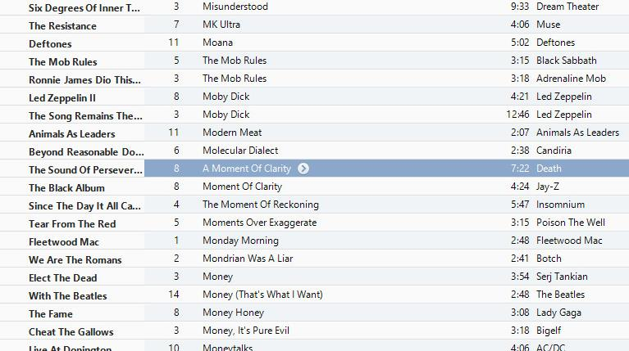
Notes:
If we zoom in here we’ll see there’s another one.

Slide 13
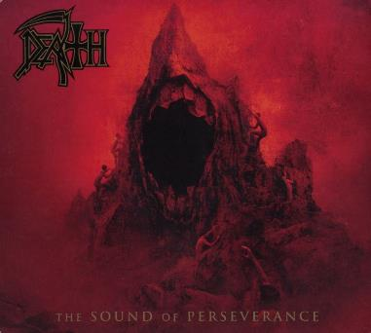
“What vision lets me see
Time after time
Unneeded misery
My dreams
I own
No price for you
I grip them tight
And hope for sight
Open my eyes wide
To see a moment of clarity
Confusion gone, it's in your hands Your turn to ask why” - Chuck Schuldiner
Notes:
The other song is by the band Death. I figure I can bring this up here because Montreal IS the North American capital for heavy metal.
This song was specifically written by the band’s mainman, Chuck Schuldiner, who is largely attributed with creating the death metal genre (in case you didn’t know).
Schuldiner has a special place in my heart, because years ago I licensed a track from his band to be in one of my games.
I got to talk to him on the phone once, which was awesome. And particularly special to me, because a few years later he died from a brain tumor at the tragically young age of 34.
And what’s surprising is Schuldiner’s lyrics talk about the same issue as Jay’s – staying true to beliefs and dreams, his creativity, refusing to surrender them to anyone else.

Slide 14
Notes:
It’s particularly interesting to me that, for two musicians so incredibly different, they were both saying same thing –
staying true to themselves when faced with the commerciality of the music industry.
In our medium’s present time of divisiveness, with people constantly tearing others down if they aren’t like us or don’t make the type of games we deem appropriate.
I think if Jay-Z and Chuck Schuldiner can be revealed to be writing lyrics about the same thing, there’s hope for all of us to get along.
Right?

Slide 15
Moment of Clarity
Notes:
But that brings us back to our theme – most of the talks you are going to hear today are going to be about realizations our creators have made about what they are called to do, with a few other subjects sprinkled in.

Slide 16
WARREN
SPECTOR
Director, Denius-Sams
Gaming Academy
University of Texas Austin
@Warren_Spector
Notes:
Our first speaker probably doesn’t need an introduction
It’s likely you’ve played one of the many games he’s worked on, but if not you’ve certainly played games derived off of the games he’s worked on.
He is now heading up the Gaming program at the University of Texas Austin.
Warren Spector!

Slide 17
My Moment(s) of Clarity
Warren Spector
Director, Denius-Sams Gaming Academy at UT
Notes:
My moments of clarity all revolve around revelations that Changed My Gaming Life.

Slide 18
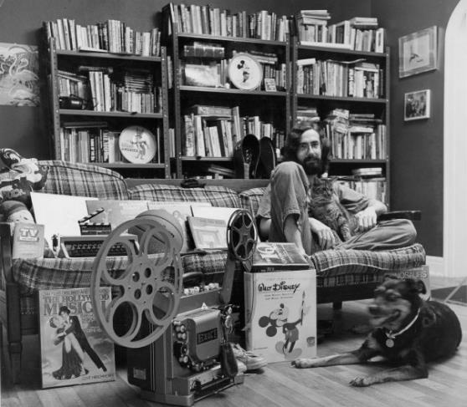
Notes:
The first such moment came when I was in grad school. Here’s me at that time, surrounded by everything that mattered. (FWIW, my girlfriend is missing because she was behind the camera…)

Slide 19
Nerd Cred
(D&D dice)
Notes:
But look closely and you’ll see what may be the most important thing of all (with apologies to my then-girlfriend!): Dice. D&D dice.

Slide 20
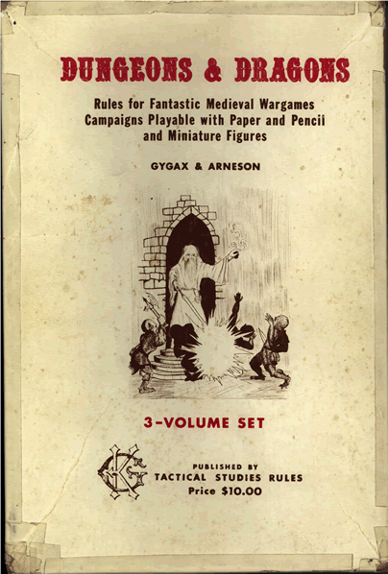
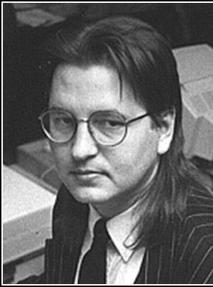
Notes:
The moment of clarity came the day in 1978 when I played D&D for the first time. SF author and cyberpunk guru, Bruce Sterling, was my dungeonmaster. He was quite a storyteller. But what made that night a life-changer was the fact that my friends and I weren’t being told a story BY Bruce. We were telling a story WITH Bruce – and with each other. That night, I realized that players could be "authors." I’ve spent the rest of my career trying to recreate that feeling.

Slide 21
Notes:
The next moment of clarity came for me in 1980. A friend of mine was having a party and, when I arrived, I saw all of my friends – my adult friends – sitting in the dark, lit only by the phosphor dots of his 25” television, mesmerized by a game called Star Raiders. That was the night I realized video games could empower players to be heroes, not just puppet masters controlling a tiny avatar. It wasn’t Luke Skywalker piloting an X-wing – it was YOU. Mind blown.

Slide 22
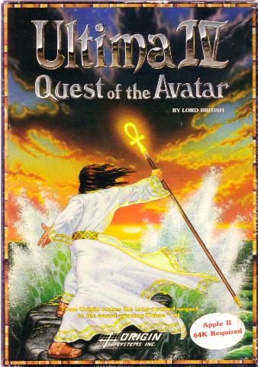
Notes:
In 1985, I experienced Ultima IV, the game that convinced me games could be about more than killing monsters and collecting treasure, or about saving the world from alien invasion. Games could have the same thematic depth as a great book or movie. They could teach players something about themselves.

Slide 23
Notes:
And then there was the day in 1989 when I saw an Ultima VI player solve a game problem in a way that wasn't pre-planned. See, Richard Garriott and I decided that every puzzle in the game would be solve-able in a couple of ways. But there was one we just couldn’t come up with but one solution. There was a lever you had to flip but you came up on it on the wrong side of a locked portcullis. You needed the telekinesis spell to flip the lever and open the portcullis. I was watching one of the testers play as he came to that portcullis without the right spell. He was screwed, I thought. But then, he told one of his party members – a mouse named Sherry – to go UNDER the portcullis and flip the lever. It worked! I fell on the floor. When I got up, I decided I was going to spend the rest of my career making sure that kind of thing happened intentionally and not just by accident. That was a D&D moment, for sure!

Slide 24
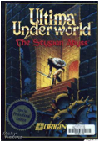
Notes:
A year later, I experienced another step on the road to recreating the D&D feeling. In 1990, I saw the first Ultima Underworld prototype and realized games could transport players to believable alternate worlds. We could combine the you-are-there feeling of Star Raiders with the player expression possibilities of Ultima VI in a package that was more compelling than either of them.

Slide 25
Notes:
Then came June 23, 2000, the day we shipped Deus Ex. That was when I realized you really could make a game where "playstyle matters“ – a game where players were empowered to tell their own stories through their choices during play. We were getting closer and closer…

Slide 26
Notes:
And most recently was the day in 2010 when we shipped Disney Epic Mickey and I realized a mainstream audience could "get" the idea of choice and consequence in games. It wasn’t just gamers who wanted to be – and were capable of being – authors of their own experiences. Normal people wanted it and could do it, too!

Slide 27
We haven’t recreated that D&D moment yet…
Notes:
I don’t know what comes next. I know we haven’t quite captured that feeling of awe and creative power I felt in 1978 when I first played Dungeons & Dragons…

Slide 28
But we will.
Notes:
But with each step on the path – each moment of clarity – I become more and more convinced it’s possible to engage players fully in the role of co-author. Someday, I know we’ll get there…

Slide 29
GUILLAUME
PROVOST
Founder & Creative Director
Compulsion Games
@G_Provost
Notes:
Our next speaker is Montreal native, but got his start in games elsewhere,
Such as doing graphics programming on Cel Damage at Pseudo Interactive
He now runs Montreal indie Compulsion games, which is developing the Kickstarted and fantastic looking We Happy Few
Guillaume Provost!

Slide 30
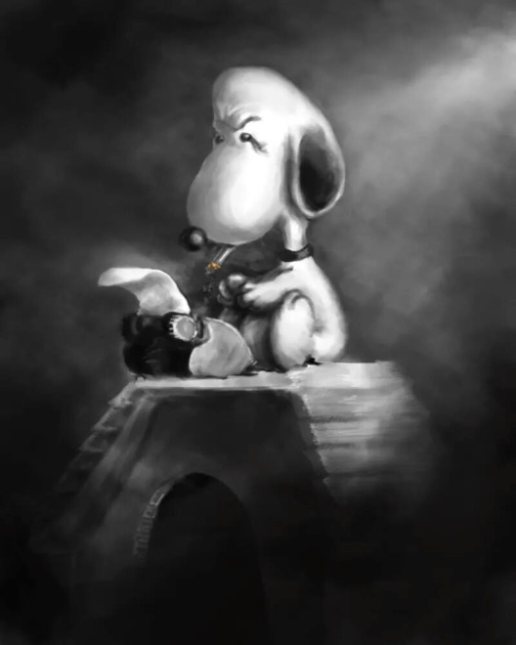
Moment
of Clarity
with
@G_Provost
Guillaume Provost
Tales from the indie trenches.
Montreal International Game Summit
Tuesday, November 17th, 4:30PM
Notes:
Hello everyone! My name is Guillaume, and I’m going to talk to you about a few lessons I’ve learned in two decades of independent game development.

Slide 31
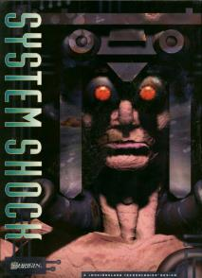
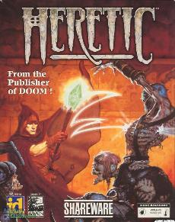
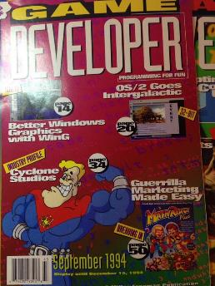
1994 in a Nutshell
Notes:
I started my career in 1994. It wasn’t an earth shattering year for the game industry. It was the first year Game Developer Magazine went to print and a year before E3 started. We would download games as shareware on local bulletin board systems.

Slide 32
My job in 1994
Notes:
My job, was a little less exciting. I was working for banks back then, and although it paid reasonably the environment wasn’t great.

Slide 33
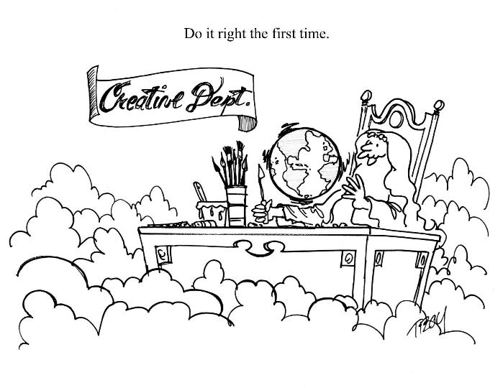
What a game job was like in 1994
Notes:
Of course I had a very definite concept about what working on games would be like.

Slide 34
Hipsters in Disguise
Notes:
So while my peers all went dancing to raves wearing neon tubes around their heads, my pals and I made “demos”. Real-time movies that would showcase our skills at programming, music and art.

Slide 35
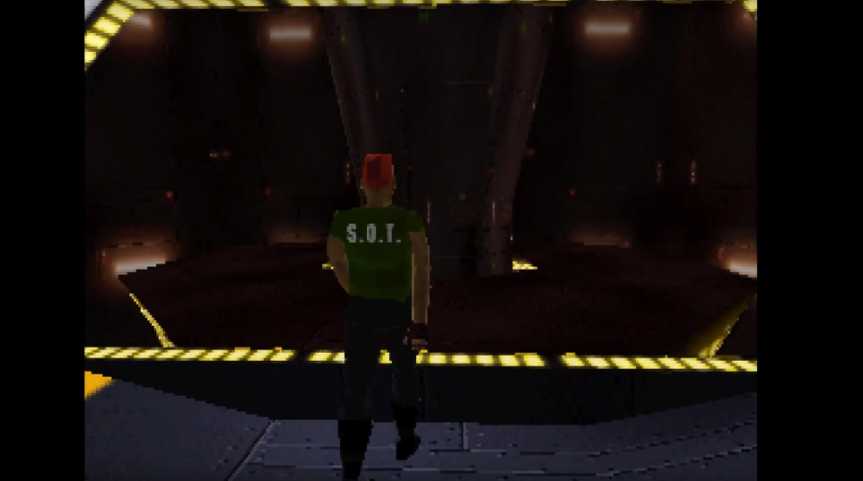
Notes:
The thought was that if we made something that looked good enough, and this was my idea of what looked good in 1995

Slide 36
Notes:
We could then apply to major videogame studios and land a job in the industry.

Slide 37
My job in 1996
Notes:
Unfortunately – it didn’t work. In 1996, I had graduated from making bank software to cash-register software, and I felt like Dilbert.

Slide 38
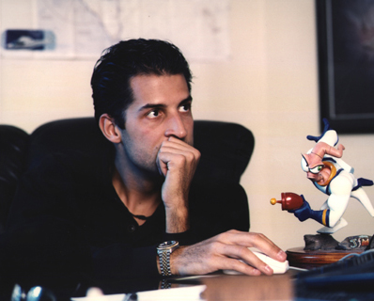
“You need to go… where the game industry is thriving.”
Notes:
David Perry, who I corresponded with at the time; counselled me to move away from Montreal and gave me some very sound advice.

Slide 39
“Montreal? It’s a giant pothole.
We’ll never make videogames here.”
Notes:
I was just in the wrong place, at the wrong time. I needed to get out of the city.

Slide 40
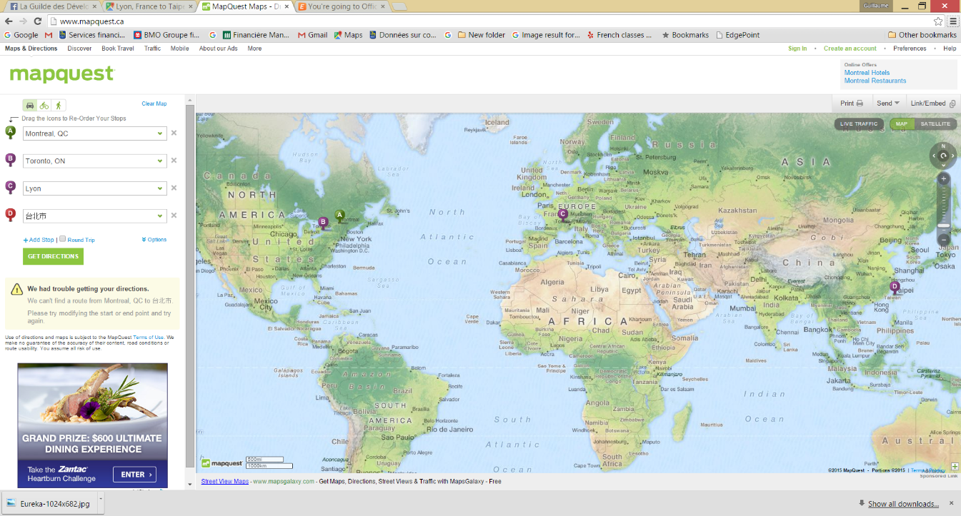
1997 – Lac St-Jean
Notes:
I would eventually move to Toronto, Lyon – France, and Taipei to work for independent game developers all over the world. It’s perhaps the greatest irony of my career that I would leave to pursue game development jobs everywhere else in the world, while the industry would flourish back at home.

Slide 41
My job in 1997
Notes:
But hey – in the meantime – I’d made it. I was working making videogames. And it was everything I had hoped it would be. For a while, anyways.

Slide 42
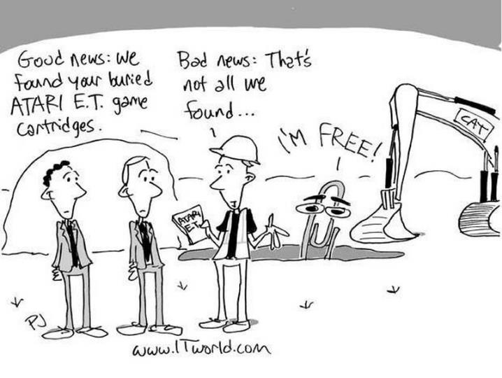
Notes:
To understand how it was to be an independent studios in the 90s, we can look at the first big crash from 1983. I’m not old enough to remember it, but it had some pretty profound impacts on our industry.

Slide 43
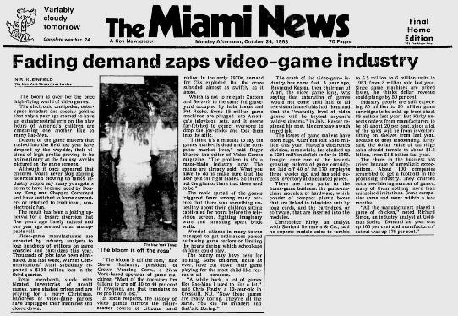
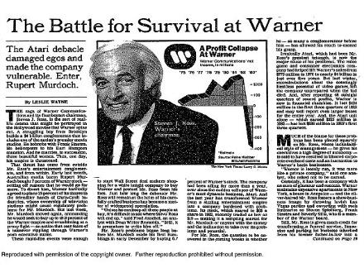
Notes:
An oversaturation of console machines and bad games caused the market to collapse, and the industry consolidated into fewer gate-keepers.

Slide 44
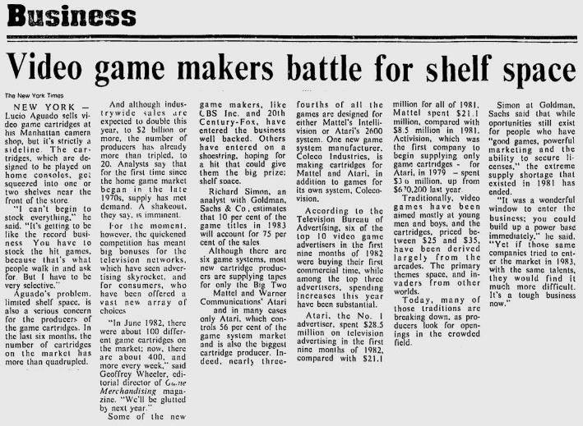
Notes:
But the NY Times called it on the money at the time. Game publishers were battling for shelf space, and they would keep doing so, for the next 3 decades.

Slide 45
Notes:
As the market grew, so did the pressure to make better, bigger games to compete for that shelf space. This is a space that only big publishers fight upon today, but one all video-game studios competed in back then.

Slide 46
What being independent meant in the 1990s and 2000s
1. Make Game
4. Beg Publishers
For money
2. Sell Game
3. Double in Size
Notes:
But for an independent game developer at the time, it meant being caught in a spiral of doom. We were forced to nearly double in size at every project, putting all of our earnings back into a bigger, riskier project. These weren’t the “indies” we have today; but larger studios that grew to 50, 60 people per project.

Slide 47
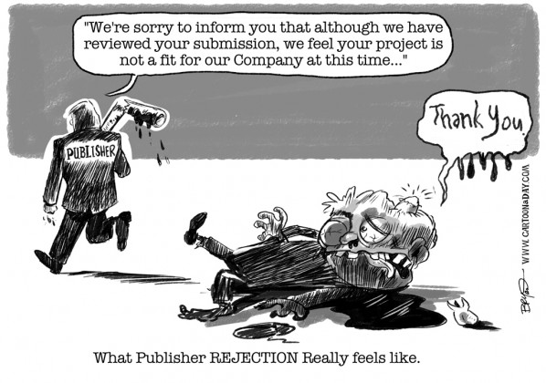
Notes:
Even if you were capable of financing your own project,10 million dollars in 2007-2008, you still needed to work with publishers to distribute your games on store shelves. This stranglehold on the distribution market made for a very lop-sided relationship between publishers and developers.

Slide 48
“2008: You should start your own studio.”
Notes:
Which is why when my boss at Arkane, Raphael, advised me in my exit interview that I should start my own studio.

Slide 49
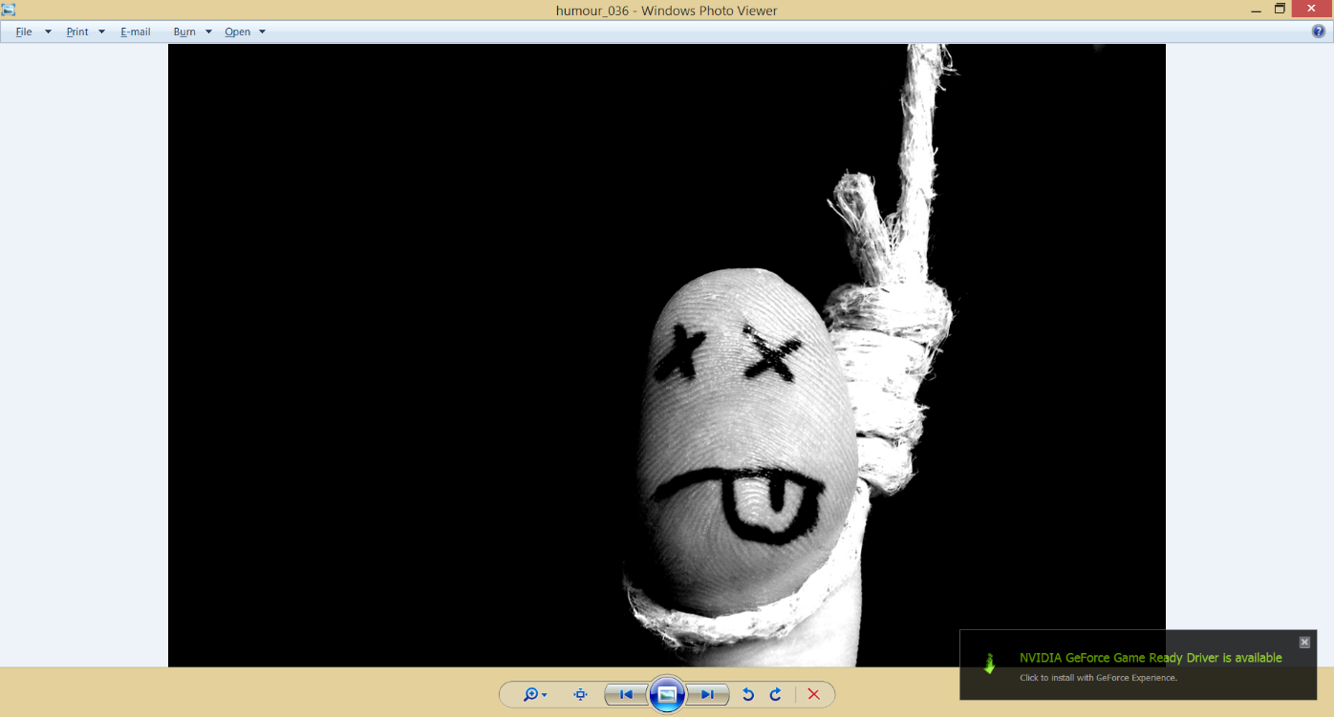
“You’re crazy. Independent Games are dead.”
Notes:
I told him he was crazy. In fact, I thought Independent games were at a dead-end. Projects would keep growing, and 3rd party development would disappear.

Slide 50
“2009: It was a bit cold,
So I turned up the heat.”
Notes:
If only I knew… The market crisis of 2008 collapsed the industry. Leaving many publishers scrambling.

Slide 51
Rest in peace
Notes:
The industry talked about the disappearance of AA development shops. In a single sweep that year, Eidos corporation slashed 14 videogames and simultaneously killed two studios I was working with; Pseudo Interactive and Widescreen games.

Slide 52
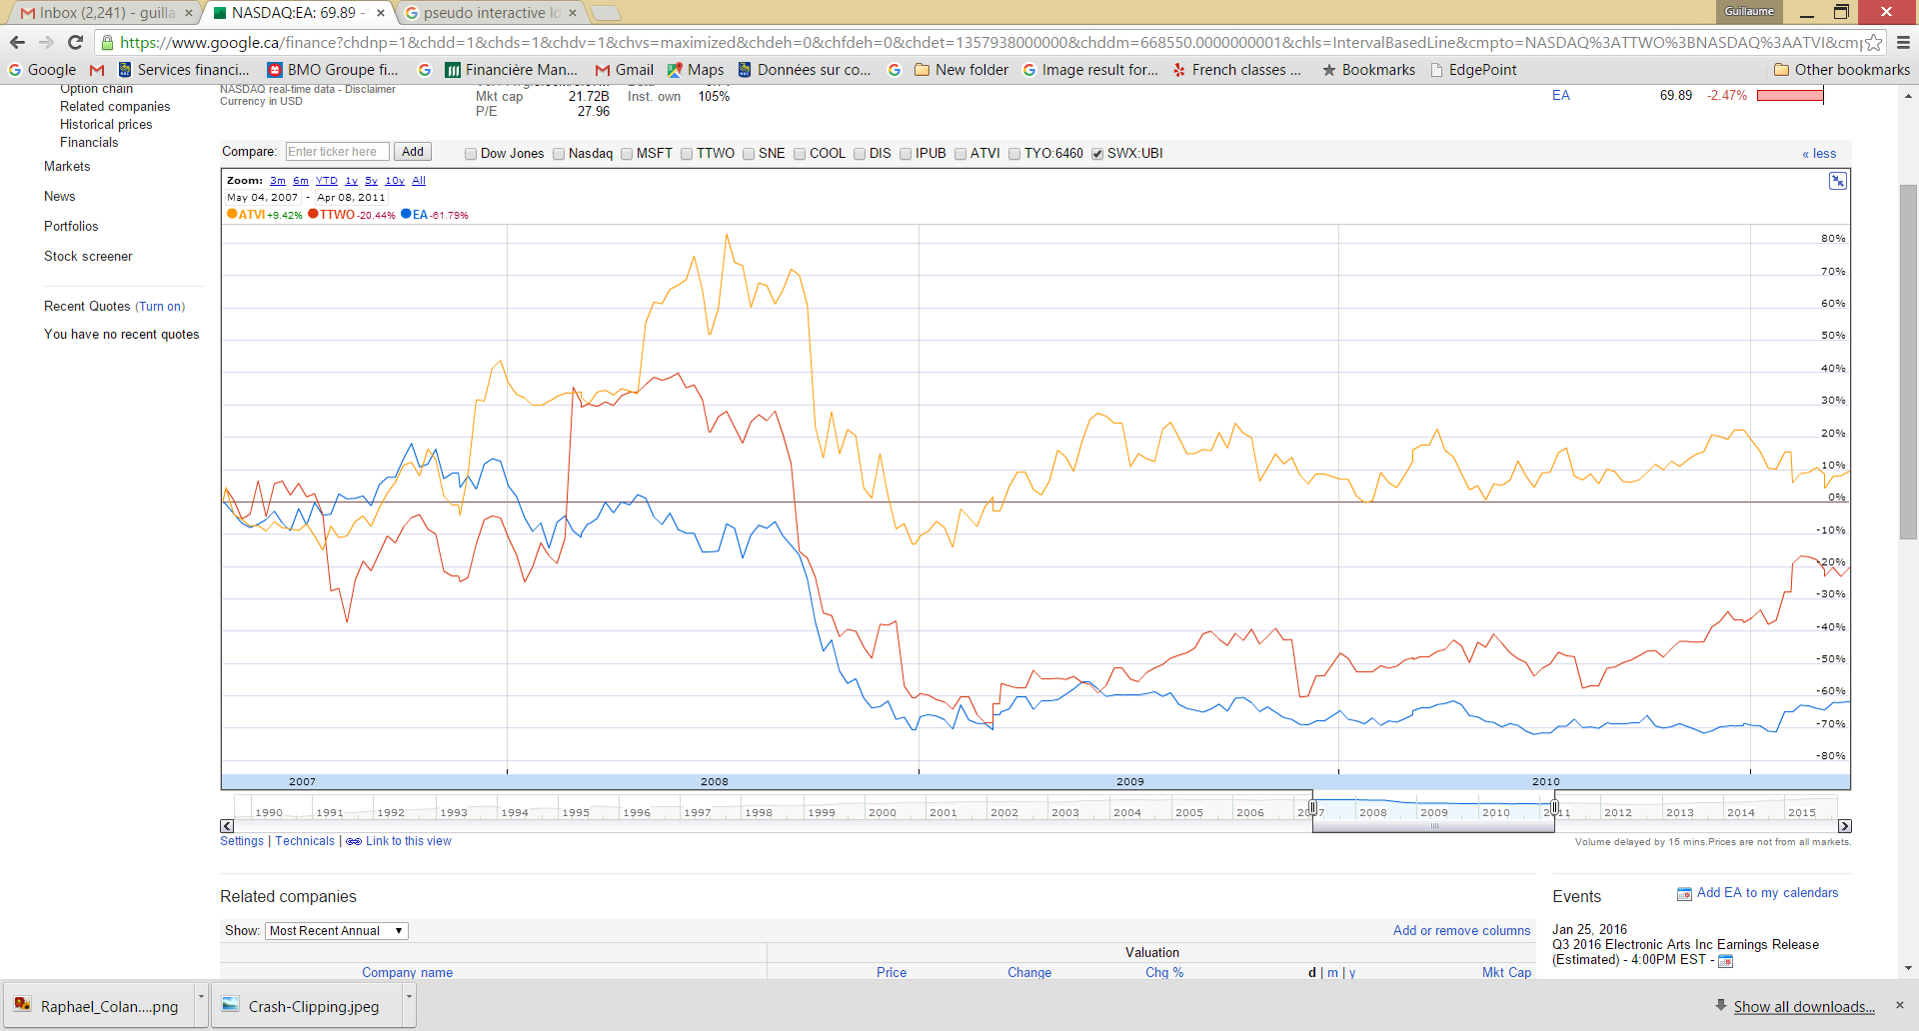
Notes:
And yet something strange happened. At the height of the market’s slump, in May 2009; when all my bleak predictions came true.

Slide 53
“Montreal? It’s a giant pothole.
We’ll never make videogames here.”
Notes:
After 12 years spent all around the world, I moved back to Montreal.

Slide 54
Notes:
And I started an independent Video-Game studio in the one city that didn’t have any independent studios.

Slide 55
Notes:
Why? Was it prescience that the market would change? That Digital Distribution, Social and Mobile would forever disrupt our industry?

Slide 57
Notes:
Because… Mary Poppins.

Slide 58
Notes:
Because I spent two decades learning how to make money and survive in this business, but that’s not why I work in it.

Slide 59
Notes:
Because there’s still nothing rational today about the idea of starting your own video-game studio.

Slide 60
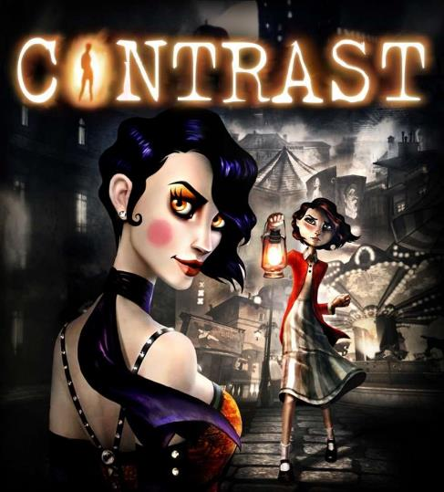
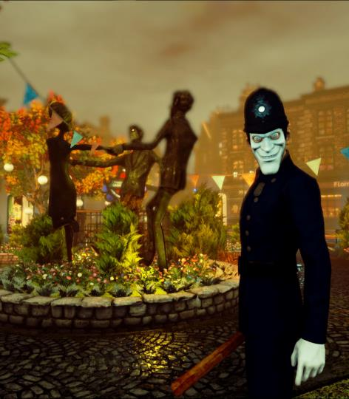
Notes:
Because it was the only way for us to create our own worlds, on our own terms.

Slide 61
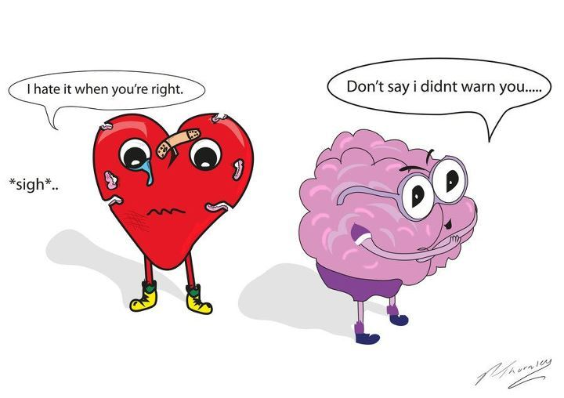
Notes:
Because sometimes making stupid decisions is the right decision.
Thank you.

Slide 62
VANDER
CABALLERO
CEO & Creative Director
Minority Media
@we_are_minority
Notes:
Our next speaker is a long time industry veteran, for a time he worked on console games like Army of Two
Before splitting off to make his own studio to focus on decidedly different games, like the award-winning Papo and Yo.
Now his work focuses on VR, like with the Time Machine VR project.
Vander Caballero!

Slide 63
VIOLENT GAMES
SURROUNDED BY WHITE PEOPLE
Men should only be penetrated by bullets
MY TIME AT EA
Notes:
(Vander did not include any notes with his slides.)

Slide 64
Moment of Clarity
#1

Slide 65
POWER FANTASIES
IMAGINED BY CAUCASIAN
PRODUCERS & CREATIVE DIRECTORS
HAVE THEY EXPERIENCED A VIOLENT DEATH FIRST HAND?
I CAN MAKE GAMES ABOUT THE POWERLESS - THE VICTIMS
Gameplay is SHOOTING & STABBING
Shooting & Stabbing is FUN & FAST
Empathy is SLOW & HARD

Slide 66
Moment of Clarity
#2

Slide 67
VR the platform of this century?
Notes:
GAZE

Slide 68
When someone looks straight into your eyes
You create a connection
Your empathy reflex kicks in
You care
HOPEFULLY you will have a harder time shooting that person in the head

Slide 69
Moment of Clarity
#3

Slide 70
MIA
CONSALVO
Canada Research Chair in
Game Studies & Design
Concordia University
@MiaC
Notes:
Going to switch things up a bit with our next speaker.
Our next speaker doesn’t spend her time making games but rather studying them, and specifically how players play them.
She is author of books like Players and their Pets about how game communities evolve, a book about Cheating in games,
and her next book called from Atari to Zelda is about the uniqueness of Japanese games and is coming out next spring.
Mia Consalvo!

Slide 71
Notes:
When I first started asking players how and why they cheated in videogames their answers surprised me. Most people admitted to cheating at some point in a game, but nearly everyone said they avoided cheating if at all possible. When pressed, the nearly universal answer was that they wanted to earn their achievements in the game. Cheating robbed them of their hard work, the sense of accomplishment the game offered. I had thought games were supposed to be a ‘safe space’ or have some sort of ‘magic circle’ for players to do things they couldn’t – or wouldn’t – in daily life. That realization came back when I started investigating how people play games that offer moral and ethical dilemmas.

Slide 72
Notes:
For the past six years, I’ve been talking with players who enjoy games like Fallout 4, Dragon Age Inquisition, Mass Effect 3, The Walking Dead, Fable, KoTOR, and Game of Thrones. People who enjoy those types of games really love to talk – at length! - about the choices they are confronted with, and how they should and do respond.

Slide 73
Notes:
Although the exact figures vary, most players – at least in their first playthrough of a game – say they play the ‘good’ option, the paragon, the hero, as opposed to another style of play. When asked why that was, they gave me a few answers:

Slide 74
Notes:
1. The way most games are structured, being ‘evil’ is really just being selfish and refusing to help people. If saying “NO” to quests eliminated gameplay options, players didn’t like that – they ‘paid for the game’ and wanted to see as much content as possible. These are the pragmatists – they choose to play as good to get as much gameplay as possible.

Slide 75
Notes:
2. Most games are designed for the player to become the hero of the story. Some players believed that not being ‘heroic’ in a certain way would be deviating from the game’s central premise.

Slide 76
Notes:
3. And many players said they had trouble playing as evil – it felt bad or uncomfortable to them; it went against their upbringing or their moral framework.
It’s this third group (which I think ties in with the second group) I’m most interested in and wanted to talk more about today because their answers led to my own moment of clarity about how people respond to games.

Slide 77
I CAME HERE TO SAVE THE WORLD FROM GUYS LIKE THIS.
Notes:
Many of these players told me they play RPGs as ‘themselves’ – either the choices they make are ‘their own’ or they’re playing as a better version of themselves. This is their ‘wished for self’ that could take action in such a setting, the self that could undertake quests and adventures, kill when necessary, but do so in maybe a noble or ego-less way.

Slide 78
I DIDN’T WANT TO KILL THOSE RAMS. I FELT BAD.
Notes:
As that ‘wished for self’ players are then confronted with characters and situations that are morally ambiguous. Many times, players told me they didn’t want to ‘let down’ in-game characters, for no reason other than that they would ‘feel guilty’ for doing so. Or they ‘felt so bad’ about actions they took that they had to stop playing the game for a while. Some games attach mechanics to those interactions like romancing or unlocking more advanced quests, but even without those, the urge to please certain characters – at least the ones the player has decided she likes – is very strong.

Slide 79
Leiliana was my character’s only friend … so I didn’t want to disappoint her.
Notes:
Moment of Clarity alert! Players don’t leave their moral frameworks behind or aside when they play games. They’re telling us that in different ways, over and over again. They don’t like to cheat because they want to earn their game achievements and take pride in those accomplishments. Many women players prefer to use female avatars when they are available. Most players, when creating humanoid avatars in places like Second Life, default to thinner, more attractive versions of themselves because that’s what society values. And if players are people who don’t want to let others down, they carry those same feelings and proclivities into games. There is no ‘safe space’ where they really want to leave those beliefs at the wayside. And games push them to keep those beliefs. If a game keeps insisting that ‘you’ are the hero, the chosen one, the Herald, the lone survivor, that only adds more moral weight to your actions.

Slide 80
Notes:
So how do players still happily accept all the killing and bloodshed in games? Mostly they justify it- and the game helps them do that too. If they are slaughtering a roomful of people, it’s generally for a good reason, or else they won’t do it. Or if it’s an optional quest and they feel queasy they opt out- they won’t kill those rams in DA:I, they won’t blow up Megaton City in Fallout 3; they won’t let Clementine see Lee killing men in The Walking Dead, they won’t play the No Russian level in Modern Warfare. Even in games, there are lines they don’t want to- or can’t- cross.
If the game forces them to do things they are uncomfortable with, or they feel the need to continue with it, they will disengage with the seriousness of the process – that’s when it becomes ‘only a game’ – but more often they grapple with feelings of discomfort or disgust—even in virtual scenarios.
Designers are getting better at creating options for players beyond kill the kitten or save the kitten; but players keep hugging the right wall- they don’t want to engage with that other content, apart from another game playthrough, if they get around to it. Players don’t believe there is a magic circle for play- a safe space where they can step outside their moral frameworks to try on other options. The challenge is to make them feel comfortable in taking those chances, in trying out those alternatives. That’s happening with games that are shorter, where it’s not so difficult to try the game again, to see what happens when you walk a different path. In games like Life is Strange, the rewind option lets players see at least some divergent paths, even if they can’t predict what will happen later on in the game due to those actions. But games still need more hooks to entice players, to help them – at least temporarily- get over the guilt of letting down digital characters, or moving beyond their personal moral frameworks – to play at other ways of engaging with the world.

Slide 81
If players are encouraged to put ‘themselves’ into the game, is it any wonder they have trouble playing against their moral code?
Notes:
. Otherwise, they will keep rehearsing the hero role, and refusing to engage with more complicated ways of being.
81

Slide 82
Notes:
Thank you!
82

Slide 83
JASON
DELLA
ROCCA
Co-Founder, Indie Evangelist
Execution Labs
@JasonDellaRocca
Notes:
You’ve probably seen Jason up on the stage at MIGS plenty of times.
If you make games in Montreal you probably know him very well, you may know he was the previous executive director of the IGDA
And he now runs the one of its kind indie incubator Execution Labs…
Jason Della Rocca!

Slide 84
Notes:
(Jason did not include any notes with his slides)

Slide 100
Execution Labs
Where top game development talent come to execute on their next great idea …or die trying
www.ExecutionLabs.com

Slide 105
BRIE
CODE
Programmer
Freelance
@BrieCode
Notes:
Next up, we have a programmer with a long history of working on AI in games in everything from Company of Heroes to Assassin’s Creed
Most recently she was lead programmer on the beautiful Child of Light
And her name is the best name for a programmer I have ever heard.
Brie Code!

Slide 106
THE BEST CANDIDATE
THERE’S NO SUCH THING
Brie Code
therealbriecode@gmail.com
@briecode
briecode.tumblr.com
Notes:
I’m here to discuss how to build the most interesting teams to create the most interesting games.

Slide 107
Notes:
I’m an AI programmer. I’ve worked in games for 13 years. 10 years in AAA, the last 3 years in smaller games.
And often I’ve been on teams where I’ve felt like this.
And this is sad for me.
And it’s sad for the people who for various many reasons don’t come work in our industry and who aren’t represented in our games.
And at some point I wanted to change it. So I started doing research about how to encourage a more diverse industry.
And I found that this is not only sad for me or for the people who don’t get to have these great jobs, but it’s also sad for the games industry itself. For many reasons, one in particular is because…

Slide 108
DIVERSE TEAMS CAN PERFORM BETTER THAN EXPERT TEAMS
Notes:
Research shows diverse teams can perform better than expert teams.
To stress this: Diverse teams can perform better than expert teams.
If you build a team of the best programmer, the best programmer, the best programmer, you might not get the best programming team. You need to think on the team level, not the individual level.
Research shows this over and over, from mathematical simulations to studies of group performance in laboratories to studies of group performance in corporations to studies of corporate performance across the Fortune 500. Diverse teams show measurably more innovation and better financial performance and they solve complex problems better and faster.

Slide 109
GROUP INTELLIGENCE
IS NOT
THE SUM OF INDIVIDUAL INTELLIGENCE
Notes:
There are a few factors at play.
When you have a balance of people with different problem solving skills, you get different approaches to solving the problem.
There’s no assumption of shared knowledge or inside communication.
There is also an unconscious assimilation pressure that happens with teams of people who are the same. They feel pressured to become even more the same than they are. When that sameness is broken and there is a balance on the team, not only do the new people bring fresh ideas but so do the experts.
And this is what group intelligence is made of. And companies that have more diversity in their workforce show measurably more innovation and better financial performance and they solve complex problems better and faster.

Slide 110
Notes:
Don’t take my word for it. Read this report. There is a strong business case for diversity.

Slide 111
Notes:
Or do take my word for it. On Child of Light, we built the prog team from different personality types, different motivations, different countries of origin, different ages, different languages, different genders, different levels of experience, different taste in games including someone who didn’t play games yet. Highest morale and productivity I have seen. What united us was the project, nothing else. No dominant groups formed.
The flipside is true too. The roughest projects I’ve been on in my career were ones where the team was not balanced, where dominant groups formed and excluded outsiders. To get the benefits of a diverse team it’s all about balance.
A different set of management challenges than expert teams.

Slide 112
Notes:
If you want tips and techniques, read this book. It takes an afternoon or less.
And it was through reading books like this that I realized that it’s not entirely a bad thing that I’m not part of the boys’ club. Innovation happens in the connections between people who are different.

Slide 113
Source: I Will Not Make Any More Boring Art, John Baldessari, 1971
Notes:
And so it was through that realization that I’ve sort of burnt my career to the ground. I’m interested in finding out what exists in the gap between people who play games and those who don’t. So now I’m making games for and with my friends who don’t play games and it’s so much fun. http://www.moma.org/collection/works/59546

Slide 114
DIVERSITY IS BETTER
THANK YOU
Brie Code
therealbriecode@gmail.com
@briecode
briecode.tumblr.com
Notes:
So think about this when you build your next team.
Thank you.

Slide 115
RICHARD
ROUSE III
Director/Designer/Writer
Paranoid Productions
@richardrouseiii
Notes:
And who’s this next speaker? Oh, it’s me!

Slide 116
THIRTY
YEARS
LATER
@richardrouseiii
Notes:
Now my story is going to have some overlap with Warren’s, so I apologize We developed similar opinions, but for different reasons.
We’ve had quite a few stories about why people got passionate about games – or about what they specifically wanted to do with games.

Slide 117
Notes:
My tale starts when I first decided video games were amazing.
I saw an arcade game at a Mexican restaurant in my hometown. It was a cocktail version of Space Invaders. I was 5. I spent ages with it, thinking I was playing it, not realizing I had to put quarters in to actually play.
But it didn’t matter if I was failing to monetize, I was still hooked.

Slide 118
Notes:
Go forward a eight years, and I was really into Ray Bradbury
In Fahrenheit 451 there’s a point where the character engage in television watching… but it’s interactive.
Bradbury was actually trying point up how vapid this activity was and how fake-interactive TV was dumb.
But I completely missed that point. I loved it because I somehow new immediately it could be good.

Slide 119
Notes:
See at the time I was also obsessively playing lots of games on my Apple II computer, some of which told stories, and some of which didn’t.
The stories in these were not truly interactive, but I couldn’t help but imagine how they could be.
I wanted to play these games but get to make choices about what happened in them. I wanted that to tell me more about the world, about the subject matter.

Slide 120
Notes:
See, around that time I was also really into films and TV shows that were both entertaining but also were about serious subjects – and had a unique thing to say about them.
And I thought – what if we could tell stories like this, that were really ABOUT a big subject, but make them interactive.
I wanted to see more than one side of a story, more than one version of a world. I wanted to make wildly DIFFERENT choices.
So that was 30 years ago.

Slide 121
Notes:
Now there have been some games that have done really interesting things with interactive narrative.
For instance, way back then, there was a little game called Ultima IV that systemically implemented ways the world react to you based on your choices

Slide 122
Notes:
Or if we look at some of the games of Will Wright,
Even though his games are seldom thought of as storytelling games.
They were really good at showing the consequences of our choices.
Sim City taught us that super-highways were bad for cities.
Or The Sims taught us that if you buy too much junk your house will burn down.

Slide 123
Notes:
Or Civilization and specifically its cousin Alpha Centauri made us weigh the pluses and minuses of how you build a civilization
Alpha Centauri included a narrative layer that showed how this would effect different personalities, and whether they would ally with us or not.

Slide 124
Notes:
Or for an even more recent example, we can look at Papers Please.
That game turned a boring job into gameplay and made us empathize with people in impossible situations and let us try, desperately, to get to an ending that wasn’t depressing.

Slide 125
Notes:
And over the years, I’ve been fortunate enough to work on some games where we got to play with interactive stories.
For instance, in The Suffering the choices you made effect not just the future but also the past
Or in State of Decay, there’s a fully simulated world and community you get to interact with, and in the process dark choices you had to make to survive a zombie apocalypse while retaining your humanity.
But, to be honest, I’ve also had some other projects where we tried to tackle some serious subject matter and give players lots of interesting choices where in the end the publisher decided they didn’t want to make that game.
But never mind about that.

Slide 126
Papers. Sim city. The sims train alpha centauri blade runner
Notes:
But now it’s 2015, and I’m a little sad.
Remember how a few weeks ago it was Back to the Future day and the fucking Internet couldn’t get enough of it. God, I’m glad that’s over.
But anyway, a Lot of people were upset about the lack of flying cars.
But I don’t really care about the flying cars, they sound really dangerous.
What I care about is WHERE ARE ALL THE INTERACTIVE NARRATIVE GAMES

Slide 127
2015
Notes:
Though I’ve pointed out some interesting examples of games with interesting interactive narratives, they are, frankly, few and far between.
We have a lot of games with great stories that offer extremely linear experiences.
Some offer a lot of gameplay choice but no narrative choice whatsoever, which has always felt bizarre to me.
And don’t get me wrong – I love a lot of those games too. It’s fine to make those games.

Slide 128
2015
Notes:
But should they really be the vast majority of our big games?
If back in 1985 you had told me in 30 years I would be standing on a stage at a conference addressing a huge audience of developers, I would never have believed you.
But if you told me that video games would still MOSTLY be telling linear, fixed stories? THAT would be crazy!

Slide 129
Notes:
But there is hope. Games that offer dynamic single player experiences are on the rise.
So often over the years I hear interactive narrative is not worth the time because players only play single player games once through anyway, so what’s the point? Why not tell the BEST possible story?
There’s lots of reasons that’s a silly argument.
But the rise of the games on the screen behind me shows that people love replaying single player games… if you give them a reason to!
And as these games add narrative to them, if that story is always the same, the reasons to replay are going to diminish substantially.
If you’re setting your game in a really interesting world, why now let the story explore all the potential narrative paths through that world?

Slide 130
Notes:
And I should also acknowledge that the road to making truly interactive stories is littered with people who valiantly tried to make THE PERFECT interactive story system.
And failed spectacularly.
So I suggest we don’t try to make the “perfect” solution.
One of my favorite lessons comes from an analogy about pottery. A teacher had two sets of students – one were told to make a perfect pot, another was told to make as many pots as possible.
Who in the end made the best single pot? The ones who made a lot.
We need to make a lot of attempts at meaningful interactive narrative
Don’t try to make it perfect – just try to make SOMETHING.

Slide 131
Notes:
Finally, when people ask me why I’m so obsessed with this, I think I’m going to start quoting Mr Trudeau.
You remember when he was asked about why he wanted diversity and an even gender split in his cabinet?
And he said…

Slide 132
“Because it’s 2015.”
Notes:
Because it’s 2015.
Much as I agree with Brie and so many others that the lack of diversity in the game industry is a major problem that we should work hard to fix,
I also want to know where all my interactive narratives are!
BECAUSE ITS 2015!!!

Slide 133
@richardrouseiii
Mailing List at:
www.paranoidproductions.com
Notes:
And not surprisingly, I’m working on an independent game that tries its own little piece of imperfect storytelling.
And if you want to know more about that why not sign up for my mailing list – news coming soon! (see website above)
Thanks!

Slide 134
AMY
HENNIG
Senior Creative Director
Visceral Games/EA
@amy_hennig
Notes:
Now, for our final speaker, remember how I said that though I love interactive narratives I also love linear games? Well our next speaker needs no introductions, and also made one of my favorite story games of all time, Uncharted 2.
She is now working on some Star Wars game that we don’t know anything about.
A few years ago, I saw her do this talk at GDC,
and when the opportunity came to have her join the Brain Dump, I asked her to do an encore presentation of that talk.
Amy Hennig!

Slide 135
1
Notes:
The Uncharted series was conceived as sort of a “love letter” to the classic pulp adventure genre. Our goal from day one was to capture not only the thrills, but the color, charm, humor, romance and FUN of the movies, books and comics we sought to emulate.
[click]

Slide 136
2
Notes:
And to that end, we drew from scores of different inspirations, from the obvious to the obscure. And we always wore our influences on our sleeve.
But there’s another, less likely-seeming, touchstone that I’ve rarely talked about...
[click]

Slide 137
3
Notes:
...and that’s Preston Sturges’ 1941 film, Sullivan’s Travels – a brilliant satire about a successful Hollywood director, John L. Sullivan, who’s fed up with churning out lightweight comedies and yearns to make a socially relevant film about the sorrows of humanity.
[click]

Slide 138
Victor “Goddamn” Sullivan
Notes:
Now, it’s no coincidence that this handsome devil from Uncharted – Nathan Drake’s mentor and partner, Victor Sullivan -- shares a surname with Sturges’ protagonist.
[name text]
The movie was one of the inspirations behind his name.
[click]

Slide 139
5
Homage!
Notes:
...And although this was a “blink and you’ll miss it” moment --- keen-eyed players may have noticed that Sully’s vintage powerboat in Uncharted: Drake’s Fortune is even christened with the name “Sullivan’s Travels” – a deliberate homage to Sturges’ film.
[click]

Slide 140
Notes:
But anyway – back to the movie.
[image auto-advances]
Dissatisfied with directing profitable but shallow comedies like “Hey, Hey in the Hayloft” and “Ants in Your Plants”, Sullivan longs to make a picture that will realize the potential of film as a sociological and artistic medium.
[click]

Slide 141
11
“Maybe they’d like to forget that.”
Notes:
Here’s a short clip from the beginning of the movie, where he tries to pitch the studio heads on his idea.
[click]
[ ends on “maybe they’d like to forget that” ]
[click]

Slide 142
14
“I wrote ‘Sullivan’s Travels’ to tell them that they were getting too deep-dish; to leave the preaching to the preachers.”
Notes:
This is a good place to note: Sturges wrote Sullivan’s Travels as a plea to his fellow filmwrights not to “abandon the fun in favor of the message”.
[click]
He said the film was the result of an urge to tell some of them that they were getting a little too deep-dish; that they ought to leave the preaching to the preachers.
[click]

Slide 143
8
“What do you know about troubles?”
Notes:
Now -- after his studio bosses point out that he doesn’t know anything about hardship,
[image auto-advances]
Sullivan hits the road disguised as a tramp, with only ten cents in his pocket.
[image auto-advances]
He wants to “know what trouble is” first-hand, so he can return and make a film that truly depicts human suffering.
[click]

Slide 144
9
Notes:
[images auto-advance]
But no matter how hard he tries, he can’t shake Hollywood. Trailed by an entourage hoping to turn his journey into a publicity stunt, and thrown together with a down-and-out actress, Sullivan stumbles into one comic misadventure after another.
[last image: bare feet]
[click]

Slide 145
10
Notes:
The movie then takes a dark turn.
Having experienced their suffering first-hand,
[click]
Sullivan tries to improve the plight of the homeless by handing out cash in the railyard. He gets mugged, robbed of his clothing and ID, loses his memory, and is given up for dead.
[ends on: newspaper headline]
[click]

Slide 146
13
Notes:
[images auto-advance]
He gets arrested, and is sent to work as a prisoner in a brutal chain gang. Sturges said, “Bit by bit I took everything away from him – health, fortune, name, pride, and liberty. When I got down to there I found he still had one thing left: the ability to laugh.”
[ last image: shirtless & handcuffed ]
[click]

Slide 147
13
Notes:
[images auto-advance]
When the prisoners are allowed a brief break from their dreary lives to watch a cartoon, Sullivan shares their joy and realizes that his greatest gift as a filmmaker is to make people laugh. As Sturges said, he regains the dignity of his profession and ultimately returns to Hollywood to make laughter.
[last image: Veronica Lake, hand on his shoulder]
[click]

Slide 148
7
Horrible Crimes
Against
Juxtaposition
“One local reviewer wanted to know what the hell the tragic passages were doing in this comedy, and another wanted to know what the comic passages were doing in this drama.
They were both right,
of course.”
Notes:
After a mixed critical reception, Sturges said the film had made…
[click]
…some ”horrible crimes against juxtaposition ...
[click]
One local reviewer wanted to know what the hell the tragic passages were doing in this comedy, and another wanted to know what the comic passages were doing in this drama. ...
[click]
They were both right, of course.”
[click]

Slide 149
15
Notes:
[images auto-advance]
But, see, this is the beautifully subversive thing about Sturges’ movie…
… he made a message film arguing against message films.
[image auto-advances]
Sullivan’s Travels exemplifies how meaning and substance can be embedded within engaging comedy and escapist fun.
[last image: Sullivan standing in crowd]
[click]

Slide 150
16
Notes:
Lately, we find ourselves confronted by skepticism about our own medium – from outside the industry, from within the development community, and even from our fanbase.
“Games are not and will never be art”…
“games are a lousy storytelling medium”…
So much dogma about what games should and shouldn’t be.
[click]

Slide 151
6
Notes:
And we want so badly to be taken seriously, my fear is that, in the face of this criticism, we’ll start to take ourselves too seriously --
… that we’ll “abandon the fun in favor of the message,” …
… and forget that above all, our goal is to entertain.

Slide 152
18
Notes:
And that’s why Sullivan’s Travels is an important touchstone for me. It’s a reminder that there’s nothing wrong with escapist fun.
It’s okay to “just” entertain, and in fact, maybe that ought to be our primary goal.
[click]
Our games have the power to transport people out of their daily lives.

Slide 153
Notes:
And even in the midst of all the gunslinging,
two-fisted combat,
stunts
and spectacle... we can still tell a story
[click]
about beauty,
despair,
compassion,
fear,
loss,
regret
and grace.

Slide 154
19
Notes:
...but with a little sex in it.
[Thank you]

Slide 155
Your Turn to Ask Why
- Chuck Schuldiner (RIP)
Notes:
Thanks everyone – I’ll leave you with something else from the mighty Chuck Schuldiner – its your turn to ask why.
Think about your own moment of clarity, where you decided to care about making games, and specifically what to care about.
Maybe you haven’t had it yet – that’s fine. Just as yourself… why am I doing this?

Slide 156
MIGS BRAIN DUMP THANKS EVERYONE
@Warren_Spector
@G_Provost
@we_are_minority
@MiaC
@JasonDellaRocca
@BrieCode
@richardrouseiii
@Amy_Hennig
Notes:
Thanks for sticking around to the end!
Thanks to all our speakers – thanks for people who did two talks at MIGS for us.

Slide 157
SLIDES AT www.paranoidproductions.com
@Warren_Spector
@G_Provost
@we_are_minority
@MiaC
@JasonDellaRocca
@BrieCode
@richardrouseiii
@Amy_Hennig
Notes:
Slides at this website! Be well!

