Slide 1
MIGS Brain Dump
2014 – BACK TO THE START
Your host
Richard Rouse III
Patrice Désilets
Manveer Heir
Celia Hodent
Leah Hoyer
Ashraf Ismail
Deirdra Squinky Kiai
Patrick Plourde
Tanya X Short
@richardrouseiii
@PatriceDez
@manveerheir
@CeliaHodent
@LeahHoyer
@AshrafAIsmail
@TheSquink
@patrick_plourde
@tanyaxshort
with
Montreal International Game Summit
Tuesday, November 11th, 5:15PM
Notes:
Welcome to our fourth edition of the MIGS Brain Dump!

Slide 2
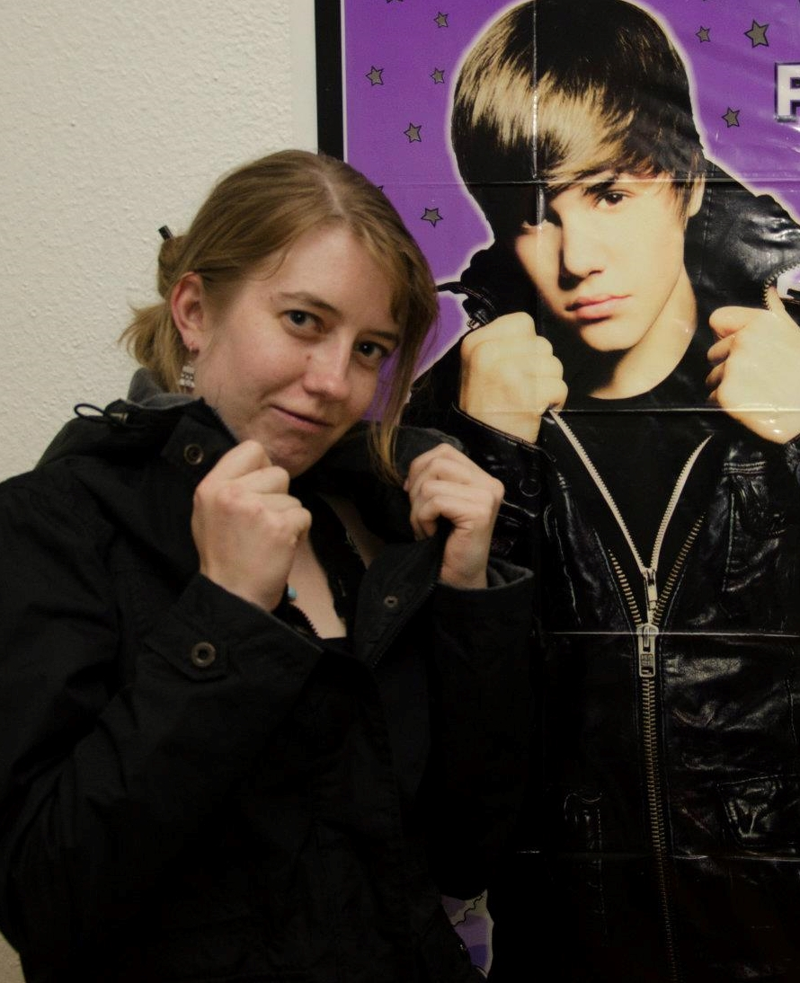
Notes:
This is the session where we get some speakers who have already talked at MIGS and get them to talk a second time (thanks all!)

Slide 3
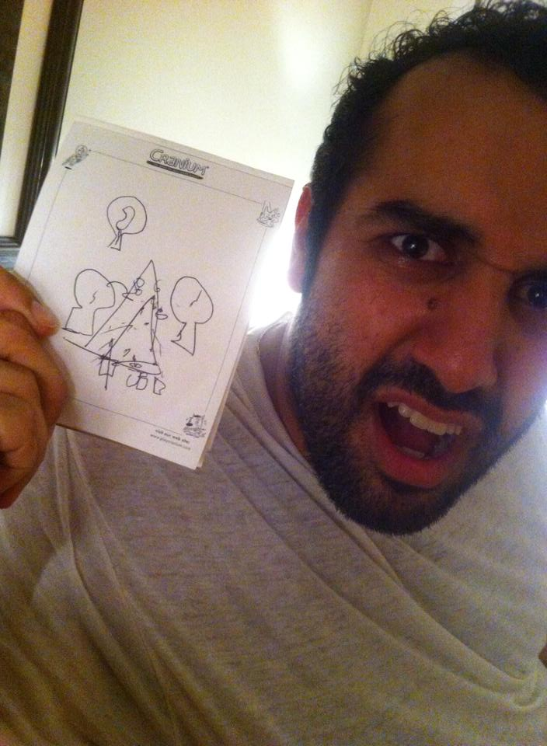
Notes:
And then ask some more people from around Montreal if they’d like to join us.

Slide 4
5 MINUTES
Notes:
They each talk for 5 minutes

Slide 5
BACK TO
THE START
Notes:
And this year’s theme is Back to the Start

Slide 6
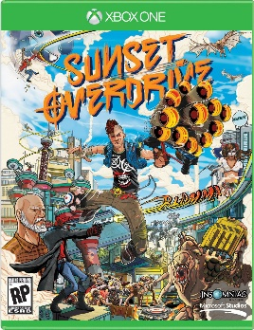
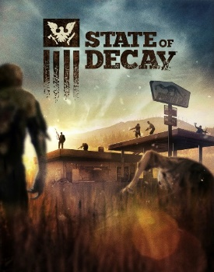
RICHARD
ROUSE III
Director/Designer/Writer
Paranoid Productions
@richardrouseiii
Notes:
Who the hell am I?
My recent background was at Microsoft, where I worked on Sunset Overdrive and State of Decay. Longer ago I made The Suffering games.
Recently, I’ve had a bit of a back to the start for myself, as I’m now taking on an indie project. It’s an action game with an experimental narrative.
And going back to the start for me right now means remembering how to program. What joy!

Slide 7
Notes:
If we go back to the first brain dump, three years ago, we find I already did my version of this talk.

Slide 8
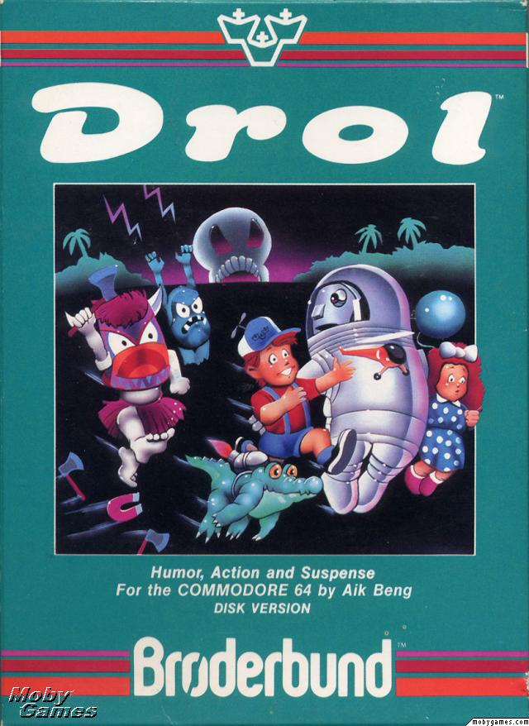
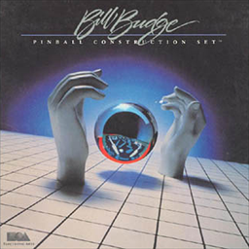
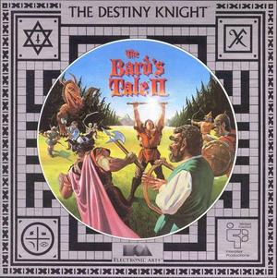
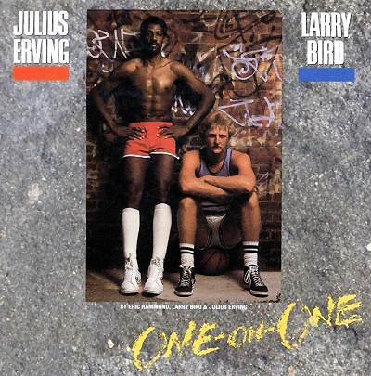
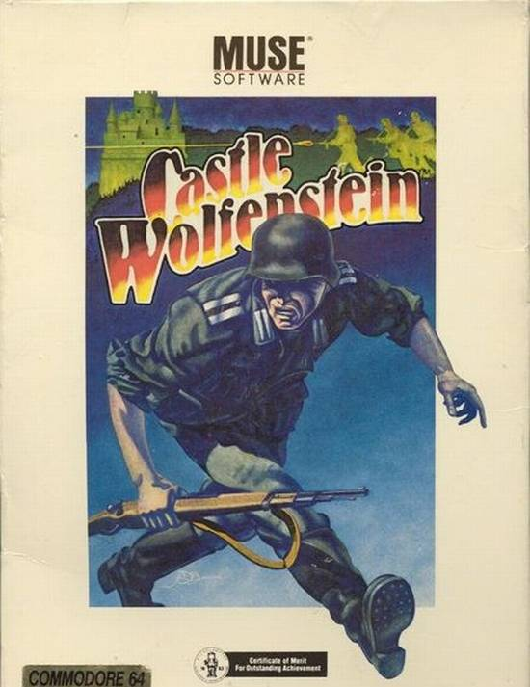
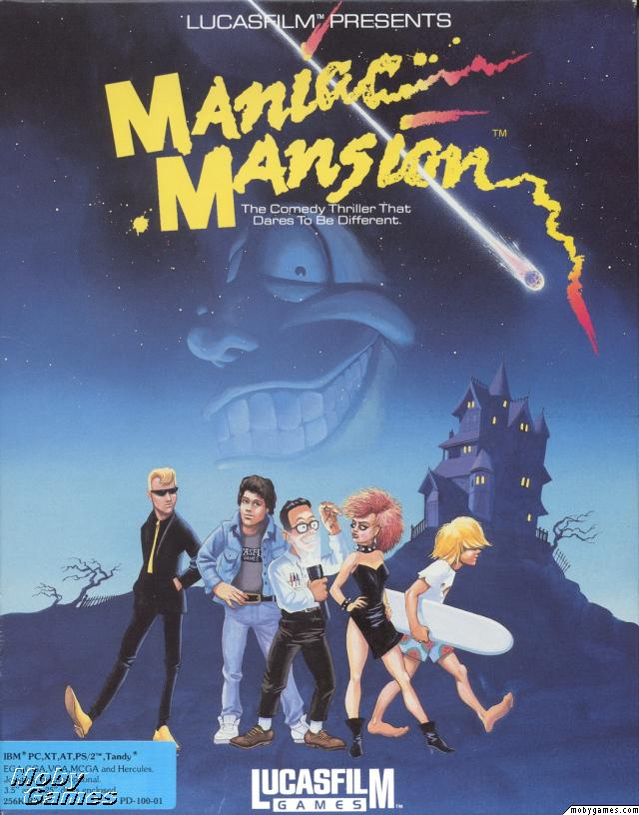
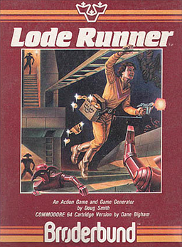
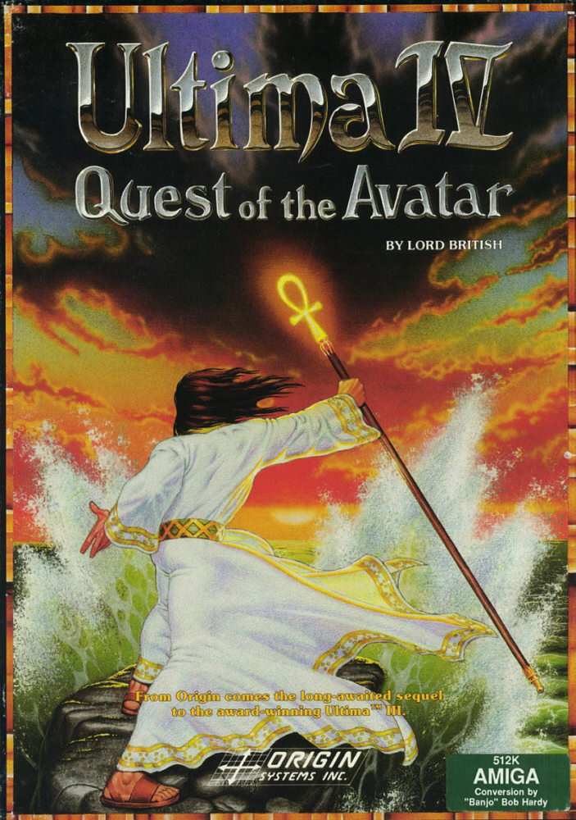
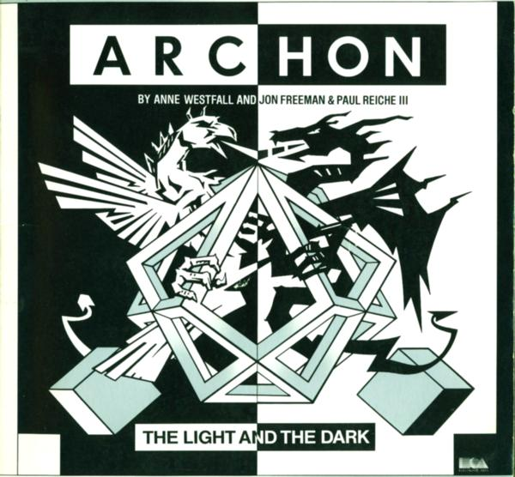
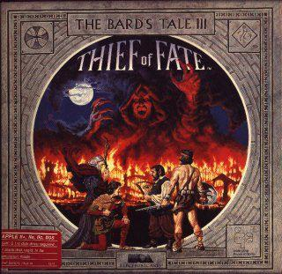
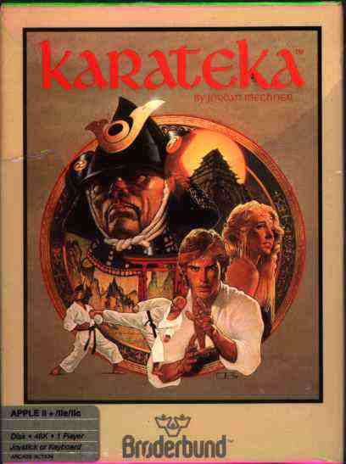
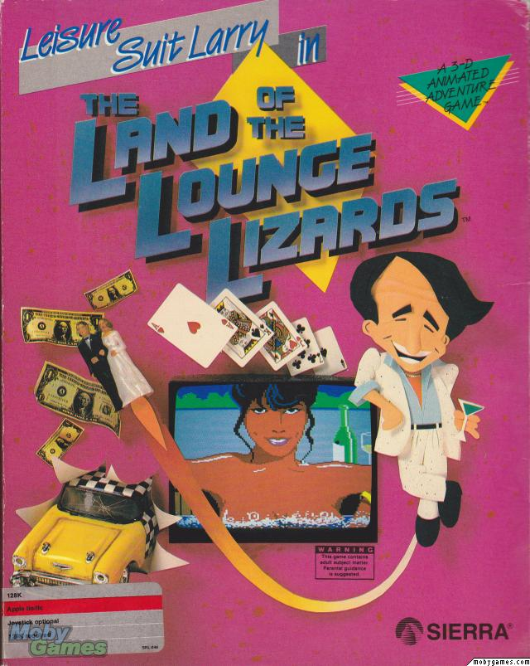
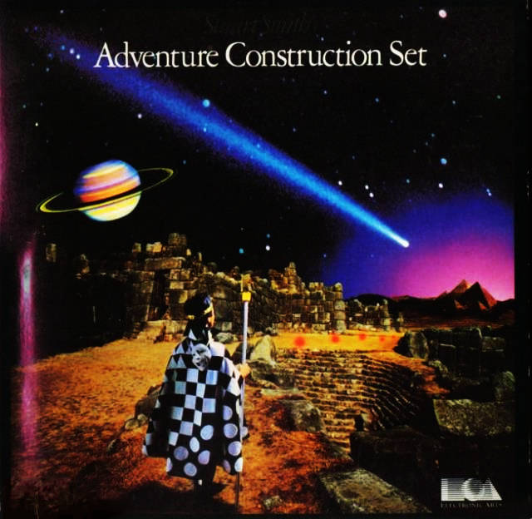
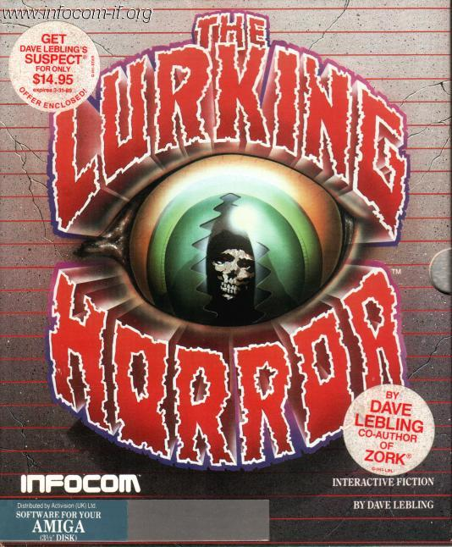
Notes:
At that first talk I discussed my inspiration for getting into game design. My parents got me an Apple II in 1985 instead of a console because they wanted something that I could also program – turned out to work out pretty well in the end.
Fortunately they did let me play a LOT of games on it.
For me this was a golden era of game design – I loved these games, and still do.
(Indeed, the gameplay is in my indie project is largely inspired by one of the games on screen now.)
Looking back on these games for me makes me amazed at how much invention there was. Every game seemed to have a new mechanic and wildly different styles of gameplay.

Slide 9
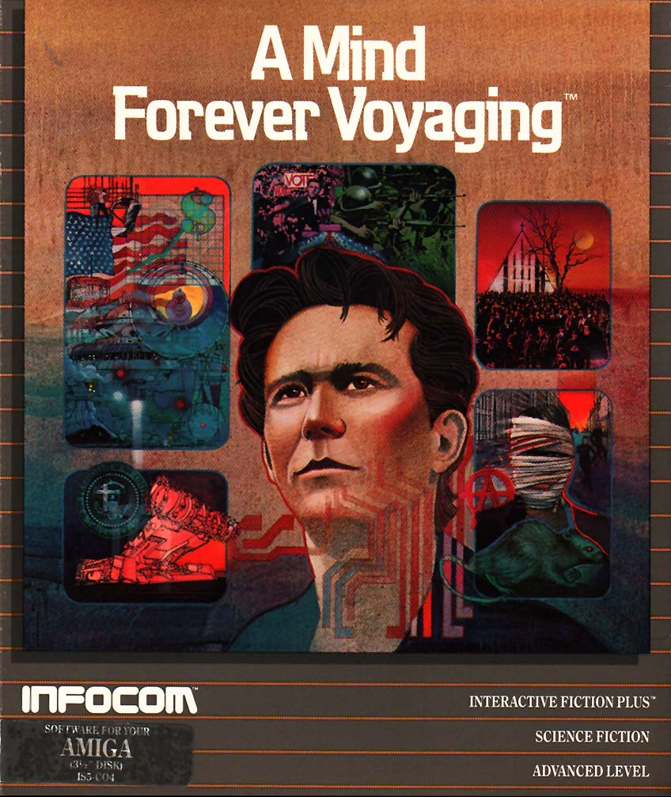
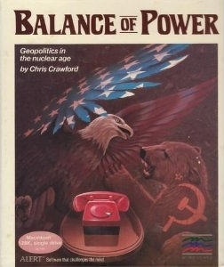
Notes:
They also featured a really wide range of subject matter. Some big commercial games even got into politics in some interesting ways. And they weren’t just doing for shock value, but to try to be thoughtful about the world and express that through a game’s systems.
For me, this was perhaps the best period for game design ever…

Slide 10
“Nostalgia – it’s delicate, but potent.”
Notes:
Or was it? Am I just being nostalgic?
Nostalgia is a very powerful motivator – as Don Draper says in the Carousel pitch scene at the end of Man Men Season 1 (surely the best written scene of TV ever so I’m sure you’ve all seen it)
Indeed, I think games are one of the more nostalgic forms of media out there – so much we do recalls that feeling of play that most of us associate with our youth.

Slide 11
Notes:
So partly it’s nostalgia that makes this my golden age.
I bet everyone in this room (or reading this later) has their own golden age. For some of you this period may be the NES, for others maybe it’s the PS2 era, some may be young enough it can even be the start of the Xbox 360.
Regardless, I bet you see the time when you first got into games as a golden age. A lot of us got into this industry because we fell in love with games as kids – I think most artists do what they do because they fell in love with it when they were young and then it solidified as “that thing we love” and that brought about the desire to make your own.

Slide 12
Got an Apple II in 1985
Notes:
But if I look at that era more critically, I remember it wasn’t always so great.
Above is Pac-Man, surely a classic. This is the Apple II port, which isn’t’ the best version of Pac-Man around, but it’s OK.

Slide 13
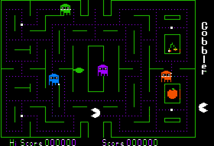
Got an Apple II in 1985
Notes:
But you know what we had a lot of back then? Clones. Tons and tons of them, really.
For instance, here’s a Pac-Man clone called Gobbler.

Slide 14
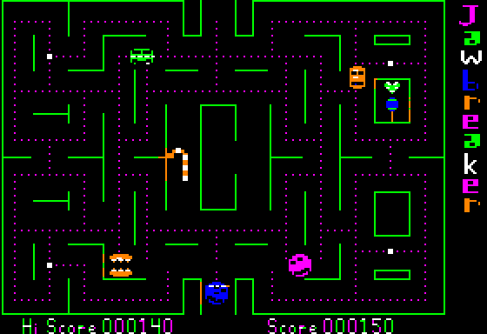
Got an Apple II in 1985
Notes:
Here’s another clone (that looks almost identical) called Jawbreaker.

Slide 15
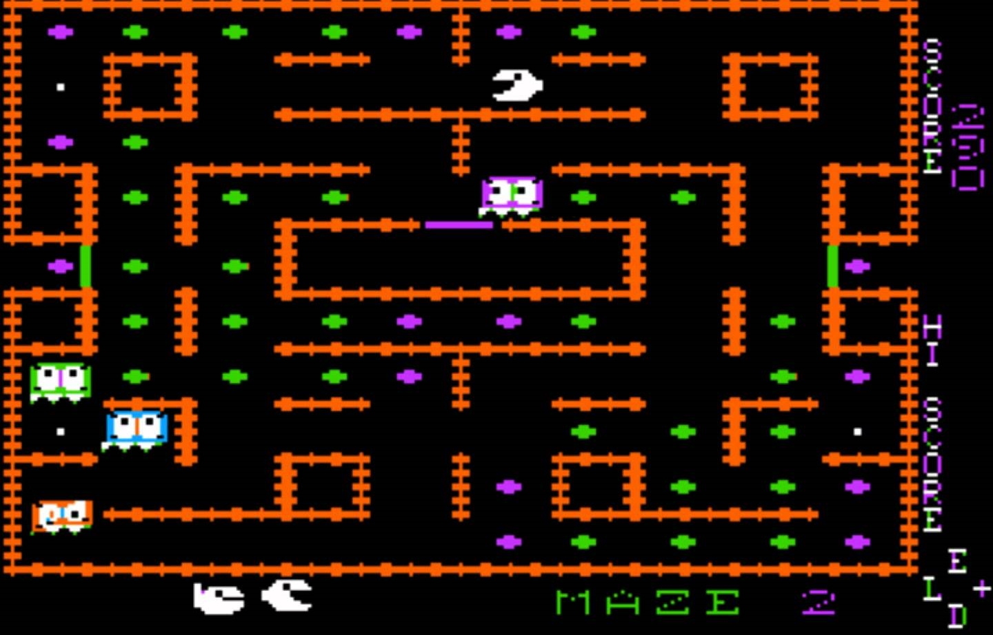
Got an Apple II in 1985
Notes:
And here’s Snack Attack.
None of these are good game, and they’re shameless in how much they copied Pac-Man.

Slide 16
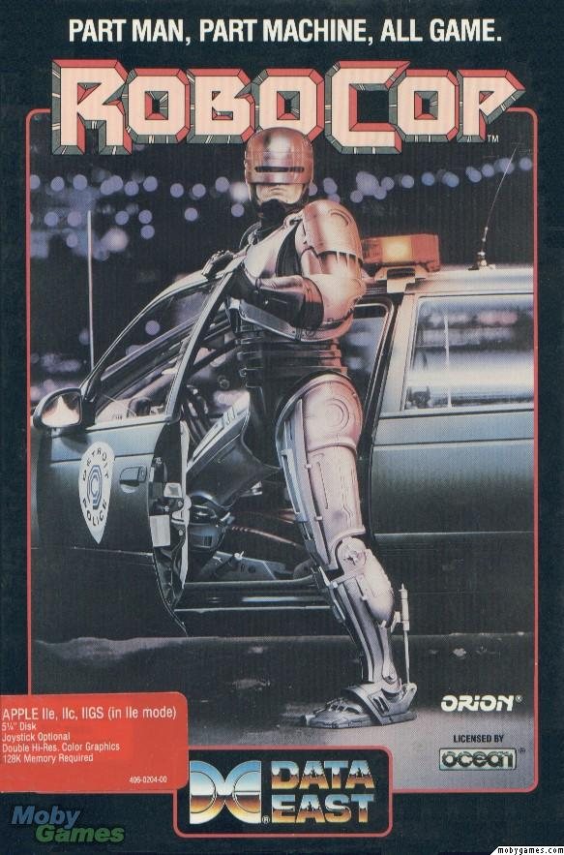
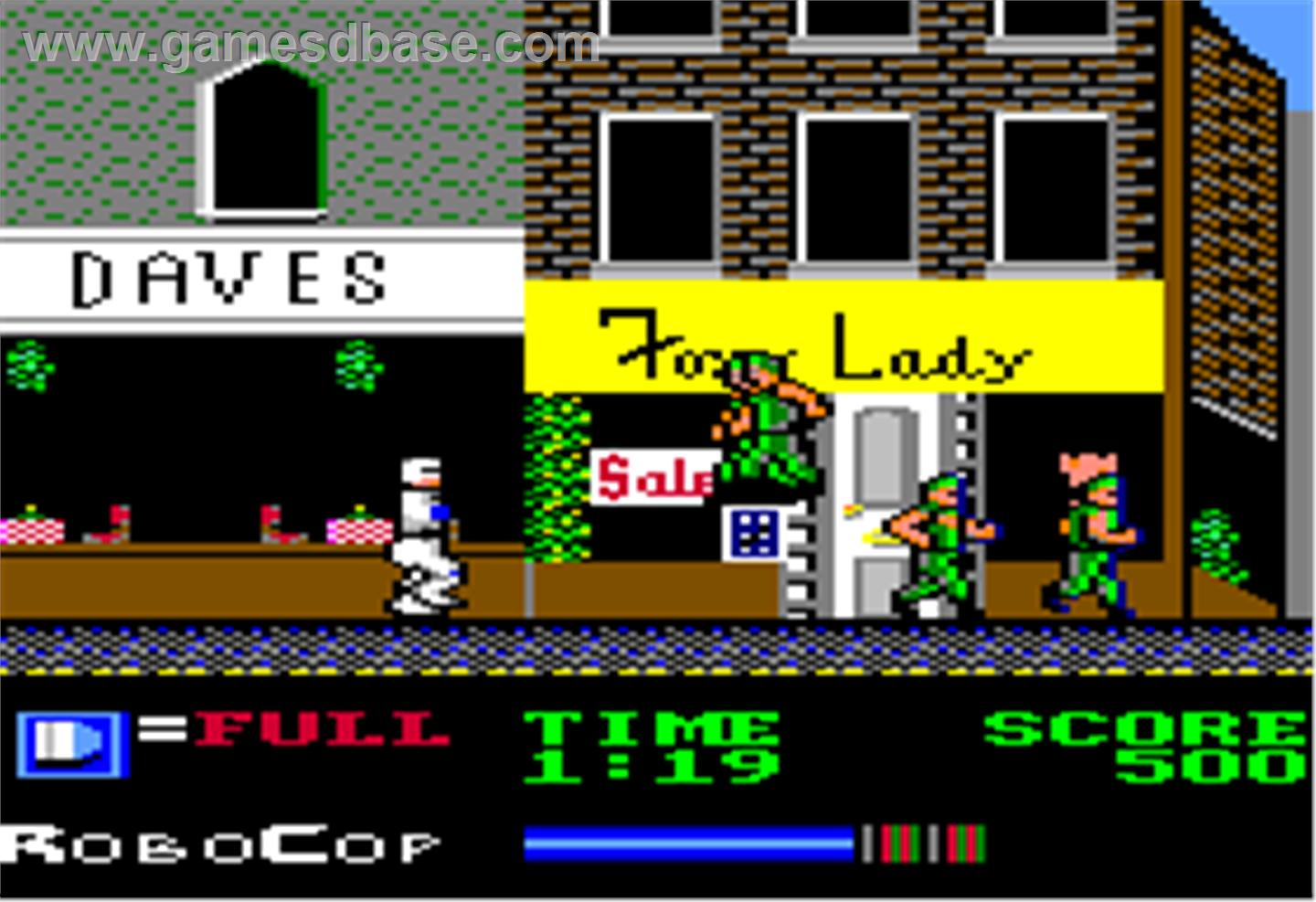
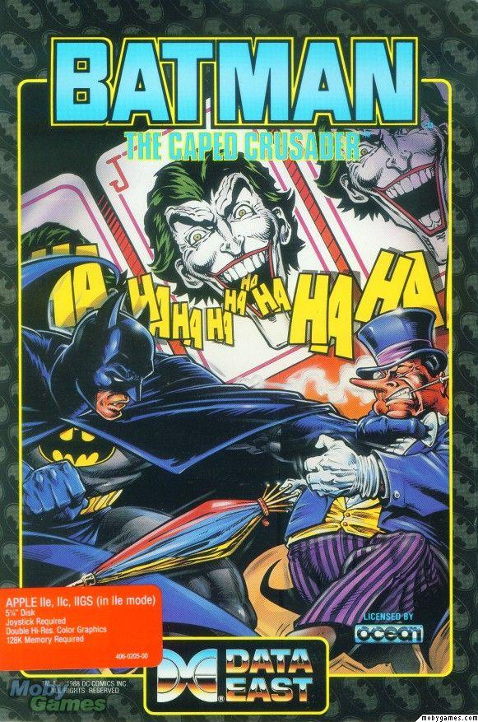
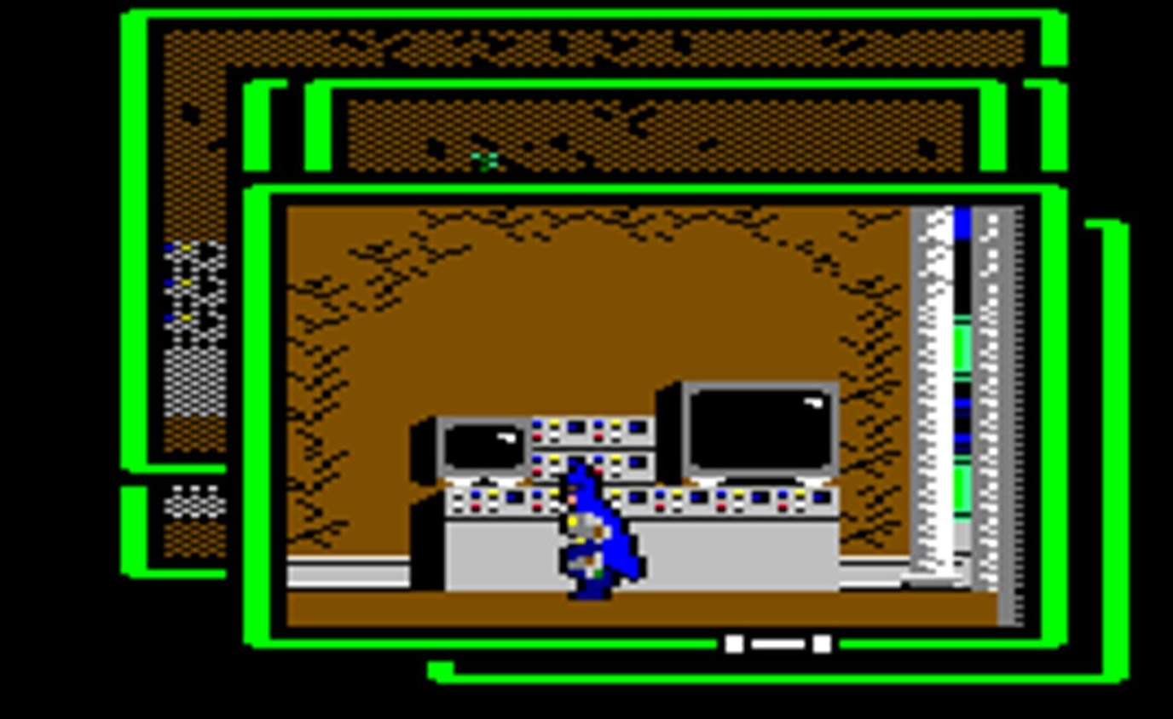
Got an Apple II in 1985
Notes:
There were also awful licensed games, like I remember buying Robocop and Batman and thinking “These could be cool!” only to find out they were just the IP plastered onto generic side-scrollers. What a disappointment.
(The cover art for this Batman game is fantastic though man, I think that’s Brian Bolland)

Slide 17
Notes:
And you’ve probably heard of Infocom, the text adventure company, one of my most beloved studios of that period. Amazingly high quality, well written games which showed maturity and diversity in their offerings.
Well in 1986 Activision bought them and within three years shut them down!

Slide 18
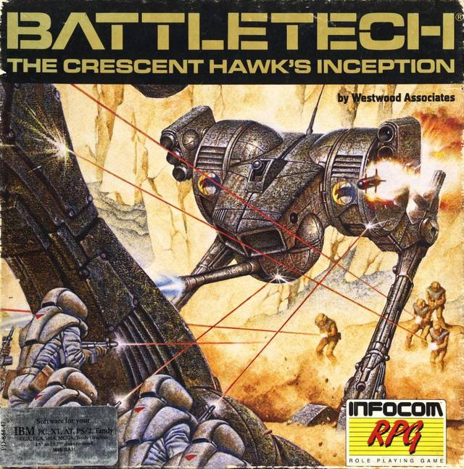
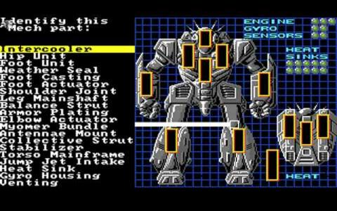
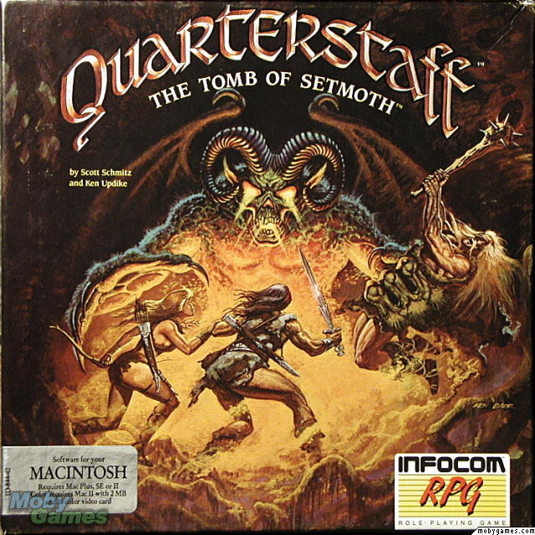
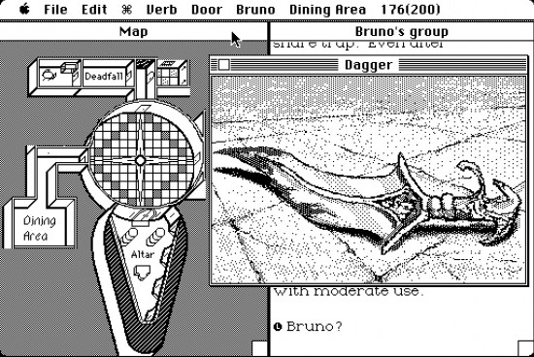
Got an Apple II in 1985
Notes:
But it gets better! Activision then took the name “Infocom” and for a brief while slapped it on other games made by other people.
Like a Battletech game! And this random RPG!
These may be fine games, but I know this: they are definitely NOT Infocom games.
Classy move, Activision. Glad you’ve learned from that.

Slide 19
Notes:
And even the best of these games, if you go back and play them… they can be a pretty rough experience.
Some of these games even required you to use both a joystick and a bunch of buttons on the keyboard. Not exactly elegant interface design. Playing games as complex and confusing as Day Z and Steel Battalion was basically the norm.
Even for the best games from way back then, it’s inarguable that the crafts and best practices and totality of the user experience is better in today’s games.

Slide 20
“A place we ache to go again, where we know we are loved.”
Notes:
So the sad fact is we weren’t all that much “better” back then.
Nostalgia can be dangerous to our perceptions - it’s so emotional. We forget the reality and romanticize our past. We want to go back to that time when we loved games so intensely. And we felt they loved us back.
But if games weren’t that different back then, if they were always full of flaws and bad games and all that, why did we love those games so much?
I think what changed is us. For the most part we were new to the medium of games, falling in love with it. We approached games with wonder and wanting to find the best in them.
We need to remember those feeling we had at the time – the love we had for games and the love we felt they had for us.
`

Slide 21
Notes:
So when I think of “Back to the Start” it’s not about literally going back in time and living it exactly as it was.
But instead trying to remember our outlook. Being of a state of mind where we look past their flaws and try to find their beauty. Not every game will have it, but we need to be less critical of things that don’t matter. We need to give them the benefit of the doubt and they may surprise us.
It can be tough to stay enthusiastic while working in games. After the long hours and endless analysis and cancelations and unlived up to hype.
I often hear developers saying how much they hate games today. But if you catch yourself saying games now are all garbage or they’re all derivative, I think you’re just not looking for them in the right places or looking at them in the right way.
With the right state of mind, now can be another golden age in games. Any era can be. It’s all in how you choose to look at them.

Slide 22
BACK TO
THE START
Notes:
So that’s what I think of when I think of back to the start.
It’s not literally about going back in time, because that’s foolish and ultimately impossible.
I think it’s about a mind-set. And you’ll find that most of our speakers today approached our theme in the same fashion. We have 8 talks coming up about putting yourself in the mindset that helps you go back to the start….

Slide 23
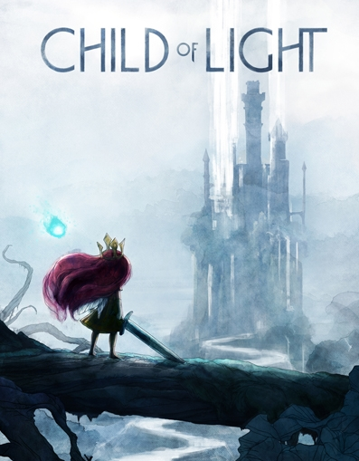
PATRICK
PLOURDE
Creative Director
Ubisoft Montreal
@patrick_plourde
Notes:
Our first speaker has been at Ubisoft for his entire career. He worked on a franchise dear to my heart, Rainbow 6, before leading the creative on my favorite shooter of the last few years, Far Cry 3. And then he did something different, shipping Child of Light earlier this year.
Pat Plourde!

Slide 24
Patrick Plourde
Creative Director
Ubisoft Montreal

Slide 25
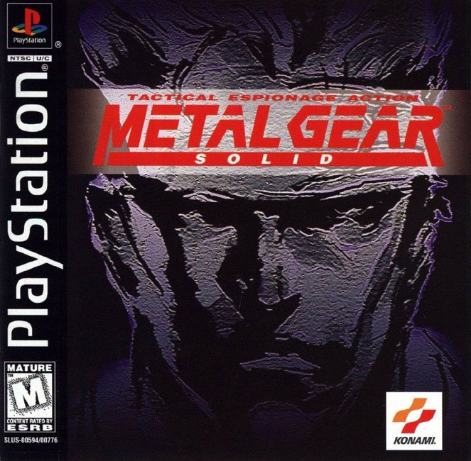
Notes:
At some point in my teens, I bought a Demo disc with Metal Gear Solid on it.
The game was a relevation! a techno thriller where you play a super spy.
I finished the game in a weekend.
I remember clearly my though after finishing the game: WOW, this experience is better than any movie I’ve ever seen.

Slide 26
Notes:
Games are so cool, I want to make one.

Slide 27
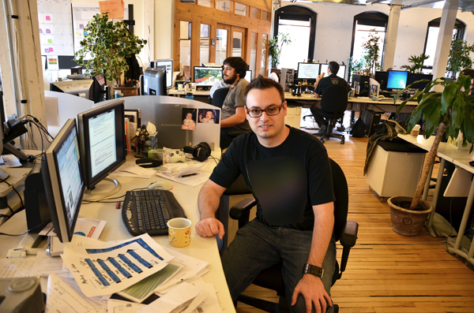
15 years (and 30 pounds later)…
Notes:
Fast forward 15 years and here I am, having the chance to make a career with the medium I love.
I consider myself extremely blessed.

Slide 28
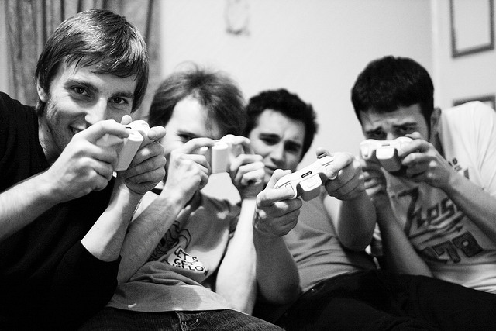
Notes:
At the same time, looking back, I was lucky because I was born in the right demographic:
I joined the industry as a White Male in his mid 20’s.
I remember going to a meeting once in Quebec, where I felt I was in a meeting with my cousins back in the day.

Slide 29
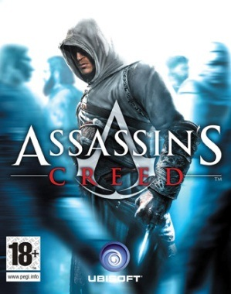
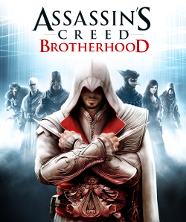
Notes:
And so I got to work on real boys games: Rainbow six, Assassin’s Creed, Far Cry…
The Xbox 360 generation was goooood for that.

Slide 30
#BORED
Notes:
until, after I became kinda bored of them.
And being bored is the death of a creator.
There must be other themes to explore in games. And so I began to start to look elsewhere for inspiration in the case that the opportunity would arise

Slide 31
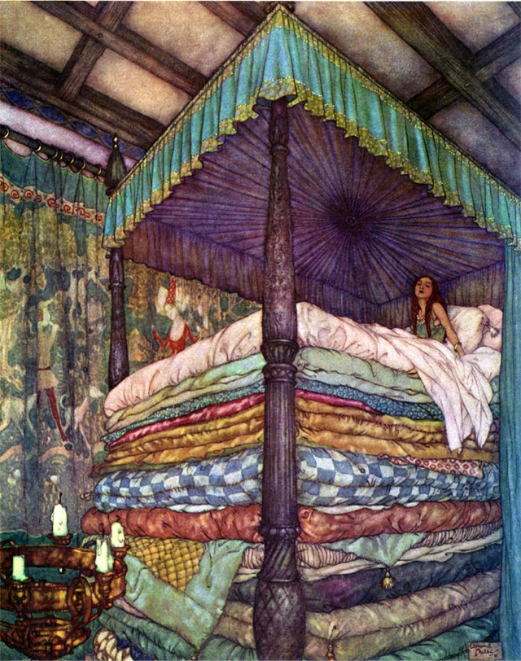
Notes:
So I started to become really interested in classic fairy tales. How they used symbolism to convey meaning to children about the dangerous world of adulthood.
And then the Idea of flipping the script on them, and have the princess take the sword and become the saviour. For me that was really exciting.
I also love the ambiance of the watercolour paintings that were done for those books at the end of the 19th century

Slide 32
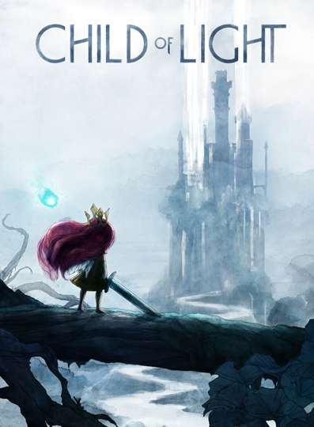
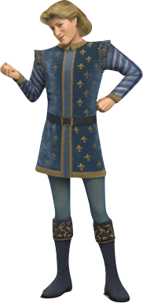
Notes:
that lead to the creation of Child of Light. Its a Fairy Tale inspired Role Playing Game where you play a young girl that is lost in the world of Lemuria.
Its a story where there are no prince charming. She takes on the quest and we see her mature through the adventure. For me that was a unique hook
That enthousiams wasn’t universal. I told a couple of times by some colleagues that they wouldn’t play the game because they didn’t want to play a girl.
Why doesn’t it lights up in their mind that the opposite could be true? That a lot of girls wouldn’t want to play a game because the hero was a boy?
Then I got a suggestion to let the player choose between a boy and a girl. But it cemented in my mind that what I wanted to do was to do the ‘girl game’.

Slide 33
Notes:
And making that game was awesome.
The fact that we had a different theme attracted a different team composition. About 1/3 of the team where women.
The vibe on the floor was really different then previous games I worked on. It was not the old locker room atmosphere, the boys club.

Slide 34
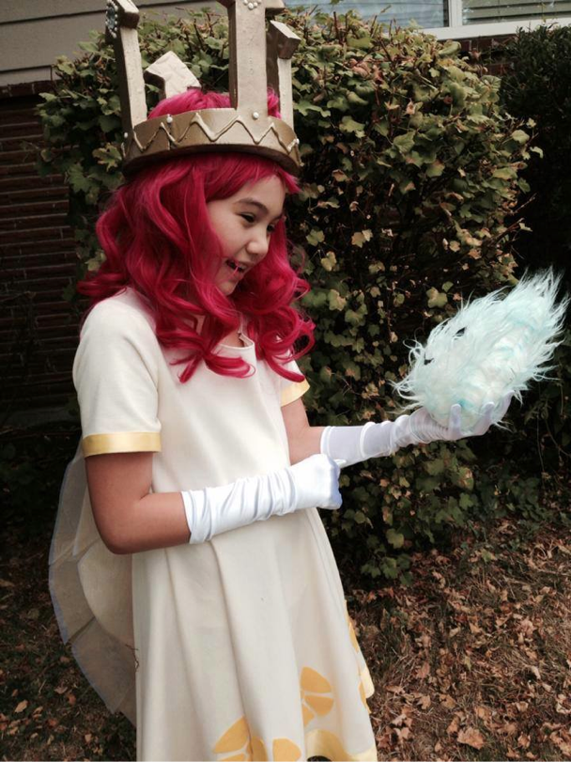
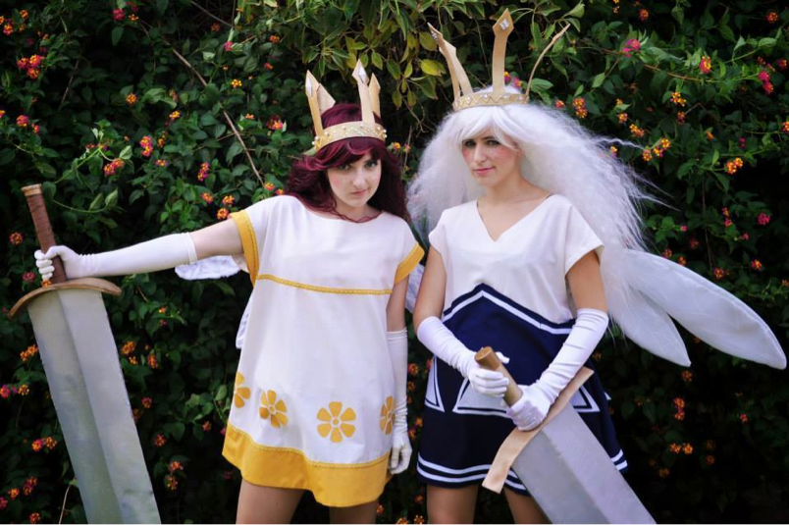
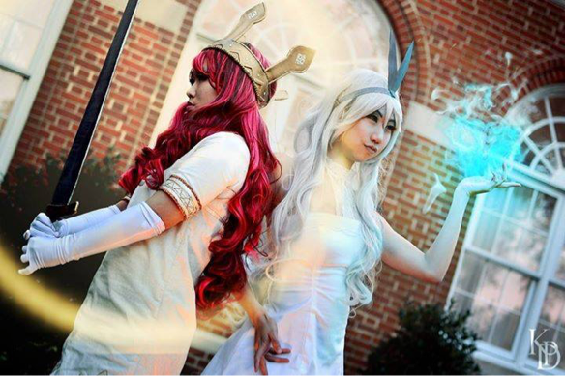
Notes:
Then once the game came out, it definitively attracted a different crowd.
A fan base way more positive vibe coming from the online community.
We received letters from fans who the game helped them live through personal crisis. Those where really touching.

Slide 35
Notes:
Even a a personal level, it happened to me.
a couple of weeks ago at a family reunion Little Marianne – 12 years old, was so excited to come and talk to me about the game.
She was telling me how much she felt like the main character and how she was relating the events to the game with what was happening in her family.
She loved the game so much that she even learned to play the piano in order to play the main theme of the game.

Slide 36
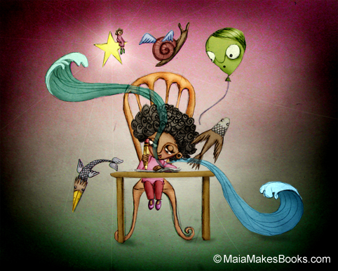
Notes:
And I could really relate to her: A video game had triggered the spark to start creating.
but this time, the player was not ‘me’.
That could be my favourite achievement.

Slide 37
#BORED
Notes:
Conclusion:
If like me you are part of the game dev cliché (White Guy in his 30s) and you’re thankful to be working in this industry, I have one piece of advise to open our doors to others:
Be bored.
Find new stuff to be inspired by.
In my case it was the start toward to a whole new world; more inclusive and open.
And it can be the start of something new.

Slide 38
Thanks!
@patrick_plourde
plourdepatrick@hotmail.com
Notes:
Thanks

Slide 39
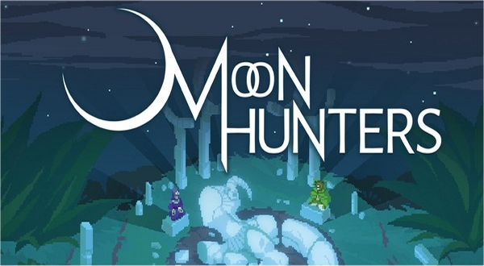
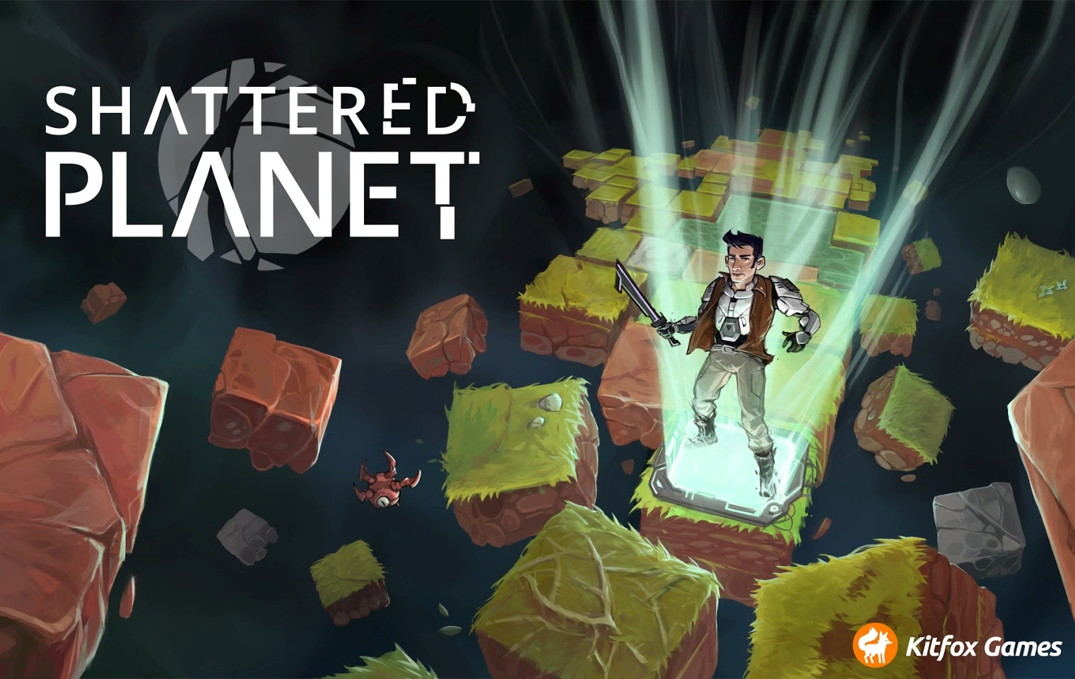
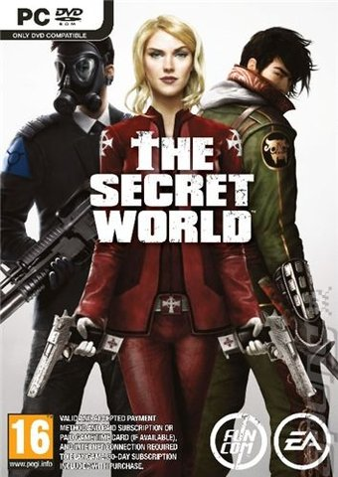
TANYA X
SHORT
Creative Director
Kitfox Games
@tanyaxshort
Notes:
Tanya X. Short is the Creative Director at Kitfox Games. In a past life she worked at Funcom on Age of Conan and The Secret World. Then she co-founded Kitfox - their first game, Shattered Planet, released to great success earlier this year. Their next game, Moon Hunters, recently successfully completed a very Kickstarter campaign.
Tanya Short!

Slide 40
Procedural Generation:
Back to the Start
Tanya X. Short
@kitfoxgames

Slide 41
Good Design
“a series of interesting decisions” – Sid Meier
“Satisfaction + Surprise” – Mark Venturelli
“just another word for learning” – Raph Koster
“a system of rules for play” – Zimmerman & Lantz
Notes:
wh

Slide 42
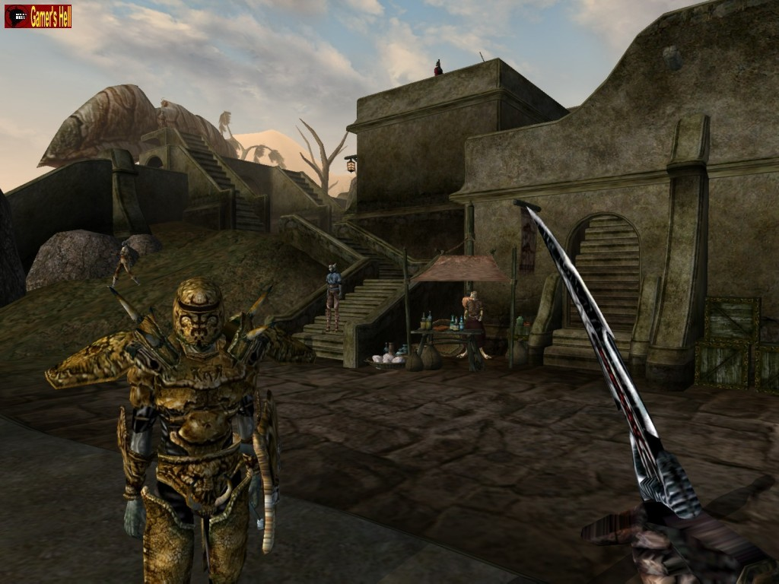
Pattern Recognized

Slide 43
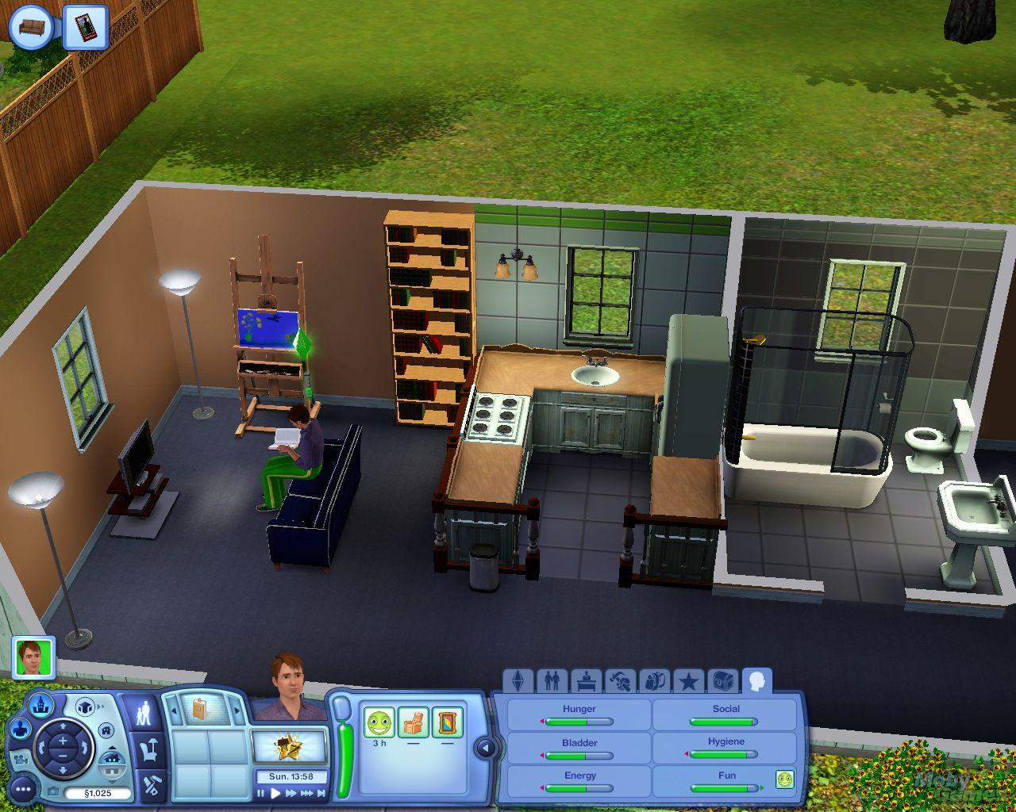
Pattern Recognized

Slide 44
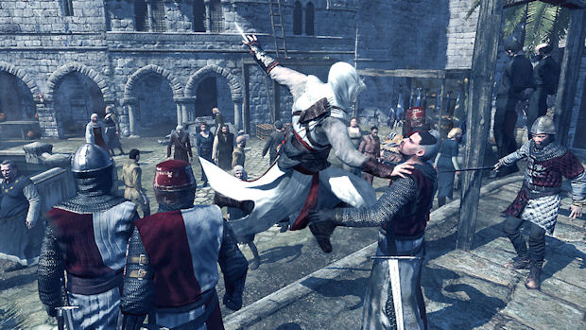
Pattern Recognized

Slide 45
Pattern Broken

Slide 46
Pattern Broken

Slide 47
Pattern Broken

Slide 48
Procedural Generation
Notes:
Procedural generation – a new kind of blank slate

Slide 49
Procedural Generation
The trick of creating infinite levels/worlds/content
Notes:
Initial challenge seems to be about creating, and creating, and creating

Slide 50
Procedural Generation
The trick of creating infinite levels/worlds/content
Notes:
But making a bunch of bad content isn’t useful – somehow we need the infinite game stuff to be good, enjoyable, interesting

Slide 51
Procedural Generation
The trick of teaching a compiler how to design
Notes:
So what I realised I’m actually doing is going back to the start, re-analysing my level design learnings and rules

Slide 52
Back to the Start
Shattered Planet
Notes:
As a designer, I had to reevaluate every technique, every instinct, every superstition to validate it

Slide 53
Algorithm, Get on My Level
Higher risk (or effort) can result in higher reward
Implied: teach algorithm optional challenges
Shattered Planet
Rogue Legacy

Slide 54
Algorithm, Get on My Level
Dead ends should be rare
Reconnect branches, measure “level flow”
Shattered Planet
Don’t Starve

Slide 55
Algorithm, Get on My Level
Satisfying pacing is peaks and valleys
Not a ramp
Left 4 Dead’s A.I. “Director”

Slide 56
Algorithm, Get on My Level
Can you teach your algorithm how to use ‘cramped’ and ‘spacious’ areas well?
No Man’s Sky

Slide 57
Pattern Recognized

Slide 58
Pattern Broken

Slide 59
Back to the Start
The trick of teaching a compiler how to design

Slide 60
Back to the Start
The trick of teaching a compiler how to understand us

Slide 61
Back to the Start
The trick of teaching a compiler how to talk

Slide 62
Back to the Start
The trick of teaching a compiler how to tell stories

Slide 63
Back to the Start
The trick of teaching a compiler what we want

Slide 64
Back to the Start
The trick of teaching a compiler who we are

Slide 65
Thank you!
Tanya X. Short
@kitfoxgames

Slide 66
MANVEER
HEIR
Senior Gameplay Designer
BioWare Montreal
@ManveerHeir
Notes:
In the dark past our next speaker worked at Raven on the Wolfenstein franchise. Currently he is at BioWare Montreal, where he is working on Mass Effect, Mass Effect and more Mass Effect. When he’s not modeling for male calendars (with me, ack! www.menofgamedev.com) he has been known to speak about diversity issues in games...
Manveer Heir!

Slide 67
Notes:
So let’s hit that reset button and go back to the start, or at least back to my start. My start of wanting to make video games for a living, to be specific. We have to go back to the early 90s, when 10 year old Manveer is reading every issue of PC Gamer and playing every game he can get his hands on.

Slide 68
Notes:
It was around this time that I started going from playing games to wondering what it would be like to make games. And thankfully there was no dearth of people talking about making video games in the press. I read interviews with Richard Garriot, Peter Molyneux, Warren Spector, John Carmack, and Sid Meier. I played their games exhaustively.

Slide 69
Notes:
I lived in Rockville, MD and at the time there were two video game companies in town, both of which were gracious enough to allow me to visit as a teenager. Epic Mega Games, where I got to see Tim Sweeney while the first Unreal was in development, and also Bethesda Softworks where I met RPG legends such as Ken Rolston and Todd Howard.

Slide 70
Notes:
But somewhere along the way I started noticing something. Maybe you’ve already noticed it. There’s something very different between me and all the people I saw as role models. And it wasn’t age. Yes, they were all white men. I remember this feeling weird at the time. A few friends told me brown people don’t make games, that we work at 7-11s or drive taxis. But making games? That wasn’t something we did. Not my people.

Slide 71
Notes:
This seemed weird to me. Why the hell couldn’t I make games and be creative? Why was video game creativity the eminent domain of white men? Well it’s not, but teenage Manveer didn’t know that. So, I got a degree in Computer Science, in part because brown people learn to code not design games. I told people I really wanted to design games and programming was just a way to get my foot in the door and have a demonstrable skill.

Slide 72
Notes:
But along the way from then until now? There was doubt. I’ve felt like an outsider most of my life. Small things like being called the name of the one other Indian guy at work may seem small, but they add up and affect your psyche. And I made it through! What about the others who didn’t?

Slide 73
Notes:
What about the boyfriend of a relative of mine, a black man, who started asking me questions about how to make games once he found out what I do for a living. What do I do with his revelation when he said “I wish I knew you could make games as a career. No one tells you that when you’re a black kid.” What about the women I know who left the industry after a couple years due to the culture feeling too much like a “nerd frat house”? What about THESE others? What possible amazing games could all of these potential designers have made? Why do these voices have to be relegated to indie games only?

Slide 74
QUI
Notes:
I want every single one of you, especially those of you in AAA, to think about WHO is in charge of the creative on your games. WHO is the creative face of your games to the press? For most of you it’s a white guy. It’s the guys I listed before. Not only are white men predominantly in the industry but they also are the predominate faces of the industry we trot around to sell the games, to hype people, to inspire.

Slide 75
Notes:
Because, really in AAA development how many women can you name in charge of creative development? Amy Hennig? Lucy Bradshaw? Kim Swift? How many ethnic minorities can you name in charge of creative in AAA? Is it more than you can fit on two hands? It wasn’t when I tried this exercise at home.

Slide 76
Notes:
Why the hell is it that the largest space we have for game development feels like it has the smallest amount of opportunities for those of us not born with the fortunate condition of being a white man? And if any white men in the audience feel attacked by these statements, don’t worry: some of my best friends are white men.

Slide 77
Notes:
The status quo is not enough. It already questions our existence. Meritocracy is a proven lie if you aren’t a white man. Rape jokes are made. You get called the other Indian guys’ name. You’re told your too aggressive and told to control your tone. So I want you to ask yourself this question: what is your company currently doing to promote, retain, and nurture ethnic minorities and women and grow them into the future faces of your company?

Slide 78
START PROMOTING
WOMEN
AND
MINORITIES
NOW
Notes:
We absolutely need to work at promoting qualified minorities and women to leadership positions and having them PROMOTE OUR GAMES TO THE PUBLIC SO THAT THEY CAN BE POSITIVE ROLE MODELS FOR OTHER MINORITIES AND WOMEN WHO WILL JOIN THIS INDUSTRY SOME DAY I HOPE. Look at the people in your company. Identify people who may not typically get into the lead track and figure out if that’s something they want and how to help nurture them there. Not just one woman or minority. Many. At each company. All the time.

Slide 79
Notes:
So let’s hit that reset button to go back to the start and fix our hiring and promotion practices so that the next 10 year old Indian kid who wants to make games for a living isn’t told, that’s not what brown people do.

Slide 80
LEAH
HOYER
Narrative Design Director
Arena Net
@LeahHoyer
Notes:
I had the pleasure of working with Leah at Microsoft on games like Sunset Overdrive and Quantum Break. She comes to games from a background in TV animation, and is now the narrative director at Arena Net where I can only imagine she’s working on more Guild Wars.
Leah Hoyer!

Slide 81
An industry of masochists
Leah Hoyer, ArenaNet
@LeahHoyer

Slide 82
Back to the start…
of 2014

Slide 86
14 percent of developers surveyed said they were laid off in 2013
Are AAA Studios DOA?
Console gaming is dead
Here's why PC Gaming is Dying
In Memoriam: Game Studios That Closed in 2013
Triple-A console studios reduced to 25 worldwide
EA Shuts Down Mythic
Interactive Unit at Disney Cuts a Quarter of Its Staff
More Layoffs at Microsoft
What Irrational Games' closure means for the industry

Slide 88
Wallow

Slide 89
Gut Check

Slide 90
Karma’s a Dick
Feelers Out

Slide 91
Innovate

Slide 92
ASHRAF
ISMAIL
Game Director
Ubisoft Montreal
@AshrafAIsmail
Notes:
Got his start out west working with Electronic Arts on the FIFA franchise and EA Skate. He then came east and spent a time at Behavior before landing at Ubisoft where he worked on shipped Black Flag as the Game Director.
Ash Ismail!

Slide 93
Back to the Start
Notes:
Its not often that a person gets the attention of a large group of people who are forced to listen to him – so I’m very grateful for this opportunity because I do love hearing myself talk.
So “back to the start”, a few things came to mind.

Slide 94
Notes:
Creation of the universe, creation of life,… my mind couldn’t help but go there. Reflecting on the beginning of things, reflecting on the WHY of things and how does that WHY have relevance today
Whats great about this slide is that you can take those 2 pics separately or you can take them together, it still works.
But my mind quickly lingered on a specific beginning,…

Slide 95
Notes:
This. Checkmate was a mod for Unreal Tournament that myself and my best friends had made. It was our first real production of something that was released. Released in late 2003.

Slide 96
Notes:
Team based DM with rules and player classes heavily inspired by Chess. We spent 8 months on it.
Having no social life at all, barely paying the rent or eating, we lived, breathed and slept Checkmate.
We were intimately dedicated to this project and it was glorious.
To this day it is still one of my proudest achievements and one of my fondest memories of game dev.
We werent doing it for a paycheck or to have some kind of critical fame or mass fame, we were doing it out of cheer passion and joy for making games and of offering an experience for others to enjoy.

Slide 97
Notes:
A few months after the release of checkmate I got hired at EA Canada and my professional career started there. The details of that is an interesting story but for another day.
At EA I worked on many sports titles and at some point I had a stretch of finaling game after game. At a certain point after almost 6 months of 7 days a week, 12-16 hour days, I was burnt. I really questioned if I was at the right place, if I was really built for making games. If this was the life I wanted. The passion I had making checkmate, was gone and even forgotten. I was a robot mechanically going about my day, engaged in my work only in superficial ways.
And then one day I was lurking on a forum and saw this message.

Slide 98
“Nothing is more satisfying than a good checkmate. No the shacks favorite red head has not gone to revisit his days as a middle school chess champion but rather he revisted a time when ut2k4 thrived and shackmods were beloved by many. I booted up Checkmate and it was good. i can claim no credit beyond a few suggestions for this gaming extravaganza but one of our very own can. piotyr was one of the few which gave birth to the most refreshing take on the fps since the double barreled shotgun. Even with bots this game is great. Alas, the news is not all good. The saturation of mods for ut2k4 (many of them quite awful) made it difficult for the true gems such as Checkmate to come forth. hopefully, each of you will visit or revisit this pinnacle of gaming as i have done.”
Kbnerd on Shacknews - Mar 21, 2006
Notes:
<READ QUOTE>
I`m not reading this quote as a pat on the back, I`m super proud of CM but I don’t think it’s the pinnacle of gaming. But that’s not the point.
This game meant something to him. In terms of gaming experiences it had a profound place in his mind, in his heart. We gave him something special. Something that he held on to, and kept going back to. This thing that we poured our hearts and sweat into, it meant something to this one person. I sat there reading the message over and over again, in complete awe. It was like a vale had been lifted off my heart.
It was the spark I needed to reignite my passion. but I had made a big reflection.

Slide 99
Notes:
We work in an amazing industry. We provide entertainment. But the word “entertainment” does not properly invoke the deeper meaning.
We provide people with worlds that they get sucked into, realities and stories that immerse them. But unique to our form of entertainment, we provide interaction.
These worlds and characters and stories, they are not just for watching. They can be touched, they can be interacted with and they can be enjoyed WITH other people. Your presence in the world has meaning and it has a value. And this interaction resonates in a deep and unique way.
I inherently knew this but reading that message from kbnerd, that wonderful red head, it made it tangible, it made this reflection about the game industry physical and real.

Slide 100
Notes:
We create universes. We create something that has a life. We create something that has a meaning for other people and something that demands to be touched and interacted with and shared with others.

Slide 101
Notes:
These universes can affect people beyond what we can imagine. To this day, I still read that message. When its been a tough day or a special feature gets cut or just to remind myself why I love to do what I do. Its become my security blanket.
Now I know exactly what you are all thinking right this minute. Ash I’ve never been this turned on by an Arab before, but what more can I take away from this?
Back to the start. When times are tough, when the work day has become a grind, when you’ve lost your passion and have been disenchanted by the industry, step back and remind yourself WHY you got into this industry. Remind yourself of the wonderful impact you can have on others.
And go beyond your thoughts. Go and touch a manifestation of your passion. Play your game, or read old forum posts, look at screenshots, or talk to old teammates about the good ol’ days. What ever it is, find your own kbnerd and ignite your passion again. Because this industry is better than just a paycheck. This industry is better than the daily work grind. This industry, for all its warts and scars and moles, is special and unique and wonderful and it deserves & demands your love and passion.

Slide 102
I
Game Dev

Slide 103
CELIA
HODENT
Director of User Experience
Epic Games
@CeliaHodent
Notes:
Our next speaker earned her PhD in psychology and started working with Ubi in France on User Experience for the company. She and I got to work together at Ubisoft on the Rainbow 6 franchise. She’s gone onto be Director of UX at Epic and is currently working on what will surely be a great user experience in FortNite…
Celia Hodent!

Slide 104
The Groundhog-Day Problems of UX
Celia Hodent, PhD.
Notes:
Hi everyone! I’ve been working on User Experience with multiple teams at Ubisoft, LucasArts, and Epic Games. And I wanted to share this little story with you. Each time I start in a new team, it feels like Groundhog Day, as I always encounter a lot of resistance and concerns about implementing UX practices in video games.
104

Slide 105
Notes:
UX practices have been used in industrial design and web design for a while. These practices are meant to avoid bad usability for a teapot for example, or bad multiplayer experience in the restroom.
But for some reason, in the video game industry, UX is fairly new and not always understood. And it’s weird to me, because it’s only meant to help developers design a better experience for their audience.
105

Slide 106
Top 3 reactions …
Notes:
So here I am, starting in a new team, all excited, and I’m confronted to the same reactions over and over again.
Here’s a top 3.
106

Slide 107
#1 – “UX is just common sense”
Notes:
101/common sense. Sure, there are some common sense recommendations, such as whenever the player does something, there should always be a feedback. Or that it’s better to use green for health and dedicate red for immediate threat or damage taken.
However, games ship every day with “common sense” problems, either because they were not addressed soon enough or because you’re sometimes so close to your product that you don’t even see the obvious anymore.
107

Slide 108
#2 – “UX is about making the game too easy”
Notes:
Easy. Unless the experience intended is to have an easy game, this is simply not true.
UX is all about making sure that the experience intended by the designers is the one felt by the target audience. It’s not about changing the experience. UX peeps are not here to replace designers or artists, but to empower them to refine their design into a great experience.
So, don’t worry my hardcore gamer friends, UX won’t spoil your beloved super difficult games.
108

Slide 109
#3 – “We can’t afford doing UX!”
Notes:
Very often devs would tell me the feature is not ready for testing when I show up and insist we should start testing. Or that we don’t have the time in our tight schedule. Or that we don’t have the money to build a lab and bring people in.
But UX is above all a state of mind, there are many quick and dirty tests you can do that aren’t that costly. Also, keep in mind that by not playtesting or using UX best practices, you’re simply taking more risks of failing when it’s too late. Imagine the Star Wars characters we would have if George Lucas did not iterate on his vision.
Oh, by the way, there’s always something ready for testing: iconography, paper-prototype of your HUD, character design… even when your feature is not implemented yet you can paper-test different options and gain a huuuuuge time by starting to implement a version that’s already better (of course, you will have to refine, but it’s likely to take you less iterations).
109

Slide 110
The truth is: We are all biased …
Notes:
But why most devs react that way? The truth is, we are all biased.
What do you see here? color stripes? Or Street Fighter characters? You don’t perceive the same things depending on your previous knowledge… so as a designer, artist, engineer, you don’t necessarily perceive what your audience will.
Also, think about when you’re asking for directions to someone who really knows the area well. It seems super clear for that person. But for you? You’re completely lost. And that’s the most important problem in game development: devs are so close to their game, they have such a particular way to perceive it and talk about it, that at some point they fail seeing the obvious for a new player. And they can’t even realize that’s the case until you show them someone new struggling to understand their game.
Team psychology: when deadlines come closer, you and your team enter into a tunnel vision: the brain only thinks about sprinting, it’s not analyzing where you’re going. So even if you sprint towards a massive wall, you’re not likely to see it clearly. Having a UX friend who has more distance with the game will then be key to help you gain perspective.
110

Slide 111
Notes:
Every time, developers keep having concerns that I want to take over design and decide the experience for them.
Every single time, I have to reassure them that UX is actually meant to understand what experience the devs what to offer to their audience and guide them to achieve their goal by actually anticipating and analyzing how the players perceive the game and behave in it, and by helping the developers taking a step back from their games.
So please, don’t fear your UX peeps, they just want you to be successful faster and the players to be happy! And if you see me in the corridor of your studio one day, please don’t make me feel it’s groundhog day all over again. And at least let me try to show you how we can use ux practices early and often to gain time and improve efficiency. I know the game you’re making is a bit like your baby, I promise I’ll take good care of it. ☺
111

Slide 112
Thanks for your attention!
Notes:
112

Slide 113
DEIRDRA
SQUINKY
KIAI
MFA Candidate
UC Santa Cruz
@TheSquink
Notes:
Our next speaker is known for some fascinatingly quirky games. They are perhaps best known for the IGF-nominated Dominque Pamplemousse, a point-and-click adventure game about social awkwardness that also happens to be a musical. Currently they are an MFA Candidate at UC Santa Cruz where they are working on Coffee! A Misunderstanding, an interactive theater piece about, once again, social awkwardness.
Squinky!

Slide 114
Making a Game as Catharsis during a Dark Time
Deirdra “Squinky” Kiai
squinky.me
@TheSquink

Slide 115
Notes:
Something happened this year. Don’t get me wrong; it’s the same thing that’s been happening for a while: women and queer people are getting harassed for ruining videogames. The only difference is, now the harassment has gotten so big that even the mainstream media knows about it.

Slide 116
Notes:
These nincompoops doing the harassing, see, they’ve hated us for a long time. How dare we make walking simulators about our delicate fee-fees instead of real games! With guns! And how dare those game journalists write about our work when it’s not even good! Collusion!

Slide 117
Notes:
So, an internet buddy of mine decided to start this game jam, “open to anyone and everyone who has been, is being, or plans to be accused of ruining the games industry”. And I felt inspired.

Slide 118
Notes:
So I wrote this Twine story -- because nothing says “that’s not really a game” like Twine -- called “Quing’s Quest”, about a young monarch of mysterious and indistinct gender exiled from their home planet, Videogames.

Slide 119
Notes:
In this game, you spend your days on a hot pink spaceship with floor-to-ceiling glass windows, called the Social Justice Warrior.

Slide 120
Notes:
You pick out cute outfits to wear...

Slide 121
Notes:
...you take adorable selfies...

Slide 122
Notes:
...you make classic point-and-click adventure game references...

Slide 123
Notes:
...and you even get to romance your hot crewmate.

Slide 124
Notes:
But as it transpires, the reason you’re in exile in the first place is because Videogames has been invaded and colonised by the misogynerds. And, just like any other colonists, “...they act as if this is the way it’s always been, as if Videogames was a planet that they alone discovered, as if your people hadn’t been there first.” And that was my way of saying, hey, I’ve been into games longer than many of you kids were even born. Hence all the adventure game references. So don’t be accusing me of swooping in from the outside to take away your games; you took them away from ME.

Slide 125
Notes:
I also wanted to call out the game industry itself as complicit in creating this culture of toxic masculinity and entitlement in games. In Quing’s Quest, your people basically welcome their new overlords -- this obviously doesn’t sit well with you, but if you complain or, god forbid, try to make positive change on your own initiative, you get in trouble for it. So, you’re left with little choice but to rebel and strike out on your own.

Slide 126
Notes:
Of course, the Gamer Police catch up to you, eventually. So what do you do?

Slide 127
Notes:
You start dancing. And as you dance, all the misogynerds explode into a cloud of glitter, and it’s glorious. And you discover a new power within yourself.

Slide 128
Notes:
Upon discovering this power, you’re faced with a choice. Do you save Videogames? Destroy Videogames? Get the hell away from Videogames?

Slide 129
Notes:
Spoiler alert: you can’t save Videogames. What I mean by that is, the culture surrounding videogames is so toxic that we either need to start over and build something new, or leave for greener pastures. Both these options are easier said than done, and I have no concrete solution as to how to proceed.

Slide 130
Notes:
One thing I do know is that making this game definitely made me feel better. And it made a lot of other people feel better, too. And it helped me remember why I do what I do, why I love being creative and sharing my work with like-minded people. Because really, the only way to fight this is to keep making beautiful things.

Slide 131
squinky.me/quing
Notes:
Here’s the link, by the way, if you want to play it yourself. Thank you.

Slide 132
PATRICE DÉSILETS
Creative Director
@PatriceDez
Notes:
Finally we have someone who has been at the center of the Montreal game development scene as long as there has been one. He had his breakthrough on Prince of Persia: The Sands of Time before he went on to spearhead the creation of the Assassin's Creed franchise. And now he’s onto a new adventure…
Patrice Desilets!

Slide 133
Before we start…
Patrice Désilets – Creative Director at Panache Digital Games
Notes:
Tweet, Vine, Facebook, etc. the hell out of this..
1666 fight still going on but now working on brand new game in my new indie AAA studio

Slide 134
So Back to the start
I was here 4 years ago, doing the same thing
Back to the Start represents well the adventure of making video game : we are always at the start…
Notes:
Funny because
so I’m back to the start
I accepted to do it because of the subject matter
or any other way of human expression

Slide 135
My start…
July 1997, very first day at Ubi MTL
10 people…
Didn’t have a background to make video games
Notes:
Makes me feel old all of a sudden…
Which is why I can not do just “a game like the other”
It gave me sense of “overview”

Slide 136
MIGS’ start…
I was here 10 years ago, at the start of MIGS & Assassin’s Creed
That was before:
Facebook/Twitter/Social
Ipad/Tablets
Steam has just started…
Question: So what is now the start of something “normal” in 10 years?
Notes:
It was the start of a new Fully Digital World
Reminder: Industry of Pioneers, always!

Slide 137
A well known start…
“Inspired by historical events and characters. This work of fiction was designed, developed and produced by a multicultural team of various religious faiths and beliefs.”

Slide 138
A well known start…
Proud of that quote
Positive message about us “living together” that millions of gamers have read…
Notes:
Before they go in the game and assassinate… but still, sometimes we give positive message
It was important for me to tell the world that even if we struggle often to live in peace and harmony, when we do we can make special stuff like AC…

Slide 139
Press Start…
How I fundamentally design
Imagine what is going to happen after the most important interaction in any game:
Press Start…
Then go from there…

Slide 140
Because every day is a new Start
Each games we make is unique
It knows what it needs, just listen to it… as if each day is “Back to the Start”
No game, when finished, is what we intended back to the start
Notes:
Rewind feature of POP:SOT direct result of this

Slide 141
My new Start…
Always have Panache
In the Digital world
Making revolutionary video Games

Slide 142
Merci.
@patricedez
pdesilets@panachedigitalgames.com

Slide 143
MIGS BRAIN DUMP THANKS EVERYONE
@richardrouseiii
@patrick_plourde
@TanyaXShort
@ManveerHeir
@LeahHoyer
@AshrafAIsmail
@CeliaHodent
@TheSquink
@PatriceDez
Notes:
Thanks for sticking around to the end! Hope you had a great MIGS!
Thanks to all our speakers – and thanks for people who did two talks at MIGS for us.
Go out and do good work, and make now yet another golden age for games.

