Slide 1
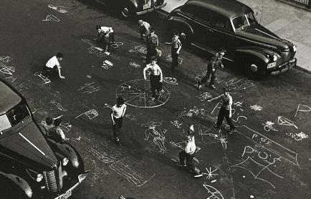
Rules of the Game
Five Tricks of
Highly Effective Designers
Your host
with
Richard Rouse III
Nels Anderson
Chris Avellone
Kim McAuliffe
Laralyn McWilliams
Dan Teasdale
@richardrouseiii
@nelsormensch
@ChrisAvellone
@EnameledKoi
@laralyn
@DeliciousBees
Notes:
Welcome.

Slide 2
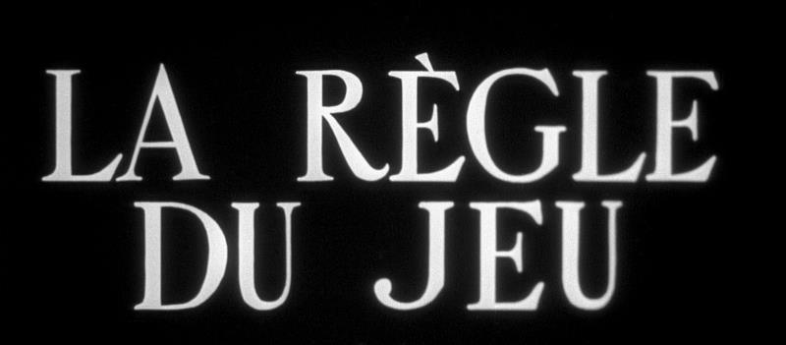
Notes:
I am fascinated by game design rules. Tricks. Tradecraft. Whatever you want to call them.
As game designers our jobs are literally to make up rule sets for the games we design
Many of us start thinking about life in terms of what rule sets define it – if we are modeling life in our games, we need to figure out those rules.
And naturally, we want there to be rules about game design itself. And if we followed those rules, would we be guaranteed to make a good game? Of course it’s not that simple.
And I’m sure you’ve heard such rules many times before…

Slide 3
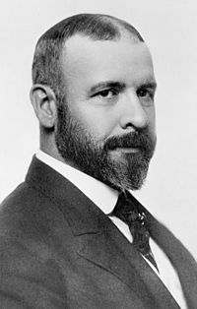
“Form follows
function.”
- Louis Sullivan
Notes:
Some rules that we inherit from other mediums. Like this one we borrowed from architecture
19th century architect Louis Sullivan
Basically, figure out what your thing needs to *do* and then worry about what form it should take and how it should look. Not the other way around.

Slide 4
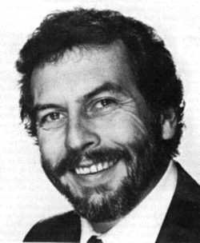
“Easy to learn,
hard to master.”
- Nolan Bushnell
(paraphrased)
Notes:
We also have some sayings in game development that are so universally held that we don’t even know who said them.
For example, I was surprised to learn this chestnut is attributed to businessman Nolan Bushnell.
Funny, I had always attributed it to…

Slide 5
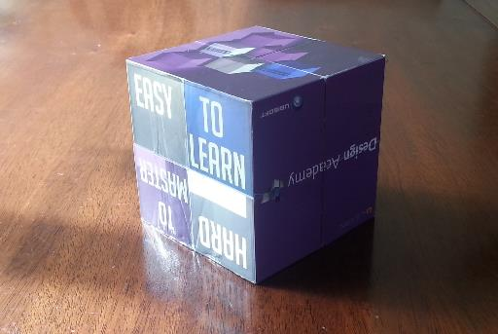
“Easy to learn,
hard to master.”
- The Ubisoft
Cube
(after Bushnell)
Notes:
... The folding cube I got when I went to the Ubisoft Design Academy.
It contains much wisdom!

Slide 6
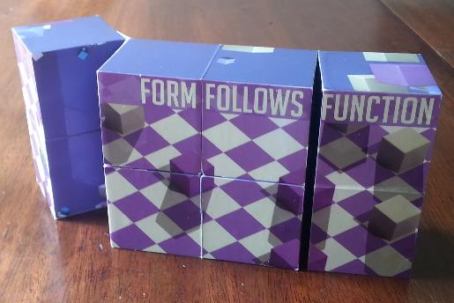
“Form follows
function.”
- The Ubisoft
Cube
(after Sullivan)
Notes:
If I flip it around it says “Form Follows Function!” It’s pretty sweet like that.
Probably one of the smarter cubes I know.

Slide 7
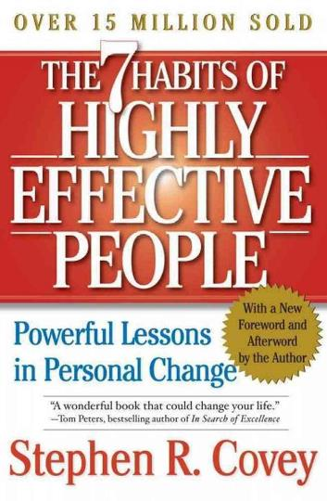
Notes:
Those rules are fine, but sometimes too broad is not good. And I always like to consider the source of the rules I’m studying.
I often find the people who are setting out to write “universal truths” end up writing something so broad, so mushy, that it’s just not all that useful, unless you literally have never thought much about How Life Works. Just look at the “self-help” book industry (or the “business-wisdom” book genre)

Slide 8
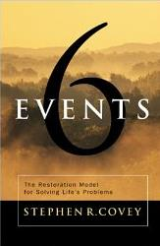
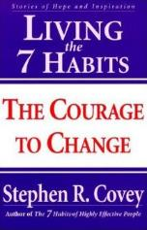
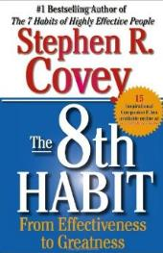
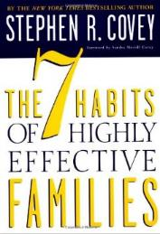
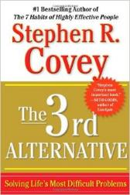
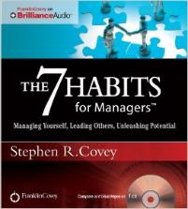
Notes:
Sometimes it turns out these rules come from people who are in the “Advice giving business.” Their main accomplishment in life is giving advice to people, not making something themselves.
And that’s fine – people can learn a lot from a good educator who may not be much of a practitioner.
But the rules I’m interested in are more specific to the person who said them.
If I don’t really know whose rule it is, I don’t feel I can completely trust it. If I know who said it, I can put it in the context of what they meant at a deeper level.

Slide 9

“There are 3 types of games:
Games where the designer is having all the fun.
Games where the computer is having all the fun.
Games where the player is having all the fun.”
- Sid Meier
Notes:
For instance, Sid Meier has probably stated as many game design “rules” as anyone – here’s one of my favorites.
<Read quote>
Guess which one he recommends you make?
This is a reminder to all of us that we should have MORE fun playing the games we make than we did making them – some of you in this room probably know exactly what that feels like.
And to also be careful the simulation doesn’t get so complex (and the computer has all the fun) without manifesting fun for the player.

Slide 10

“The interface is
the gameplay.”
- Brenda Romero
Notes:
For another example, Brenda Romero said <Read Quote>
Here’s a reminder to everyone who thinks “yeah yeah, we’ll make that UI better later, the real game is over here in this deep system.” To the player, the interface is the game, and if the interface doesn’t do its job it doesn’t matter how fun your ruleset is.
And as Brenda said, put it off until the end of development AT YOUR PERIL!

Slide 11
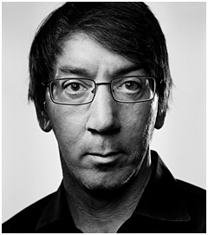
“Your game is not
complete until there’s
nothing else you can
remove.”
– Will Wright
Notes:
Will Wright is another well-liked quotesmith for game design wisdom.
<Read Quote>
This is an adaptation from a Japanese expression about gardening. Or I’ve heard it attributed to many other sources.
If you look at the best of his games, you see how this applies – like the original The Sims – which is actually a very focused game – it doesn’t have a lot of “extra” features.

Slide 12

Source: http://apod.nasa.gov/apod/astropix.html
Notes:
But are game design rules universal?
I don’t think they are.
There are 100s of types of games in existence, and I think that are 100s of types we haven’t made yet, and it’s ridiculous to think the same rules would apply to them all.
We as designers want there to be absolute rules because that’s what game designers like – but that doesn’t make it any more true.

Slide 13
Game design rules are personal, not universal.
Notes:
That’s why I say game design rules are personal, not universal.
They may be useful to think about, but we mustn’t pretend they are more absolute than they are. Often they are localized to a specific genre, or even a specific creator.

Slide 14

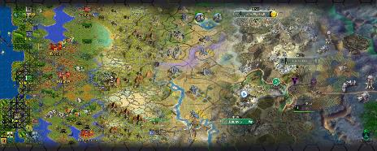

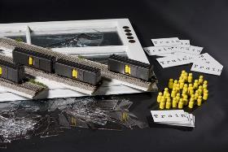

Notes:
But they can still be fascinating. Rules become interesting when you think of them in the context of the people who said them, and the games they make.
So when you hear rules from people like this or from today’s speakers, you should ask yourself:
* Does this rule apply to me and the genre of game I’m working in?
Is it more of a creative choice than an absolute?
Do I want to make a game in the spirit of Sid Meier or Brenda Romero or Will Wright? Or am I making something different?

Slide 15
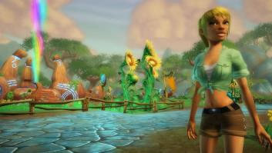
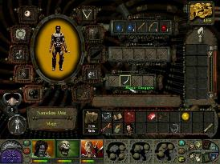
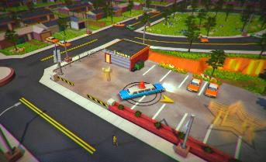
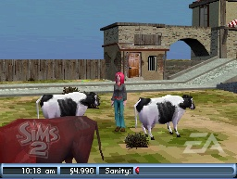
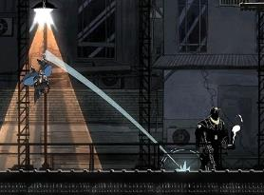
Notes:
Which brings us to today’s session – we’re going to have five designers get up here for 10 minutes each and tell us one of their personal rules that they’ve experience in the course of developing one of the titles behind us.
And they’re going to tell us rules that are less boilerplate, less commonly held, and more personal. And then you can think about your own design process and whether you agree or not.

Slide 16
LARALYN
MCWILLIAMS
Chief Creative Officer
The Workshop Entertainment
@Laralyn
Notes:
So with that, first we have Laralyn McWilliams, who has been a creative force on a wide range of titles. She’s been a Lead Designer and Creative Director on everything from the complex tactical combat of Full Spectrum Warrior to a Snoop Dogg game that I got to play but which (sadly) never saw the light of day to the successful MMO-for-all ages Free Realms to a time in casual games. She has just recently come full circle and is working on on new big games at The Workshop.
And in 2014 she was honored as one of Gamasutra’s top 10 game developers
Laralyn McWilliams!

Slide 17
Make Emotional Connections
Laralyn McWilliams (@laralyn)
Chief Creative Officer, The Workshop Entertainment

Slide 18

Notes:
I’ve had the good fortune to work on a bunch of unusual games. Or did I make them unusual? It’s hard to know. There’s actually something they all have in common though—emotional hooks tied in at the systems level. I think that’s not just because it’s important to me, but because I have tools to bring it into my process.

Slide 19

Notes:
As designers, we’re all about making connections between player actions and how those actions are rewarded in the game.

Slide 20
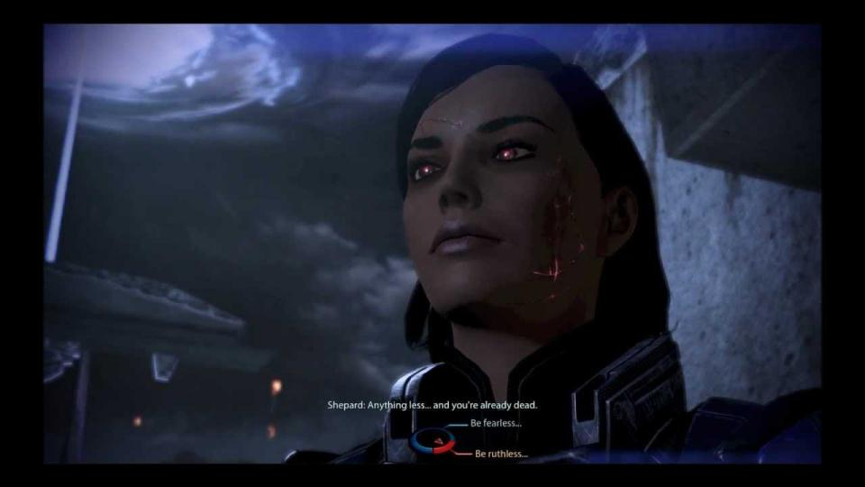
Notes:
On the front end, with rules and systems that clearly show your options…

Slide 21
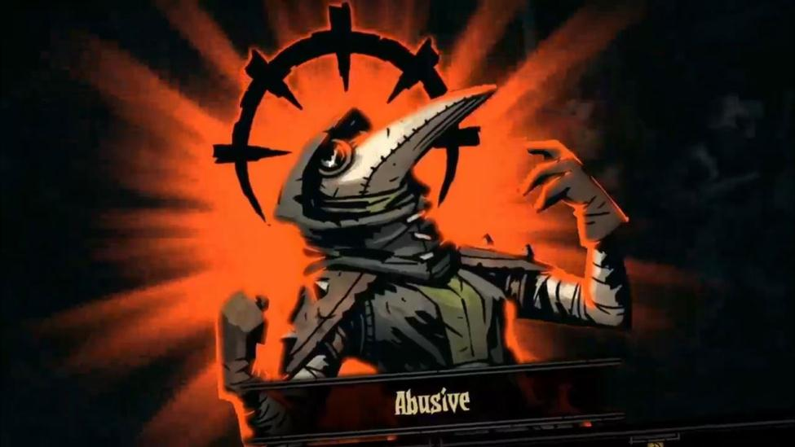
Notes:
And on the back end, for feedback about the choices you’ve made…

Slide 22

Notes:
We understand these tangible needs, and we translate them into numbers—into systems and interactions. At the heart of our interactions with players, though, are basic human needs.

Slide 23

Notes:
Wealth

Slide 24

Notes:
Relationships

Slide 25

Notes:
Mastery…

Slide 26

Notes:
Even our search for meaning in life.

Slide 27

Notes:
We think about systems in a whole separate category from emotion, and we sometimes struggle to see past the numbers to the person on the other side.

Slide 28
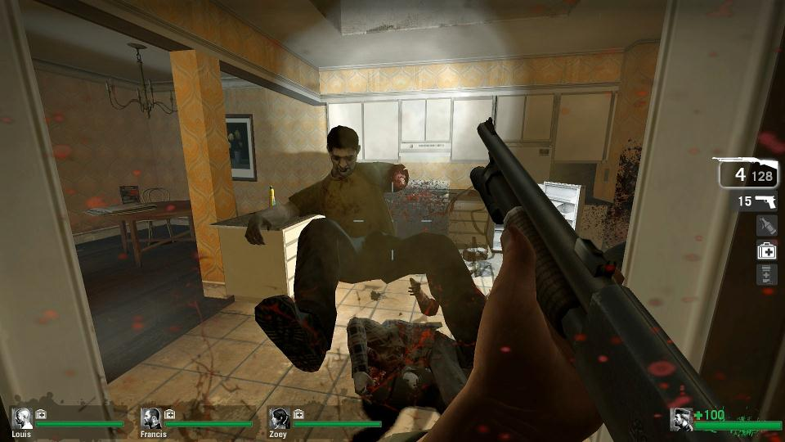
Notes:
But our ultimate goal in our games is to affect players emotionally, right? Even if that emotion is simply “Fuck yeah, eat it, zombie!” I remember being really influenced by System Shock’s last bullet system. I created a framework to keep player emotion at the forefront.

Slide 29
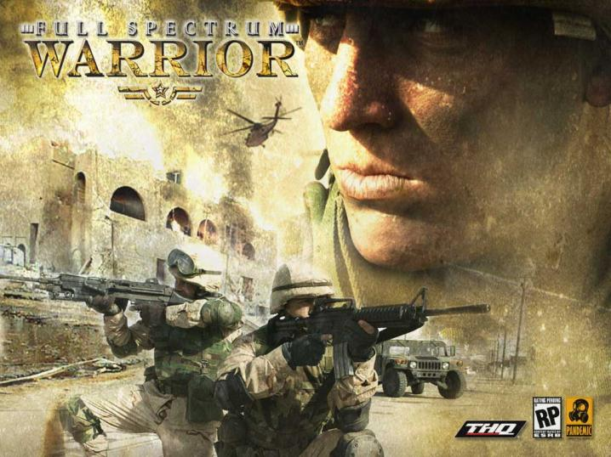
Notes:
Full Spectrum Warrior was a hardcore military simulation where you controlled two squads of US Army dismounted light infantry soldiers. It started as an official Army training tool and we continued that absolute need for authenticity into the commercial version. The Army has a zero tolerance policy for casualties.

Slide 30
NEEDS
Relationship
Skill
Ownership
Information
Progress
Social Status
Individuality
Escapism
Notes:
I start by listing out player needs. These are the needs that were relevant to Full Spectrum Warrior but they’re pretty universal.

Slide 31
NEEDS
Relationship
Skill
Ownership
Information
Progress
Social Status
Individuality
Escapism
INTERACTIONS
Soldier
NPC
Enemy
Cover
CASEVAC
Trigger
Another Player
Notes:
Next, I list out the major player interactions. What can players, attack, talk to, examine?

Slide 32
NEEDS
Relationship
Skill
Ownership
Information
Progress
Social Status
Individuality
Escapism
INTERACTIONS
Soldier
NPC
Enemy
Cover
CASEVAC
Trigger
Another Player
REWARDS
Mission Advances
Story Advances
Attachment
Expertise
Accomplishment
Emotional Impact
Notes:
Finally, I listed out rewards we gave in the game. In FSW, rewards were more like most single-player shooters. You could have mission or story advancement, attachment to the world or your soldiers, growth in your expertise, a clear sense of accomplishment, or simply the reward of elicited emotions.

Slide 33
NEEDS
Relationship
Skill
Ownership
Information
Progress
Social Status
Individuality
Escapism
INTERACTIONS
Soldier
NPC
Enemy
Cover
CASEVAC
Trigger
Another Player
REWARDS
Mission Advances
Story Advances
Attachment
Expertise
Accomplishment
Emotional Impact
Experience
Notes:
Effectively, this forms a core loop of the player’s experience in the game.

Slide 34
NEEDS
Relationship
Skill
Ownership
Information
Progress
Social Status
Individuality
Escapism
INTERACTIONS
Soldier
NPC
Enemy
Cover
CASEVAC
Trigger
Another Player
REWARDS
Mission Advances
Story Advances
Attachment
Expertise
Accomplishment
Emotional Impact
Experience
Notes:
More important, it includes the player’s emotional needs as a key element of that loop. So now I can start to make connections. Some of these are obvious.

Slide 35
NEEDS
Progress
Combat Loop
INTERACTIONS
Enemy
REWARDS
Mission Advances
Notes:
You have a need to make progress, so some enemy kills like bosses or a certain squad trigger the mission to advance. That’s part of the core combat loop. But I wanted to solve a more complex problem.

Slide 36
Notes:
<video removed to reduce file size>
So I invested in a system that gave the characters unique personalities, expressed dynamically on the battlefield. I wanted you to hear the soldiers, to get to know them as people. I wanted you to feel their stress as they come under fire. I wanted you to value them.

Slide 37
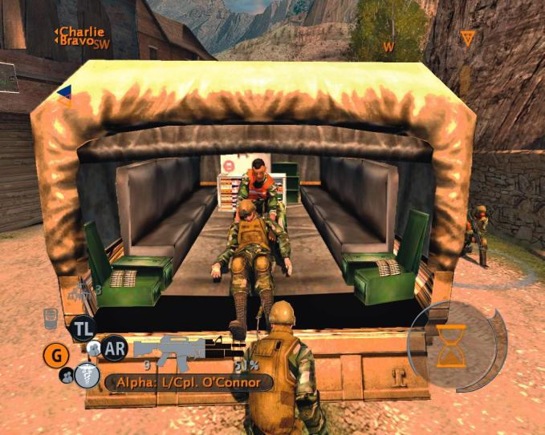
Notes:
But when we went into usability testing, we discovered a problem. Players cared so much about their soldiers that they would immediately reload the game as soon as one got hit. It destroyed all of our hard work on immersion. I needed to develop a system that directly rewarded the emotion players felt for the soldiers on their squad.

Slide 38
NEEDS
Relationship
Combat Loop
INTERACTIONS
Soldier
REWARDS
?
Notes:
I wanted to get at this.

Slide 39
NEEDS
Relationship
Combat Loop
INTERACTIONS
Soldier
REWARDS
Mission Advances
Notes:
Could I, in fact, tie it to some kind of mission advancement? By framing the problem this way, I arrived at a solution. When a soldier on your squad was shot, we generated a spontaneous mission objective to carry that soldier to the CASEVAC. They would also talk about needing to help him, and continue calling him by name. We made a system out of your emotional attachment.

Slide 40
Notes:
<video removed to reduce file size>
The result? Players stopped reloading and started rescuing their soldiers, and they stayed immersed in the world we created.

Slide 41
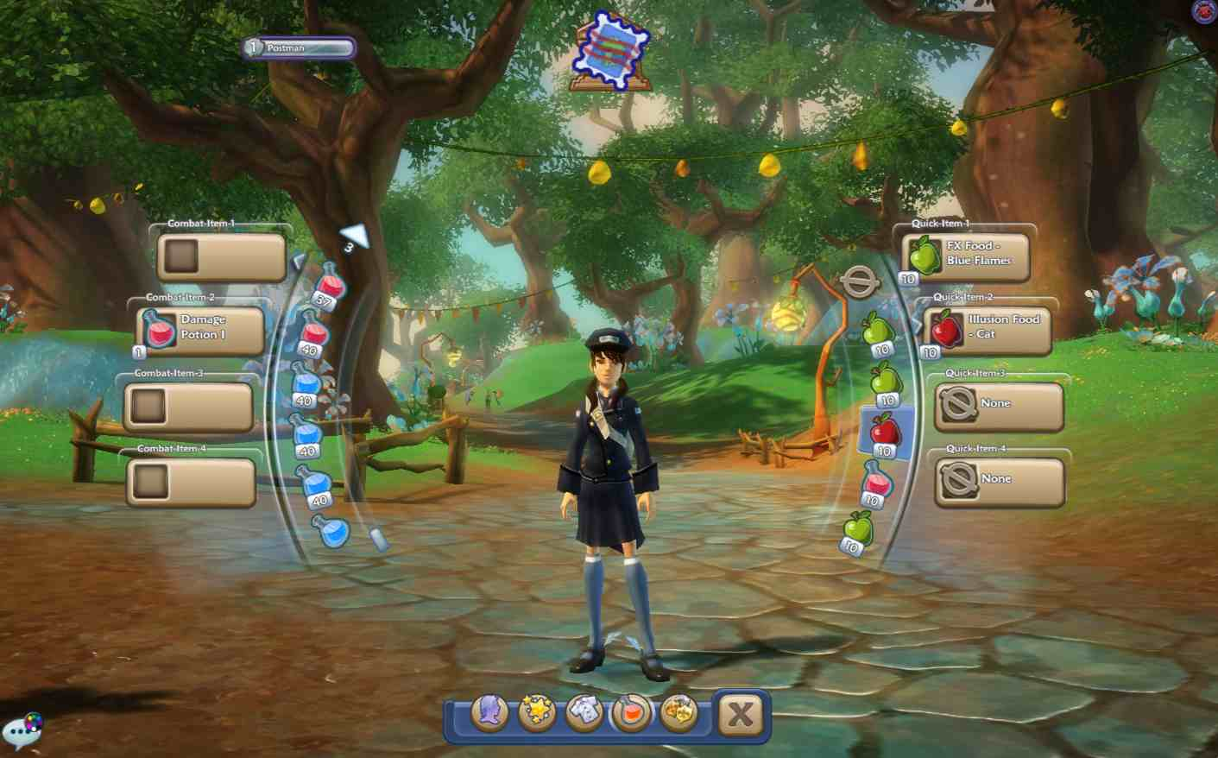
Notes:
Free Realms was an MMO for families & kids. You could do whatever you want, whenever you want, and the game would reward you. Players could switch jobs (or classes) at any time, and all classes had to be equally rewarding.

Slide 42
NEEDS
Wealth
Relationship
Skill
Ownership
Information
Progress
Social Status
Individuality
Escapism
INTERACTIONS
NPC
Enemy
Object
Mini-Game
Website
Another Player
REWARDS
Money
Level Up
Leaderboard
Friendship
Expertise
Appearance
Laughter
Experience
Notes:
These are the needs, interactions and rewards for Free Realms. Many are shared, but some are more unique to game style (like leveling up) or genre (like Laughter as an explicit reward).

Slide 43
NEEDS
Progress
Combat Loop
INTERACTIONS
Enemy
REWARDS
Level Up
Notes:
Some of the connections here are obvious, too. Here’s the standard MMO combat loop, which we included in Free Realms. Players need to feel progress, so when they attack an enemy, they get XP and are rewarded by leveling up.

Slide 44

NEEDS
Wealth
Relationship
Skill
Ownership
Information
Progress
Social Status
Individuality
Escapism
Notes:
But what about some of those other needs? You know—the ones we usually don’t build systems around?

Slide 45
NEEDS
Wealth
Relationship
Skill
Ownership
Information
Progress
Social Status
Individuality
Escapism
INTERACTIONS
NPC
Enemy
Object
Mini-Game
Website
Another Player
REWARDS
Money
Level Up
Leaderboard
Friendship
Expertise
Appearance
Laughter
Experience
Notes:
Let’s make an unusual connection now—NPC, INFORMATION, LAUGHTER.

Slide 46
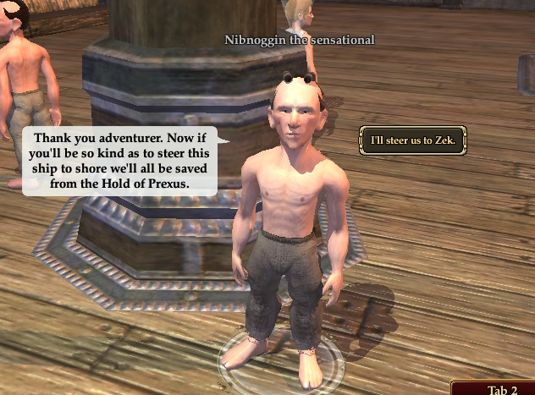
Notes:
It sounds odd, but think about NPC dialogue in your standard MMO. Even the speech bubbles are pretty dry.

Slide 47
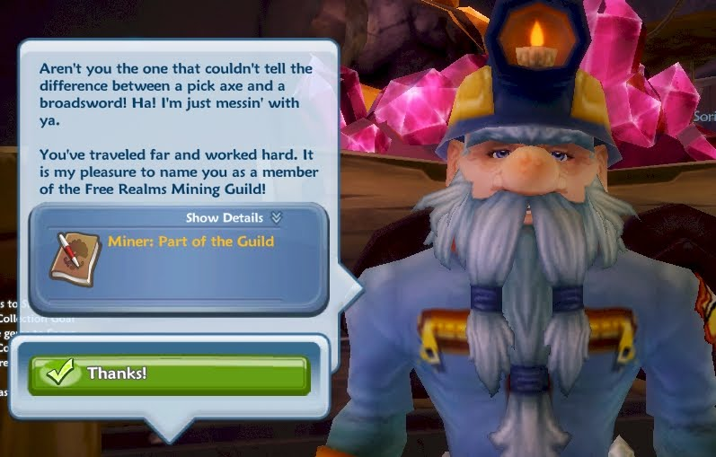
Notes:
Making that connection between interacting with an NPC and a reward of Laughter triggered several brainstorming sessions around NPC idle animations, dialogue UI, sound effects. We focus more closely on the character’s face, to make the UI interesting and bouncy, and to keep the writing shorter.

Slide 48
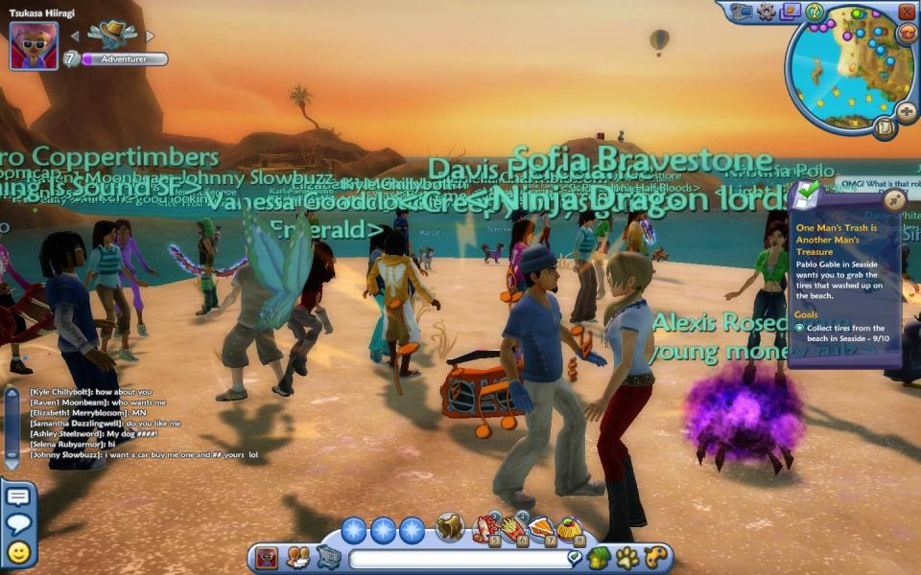
Notes:
When we first launched Free Realms and watched the metrics, we saw a bunch of players weren’t leveling up. They weren’t leaving the starting area because they were socializing—that was their #1 priority. We not only had no meaningful way to capture that information in metrics—we had no explicit rewards for it.

Slide 49
NEEDS
Social Status
INTERACTIONS
Another Player
REWARDS
Level Up
Notes:
It was, effectively, an interaction dead end in our experience loop.

Slide 50
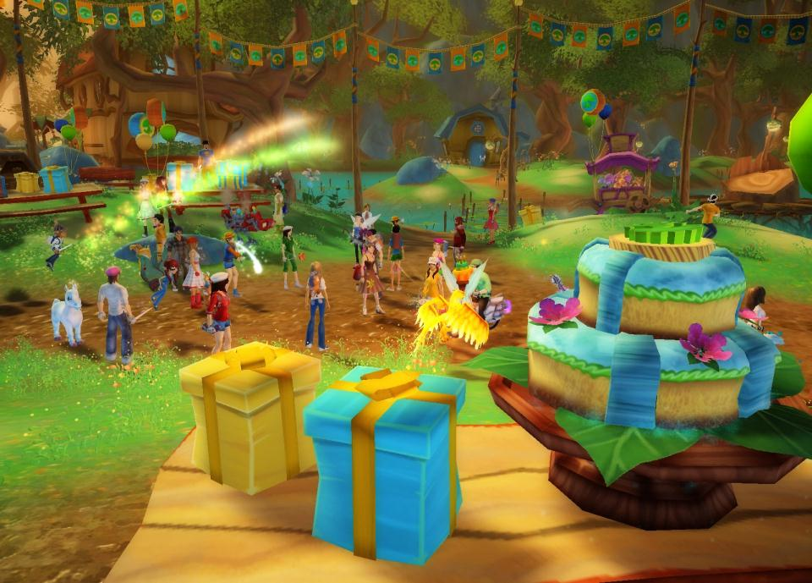
Notes:
Socializing is a fundamental human need. We all recognize that. Yet how is that explicitly rewarded in current multiplayer games? Why don’t we have systems for parties?

Slide 51
NEEDS
Social Status
Social Loop
INTERACTIONS
Another Player
REWARDS
Appearance
Notes:
So we started to think about it differently. I never got to tackle leveling up by socializing directly, but we formalized its support in our systems. We made connections like this.

Slide 52
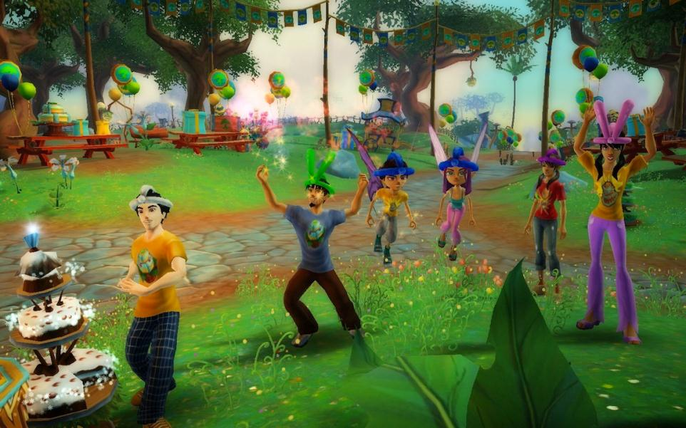
Notes:
We offered items. We shored up our chat system. We started supporting it as a core activity with rewards.

Slide 53

Notes:
These are just a few examples of how this kind of mapping between needs, rewards and interactions can help create unexpected connections. They’re great for framing brainstorming sessions too, to help focus on the specific player need you’re trying to address.

Slide 54
NEEDS
Wealth
Relationship
Skill
Ownership
Information
Progress
Social Status
Individuality
Escapism
INTERACTIONS
NPC
Enemy
Object
Mini-Game
Website
Another Player
REWARDS
Money
Level Up
Leaderboard
Friendship
Expertise
Appearance
Laughter
EMOTION
Notes:
More important, they bring player emotions and emotional needs into the loop as a core part of our thought process.

Slide 55
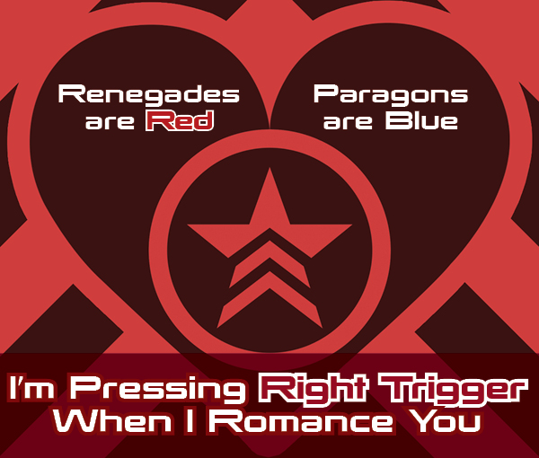
Notes:
Because ultimately that’s why we make games, right? To create something with lasting emotional meaning for players, and for us.
[ Richard Concludes]
People often talk to me about the intersection of game design narrative, and trying to evoke emotions in players –
and Laralyn talks reminds me how powerful rules can be and getting to those emotions – making players live and experience, not just through the non-interactive portion of your narrative. And the most strong emotional experiences players will have is during games, so it only makes sense that systems will be the way to go.

Slide 56
CHRIS
AVELLONE
Creative Director
Obsidian Entertainment
@ChrisAvellone
Notes:
Our next speaker has worked on so many classic games I could take up the rest of the session listing out his ridiculous resume.
I’ll just say two things. If you’ve played a single player computer RPG in the last 20 years there’s a good chance Chris worked on an entry in that franchise – particularly if it’s post-apocalyptic.
Or you may just know him as the lead designer and writer on one of the most beloved narrative games of all time – Planescape Torment.
I give you… Chris Avellone!

Slide 57
Look for the Silver Lining
Chris Avellone (@chrisavellone)
Creative Director, Obsidian Entertainment
Notes:
[Chris takes over]
Quick intro, welcome.

Slide 58
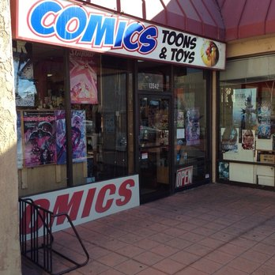
Notes:
Richard approached me about using design tricks, I went through a few. This particular design trick, starts simply with Comic Book Day.

Slide 59
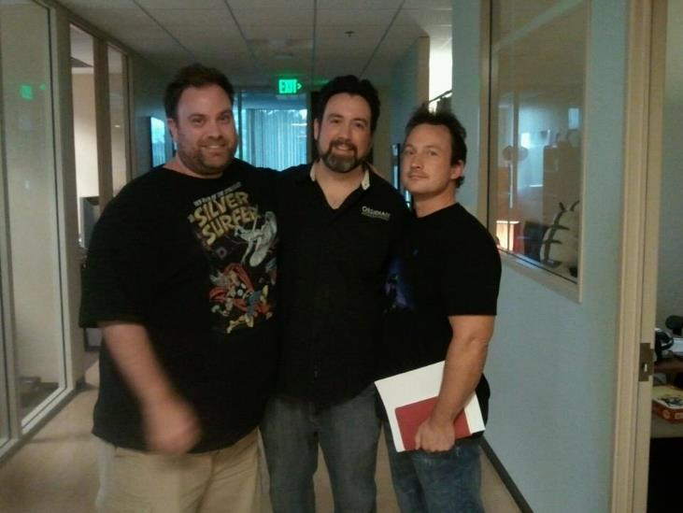
Notes:
I go to Comic Book Day every Wednesday with my friends, Brian Menze (vault boy), Anthony Davis… [Sequence of 3 images on single sentence.]

Slide 60

Notes:
...responsible for the Vault Boy, and Anthony Davis...

Slide 61
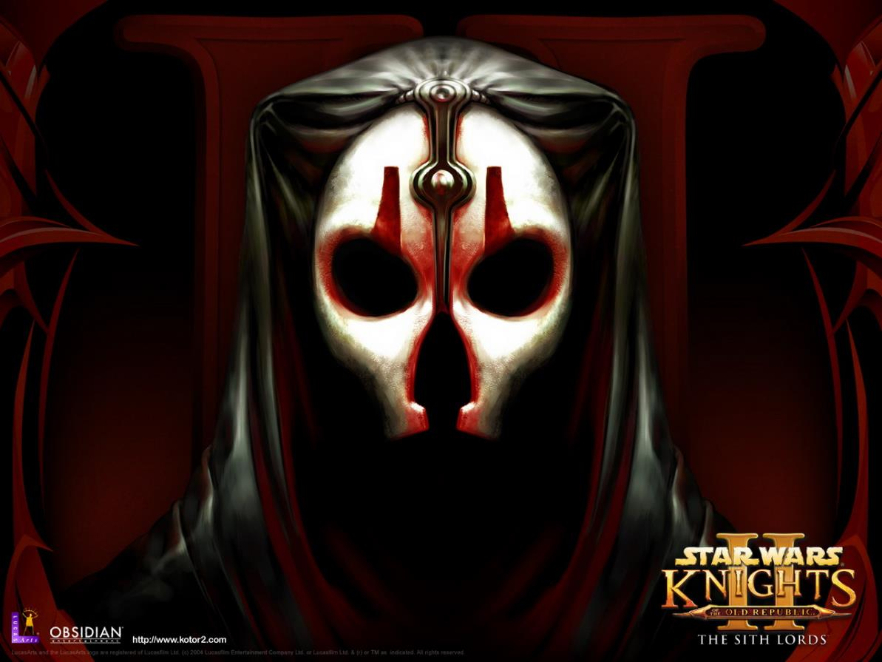

Notes:
...who worked with Menze and I on KOTOR2.

Slide 62

Notes:
…on these comic runs, we discuss movies and why they are awful or why they are good, and usually, I am very wrong. The central idea of what constitutes “bad” entertainment (TV, movies)...

Slide 63
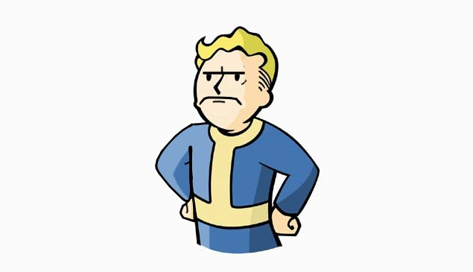
Notes:
And then I get upset because I don't like to be wrong.
But also the “stigma” of a bad film and the lost possibilities it may contain.

Slide 64
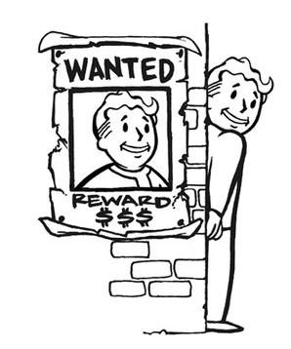
Notes:
One takeaway from it, it's easy to hate something. I'm guilty of it.

Slide 65
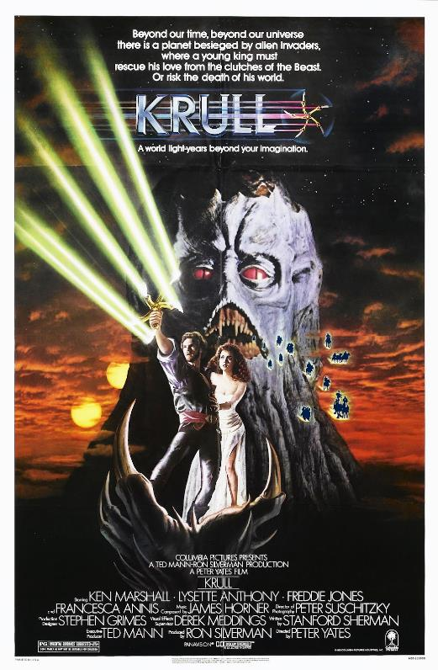
Notes:
And when it comes to films, we all have our particular weaknesses.

Slide 66
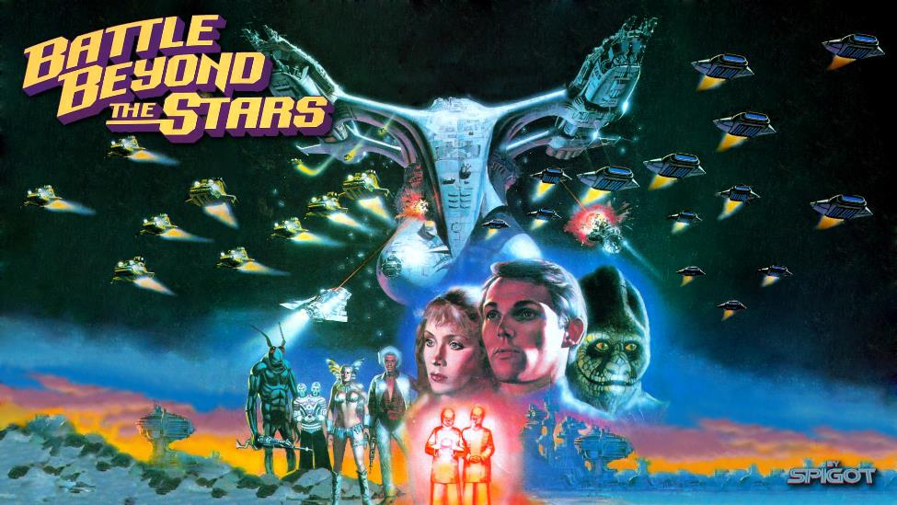
Notes:
...perhaps more than one.

Slide 67

Notes:
And this movie ended up being the example that set this topic off. In formulating its defense and the defense of the “bad” movies below, it occurred to me that what I liked about these books, comics, shows, movies...

Slide 68
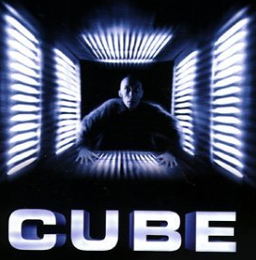
Notes:
...whether Cube...

Slide 69
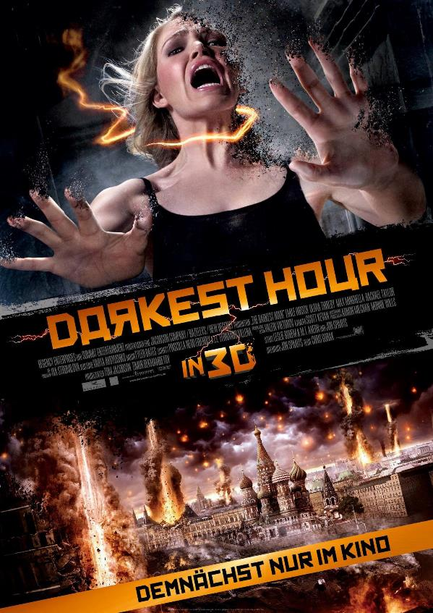
Notes:
...the Darkest Hour...

Slide 70

Notes:
...Twilight (yes, Twilight)...

Slide 71

Notes:
...was that from a design perspective, it was the "silver lining" in these experiences and using gems hidden in these works to strengthen game design.

Slide 72
Notes:
1st, Cube. Cube is easy to hate. For me, it's a designer's wet dream.

Slide 73
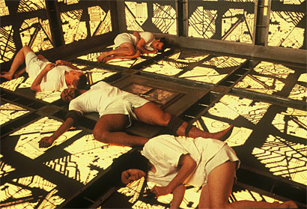
Notes:
A bunch of prisoners wake up, trapped in a series of similar shifting CUBE-shaped rooms, each with different deadly traps and challenges, and they try to find a way to escape. It's low budget, not the best movie in the world, but it taught me a lot. For example:

Slide 74
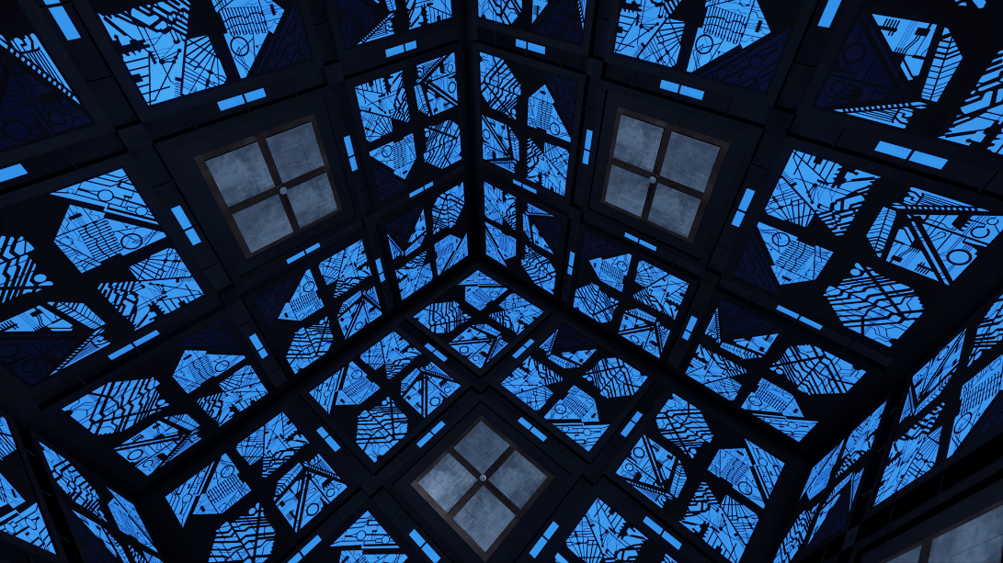
Notes:
The idea of easily replicatate-able rooms with various traps and color palette shifts, given the right narrative context, can make your environment artists' lives incredibly easy. CUBE is all about easily-tiled environments that work with the narrative.

Slide 75
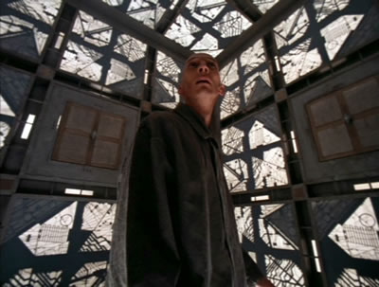
Notes:
Every prisoner has a personality quirk that helps to solve the prison's challenges. When they work together, co-op, an adventuring party is capable of some amazing gains. They may not have given the best performances or have the best lines to say, but the idea is still strong.

Slide 76
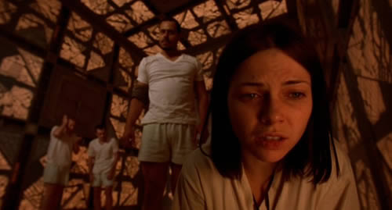
Notes:
Lastly, CUBE's set-up keeps the NPC cast down and still creates a compelling experience. You don't need a huge cast for intensity, sometimes 2 to 5 can do you just fine.

Slide 77
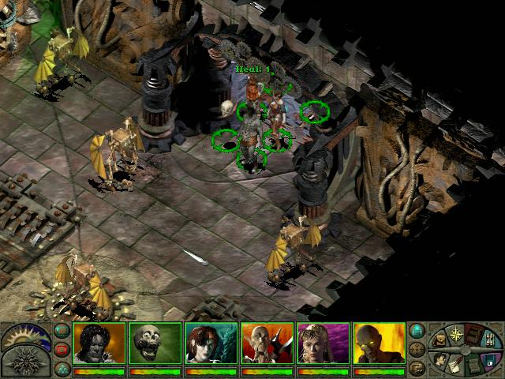
Notes:
I used both of these design principles in previous games. Once, in Planescape, to create the Modron cube...

Slide 78
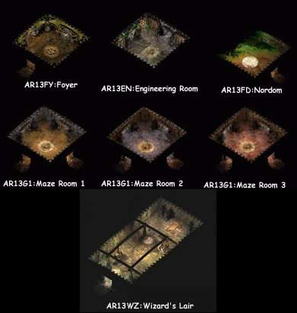
Notes:
...where we constructed complex dungeons using cube-pieces of different hues and play around with some tropes...

Slide 79
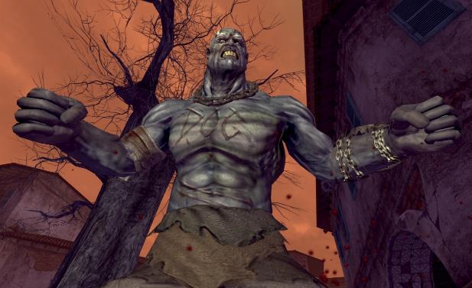
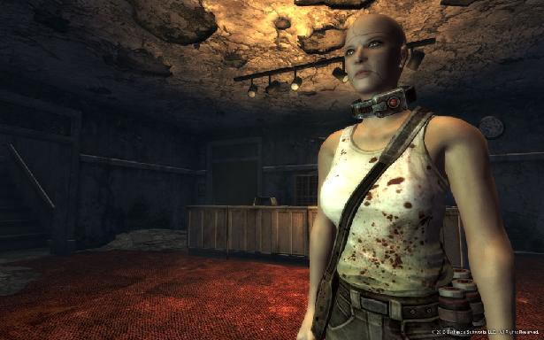


Notes:
...and the second design principle, using a limited cast, we used in Fallout New Vegas, with Dead Money, where your companions formed the supporting cast, each companion with a specific agenda, a threat, and also a special ability, once you were aware of it, that would allow everyone to succeed.

Slide 80

Notes:
Now: comics. Once upon time, there was a comic called the Elementals. Which at first glance, I thought was weird. Worse...

Slide 81

Notes:
The principle for the origin of the Elementals was each took an element as their base power, which I thought was boring.

Slide 82


Notes:
...but the fact they had all gotten it by dying and perishing in that element meant their bodies could recover from catastrophic damage...

Slide 83

Notes:
...allowing for a lot of fun combats of them being torn apart and being able to regenerate quickly, even losing a limb.

Slide 84

http://files.khinsider.com/vgwallpaper/1024x768/2467-planescape-004-yzkyn.jpg
http://files.khinsider.com/vgwallpaper/1024x768/2467-planescape-004-yzkyn.jpg
Notes:
This inspired me with the protagonist design for Planescape where he could find limbs, eyes, and more body parts that his older previous bodies had left behind - and use these body parts again if he so wished.

Slide 85

Notes:
But what really got me was this panel... of this small girl, who in the next panel, beats up this poor unaware Butler, kicking him in the stomach and taking him out with a karate chop.

Slide 86


Notes:
The context for this, was that it was not a little girl at all, but a projecting telepath called Sanction who could reinvent his personality with each assignment, and sometimes, multiple times. He would truly believe he was the person in question... and in everyone else's minds, they would feel the same. This is a great idea, but as we saw in the sequence with the girl and the butler, they ended up with a very goofy tone.

Slide 87

Notes:
...this made me consider the idea of someone reinventing their personality with each death, resulting in 1000s of different personalities if the person couldn't die, was immortal, like the Nameless One in Planescape. Which as you may know, had a very different tone, setting, and characters than Elementals. With the idea moved here, it worked just as well and even reinforced the theme.

Slide 88

Notes:
Transmetropolitan was a comic that didn’t appeal to me before I ever read it. More shame me.

Slide 89

Notes:
In it, Spider Jerusalem, the protagonist journalist, fights for the truth.

Slide 90

Notes:
A journalist. The execution of that alone by Warren Ellis is proof of narrative strength, but it was the little touches...

Slide 91

Notes:
...like his home of appliances. For example, in the comic, he has a drug-addicted Maker (makers are appliances that can make anything) that's addicted to drugs...

Slide 92




Notes:
...which may sound funny and not terribly useful... but what if the appliance was useful? What if you filled an entire player base with these things and they DID give you bonuses? Fallout: New Vegas: Old World Blues' appliance design, each with their own personality quirks, owe their spin to Transmetropolitan.

Slide 93

Notes:
So again, the Silver Linings topic came up because of this this movie. Guys from work saw it, they were angry and laughing at the same time. When it first debuted, they were the only 4 people in the theater, and they were going on about how terrible it was. So I was looking forward to seeing how crappy it was.
And it wasn't. It wasn't great. But, from a level design perspective, from a system perspective, even some narrative design? It was pretty rich and helpful. How you ask? Well, not to give any spoilers, but here's what I took away from it:

Slide 94

Notes:
Score of said bad movie...

Slide 95

<Richard: Pending Movie Arrival>
Notes:
The way they use Adam's immediate home/immediate environment to emphasize his condition (his tenement building also looks stitched together, just like him). [2 images]

Slide 96

<Richard: Pending Movie Arrival>
Notes:
[Tandem with previous slide topic.]

Slide 97

<Richard: Pending Movie Arrival>
Notes:
The weapon design elements (segmented battle-axe) of the principal gargoyle enforcer (Jai Courtney) and how that was incorporated into both a gating mechanism for the vault in the movie - and into the end boss fight. (Sequence of 7 Images)

Slide 98


Slide 99


Slide 100


Slide 101


Slide 102


Slide 103


Slide 104

<Richard: Pending Movie Arrival>

Slide 105

Notes:
Using the symbol the demons are vulnerable to in the environment to impale and destroy them (the spire atop the gargoyle cathedral becomes a target point for throwing the enemies onto them to destroy them).
While there's plenty of other eye-rolling elements in this movie that could make a viewer sad, there's other gems in there that make it worth not throwing the baby out with the bathwater.
(4 Images: Environment, Knockback Death, Weapon, all to kill enemies normally unkillable).

Slide 106


Slide 107


Slide 108

<Richard: Pending Movie Arrival>

Slide 109
Notes:
Darkest Hour is another (not) good film for similar examples. Darkest Hour intro for interface and level design and system interaction (general branches to set up specific examples).

Slide 110

Notes:
Score of said bad movie... but there's good stuff here.

Slide 111

Notes:
Moscow's (and the world's) hit with a power-loss by electricity-based aliens, and the only way to sense and detect them in the environment is they "turn things on" when they pass through them. It was panned, but there's good stuff in there. (2 images)

Slide 112

<Richard: Pending Movie Arrival>
Notes:
First - you can find allies/adventuring party in the movie using a social networking/party app... and that also explains why people can speak the same language, okay. [Sequence of 3 social app images.]

Slide 113

<Richard: Pending Movie Arrival>
Notes:
[Social App]

Slide 114

<Richard: Pending Movie Arrival>
Notes:
[Social App]

Slide 115

<Richard: Pending Movie Arrival>
Notes:
[Social App]

Slide 116

<Richard: Pending Movie Arrival>
Notes:
So the aliens themselves emit electrical current. In odd ways.

Slide 117

<Richard: Pending Movie Arrival>
Notes:
They could light up the environment...

Slide 118

<Richard: Pending Movie Arrival>

Slide 119

<Richard: Pending Movie Arrival>

Slide 120

<Richard: Pending Movie Arrival>
Notes:
...which makes you pay attention to the surroundings, and interestingly enough, also makes urban nighttime and darkness the safest times (at least for light triggers).

Slide 121

<Richard: Pending Movie Arrival>
Notes:
This allowed for the idea that you can scatter cell phones and light bulbs in the environment as early warning systems, or take cover behind cars and shops that light up when monsters get close to detect them is great. (Sequence of images.)

Slide 122

<Richard: Pending Movie Arrival>

Slide 123

<Richard: Pending Movie Arrival>

Slide 124

<Richard: Pending Movie Arrival>

Slide 125

<Richard: Pending Movie Arrival>
Notes:
ALSO if you lure them into certain sections of the city, such as trains, cars, buses, you can use those, powered up, to travel and fight your way through the environment - from a design perspective, that's pretty slick.
Sure, there’s plenty of reasons this movie has a “12% Fresh” rating on Rotten Tomatoes, but if you look past all the characters, there’s some interesting ideas to be found.

Slide 126

Notes:
(Special Feature in Itself) Micro Tip 1: I always watch the special features, because I've rarely regretted it, even for the inadvertent things they show they don't mean to.

Slide 127

Notes:
{Special Feature) Micro Design Tip 2: Screen Capture is the best way to collect reference art when YouTube and Google isn't enough.

Slide 128
Notes:
So in conclusion while rehearsing this presentation for the customary haters, I was challenged with Twilight, one of the most hated films in our studio. Surely, you must have gotten some things from Twilight, I was asked? I did. And here, the silver linings principle still applies.

Slide 129

Notes:
Although if I had time should have chosen...

Slide 130

Notes:
Provided they fixed the premise...

Slide 131

Notes:
So I not only watched, but first, read "Twilight..." (montage)

Slide 132


Slide 133


Slide 134


Slide 135

Notes:
Note that when I read... even supposedly bad fiction... I like to make notes, and it makes my brain tick.

Slide 136

Notes:
Micro Design Tip 3: Instead of notes, I now use my Kindle to transcribe/highlight notes...

Slide 137

Notes:
Micro Design Tip 4: then extract the notes through a batch file, for...

Slide 138

Notes:
Micro Design Tip 5: ...isolating fragments of text, spells, items, ideas into categories.

Slide 139

Notes:
...which allows more time to get inspired and enjoy art. If you have ideas for transcribing even better, tweet to me. Please.

Slide 140

Notes:
But back to Twilight.

Slide 141

Notes:
Score of said bad movie...

Slide 142

Notes:
Narrative design. Though the idea of “two characters so deeply in love that they ignore the world around them” has been done plenty of times before, Twilight takes it to a fine art. The focus the two main characters have on each other,

Slide 143

Notes:
...and I don't mean when bordering into the stalkery zone or non-subtle owl wing imagery...

Slide 144

Notes:
....is the tiny details, like ignoring the waitress in the restaurant during their first date and how small touches like that factor into their romance.

Slide 145

Notes:
Parental positives (at least from the Dad aspect).

Slide 146

Notes:
...combined with cool bits of each vampire having their own power to make them stand apart rather than them all simply being the same (it’s been done before, but not so much with teenage vampires)...

Slide 147

The game mechanic concept of a power-less world and how one would track and exploit energy creatures to do the following:
- Set up alarms using cell phones and light bulbs that come to life to showcase the enemy's presence.
- The idea of "luring" charged enemies into level design zones where their presence causes machinery to come to life (trains, cranes) and then using that to help defeat them is game worthy.
Notes:
..and lastly, such a small thing, but I thought it was a clever, subtle way of dealing with immortality, and that's the display of graduation caps they have in the stairway hall of their home. If they hadn't explained it, I thought it would have been better (a good idea, clumsily executed), but that was a great environment prop you could use to visually tell a whole story of how they've been living their lives.

Slide 148

Notes:
In conclusion, my design trick boils down to perspective. Anything...

Slide 149

Notes:
...no matter how campy and terrible, can be made good if examined in terms of its positives. Take something that takes itself a little too seriously….

Slide 150


Notes:
…and put it somewhere else, perhaps a game with over-the-top satire, and you’ve just turned a bad idea into a good one. It’s given new life in a designer's hands, and become engaging for the player.

Slide 151

Notes:
So look for those silver linings even in the most seemingly flawed works, ignore the haters, and see the positives. Turn something they hate into something they'll love.

Slide 152
Look for the Silver Lining
Chris Avellone (@chrisavellone)
Creative Director, Obsidian Entertainment
Notes:
And thank you!
[Richard concludes]
And what I like is stealing from unpopular sources is that they are not DONE TO DEATH.
So instead of stealing from Alien, or Star Wars, or Blackhawk Down, perhaps consider something bad! If you steal something from I Frankenstein, there’s a good chance it won’t be worn out.

Slide 153
DAN
TEASDALE
Co-founder
No Goblin
@deliciousbees
Notes:
Our next speaker you may know from his work on some big games like Destroy all Humans or as a Lead Designer on the Rock Band franchise.
Or you may even remember his surreal puppeteering shooter game for Kinect, The Gunstringer.
But what you SHOULD know him for is his absurdist indie game Roundabout that he triumphantly shipped last year at his new company, No Goblin.
What’s that? Why should you take game design advice from a man who loves full-motion video so very much?
Well you’ll see in just a minute… Dan Teasdale!

Slide 154


>>WATCH THIS<< to find out HOW
MY DESIGN GOT BETTER IN 10 MINS
THANKS TO THIS ONE WEIRD BRAIN TRICK
BEFORE
AFTER
Notes:
[Sunday night notes]
Hey everyone, thanks for coming out!
So, this might come as a surprise given that I’m talking on a design theory panel, but I’m actually not a big “intense design theory” kind of guy. Instead of spending my time writing books or blog posts to further our craft, I’ve instead spent it creating things like

Slide 155



Notes:
the world’s number one all male game development pinup calendar.
Having said that, there was one design concept that’s intrigued me for a while. It’s a concept about a magic number that I’m pretty sure every designer in this room has used, and it’s one that until a few years ago, I had no idea why.

Slide 156

Notes:
It’s about this guy here – the number three. Three is kind of a big deal when it comes to design magic numbers.

Slide 157






Notes:
If you’ve played games for a while, you’ve probably noticed that 3’s (and to a lesser degree, 5’s) are popular numbers The number of starting lives, the number of Angry Birds stars, even things like the number of Mario Kart turns to reach full boost – they’re all balanced to the number three.

Slide 158

Notes:
Obviously, three is a magic number, but why? Just saying that it’s a “design habit” doesn’t really get to the root of why it became a habit - there’s clearly SOMETHING to the number beyond random coincidence.
I started diving into why this was. It turns out…

Slide 159

*thanks nataliedee.com!
Notes:
it stems from how the human brain deals with information!
My one weird trick is actually based around two different theories about the human brain.

Slide 160


Working memory is between 5 and 9 “objects”
Notes:
You may have heard about “The Magic Number 7 (plus or minus 2)”. It was discovered by this not at all creepy guy called George Miller.
The whole idea is that your short term memory can only remember 5 to 9 “objects” at once. This seems like a pretty useful piece of knowledge at a first glance, and it gives us a pretty strong hint as to why five is a magic number in video games, but there’s a second part of this which is equally important.

Slide 161

By combining data from several experiments, a basic human memory unit can be identified and measured
It’s 3
Notes:
The second part is based on the research by this dude, Herbert A. Simon. While George Miller wanted to find the largest amount that short term memory could hold, Herb here realized that the total space is actually divided up into what he calls chunks.
While those chunks can be different sizes, the “best” size is actually 3 units of things.

Slide 162
“5 to 9 items”
&
“human memory unit is 3 items”
=
3 chunks of 3 “items” capacity
Notes:
We can use these two theories to get a nice rough ruleset of the humans brain’s constraints
5 to 9 items
…of which the brain’s ideal container size, or chunk size, is three
…means at most, we’re dealing with three chunks that can carry three items each – so, nine items total. Let’s run through a quick example of how this works…

Slide 163


8675309
867 53 09
Notes:
Let’s take my favorite phone number – the Jenny number.
When your brain sees this number, it splits it into chunks of two to three units. You’re most likely going to separate it into a 3 digit chunk and two 2 digit chunks – that’s because the separator is providing a hint to your brain on how to chunk this information.
It’s a really good example of why separators and delimiters are important. Having a comma in a four digit number isn’t just pretty, it lets your brain chunk the important single digit on one side, while spending less time on the remaining three digits on the other side.
This isn’t the only way to chunk this number, though…

Slide 164

8675309
86 75 309
867 53 09
Notes:
If you heard the song before you saw it on paper, your brain probably chunked it to the beat – two chunks for the first bar, one chunk for the remaining digits in the second bar. That’s completely valid – your perception of the number doesn’t have to be visual only, it can be audible too!
In both these cases, your brain is trying to organize this data into three neat chunks. Let’s try and break that!

Slide 165

86 75 30 9
9035768013
(310) 867-5309
Notes:
If we split the Jenny number into four chunks, your brain has a harder time remembering it. I mean, you can probably remember it if you actively try to, but it’s uncomfortable, because you’re dealing with a set of chunks that’s bigger than three.
It’s also why you’d probably have a harder time remembering this ten digit number. Your brain is trying to fit this into three groups, but it can’t do it easily without a number falling off.
“But wait!”, you might say, “That’s j*ust Jenny’s number backwards! With an LA area code! I can totally remember that now!”

Slide 166






(310) 867-5309 69420
30 SECONDS TO INTERMEDIATE TERM
2-3 HOURS TO LONG TERM
Notes:
…and you’d be right. I bet you can even remember this fifteen digit number if you know US area codes, ’80s songs, and you’ve played Call of Duty.
That’s because in this case, we’re not dealing with short term memory alone. After 30 seconds, if all goes well, your brain will try and move that information into intermediate memory. 2-3 hours later, if all goes well, it goes into long term memory. In long term memory, those chunks of objects become unique objects themselves. Your brain is essentially compressing this data for you!
Anyway, you’re probably super bored of this five minute intro to brain theory. The real question is…

Slide 167

Notes:
…now that I know this one weird trick about the number three, how do I use this information to make games better?
Well, since we’re dealing with perception of information, UI design is a no brainer to apply it to.

Slide 168

Notes:
Take Roundabout’s main menu. Instead of your standard vertical list of five menu options, we split it by rows into two chunks – one row for gameplay stuff that matters, one row for housekeeping. That way, we make sure that we’re driving players towards gameplay with zero thought on their end, while at the same time not burying everything else.
As a bonus, it means all but one of our main menu buttons benefit from Fitt’s Law, since every button is on an edge instead of in a one dimensional list.

Slide 169

Notes:
You can also use chunking for evil. Take Roundabout’s Challenges menu!
The ideal chunk group for this would be 3x3. However, that was easily chunkable, and it gave the impression of a small challenge list. Instead, we did two rows of four and an extra item, which made slightly harder for players to internalize all of the challenges at once – which makes it feel bigger!
Yep, it’s an asshole thing to do, but

Slide 170


Notes:
I am gaming’s biggest asshole of 2013. It’s the least I could do to hold up my reputation.

Slide 171


Notes:
The best case for perceptual optimization, and actually the worst case too, is The Gunstringer. I was the lead designer on The Gunstringer, which was an on rails Kinect shooter with a skeleton marionette puppet. It was really the start of the “skeleton phase” of my career I find myself in at the moment.
Because everything was on rails, it meant we had incredibly tight control over everything the player saw, making it perfect for this kind of perception optimization. It’s also is a pretty good example about what happens if you apply the rule of threes the wrong way. Here’s why:

Slide 172
spawn
aim
fire
flee
encounter
encounter
encounter
Notes:
The Gunstringer’s gun was a six shooter. In the groove, you’d target six things, then shoot six things. It’s a really nice example of using the rule of threes to help target acquisition, and the six shooter helped reinforce that 2x3 pattern.
But, of course, I had to go and ruin a good thing. An enemy’s AI would spend a cycle spawning, a cycle aiming, a cycle firing, and a cycle fleeing. Because we were on a rail, I made all these states take the same amount of time. as the player aim and fire cycle.
I didn’t stop there, though – since we used encounter design, we naturally extended that same timing pattern to our encounter pacing. Because we had regenerating health, it meant that we also had to apply this timing to our health meter. And, because we were on a rail, we also had to time our multiplier system to those encounters too.
When I first balanced the game like this, I thought it was genius. It very quickly dawned on me that this was actually…

Slide 173








Notes:
…more like the crazy ramblings of a conspiracy theorist. I went too far down the rabbit hole, and it made The Gunstringer’s enemy balance a knife edge system. I forgot…

Slide 174



My health is (bullet damage * clip size) / 3
Notes:
…that the rule of threes is about how you perceive things. Grouping visible objects in twos and threes is a great way to optimize how your brain acquires objects, but adjusting the behavior of unperceivable things isn’t always going to pay off, because, well, they’re unperceivable.

Slide 175

@deliciousbees
(also @menofgamedev)
Notes:
I guess that works as a good summary – the rule of threes is a great way to optimize your game to the human brain. But, you have to treat it like any other optimization – don’t apply it where you don’t a benefit.
Thanks!

Slide 176
KIM
MCAULIFFE
Creative Director
Secret Master Plan
@EnameledKoi
Notes:
[Richard Takes Over]
Our next speaker has spent the last few years as a senior designer at Microsoft working on the innovative Project Spark.
She has also worked on big and small versions of everything from SOCOM to The Sims and is here to tell you whether size matters.
I give you… Kim McAuliffe!

Slide 177

Fight for the Little Things
Kim McAuliffe - @EnameledKoi
Secret Master Plan
Notes:
Often as game developers we’re focused on the big picture, but today I’m going to talk about why it can be important to fight for the little things.

Slide 178


Thank you!
Notes:
One of my favorite little things in Portal 2 is a moment where you can choose to rescue a “different” turret from incineration. It’s an extremely well-crafted encounter, from the set up that introduced you to the turret stuck in a vent a few levels earlier, to the intriguing hints about the plot you get as a reward for the rescue.

Slide 179

OMG They killed Ellis!
Notes:
Another “little thing” that contributed to my enjoyment of a game was the context-sensitive dialogue in L4D2. The way the characters responded when one of them was hurt or killed made them feel human and deepened my desire to keep them alive. The design trick I want to talk about today is “fight for the little things”, because they can have a surprisingly big impact on players, and even the development team. And the things that impact your players can then in turn have a positive impact on the success of your game.

Slide 180




Notes:
In his book “Contagious“, Wharton marketing professor Jonah Berger shares his research exploring why some products and ideas catch on and others don’t. One of the principles he focuses on is “Social Currency”. People gain social currency by talking about remarkable things, gaining positive impressions from family, friends, and colleagues. In other words, we talk about things that are cool so that we look cool to others.
http://classroom.synonym.com/DM-Resize/photos.demandstudios.com/getty/article/78/8/78184041.jpg?w=600&h=600&keep_ratio=1

Slide 181


Give people something they’ll want to talk about.
Notes:
Remarkable things are talked about more often, and smart brands take advantage of this. One example in the book is Snapple, whose quirky and weird “real facts” people couldn’t help talking about until they were ingrained into popular culture. The point to take away here is that people like to share the unusual or special things they find in your game because it makes them seem unusual or special, and so those little things you fight for now might be what gets talked about later.

Slide 182


Welcome to Strangetown!
Notes:
My first example of a “little thing” I fought for happened on my first game, Sims 2 for Nintendo DS. The DS version of Sims 2 combined an open-world sandbox with adventure game questing. The main story was that your Sim gets stranded in a place called Strangetown and ends up taking over the local hotel, befriending the citizens and defending the town from various attacks.

Slide 183







+
=
Cow Tipping
=
Notes:
The little thing in question had to do with the town’s cows. You could interact with them to get milk, but that was it, other than some mooing. I strongly felt that there was an opportunity here for more life in the world and reward for experimentation. If we added cow-tipping, and the player interacted with the cow afterward, the result would be a milkshake instead of regular milk. Additionally, elsewhere in the game we had chocolate the player could give the cow to turn it into a chocolate cow which would then yield chocolate beverages.

Slide 184




Pretty much over it
Notes:
However, my producer was concerned that cow-tipping might be animal cruelty, jeopardizing our ESRB rating, and a chocolate cow was a new asset. At this point I was unfamiliar with the concept of “feature creep” and got a programmer who liked the idea to implement it as a joke; to keep the mechanic from seeming cruel he animated the cow to bounce back up. But once EA saw the feature in the build they loved it and we had to add real animations and assets to the schedule. The producer was not thrilled with us but got over it.

Slide 185

Notes:
Having this feature added to the game at the time just seemed like a small victory to me as it was a creative contribution on a game where I was a mission designer but not the one driving the overall creative vision. The impact of this little feature turned out to be much larger than I would have ever guessed. It was called out in walkthroughs as “clever and amusing”.

Slide 186

A small victory that turned out to have a big impact.
Notes:
I was contacted by fans of the game, who surprised me by knowing all about it. Because nothing in the game hinted at this functionality I wasn’t sure many people would find it.

Slide 187




Notes:
What we couldn’t have foreseen was that this little thing would be so popular and successful that EA would bring it to the PC version. A while back Sims 3 announced that it was going to add a content pack including all of the cow-related features from Sims 2 DS plus a bunch more, turning cow tipping into a minigame, letting you play tic-tac-hoove with cows to increase Logic and adding new options like giving soybeans to get soy milk.

Slide 188


Notes:
The forum thread for the pack is 22 pages of people excited about milkshakes and cow-tipping. One post called out the fun her daughter had with the cows on the DS version of Sims 2. The excitement around the launch of the pack spawned its own hashtag. Players posted pictures of their sims playing with the set to the forum and to Facebook. Going back to Contagious and social currency, here are people talking about a feature they think is cool and interesting, and in doing so contributing to the success of the game.
Post: http://forum.thesims3.com/jforum/posts/list/30/711362.page#11298659

Slide 189



Notes:
Another example of “fighting for the little things” arose when I was working on Kinect Nat Geo TV. This project used Kinect to add gameplay to a family television-watching experience. There were multiple ways to interact with the show, including augmented reality sessions where the show grew into the family’s living room and players became the animal stars of the show to play games based on the main narrative from that episode.

Slide 190



Me
Not Me :(
Baby Mtn Lion
Notes:
One of the most significant battles over a “little thing” was fought for the Side Tracks feature. Side Tracks were special stories just for the game that were co-written with Grizzly Creek Films and then filmed on location. These were designed to be conversations directly between Casey and the players, where the players got to be in control of how the adventure unfolded.

Slide 191

Notes:
During the adventure, Casey stops and asks the player a question with two answers, and a unique segment of film plays based on the choice made. The problem we were encountering was that Kinect could only detect two skeletons, but we wanted the whole family to play these experiences together. The first iteration of the feature required one player to be the family “spokesperson” and answer for everyone using a hover cursor. This lacked the “everyone gets to participate” feeling that we wanted to cultivate.

Slide 192

This way!
Notes:
The executive team challenged us to find another solution, and the development team put their heads together and found a way to combine blob tracking and skeletal tracking to detect how many people were in the room and switch skeletons every frame to count up to eight votes. In the final version, the entire family can vote together on what should happen next by raising either their right or left hand, so everyone can play at once.

Slide 193


“Dad, I’m sorry, but I don’t think I want to work for a newspaper or
review games when I grow up any more. I want to be a naturalist.”
Notes:
The speaker is Scarlett, daughter of columnist Controller Freak in her review of KNGTV. This quote is so great because it means she was definitely impacted by the Side Tracks, the only place in the game that Casey speaks directly to kids about learning how to be naturalists. Returning back to Contagious for a sec, this is a kid talking directly about the impact a little thing we fought for had on her, in a way that was shared with a lot of people.
http://business.financialpost.com/2012/09/18/controller-freak-jr-reviews-kinect-sesame-street-tv-and-kinect-nat-geo-wild/?__lsa=83dc-0b5a

Slide 194


Notes:
The last example I want to mention is from another nintendo DS title, but this time I want to talk about championing someone else’s cause, and how fighting for a little thing can help not just a title but a team. I came onto this project later in development and was tasked with designing the final level in the game. The level artist working with me expressed frustration that other levels in the game had what he felt to be too much sameness in layout, and not much change in elevation.

Slide 195


Notes:
The concept art for the setting of this level makes it clear at a glance though that there should be lots of room for variety in level design; it’s a settlement made of shipwrecks. I started whiteboxing some ideas and involving my level artist in the process from the start to get his thoughts.

Slide 196


Help someone else fight for a little thing and you both win.
Notes:
I proposed a design that included a ton of vertical progression. Also, Frogger, because why not. He was immediately re-engaged and excited to begin. We had to win some people over because it was so different from the rest of the game, but in the end because it was the final level we were able to sell it. Fighting for this little thing made the game better, challenged me to be a better designer, and boosted morale for a team member. I didn’t realize how much of an impact being listened to had on him until he told me years afterward.

Slide 197



Thank you!
kim@secretmasterplan.com
Notes:
In closing, fighting for the little things during the development of your game pays off in big ways. If you’re on a project where you’re not the creative lead, it’s a way to carve out your own creative stamp on the game. It may be a way to support a team member by fighting for a cause they believe in. Finally, if a feature means a lot to you, it might have a big impact on players as well. And the little things that impact your players will be the things they want to share with others, which is the best promotion you can ask for.
[Richard Concludes]
In our modern age of game development, we tend to polish everything to such a level that all the little things get cut.
Never has it been more important to lie to producers.

Slide 198
NELS
ANDERSON
Game Designer
Campo Santo
@nelsormensch
Notes:
And our last speaker proudly proclaims himself the best Wyoming born game designer living in Canada
You may know him as the lead designer of Mark of the Ninja and who is now working on the stunning Firewatch which he will be demoing later this week.
If you ask him really nicely I’m sure he’ll tell you how to get in see it while you’re at the show…
Nels Anderson!

Slide 199


Game Design Rule # {X}
“Don’t Try to Evaluate Your Own Game*”
Nels Anderson
nels.anderson@gmail.com
http://www.above49.ca
@nelsormensch
Notes:
199
199
199
199
199

Slide 200


Notes:
200
200
200
200
200
I used to work at this place, I was the lead designer of this game

Slide 201

Notes:
201
201
201
201
201
Then I left to help start this place

Slide 202

Notes:
202
202
202
202
202
and now we’re working on this game.

Slide 203
“Don’t Try to Evaluate Your Own Game*”
*I’ll be important later
Notes:
I'm here to tell you my secret rule of game design - Don't try to evaluate your own game*. See, here's the problem. When you're designing a game,

Slide 204

Notes:
204
204
204
204
204
all the knowledge of how it works is in your head. I mean, of course it is, it has to be. It had to exist there before it could actually be implemented in the engine.
But what this also means is that it's impossible for you to strip that knowledge

Slide 205

Notes:
205
205
205
205
205
back out of your head. Our perspectives are wholly

Slide 206

Notes:
206
206
206
206
206
tainted by that knowledge. And this is a problem because people who don't have that knowledge still need to be able to play your game. And they need to be able to do it without you explaining it to them.

Slide 207

Notes:
207
207
207
207
207
Often, some of the biggest failures in a game's design are not its systems or its mechanics

Slide 208

Notes:
208
208
208
208
208
but rather how those systems and mechanics are communicated to the player. And at the very least, it's often nearly impossible to determine if a problem a player has with the game is because of the design itself or simply because they didn't understand what was needed.

Slide 209

Notes:
209
209
209
209
209
So obviously,

Slide 210
PLAYTESTING!
Notes:
210
210
210
210
210
you need to do a ton of playtesting. There’s a ton of talk about in terms of the

Slide 211

PLAYTESTING!
Notes:
211
211
211
211
211
how/what/when/where/why of playtesting, but that’s way more to talk about than 10 minutes will allow, plus there are a whole bunch of folks for more eloquent than me who have talked about it.

Slide 212

Notes:
212
212
212
212
212
Hell, there’s an entire chapter of Richard’s game design book just about playtesting. But there is an important practice one can engage in during playtesting that’s not really about the actual process one uses while playtesting and more about the

Slide 213

Notes:
213
213
213
213
213
design mindset one should adopt when observing and reaction to playtests. One thing that I see people doing wrong in playtesting – and I even find myself doing this sometimes – is

Slide 214

Notes:
214
214
214
214
214
they end up listening to the

Slide 215

Notes:
215
215
215
215
215
solutions

Slide 216

Notes:
216
216
216
216
216
not the problems. Here's the thing about people who aren't game designers- they're not game designers! Remember all that

Slide 217
Notes:
217
217
217
217
217
horrible tainted knowledge you have in your mind, which is why you need to have other people playtesting your game in the first place? Well, this is when that knowledge is actually useful! During playtesting, people will often talk about problems they have in terms of solutions, rather than problems. They might say,

Slide 218

Notes:
218
218
218
218
218
"My character is too weak, they need to be tougher" or

Slide 219

Notes:
219
219
219
219
219
This enemy has too much health, they're cheap.“Now, it's *possible* that your enemies might just actually have too much health.

Slide 220

Notes:
220
220
220
220
220
Or it might be that they have a weakness your playtester didn't understand, so they simply thought they had too many HP. Or maybe the playtester missed some important item that counters that enemy well. Or ... or ... or ... there's a million reasons why they could be feeling the way they are. That's why it's essential to personally

Slide 221

Notes:
221
221
221
221
221
observe playtests and focus on the player’s behaviour. If it's unclear, ask them afterward why they were doing what they were doing.

Slide 222
Notes:
222
222
222
222
222
This kind of stuff happened in Mark of the Ninja’s development all the time,

Slide 223
GDC ‘13
Designing Mark of the Ninja
www.above49.ca
Notes:
223
223
223
223
223
and I gave a big ol’ talk about it here at GDC two years ago, so feel free to check that out on the Vault or the slides/text for that talk at up on my website too.

Slide 224
“Don’t Try to Evaluate Your Own Game*”
*I’ll be important later
Notes:
Okay so, what I said at the beginning was “Don’t try and evaluate your own game*.”

Slide 225
“Don’t Try to Evaluate Your Own Game*”
*I’ll be important later
Notes:
Now remember our friend Mr. Asterisk, the caveat? Well Mr. Asterisk is actually very important. If we actually expand that rule out,

Slide 226

“Don’t Try to Evaluate Your Own Game*”
*but only you know what it should be
Notes:
what we get it: Don’t try and evaluate your own game *but only you know what it should be. So during all that playtesting I was mentioning earlier, another problem I find some designers have is they

Slide 227

Notes:
227
227
227
227
227
don't actually have a specific coherent vision for the particular moment they're trying to evaluate.

Slide 228

Notes:
228
228
228
228
228
Running a playtest, or hell evaluating an entire design, based on whether or not it is "fun" is an absolutely ludicrous notion. What is and isn't "fun" is not only utterly subjective, but it’s actually such a broad term, it generally describes almost nothing. What makes

Slide 229

Notes:
229
229
229
229
229
makes Mario Kart 8 fun is completely different from what makes

Slide 230

Notes:
230
230
230
230
230
Dark Souls fun and those are both completely different from what makes

Slide 231

Notes:
231
231
231
231
231
Silent Hill fun.

Slide 232

Notes:
232
232
232
232
232
And a brief aside, let’s maybe actually stop games should be “fun” all together, eh? One because as noted, it’s basically a meaningless word and two, calling something like Silent Hill or Dark Souls “fun” even further highlights that absurdity of using that term as some kind of universal positive descriptor for a design.

Slide 233

Notes:
233
233
233
233
233
So maybe let’s use “compelling” instead.

Slide 234

Notes:
234
234
234
234
234
Anyway, what makes a game experience compelling depends hugely on the game. So you need to have a vision for what a particular mechanic, moment, whatever is *actually* supposed to feel like. It needs to be tangible and evaluable. Apparently a term some folks use for this is

Slide 235
Design Intent
Notes:
“design intent” which I like a lot. It needs to something you can articulate and at some level, whoever is playing the game will feel it too, even if they can’t articulate it quite as clearly.

Slide 236

Notes:
And when you can do this, then you can look at your design decisions and playtest results and ask, "Is this doing what we want? If not, what can we change to get us closer to our goal?" But if that goal is just to

Slide 237

Notes:
"have the game be fun" then you just spiral into a million subjective arguments and will quickly just want to wither up and die.

Slide 238

Notes:
To be briefly tangible, we were recently playtesting Firewatch, and there’s a bit right at the beginning where the player discovers someone is setting off some

Slide 239

Notes:
fireworks, which during the middle of fire season is obviously a seriously bad idea. The player has to find their way toward where the fireworks are coming from. Now, Firewatch is supposed to be a game about

Slide 240

Notes:
narrative and

Slide 241

Notes:
exploration, but this bit is right near the beginning and we didn’t really mean for the path to be unclear. But testing it, people totally got

Slide 242

Notes:
lost! Not necessarily in a bad way, some people even said they

Slide 243

Notes:
“enjoyed the exploration” but it was totally not at all what we intended for that moment. So even though it was kinda positive, if we left it as-is, it would have made the bit later where we intentionally wanted the player to be a little lost feel same-y and taxing, instead of interesting like that initial getting lost moment was. So we improved the

Slide 244

Notes:
wayfinding in that area and will obviously keep looking out for that in playtesting.

Slide 245
Design Intent
Notes:
Okay so, this notion of design intent does stand in contrast to something that some folks talk about pretty frequently,

Slide 246

Notes:
building a "Minimum Viable Product" or MVP. Because honestly, as far as games are concerned,

Slide 247

Notes:
an MVP is kinda bullshit. The notion of an MVP is basically

Slide 248

Notes:
To build the simplest, cheapest version of something imaginable, putting that in front of people and then changing/updating it in response to what they find attractive or appealing.

Slide 249

Notes:
Wait, that sounds a lot like what we've been talking about right? Except, in almost all discussion of MVPs, there's something missing

Slide 250

Notes:
- a vision. MVPs fall out

Slide 251


Notes:
garbage heap of Silicon Valley startup culture where the only purpose for anything is to creating something worth selling, either to customers or to

Slide 252

Notes:
to probably to another Silicon Valley company. If you're making some interesting

Slide 253

Notes:
new communication software but early adopters are just using it to schedule Dr's appointments or something else absurd like that, well, you drop everything you originally wanted to do and

Slide 254

Notes:
and "pivot" to now be making

Slide 255

Notes:
scheduling software instead. I guess maybe there's value in this if all you care about is building a product to

Slide 256

Notes:
sell (and honestly, I'd even question that pretty heavily, but that's a whole other can of worms) but this is especially poor for games.

Slide 257

Notes:
257
257
257
257
257
Why? Because if you ask someone want they want in a game,

Slide 258
“A focus group will tell you what was popular 15 minutes ago.”
Notes:
258
258
258
258
258
they're just going to tell you about the last rad game they played.

Slide 259

Notes:
MVPs are very good at finding local maxima, at optimizing under known conditions. But what this result in is the creation

Slide 260





Notes:
samey games guilty of the worst sin - being boring. Some of these aren't bad games per se, they're just really, really god damn boring. They're uninteresting.

Slide 261





Notes:
There are a million of them and they're all basically the same,

Slide 262

Notes:
in terms of presentation (that vaguely cartoon-y, appeals-to-everyone aesthethic), in terms of play experience, in terms of vapidity

Slide 263

Notes:
and the empty treadmill that never ends- they're all the same.

Slide 264

Notes:
And it's pretty easy to point this same criticism at certain subsets of AAA

Slide 265

Notes:
or indie games or whatever else. Because all of those games were build to be sellable or "good" or whatever else, but not built to be something more specific than that.

Slide 266
Notes:
So don’t be content with local maxima

Slide 267

Notes:
built just to be sellable.

Slide 268
Notes:
268
268
268
268
268
I know your games can be unique, compelling experiences. Stay focused on that and while you’re having people play it as it’s being built,

Slide 269
Notes:
269
269
269
269
269
listen for the problems they’re having, not the solutions.

Slide 270

Notes:
And I’ll leave things with Mr. Gaiman, because I couldn’t have said this better.

Slide 271

“Remember: when people tell you something's wrong or doesn't work for them, they are almost always right.

Slide 272
“Remember: when people tell you something's wrong or doesn't work for them, they are almost always right.
When they tell you exactly what they think is wrong and how to fix it, they are almost always wrong.”

Slide 273
Game Design Rule # {X}
“Don’t Try to Evaluate Your Own Game*”
*but only you know what it should be
Nels Anderson
nels.anderson@gmail.com
http://www.above49.ca
@nelsormensch
Notes:
273
273
273
273
273

Slide 274
Game design rules are personal, not universal.
What are yours?
Notes:
We’ve seen five very different rules – all very personal.
Now you decide if you agree with them or not and go make your own rulebook
Because that’s the whole point. Each of us playing with different rule books is what makes each of our games different! And makes our games interesting.

Slide 275
Rules of the Game
With your host Richard Rouse III @richardrouseiii
Laralyn McWilliams
@laralyn
Chris Avellone
@ChrisAvellone
Dan Teasdale
@deliciousbees
Kim McAuliffe
@EnameledKoi
Nels Anderson
@nelsormensch
“Make Emotional Connections”
“Look for the Silver Lining”
“Chunk in Threes”
“Fight for the Little Things”
“Don’t Try to Evaluate Your Own Game*”
* But Only You Know What It Should Be
Slides at: www.paranoidproductions.com
Notes:
Thanks everyone!

