Slide 1
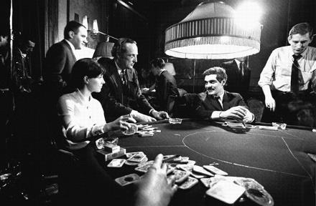
Rules of the Game
Another Five Techniques from Particularly Crafty Designers
Your host
with
Richard Rouse III
Hal Barwood
Chelsea Howe
Luke Muscat
Christina Norman
Damion Schubert
@richardrouseiii
www.finitearts.com
@manojalpa
@pgmuscat
@truffle
@ZenOfDesign
Notes:
Welcome!
In this session we take five illustrious speakers who you see listed behind me
And then we give them 10 minutes to talk about one of their personal rules about game design.

Slide 2
Rules of the Game 2015
Laralyn McWilliams
@laralyn
Chris Avellone
@ChrisAvellone
Dan Teasdale
@deliciousbees
Kim McAuliffe
@EnameledKoi
Nels Anderson
@nelsormensch
“Make Emotional Connections”
“Look for the Silver Lining”
“Chunk in Threes”
“Fight for the Little Things”
“Don’t Try to Evaluate Your Own Game*”
* But Only You Know What It Should Be
Search “Five Rules” on GDCVault.com
Notes:
And we’ve done this a few times before. Back in 2015, we had these amazing designers talk
This one is up for free on the vault.

Slide 3
Rules of the Game 2016
Lee Perry
@MrLeePerry
Emily Short
@emshort
George Fan
@TheGeorgeFan
Liz England
@lizardengland
Michael de Plater
“Pizzazz First, Polish Later”
“Visualize Early”
“Make Your Enemies Actually Different!”
“Make Actionable Documentation”
“Make Your Game Tell Real-World Stories”
Search “Five Rules” on GDCVault.com
Notes:
This one is up on the vault but not, as of yet, free to view. But the slides are there! And hopefully it will be free too… soon…

Slide 4
Why Rules?
Notes:
So why do we care about rules?
Well as game designers our job is making rules.

Slide 5
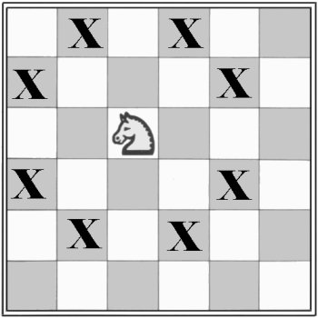
Notes:
We like games, after all, that’s why we are here. Many of us like the knowableness of rules in a game – they make it work – they make it fair.
Like in the game of Bridge, we like the fixedness of who goes in what order, of how you bid, and how you win contracts.
And it’s always clear cut who wins or who loses. Because of those rules.

Slide 6
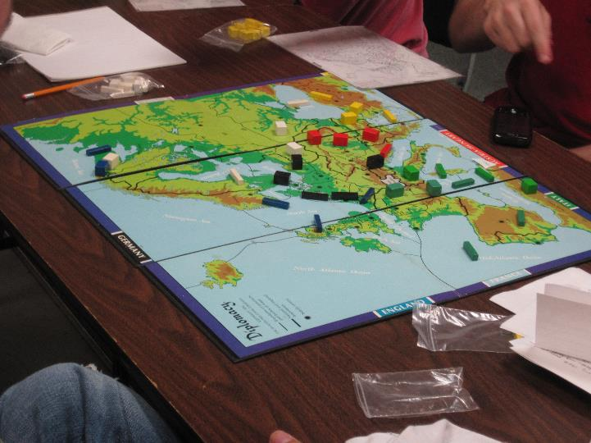
Notes:
Even in a more complex game, like Diplomacy, the rules becomes harder to understand, and many house rules may exist.
But before playing , you agree on what the rules are and so by the time you are playing, hopefully, everyone agrees on how things work.
Even when they are losing, a player will admit the rules are important. No one likes someone who changes the rules depending on whether they are winning or losing.
We game designers may even appreciate the rules in areas outside of gaming…

Slide 7
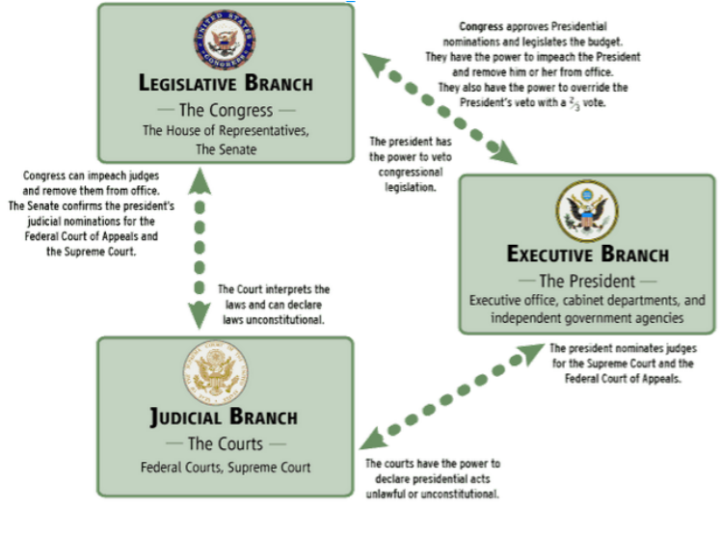
Notes:
… like in our governments.
We may appreciate that when systems are put in place for good reason – that even when someone may go off the rails in one branch, the system, hopefully, keeps them from destroying everything.
And we as designers recognize that these rules are important even when the person we like IS in charge.

Slide 8
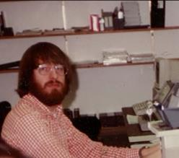
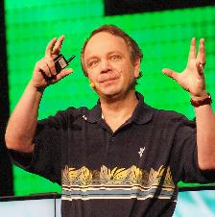
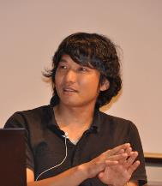
Notes:
In game development, the reality is there are no rules, not hard and fast ones. Like all creative enterprise, many rules are a matter of personal taste
These are some of the designers who have been highly influential to me over the years, and if you asked them how to make a game, you would get some very different answers
So as you hear these specific rules here today, you may not think they apply to you.
And they may not, at least, not right now.

Slide 9
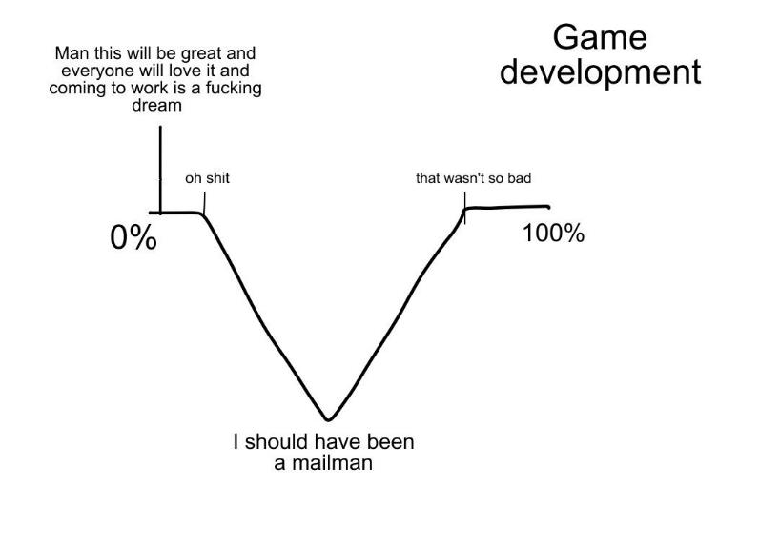
Handy chart courtesy David Goldfarb
Notes:
But maybe they will apply later.
We’re all familiar with the dark doldrums of the middle of game development, when everything is horrible
When you are stuck on a problem, down at your lowest point, look back on the rules you hear today to see if they can reframe your thinking and get you out of a rut
This actually happened to me recently – running up to GDC I was working on my game The Church in the Darkness and found myself at the very lowest nadir of this chart.

Slide 10
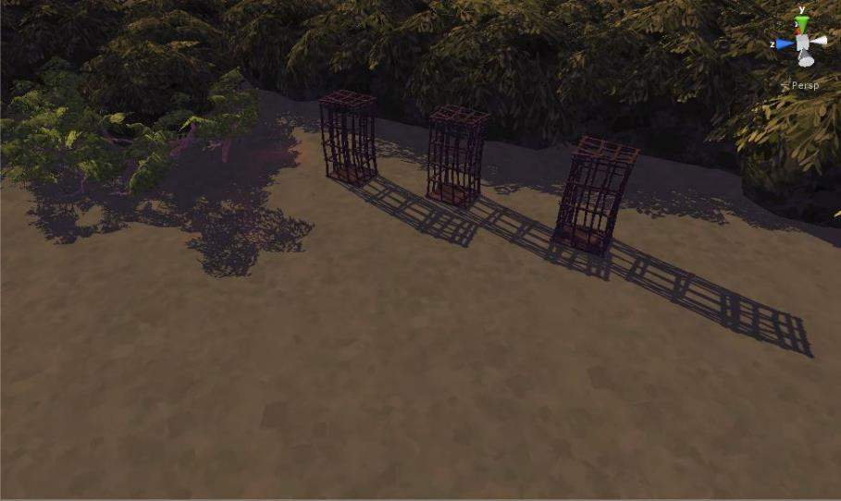
Notes:
I was working on a new demo for my game, and this is what most of it looked like.
I had stubbed in various parts of the level at their lowest possible pizzazz level, and during this time I was not enjoying working on my level.

Slide 11
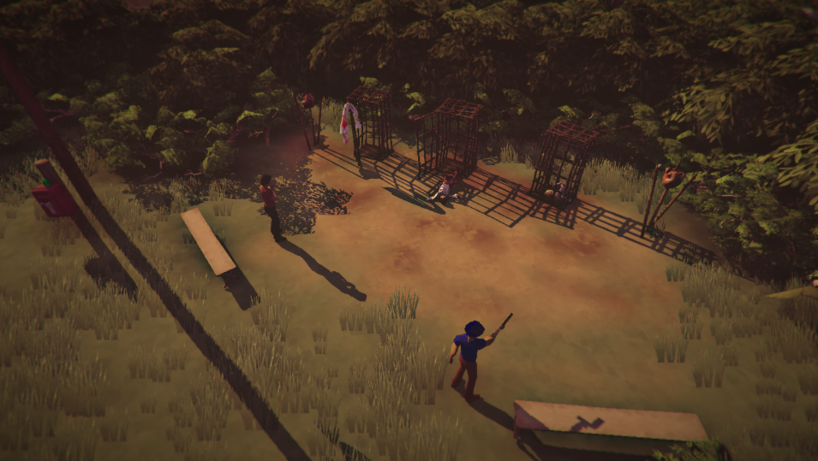
Notes:
But then in the last week I finally added all the fanciness to the level.
This went from an ugly snub to something with life in it – now there’s a guy shooting at a pigs head next to cages with dead people. It also became a scene you could interact with, and that changed depending on the story.
And this took me about an hour to implement.
What if I had just thrown this in earlier? How great would that have been to my morale when I was at my lowest point if I just made my level with a bit more pizazz.

Slide 12
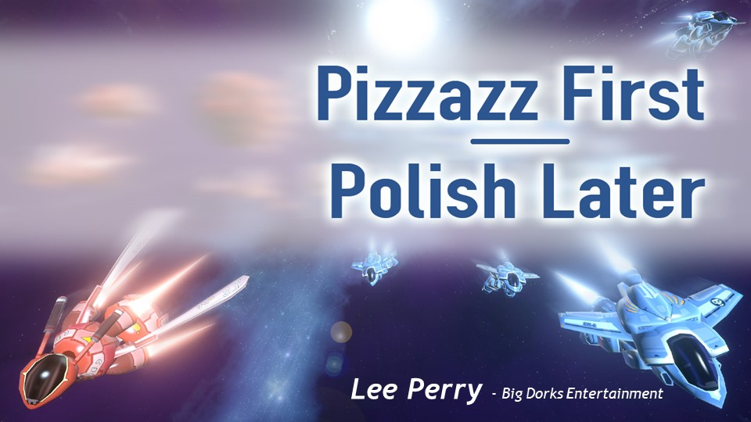
Notes:
And I should have KNOWN this – because last year one of our speakers – Lee Perry – gave a talk on this very subject.

Slide 13
Notes:
He talked about that low trough, particularly when you are working solo, that you may forget to add the snazzy stuff because often it’s the easy stuff. You’re focused on the bigger risks.
But then you run the risk of hating your own game because it’s so dull.

Slide 14
Notes:
But if you add pizzazz earlier, the whole game becomes more enjoyable.
For more on pizzazz and polish, you should definitely go check out Lee’s talk.
And the moral here is to listen to these rules not necessarily for them to help you today, but maybe to help you later when you desperately need it.

Slide 15
EVERYTHING
Notes:
Now, when I do round up speakers for this session, I don't give them a theme – the speakers can pick any rule they want.
But now that I have all the talks, I can see that one has emerged. And this year it's EVERYTHING YOU KNOW IS WRONG
Which seems timely, doesn't it?
Our speakers today are going to challenge common assumptions and make us rethink how we develop games.

Slide 16
EVERYTHING
YOU KNOW

Slide 17
EVERYTHING
YOU KNOW
IS WRONG
Notes:
Which seems timely, doesn't it?
Our speakers today are going to challenge common assumptions and make us rethink how we develop games.

Slide 18
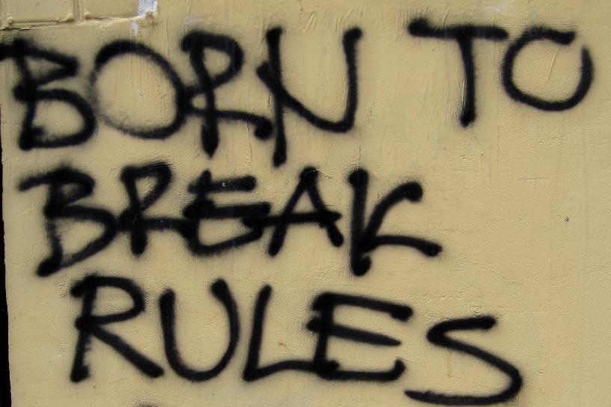
Notes:
And though I’ve been talking about how rules are important, it’s important too to remember that many of us got into game development because we wanted to do something different with our lives.
We didn’t pick the safe career, or the most lucrative career, we broke away from societal rules and wanted to do something different.
Which means, in a way, you want to break the rules.
And if you’ve been in game development long enough, you’ve heard those rules that you may feel are just stifling you.

Slide 19
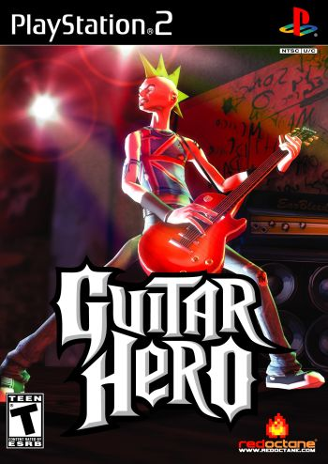
Notes:
Like maybe you’ve head the one about games with peripherals never selling.
Until someone makes the game that does.

Slide 20
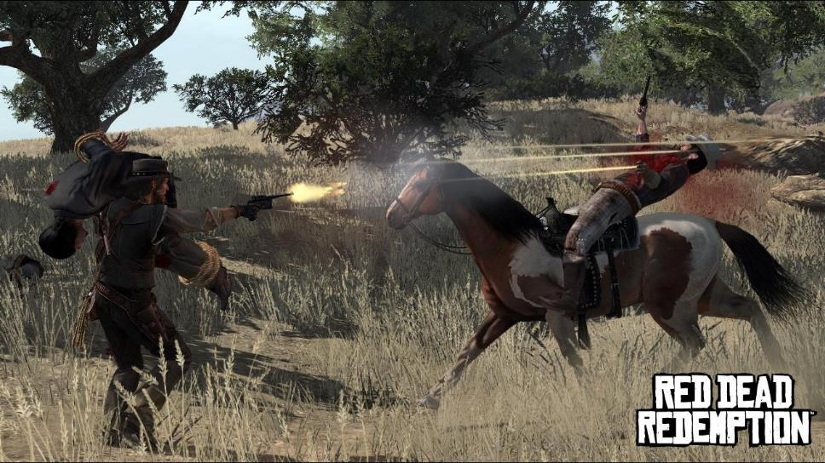
Notes:
Or that no one wants to play a Western Game… those will never sell
Until one does.

Slide 21
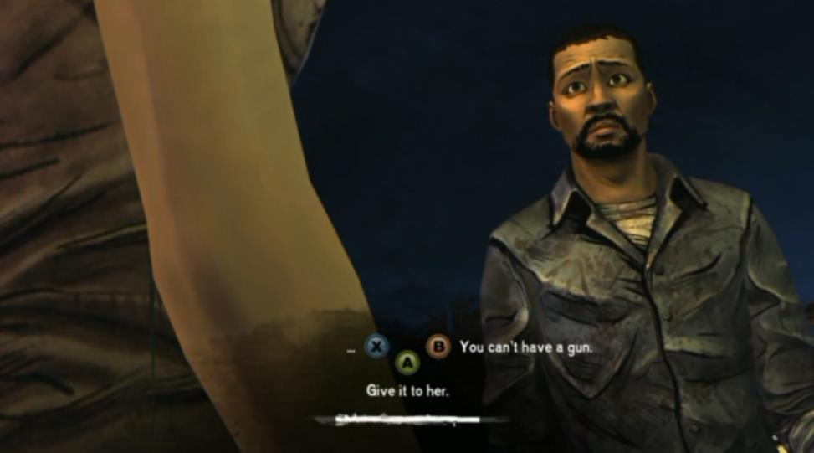
Notes:
Or that adventure games are dead
Until they’re not.

Slide 22
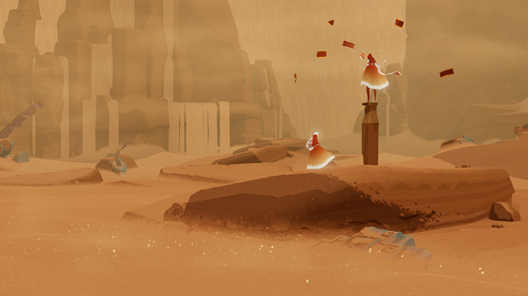
Notes:
But we as designers can be just as guilty as the business people who tell us what won’t sell.
Like when we declare that everyone online is an asshole so we can only make shooters

Slide 23
Notes:
Or that players only want to win, that everything has to be easy.

Slide 24
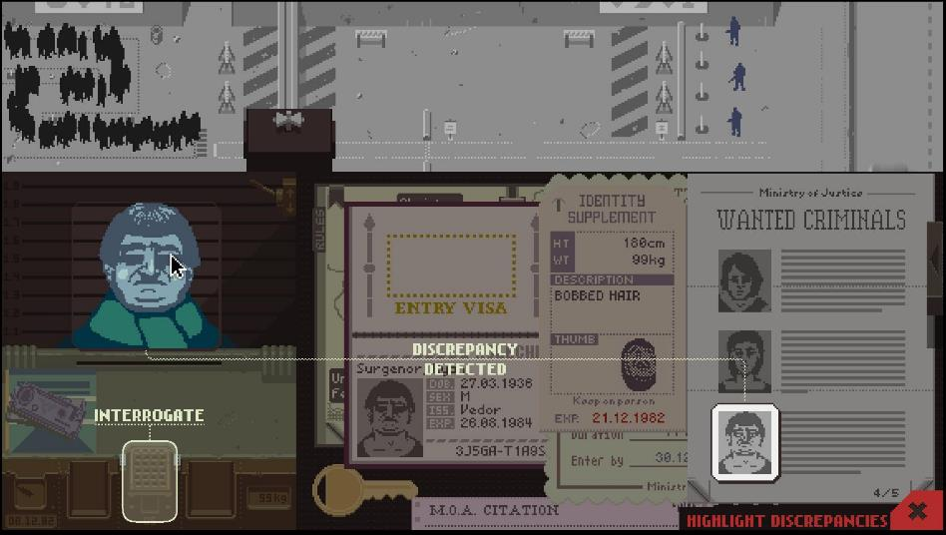
Notes:
Or the dreaded “That doesn’t sound like fun.”

Slide 25
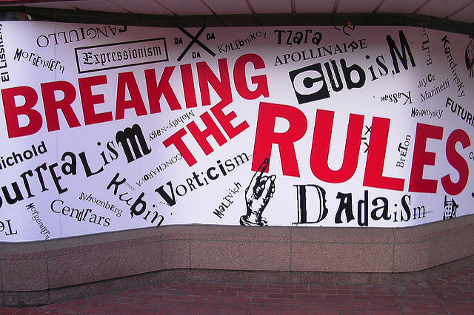
Notes:
From all those examples and many more outside the world of games, we know that it’s through breaking these “constricting” rules that great new artistic breakthroughs can occur.

Slide 26
A good rule doesn’t close down possibilities,
it opens them up.
Notes:
I would ague that a good rule doesn’t need breaking – because it opens up the possibility set of what you can do.
It inspires you, and makes you be a more thoughtful creator.
I think the rules we have today are all of this sort.

Slide 27
EVERYTHING
YOU KNOW
IS WRONG
Notes:
So today this is our theme after the fact, and I think these rules are going to open up your world.

Slide 28
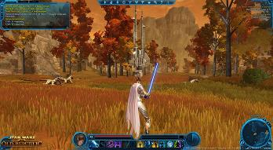
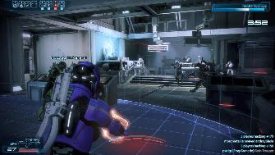
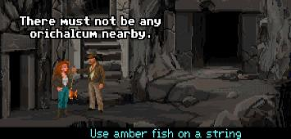
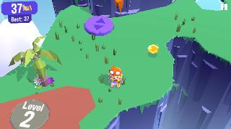
Notes:
Today, we will have a series of accomplished designers each tell you a rule they feel strongly about.
A little later, Damion Schubert is going to remind us who are true player base is.
Christina Norman is going to show you how your assumptions about what you need out of a feature may well be wrong
Hal Barwood is going to suggest the way we’ve done rules in the past has been wrong
And finally Luke Muscat is going to question the very validity of… well you’ll just have to wait for it.
BUT FIRST

Slide 29
CHELSEA
HOWE
Family Guy: The Quest for Stuff,
FarmVille, Scaling the Sky
Creative Producteur & Owl Overseer
Owlchemy Labs
@Manojalpa
Notes:
First off, Chelsea Howe is going to tell you how you may be thinking of things at the wrong scale
Chelsea likes making games that make a difference. She's currently Owlchemy Labs' creative producteur and owl overseer and co-founder of the Queerness and Games Conference. Previously, she's worked at EA, TinyCo, SuperBetter Labs, and Zynga, experimenting with F2P and consulting on playful experiences. By night Chelsea designs award-winning indie games, runs game jams, and teaches students at places like Coder Dojo and California College of the Arts. Her recognitions include Forbes 30 Under 30 in Games, Fortune's 10 Powerful Women in Games, and Fast Company's 100 Most Creative People in Business.

Slide 30
Design by Fractal
Notes:
Today I’m going to talk about one of my favorite topics of all times: fractals. My rule, broadly, is “Design by Fractal” though as you’ll see fractals are an all around wonderful way to conceptualize, communicate, and create games.

Slide 31
Why Fractals?
Notes:
OK, so why fractals?

Slide 32
Notes:
Our human brains are hard-wired to find patterns. Patterns help us cluster and predict the constant flow of data streaming into our brains. They let us survive and act and optimize our performance in an otherwise overwhelming world.

Slide 33
Notes:
Some patterns are easier to see than others. Songs have choruses, verses, bridges. Novels have the three act structure and hero’s journeys. Politics ebb and flow, conservative to liberal and back again.

Slide 34
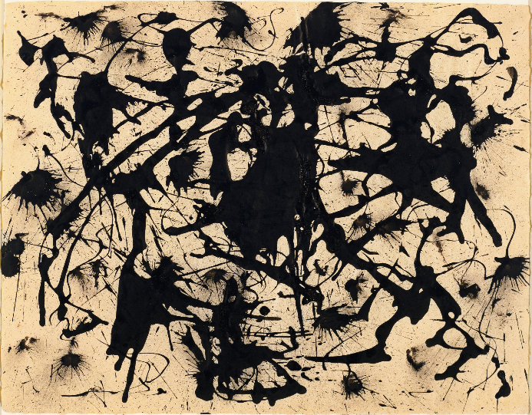
Notes:
But games aren’t simple nor linear entities. They are vast and complex systems, multi-faceted, multi-layered.

Slide 35
Notes:
Even games with the simplest underpinnings can have vast and unpredictable results.

Slide 36
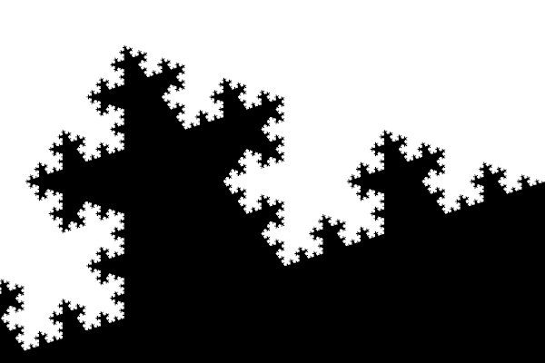
Notes:
And that’s the beauty of fractals, too.
Fractals are patterns that exist across scale, that describe infinite systems. The defining property of a fractal is that it is self-similar – that is, you can see the same basic shapes and patterns no matter how far you zoom in or out – and often where you look.

Slide 37
One algorithm.
Infinite fractal.
Notes:
And all of that infinite complexity comes from one tiny little set of variables.
All fractals have an equation, an algorithm, that defines their repeating patterns. This simple equations here generates the Mandlebrot fractal.
That single algorithm feeds back in on itself, multiplying onward, outward, upward. With just one underlying and foundational set of variables, an infinite and beautifully resonant pattern emerges.

Slide 38
Game = Fractal
Notes:
And ultimately, that is exactly what we want with our games. We want coherent design across massive, interrelated systems.

Slide 39
Game = Fractal
Vision = Algorithm
Notes:
This mean your vision needs to be that algorithm. Everything in the game needs to stem from that core identity.
We use a bunch of different terms for it: a vision statement, a 1-liner, an X statement. But at its heart, it’s the aggregate of values from which the rest of your game can be derived.

Slide 40
Game = Fractal
Vision = Algorithm
Pillars = Variables
Notes:
Usually we designers go a step farther and define a set of keystones; those become the variables within our algorithm.
The clearer those pillars, the better we empower our teams to bring the game to life at whatever scale they’re working at. If your team can really grok the algorithm, they can generate code, content, and creativity without designers always looming over them.

Slide 41
Fractals in Practice
Notes:
So there’s the theory. Let’s see a few examples of how it plays out in reality.

Slide 42
Teaching
Mechanics
(with fractals)
Notes:
Fractals help when conveying information to players and swiftly teaching them the core components of your system.

Slide 43
Notes:
A dominant learning paradigm is scaffolding, where you teach a small concept, practice it until mastery, and then build off that smaller concept into a bigger concept which feeds into a bigger concept. Learning fractals.

Slide 44
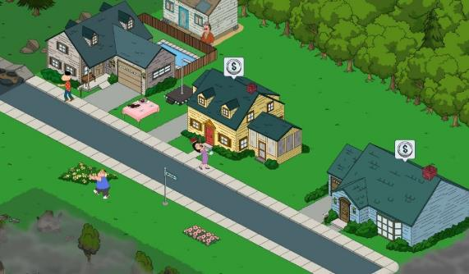
Notes:
For Family Guy we started by teaching players about a single item - how to get it and use it. Then we introduced characters, who needed multiple items. Then we focused on districts, which held multiple characters. And finally, we showed them the meta game, which involved a multi-district stroyline. We started at the most immediate level of the fractal and zoomed out over time.

Slide 45
Creating
Player Emotion
(with fractals)
Notes:
There’s also something magical that happens when players feel that order of magnitude change. There’s a moment of awe when your mental model suddenly shifts, expands, or breaks entirely. The possibility space is forever altered. Your conception of the world changes. Fractals invite the sublime.
We can use those scale shifts to our advantage to evoke those more complex feelings in our players.

Slide 46
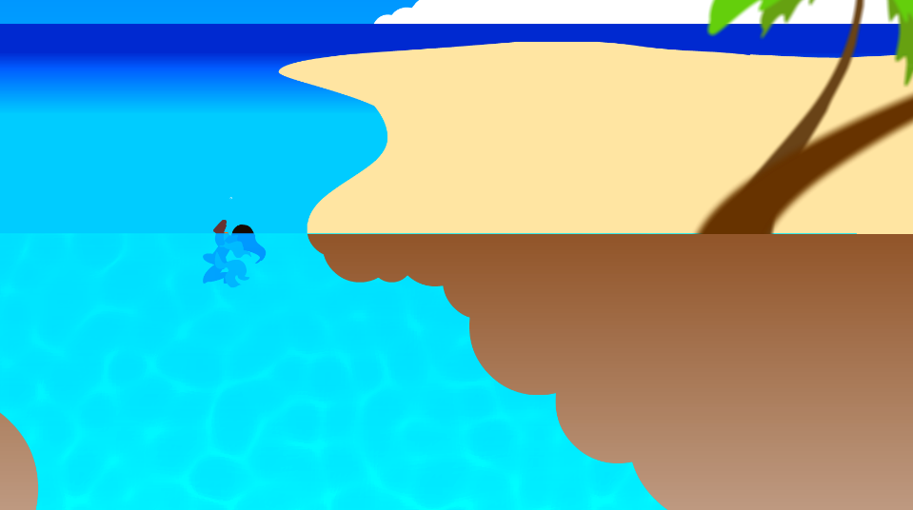
Notes:
At the end of our indie game, Scaling the Sky, players wind up ascending so far into the sky that they pop out of the ocean, right back where they started. It was fascinating watching people’s expression on our Let’s Plays when they realize they’ve looped around, when they understand their Mobius world, their repeating pattern.

Slide 47
Creating
Stakeholder Emotion
(with fractals)
Notes:
And of course, powerful emotions aren’t just useful to players, but stakeholders too.

Slide 48
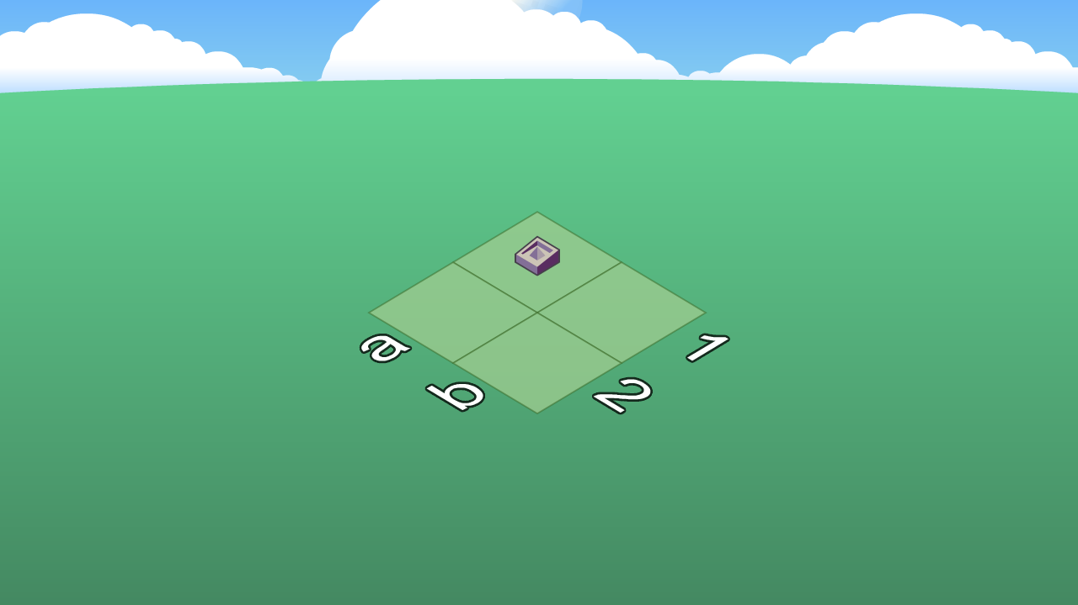
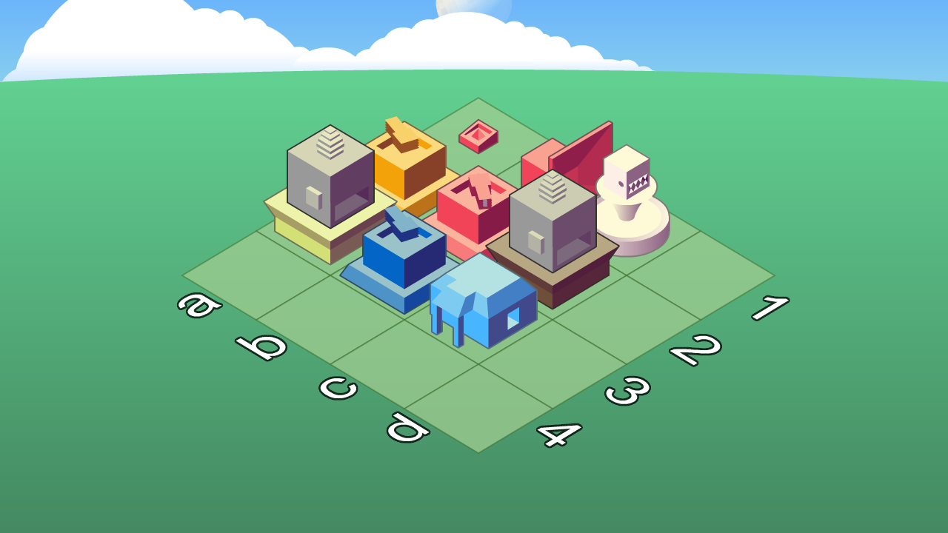
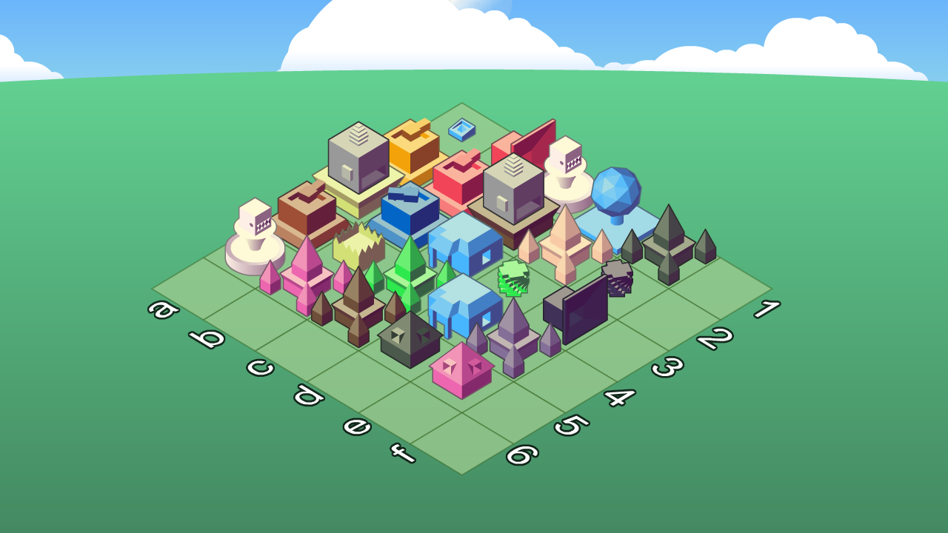
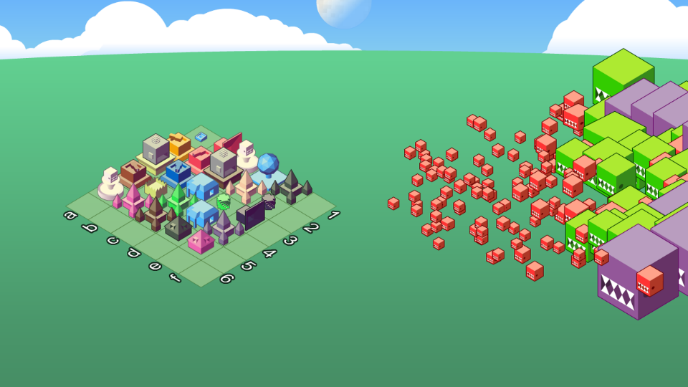
Notes:
Here’s the pitch we used for a game called CityStream. See if you can follow the fractal.
In City Stream, every person in a twitch chat becomes a little dot in the world.
Each dot can gather resources to help build this tower, trying to level it up so it can reach the moon.
And this tower is actually just one structure in a bigger city that players build and customize and defend over time.

Slide 49
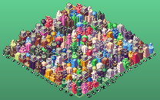
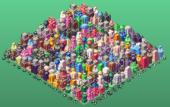
Notes:
And that whole city they’re working on? That’s just one city, on one channel, and in fact any streamer on Twitch can launch their own city against someone else’s in massive territorial battles for ultimate glory.

Slide 50
Build
Building → City → Society → World
Notes:
When we subvert expectations we jokingly say “mind-blown”, but that’s exactly what we’re doing: disrupting mental models. Changing people’s schema.
When you pitch, you WANT to blow people’s minds. Designing with fractals means asking what your game would be like if you ramped it up another level, if you zoomed out one more order of magnitude. If you looked to the left and discovered a second, self-similar branch of the system.

Slide 51
Understanding
Player Engagement
(with fractals)
Notes:
And fractals don’t just engage people in the moment.
I also use fractals for virtually any element that can hold a player’s attention - narrative, difficulty, level unlocks, marketing, content releases

Slide 52
 | Small | Medium | Large | XL
Narrative | Dialogue | Quest | Story Arc | Hero’s Journey
Release Cadence | Hot Fix | Daily Challenge | Weekly Quests | Quarterly Expansion
Audio | SFX | Character Timbre | Character Theme | Soundtrack
Content Marketing | Teaser Image | Teaser Trailer | Full Trailer | Game Release
Notes:
A narrative fractal might start with a single line of dialogue or flavor text. Then conversations, then quests, then story arcs, and finally the entire hero’s journey.
For content releases you might have daily bug fixes, bi-weekly challenges, weekly quests, monthly feature additions, and quarterly expansions.
Go ahead – any area of your game, anything whatsoever, use fractals to think about how it scales: either over time, in size or scope, or level of attention. Where are your gaps?

Slide 53
Communicating
Design
(with fractals)
Notes:
I know we all love design documentation, and that’s another area where fractal like structures are well utilized.

Slide 54
This is a single line about how great my game idea is so that you get the gist and really want to know more
This is a single line about how great my game idea is so that you get the gist and really want to know more.
In an elevator I can give you maybe six solid sentences. That’s enough to give you one sentence of lead in, a sentence that’s the core idea, three supporting features or pillars that make the game really interesting, and then a final line summarizing why the game deserves your time and attention.
The faster I’m able to communicate the most salient parts of the game, the better the game’s chances.
This is a single line about how great my game idea is so that you get the gist and really want to know more.
In an elevator I can give you maybe six solid sentences. That’s enough to give you one sentence of lead in, a sentence that’s the core idea, three supporting features or pillars that make the game really interesting, and then a final line summarizing why the game deserves your time and attention.
The faster I’m able to communicate the most salient parts of the game, the better the game’s chances.
This is a single line about how great my game idea is so that you get the gist and really want to know
In an elevator I can give you maybe six solid sentences. That’s enough to give you one sentence of lead in, a sentence that’s the core idea, three supporting features or pillars that make the game really interesting, and then a final line summarizing why the game deserves your time and attention.
The faster I’m able to communicate the most salient parts of the game, the better the game’s This is a single line about how great my game idea is so that you get the gist and really want to know more.
In an elevator I can give you maybe six solid sentences. That’s enough to give you one sentence of lead in, a sentence that’s the core idea, three supporting features or pillars that make the game really interesting, and then a final line summarizing why the game deserves your time and attention.
The faster I’m able to communicate the most salient parts of the game, the better the game’s
This is a single line about how great my game idea is so that you get the gist and really want to know more. I just need a few more words here to make it look not so copy pasted.
In an elevator I can give you maybe six solid sentences. That’s enough to give you one sentence of lead in, a sentence that’s the core idea, three supporting features or pillars that make the game really interesting, and then a final line summarizing why the game deserves your time and attention.
The faster I’m able to communicate the most salient parts of the game, the better the game’s
This is a single line about how great my game idea is so that you get the gist and really want to know
In an elevator I can give you maybe six solid sentences. That’s enough to give you one sentence of lead in, a sentence that’s the core idea, three supporting features or pillars that make the game really interesting, and then a final line summarizing why the game deserves your time and attention.
The faster I’m able to communicate the most salient parts of the game, the better the game’s
Notes:
You have the one-liner, the elevator pitch, the one-pager. Then there’s the concept deck, the systems doc, all the way to the oft-lamented design bible or wiki. Thinking of them all as the same basic entity, just at scale, helps me keep the ideas consistent throughout. And remembering that different people on a team work at different levels of the fractal helps me figure out the most useful way to talk to them. The global exec team needs the one-liner. The technical artist needs their subset of the design bible.
(I’ve also noticed some people have a ‘default scale’ when they think up ideas - I tend to revert to a concept doc; find the scale you’re comfortable at and then practice scaling up or down).

Slide 55
Understanding
Other IP
(with fractals)
Notes:
The good news is that fractals aren’t just good for communicating your own IP, but for understanding other IP as well. If you’re aware of patterns across scale, you can identify the keystones of other identities – other brands, franchises, experiences.

Slide 56
Notes:
I’ve designed for many different licensors and IPs, and unlike most folks I love that work. Because, again, when you can see that pattern, you are empowered to use it in new, unexpected ways.

Slide 57
Notes:
Once you’ve seen the consistent themes in a celebrity’s twitter feed, instagram, interviews, concerts, filmography, you understand how to infuse that identity into a game.
**Specific Example + Talk about Trust/Bonding/Faith in external partnerships when you can echo their values back to them**

Slide 58
Understanding
The Future
(with fractals)
Notes:
And of course, this isn’t just about seeing the current patterns, but looking at how they’ve changed over time. Because once you understand the way something HAS changed, you’re better able to predict how it WILL change.

Slide 59
Where are we going?
Notes:
When my UX designer and I were coming up with early concepts, we found a curious trend. We saw that despite mobile gamers complaining about a lack of real gameplay - which meant in almost every case moment to moment control and input and strategy - they would almost always use an ‘automate’ button for that gameplay as soon as it was provided. We saw idle games becoming increasingly popular on flash portals and just starting to leak into the apple charts - games that for the most part play themselves. We saw an overall shift of player attention from the moment to moment interactions to the meta game.

Slide 60
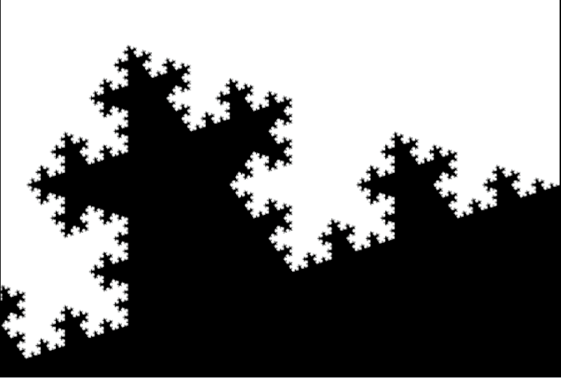
=?
Notes:
In this case, we saw a broad, general algorithm playing out in many different areas. I mentioned fractals aren’t just about scale; they’re spatial as well. By seeing a pattern in one area of entertainment, we figured we could apply it to *our* area of entertainment.
We fused that trend into our concept. Other design teams had been pitching for over a year; our design was greenlit in less than two months.

Slide 61
Understanding
The World
(with fractals)
Notes:
I can’t help thinking in fractals at this point. So let’s talk about one more application.

Slide 62
Microcosm
When we get a new art director
he’ll take over the concept meeting
(hopefully not you)
Notes:
A team is a small, small microcosm of society. Every team has its own quirks and its own dynamics, but it will always in some ways reflect bigger issues. When small things happen in your team, don’t just let them slide. Don’t accept them as part of a bigger pattern.

Slide 63
Macro Effect
When we get a new president
they’ll restore basic human rights
(hopefully you)
Notes:
Because change at any scale affects the others. One simple correction can make a difference. When we think in fractals we are no longer helpless individuals; we are simply at a different scale, and we can create vast change.

Slide 64
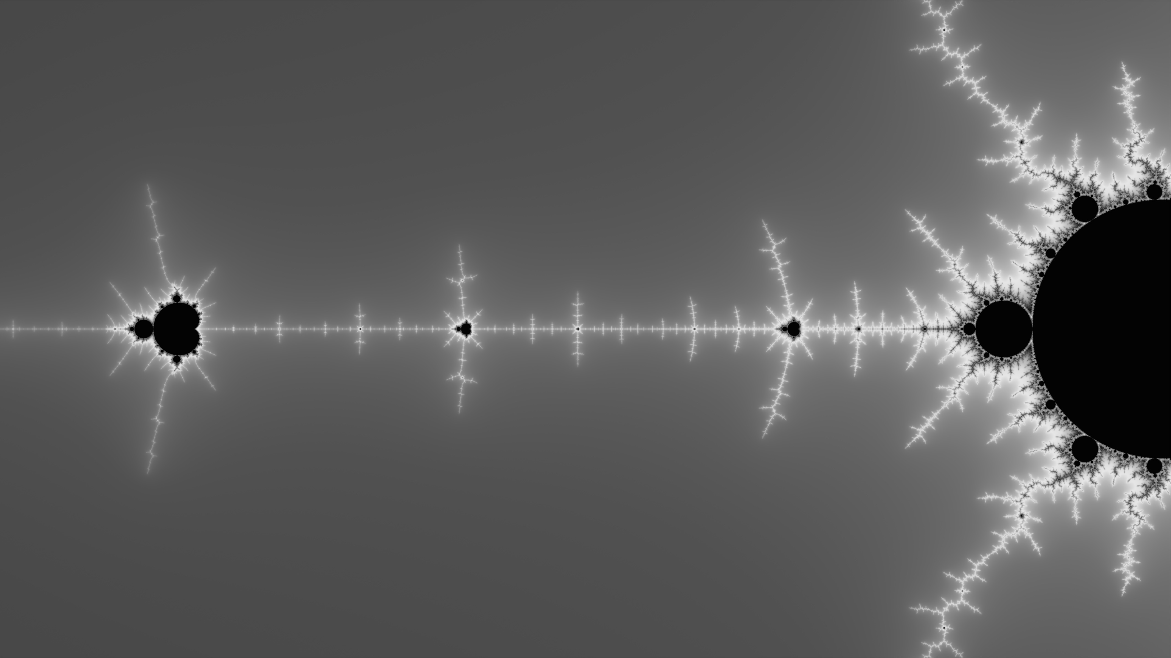
Thanks
@manojalpa
Notes:
Thanks

Slide 65
CHELSEA
HOWE
Family Guy: The Quest for Stuff,
FarmVille, Scaling the Sky
Creative Producteur & Owl Overseer
Owlchemy
@Manojalpa
Notes:
[Richard] This is exactly the type of rule that I think can really help you when your stuck – maybe you need to change your scale and look at your problem again.

Slide 66
DAMION
SCHUBERT
Dungeon Boss,
Star Wars The Old Republic
Creative Director
Boss Fight Entertainment
@ZenOfDesign
Notes:
Next up, you may know Damion for his many years working on MMOs, culminating as being lead designer on Star Wars The Old Republic. He now works on the mobile RPG Dungeon Boss.
Some years back Damion gave a famous talk on how everything we know about writing design documents was wrong, now he’s going to tell us how we may well be looking at our player base wrong…
Damion!

Slide 67
Free is the DEFAULT

Slide 68
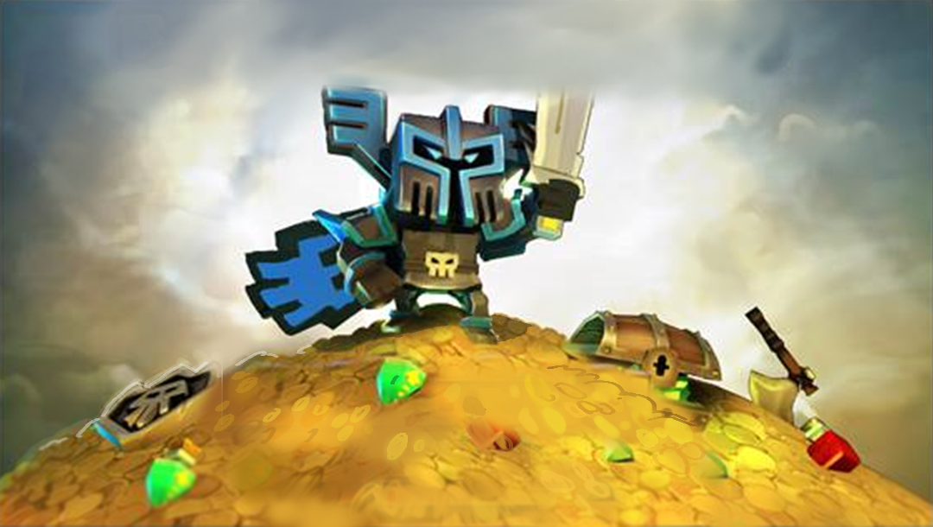
When we talk about F2P, too often we talk about the big spenders.
Notes:
When we talk about Free to Play games, the most natural thing to do is to talk about … how to make money. I mean, that’ s not unnatural. After all, while many of us are doing this for the passion of making games, we do like to actually be able to pay our rent. And, you know, our bosses generally expect us to build a viable business, for some reason. But there’s been lots of talks about the spenders. You know, the ‘whales’ (I hate it that we call them that). You wanna hear more about that, there’s entire conference tracks – heck, entire conferences – about how to make money.

Slide 69
2%
The conversion rate of a successful Zynga game…
98%
The percentage of people who never spend a dime.
Notes:
I wanna talk about the other edge of the coin. I mean, we know that these heavy spenders spend a lot of money in our games. They are, effectively, subsidizing a whole bunch of other players who aren’t paying anything at all. How big is that disconnect? Well, I kept looking for numbers that are actually releasable. Here’s a good one. Zynga games, in their heyday, would declare a game a huge success if one of their facebook games had 2% conversion rates – i.e. 2% of their players EVER paid them a dime. That means that the other 98% are, effectively, freeloaders.

Slide 70
10%
The approx. number of people playing today who paid
90%
The rest of the ‘freeloaders’.
Notes:
I wanna talk about the other edge of the coin. I mean, we know that these heavy spenders spend a lot of money in our games. They are, effectively, subsidizing a whole bunch of other players who aren’t paying anything at all. How big is that disconnect? Well, I kept looking for numbers that are actually releasable. Here’s a good one. Zynga games, in their heyday, would declare a game a huge success if one of their facebook games had 2% conversion rates – i.e. 2% of their players EVER paid them a dime. That means that the other 98% are, effectively, freeloaders.

Slide 71
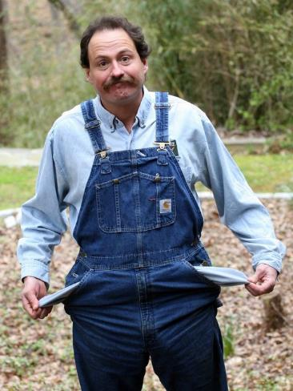
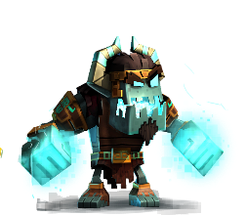
For most people, ‘Free-to-Play’ means… exactly that.
Notes:
For most people, free to play means exactly that. They download your game, they play the game, and they do it all intending to never give you a single dime. Even if they love it. These guys have lots of free options for entertainment nowadays. Many of them are kids, who don’t have credit cards. Some of them see playing for free as a badge of honor. How many of us played Candy Crush as far as we could go just to see how well we could do?

Slide 72
So what does that mean for us designers?
Notes:
So what does that mean for us designers? Those of us who are battling the forces of the evil Project Managers who want to turn our customers over and shake them for spare change?

Slide 73
Takeaway #1
Realize that the bulk of your population will never spend.
Notes:
Well, first off, designers need to get in the mindset that the massive bulk of your population is playing for free. Heck, remember that 2% number we mentioned before? Let’s double that. You’re an amazing designer. You have discovered the holy grail of monetization. You’re a genius. …. And 96% of your players are STILL not giving you any money. The massive bulk of your population is still playing for free.

Slide 74
Takeaway #1
Realize that the bulk of your population will never spend.
Notes:
Well, first off, designers need to get in the mindset that the massive bulk of your population is playing for free. Heck, remember that 2% number we mentioned before? Let’s double that. You’re an amazing designer. You have discovered the holy grail of monetization. You’re a genius. …. And 96% of your players are STILL not giving you any money. The massive bulk of your population is still playing for free.

Slide 75
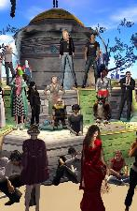
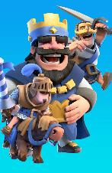
Takeaway #2
Virality
Rivals
Content
Partners
Fodder
Community
Free Players should add value to your spenders or to the game itself.
Notes:
And let’s keep in mind that freeloaders are not just freeloading. In the worst case scenario, they are making the game viral. You played Clash Royale because you heard about it from someone else. You played Candy Crush to see if you could catch your buddy in the ‘saga map’. In Second Life, free players might make amazing content for you to enjoy. In Star Wars: the Old Republic, free play filled out dungeon queue with other players again. And, of course, in most mobile games, free players give plenty of easily stompable opponents for spenders. You shouldn’t want to get rid of free players. Their existence should make your game stronger, even if they never spend. That’s what being a F2P designer really centers on.

Slide 76
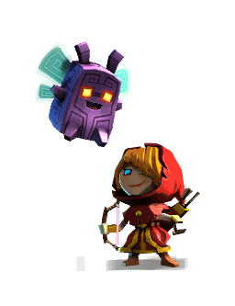
Takeaway #3
Build and Test the game as if players will never spend.
Notes:
So if you ARE building a game that’s free, great. Sure, you should build, test and focus on things that people spend on, but for the love of god, don’t lose sight of the fact of what it’s like NOT to spend. Be sure your testers are TESTING what it’s like to play without money. Be sure your designers are playing like a miser. Because frankly, if everyone is playing with free currency like the 1%, they are NOT playing the same game as everyone else. And you miss stuff – like playing with characters that haven’t been maxed out is REALLY lame because you don’t see their special abilities. One of the things that happened to us on Dungeon Boss was that we didn’t keep track of our pop ups. We kept adding game systems that had popups for our non-spenders. When we finally went back and took a look at things, we had just an OPPRESSIVE initial experience into the game, just a few months after ship. We actually spent a milestone going back and streamlining this experience to being sure that new players have a great experience.

Slide 77
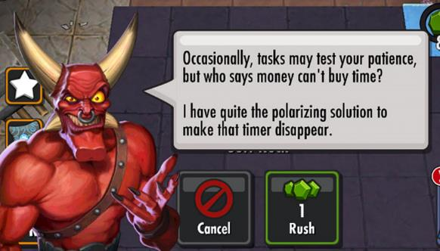
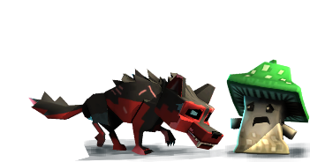
Takeaway #4
Watch those paywalls – Give People a chance to fall in love with the game.
Notes:
And about those free players – watch those paywalls. A paywall is when you put a huge ‘cliff’ in the game design, that’s designed to make the player either spend or choose a free alternative – usually grind a few levels, or wait for stamina to refill. One of the most common mistakes I’ve seen is for designers to put up too harsh paywalls too quickly. They go up before players fall in love with the game. When this happens, your brain extrapolates that pacing to the rest of the experience. You do the math, and you realize – wow, this supposedly FREE game is really not free at all! If Free is the Default, then the people who fully intend NEVER to pay will be chased out almost immediately – and your game will be a ghost town. By contrast, when we converted Star Wars: the Old Republic to F2P, I fought hard – and won – my battle to not put up anything that was even remotely like a paywall on the first planet – that’s 3-4 hours of gameplay, people. Why? Well, my argument was that we had empirical proof, according to EA’s testing lab, that this was the best MMO newbie experience ever released when we were a subscription game. Why screw that up? Instead, we bet that if we gave people 3-4 hours for free, they would fall in love with the game, and they would spend. And in our case, this was the right decision. We ended up GAINING subscribers when we converted to free to play – because it turns out that we gave players a great, full-featured demo experience, and they WANTED to help out.

Slide 78
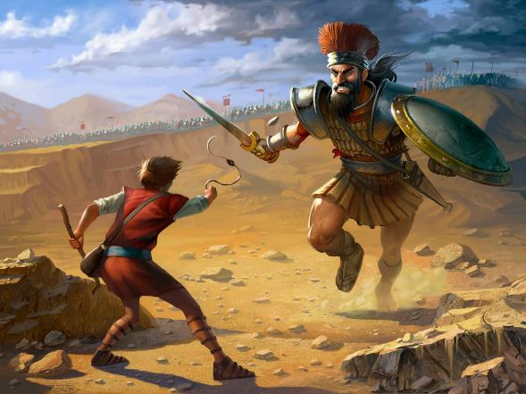
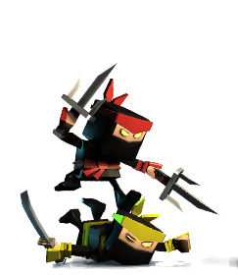
Takeaway #4
Matchmaking is vital to keep F2Ps from being stomped too often by spenders.
Notes:
Remember how I said that F2P players make for good fodder for big spenders? Yeah, well, you have to be careful. It’s not a fun experience to get ROFLStomped ridiculously. Now, I’m not saying that free players should always be paired against other free players. However, and this was a painful learning experience on Dungeon Boss, if you have a PvP system where your free players are frequently being paired against players who have spent a thousand bucks, they’re usually going to get stomped. If that happens, your free players will cease to interact with that system, which can really cause a cascading spiral of derp. If Free is your default, but your free players stop playing an aspect of your game, that aspect of your game will go into a death spiral. In many games, you buy a LOT of power when you spend. In Dungeon Boss, the characters in our gem portal are MUCH more powerful than the free heroes, and people who spend have a MUCH easier time acquiring them and maxing them out. Which is fine. What’s less fine is when free players face a wall of enemies they cannot defeat. What you want to do is be sure that players encounter close battles. You want them to feel like if they spent a TEENSY amount, they’d be competitive. But you don’t want them to hit a brick wall. You don’t want them to see NO CHANCE of success. Oh, sure, David beat Goliath, but this is a great story because of how fantastically impossible that was. Most of the time, Goliath stomps David so hard that David throws his iPad against the wall.

Slide 79
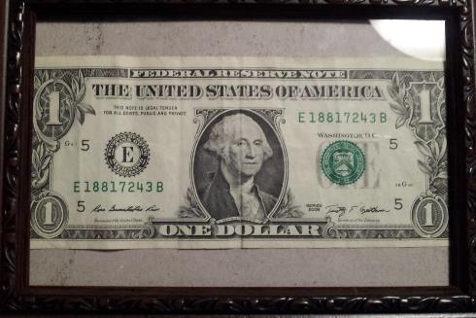
Takeaway #6
Don’t try to make whales. Try to get them to spend a dollar.
Notes:
Which leads to the last point. If you take all of this together – ensure free players have value to the game, be sure they have a fun time that’s not too obnoxious, let them play without spending and then give them a hint of the idea that spending might make them just a LITTLE better and they’d be having a LITTLE more fun if they did, then you have created a game that’s ripe for some of those free players to convert. Now, the vast majority of our money from these games comes from whales – I’m sorry, heavy spenders. But you don’t make those overnight. You have to coax them into it. And so, instead of figuring out how to get $50 bucks from every player, focus on how to get one. Make that spend well worth it. Make it so they want to spend a second, and stairstep them up the spend experience. Now most of them will STILL never spend. And that’s normal, and that’s fine, get used to it. But if you can get players to spend ONCE, and that spend has obvious advantages, it’s much, much easier to get them to ramp up their spend. Still, don’t be disappointed if not everyone spends. Remember: Free is your Default. Even the people who spend a dollar are outliers.

Slide 80
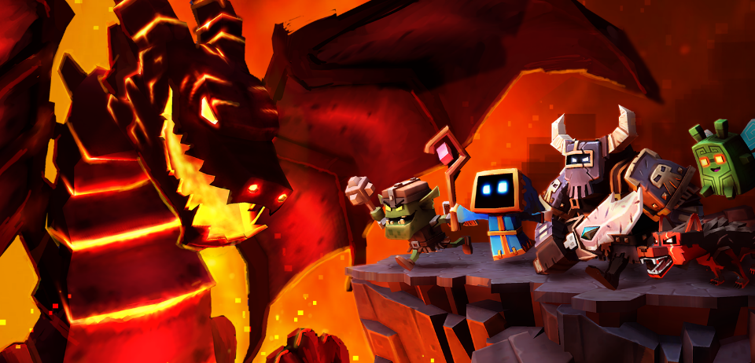
In Conclusion
Free Players are the ‘Normal’ ones. Design your game as such.

Slide 81
DAMION
SCHUBERT
Dungeon Boss,
Star Wars The Old Republic
Creative Director
Boss Fight Entertainment
@ZenOfDesign
Notes:
[Richard]I think there’s a broader story here of being careful about what part of your audience you are addressing.
Even if your game isn’t F2P, are you giving the hardcore too much of your attention? Are you worried about people who try to exploit your game when they’re in the minority?
Always remember to spend most of your time on most of the players, whoever they may be.

Slide 82
CHRISTINA
NORMAN
Mass Effect 1/2/3,
League of Legends
Lead Designer
Riot Games
@truffle
Notes:
Next up we have Christina Norman. She was a programmer and then designer at BioWare on the Mass Effect series, and now works on that little game League of Legends
And she’s here to say, that problem you think you have? Maybe you don’t actually have it the way you think you do.

Slide 83
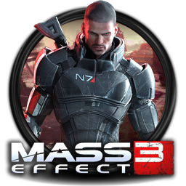
EMBRACE RADICAL CONSTRAINTS
Lead Designer
Riot Games
@truffle
CHRISTINA NORMAN
Notes:
Hello, I’m Christina Norman, a Design Leader at Riot Games. I’ve worked in the industry for 12 years on games like the Mass Effect trilogy and League of Legends.

Slide 84
DESIGNERS HATE CONSTRAINTS
Time
Resources
Technology
Workflow
Game Marketing
Lead Designer
Riot Games
@truffle
CONSTRAINTS CAN RESTRICT US
Notes:
Many designers hate constraints, and that’s understandable. Constraints limit what we can do, so it’s natural to dislike them.

Slide 85
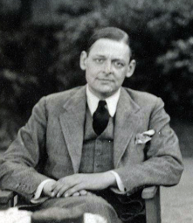
CONSTRAINTS FOCUS CREATIVITY
“When forced to work within a strict framework the imagination is taxed to its utmost-and will produce its richest ideas. Given total freedom the work is likely to sprawl.” - T.S. Eliot
Lead Designer
Riot Games
@truffle
NECESSITY IS THE MOTHER OF INVENTION
Notes:
But sometimes we do our best work while we’re under the strictest limitations. Constraints can inspire us to solve the hardest problems, and to innovate as designers.

Slide 86
THREE CONSTRAINTS SCENARIOS
FRAMEWORK
INTRODUCTION
PROBLEM:
INVENTORY
PROBLEM:
MULTIPLAYER
Game Designer
Riot Games
@truffle
FRAMEWORK + TWO IMPOSSIBLE PROBLEMS
Notes:
Today I’ll take you through my constraints framework, and talk about how I use it to solve impossible problems. All of today’s examples are real and come from the Mass Effect trilogy.

Slide 87
THREE PANDA NOTATION
HAPPY DEVELOPER
PANDA
SAD PANDA
DEVELOPER
SNEAKY
PANDA DEVELOPER
Content within constraints
Frustrated by constraints
Violating Constraints
Game Designer
Riot Games
@truffle
SIZE OF PANDA INDICATES IMPACT
Notes:
And I’ll be using industry-standard three-panda notation to express how the team felt throughout all this - because constraint management can be stressful. Happy pandas are working comfortably within constraints, Sad pandas feel constraints are limiting them, and Sneaky Pandas are ignoring constraints to solve the toughest problems.

Slide 88
THREE CONSTRAINTS SCENARIOS
FRAMEWORK
INTRODUCTION
PROBLEM:
INVENTORY
PROBLEM:
MULTIPLAYER
Lead Designer
Riot Games
@truffle
FRAMEWORK + TWO IMPOSSIBLE PROBLEMS
Notes:
Let’s start with the story of Mass Effect 1

Slide 89
Notes:
All games start with infinite possibilities. Before Mass Effect was Mass Effect, it could have gone in any direction.

Slide 90
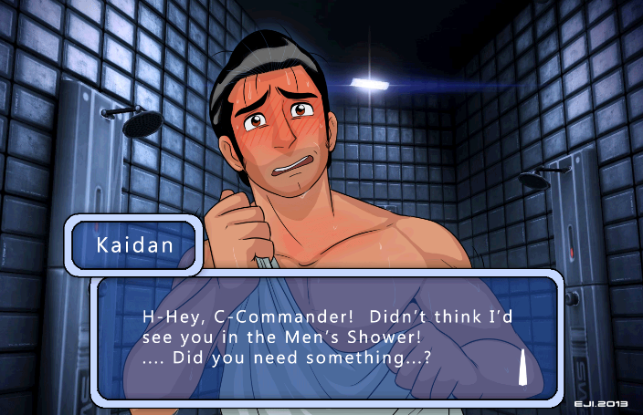
Notes:
Like a pure dating sim. I’m sure there’s an alternate universe out there where that happened and it’s probably pretty cool.

Slide 91
Notes:
But our team had different ambitions. We wanted Mass Effect to be an Epic Space Opera RPG in which you could explore the galaxy, save the universe, and command an elite squad of super heroes.

Slide 92
Notes:
We had a schedule and a budget so we had to get specific. We fleshed out the plot, characters, RPG rules, conversations and gameplay and made some tough calls.

Slide 93
Notes:
We prototyped key systems, verifying they were both possible and valuable. It was becoming clear what Mass Effect would be, and what it wouldn’t be.

Slide 94
Notes:
Then E3 happened. We wanted to demonstrate all the key experiences players would have in Mass Effect, like exploration, cinematic conversations, and intense squad combat. This was hard, but the team gave it their all, and we were happy with the results.

Slide 95
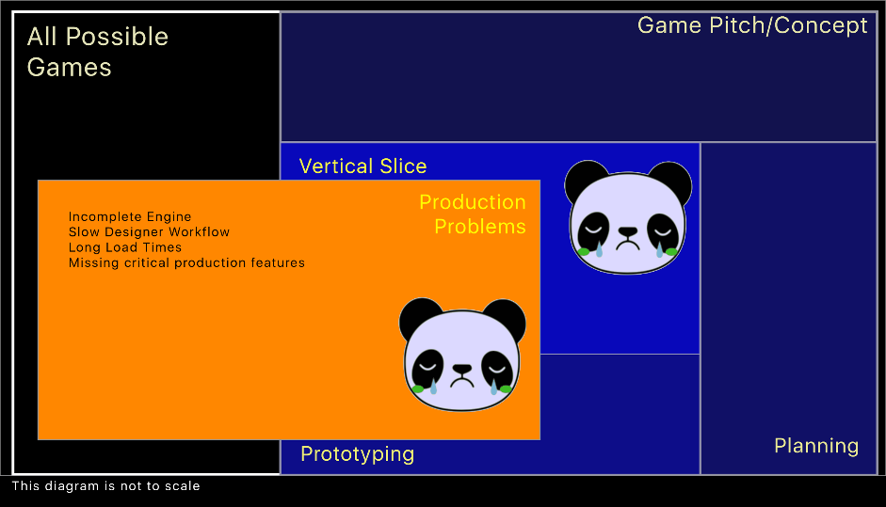
Notes:
We set out to realize this vision across the entire game but encountered problems executing at scale. Our E3 demo was visionary, but it wasn’t real. As hard as we tried we couldn’t hit that experience at scale. Engine and workflow problems kept slowing us down. For the first time we felt hampered by constraints that were blocking us from building the game we wanted to make.

Slide 96
Notes:
It got worse. We started cutting features and even planets from the game. We had to rebuild existing content and systems to make them more efficient. All this slowed us down. We felt like Mass Effect was slipping away.

Slide 97
Notes:
So we crunched hard and we crunched long. Through force of will, talent, and focus we dragged Mass Effect back towards where we wanted it to be but the cost on the team was high.

Slide 98
Notes:
Despite all this adversity we shipped Mass Effect and it was awesome and players loved it. It wasn’t everything we wanted, but it was definitely a great game.

Slide 99
Notes:
Reflecting on the journey from blank slate to Mass Effect, I started to see constraints as a roadmap for progress, and wondered if I could use them to help lead my team towards better games, with fewer sad pandas.

Slide 100
THREE CONSTRAINTS SCENARIOS
FRAMEWORK
INTRODUCTION
PROBLEM:
INVENTORY
PROBLEM:
MULTIPLAYER
Lead Designer
Riot Games
@truffle
FRAMEWORK + TWO IMPOSSIBLE PROBLEMS
Notes:
And we were all focused on making Mass Effect 2 better. We wanted it to be a more refined and polished game, and we wanted to be kinder to ourselves as we built it.

Slide 101
Notes:
So when we started at the blank slate of Mass Effect 2 we knew we had to address Mass Effect’s problems first.

Slide 102
PROBLEM: SLOW, CLUNKY, INVENTORY
Notes:
And our Inventory was top of mind. It was slow, and clunky, and players used it constantly. It was a clear must fix.

Slide 103
Notes:
So we locked in one constraint early - we’d have a good inventory system.

Slide 104
Notes:
And we designed a great inventory system, but we were rebuilding our UI workflow and technology from scratch, and we lost some UI programmers. It became clear that the inventory we wanted was not possible.

Slide 105
Notes:
So we designed a lower scope inventory, but that wasn’t possible either.

Slide 106
Notes:
And then we designed a possible inventory, but it wasn’t that good. Plus we’d have to cut some great things from the game to even build it. No one was happy with that.

Slide 107
Notes:
But then I had an idea - if we had to cut something - why not cut the inventory itself?

Slide 108
Radical Constraint:
A constraint that violates a seemingly non-negotiable pre-existing constraint
Notes:
I proposed this to the team and they were confused. Everyone knew Mass Effect was a BioWare RPG, and BioWare RPGs have inventories. Wasn’t the whole point to make sure we had a good inventory?

Slide 109
Re-Framing Problems:
Deconstruction and re-expressing a problem in a way that allows more solutions.
Notes:
I proposed that what we really wanted was to not have a bad inventory system. Re-framing the problem this way opened the team’s mind.

Slide 110
Problem Identification:
Exploring the implications of a radical constraint to quantify the implications, reducing team anxiety.
Notes:
But people were skeptical - what would Mass Effect without an inventory even look like? Would it still be an RPG? Would it still be fun? This were important questions to answer, so we went deep, deconstructing why we needed an inventory, and identifying the problems we’d have to solve if we removed it.

Slide 111
Solution Ideation
and Validation:
Proposals and
viability analysis of solutions to all new problems
Notes:
One by one we proposed solutions to those problems, building confidence in the new direction until we had buy-in from the team.

Slide 112
Notes:
As a result Mass Effect 2 didn’t have an inventory and it was a much better game. By going outside of our comfort zone we solved an impossible problem, and unlocked a new line of thinking that lead to a more focused and polished Mass Effect.

Slide 113
Notes:
I wanted to generalize what we had done, and see if it could be applied consistently. Expanding on my constraints framework, I looked at how different modes of thought had been helpful in solving problems in different ways.

Slide 114
Notes:
The first step was identifying an impossible problem. Teams don’t like to admit when they are blocked. But when repeated attempts to solve problems creatively, and analytically, are failing it’s important to acknowledge that you are not trending to success. This helps the team open their mind up to new ideas.

Slide 115
Notes:
Ideation comes next, and must be free of existing constraints, or even analysis of implications. No buzz-kill pandas allowed. Dangerous ideas must be allowed, and even encouraged.

Slide 116
Notes:
When a promising idea is identified, it’s time to re-introduce constraints, re-framing them so the proposed solution is possible. This will raise concerns which should be noted. Additional analysis should be employed to identify other problems. The implicit contract is solving these problems will enable us to move forward in a new direction.

Slide 117
Notes:
Next you prioritize and solve quickly. With each problem solved you reduce stress in the team, and improve buy-in. The focus is on quickly showing progress, over building shippable code and content.

Slide 118
Notes:
Once viability is clear enough it’s time to seek acceptance so you can return to development. Your team should be happy pandas, excited to work within new constraints.

Slide 119
THREE CONSTRAINTS SCENARIOS
FRAMEWORK
INTRODUCTION
PROBLEM:
INVENTORY
PROBLEM:
MULTIPLAYER
Lead Designer
Riot Games
@truffle
FRAMEWORK + TWO IMPOSSIBLE PROBLEMS
Notes:
I was eager to try this framework which meant I needed an impossible problem to solve. Luckily game dev is full of those.

Slide 120
Notes:
Coming off the success of Mass Effect 2 we wanted to do something big for Mass Effect 3.

Slide 121
ME3 MULTIPLAYER SCENARIO
Lead Designer
Riot Games
@truffle
AN IMPOSSIBLE PROBLEM
Notes:
Multiplayer was big, and it was something we’d always wanted to do. At the same time we knew it couldn’t feel tacked on. It had to be good. The team was nervous but excited by this ambitious goal.

Slide 122
Notes:
Our initial analysis proved troubling. All our data and surveys said multiplayer was a winner take all market dominated by big PvP games. Even worse, BioWare players had lower engagement in multiplayer than most console gamers, and surveyed players weren’t that excited by the idea of multiplayer Mass Effect.

Slide 123
Notes:
So to make successful high quality multiplayer, we knew we had to build a different kind of multiplayer. BioWare multiplayer.

Slide 124
Notes:
That meant a co-op game with everything BioWare players love.

Slide 125
Notes:
Like an exclusive story

Slide 126
Notes:
Co-op level mechanics, and levels you couldn’t cheese solo.

Slide 127
Notes:
New enemies, powers, and weapons

Slide 128
Notes:
Plus social network integration so recruiting your friends would be easy.

Slide 129
Notes:
At this point multiplayer’s scope was starting to look like a full game. This was cool, but it wasn’t feasible Mass Effect 3 multiplayer. We had another impossible problem, and a great chance to test my framework.

Slide 130
Notes:
So we acknowledged that our current multiplayer direction would not work. The scope was too high to ship it even with a dedicated multiplayer team.

Slide 131
Notes:
We ideated outside of constraints. What if Mass Effect’s gameplay + co-op was really fun? What if we didn’t need a new story, enemies, powers, level mechanics, or even new weapons to make it successful?

Slide 132
Notes:
So we re-framed our problem and asked the question - if co-op mass effect was really fun, what issues would we still need to address? We noted those for later.

Slide 133
Notes:
We prototyped co-op horde mode, and verified it was fun. Based on playtesting feedback we added objectives, limited power sets, and high difficulty. Then we iterated through our problem list, designing progression systems to ensure players had long term goals to motivate engagement.

Slide 134
Notes:
With a strong prototype, a clear problem list, and designs for engaging progression systems we got buy-in from the team, updated our vision and started moving forward.

Slide 135
Notes:
Shortly after this I left BioWare to join Riot, but the Mass Effect Multiplayer team took their prototype and continued to develop it into Mass Effect 3’s multiplayer. That same team went on to build Andromeda and I can’t wait to check it out.

Slide 136
Players spent more hours in Multiplayer than in Single Player
Notes:
And just to be clear players loved Mass Effect 3’s multiplayer. Not only did they play it, they spent more time collectively in multiplayer than they did in single player. For the third game in a single player franchise that’s just crazy.

Slide 137
EMBRACE RADICAL CONSTRAINTS
Lead Designer
Riot Games
@truffle
CHRISTINA NORMAN
Notes:
Since then I’ve continued to develop and apply this framework at Riot, using constraints, analytics, and creativity to solve really tough problems. Now it’s your turn. Thanks so much for listening, it was awesome sharing my framework and story with you today, I hope this inspires you to solve your impossible problems.

Slide 138
CHRISTINA
NORMAN
Mass Effect 1/2/3,
League of Legends
Lead Designer
Riot Games
@truffle
Notes:
[Richard] For me this one comes back to remember that sometimes we need to comes down to rethinking your true motives.
“We’ve always done it that way?”
“Yes, but why?”

Slide 139
HAL
BARWOOD
Indiana Jones & The Fate of Atlantis
Indiana Jones & The Infernal Machine
Writer / Designer
Finite Arts
www.finitearts.com
Notes:
Our next speaker is unique in that he was one of the first inspirations for doing this series of talks.
Beyond working on multiple classic games in LucasArts’ heyday and the most famous games Indiana Jones has ever appeared in, Hal first did some of the first GDC talks about rules

Slide 140
Notes:
There are a lot of slides in the following deck. Don't be alarmed — I’m not using PPT’s built-in transitions — most of the slides will fly by in an instant as deliberately staccato animations

Slide 141
Notes:
My rap is about exploiting the possibilities with game characters, so I have a little character here to obey my own rule and personify its explication

Slide 144
QUICK HISTORY
Notes:
A brief look back . . .

Slide 145
QUICK HISTORY
1st Rule Talk @ GDC
Notes:
I delivered the first talk on game design rules 16 years ago @ GDC 2001 . . .

Slide 146
QUICK HISTORY
1st Rule Talk @ GDC
4 of the 400
( GDC 2001 )
Notes:
I thought designers were already using rules, but in a loose, intuitive, inarticulate way. I imagined that there might be as many as 400 rules sitting out there unexpressed, and I proceeded to examine four that I use. (For the record, those rules — not to be discussed here — were: Fight Player Fatigue; Maximize Expressive Potential; Maintain Level of Abstraction; Concretize Ideas.)

Slide 147
QUICK HISTORY
Notes:
All creative endeavors — visual, verbal, musical, technical, you name it, are so complex they defy perfect understanding

Slide 148
QUICK HISTORY
arts have their rules
Notes:
Graphics, Writing, Music, Architecture — as a result of their complexity, most arts have generated rules of thumb for guidance.

Slide 149
QUICK HISTORY
arts have their rules
most artists use them
Notes:
And most creative people need and use them!

Slide 150
QUICK HISTORY
arts have their rules
most artists use them
but I noticed game designers
DID NOT (seem to, anyway)
Notes:
But game designers — at least in bygone days — did not seem to participate.

Slide 151
QUICK HISTORY

Slide 152
QUICK HISTORY
games too new?
Notes:
Do game designers rely instead on a set of formal principles (as a faction of designers and coders have often advocated) ?

Slide 153
QUICK HISTORY
games too new?
formal principles?
Notes:
Do game designers rely instead on a set of formal principles (as a faction of designers and coders have often advocated) ?

Slide 154
QUICK HISTORY
games too new?
formal principles?
rules be damned?
Notes:
Or is the attitude just a crusty refusal to submit? The creative process demands freedom! We don’t need no stinking rules!

Slide 155
QUICK HISTORY

Slide 156
QUICK HISTORY
rules exist
Notes:
I thought (and still think) the answer is pretty simple and lucid — rules exist, all right, and there are many . . .

Slide 157
QUICK HISTORY
rules exist
unstated
Notes:
But most of these rules were (and still are) implicit, intuitive — unexpressed, undeclared, unpublicized.

Slide 158
QUICK HISTORY
rules exist
unstated
unreliable !
Notes:
They are foggy notions at best, and therefore they are unreliable guides.

Slide 159
QUICK HISTORY

Slide 160
QUICK HISTORY

Slide 161
QUICK HISTORY
we’re still identifying rules 16 years later !
Notes:
When I look back, I think I was on the right track — because, here we are in 2017, still talking about the problem.

Slide 162
Notes:
Noah Falstein and I did a couple of follow-up talks @ GDC, and we started The 400 Project, inviting developers of every stripe to articulate rules they use, submit them, so we could publish them up for everyone to see. I still think this was a good idea, and before Noah and I moved on to other things, we collected over 100 rules, which can be seen on our websites

Slide 163
Notes:
Let’s look at a few of the rules we collected . . .

Slide 164
let the player turn the game off
Notes:
Savegame systems can be an afterthought; they can require a lot of effort, and so they are sometimes neglected, to the pain and rage of players who are forced to trudge repeatedly through long tracts of a game because they screwed up. Bad savegame systems are barriers, and good ones are big promoters of goodwill.

Slide 165
let the player turn the game off
add a small amount of randomness to AI calcs
Notes:
Mere décor, for example, should look slightly different from, and more inert than, items that can be picked up, which should all share in turn a graphical emphasis

Slide 166
let the player turn the game off
add a small amount of randomness to AI calcs
things that look alike should behave alike
Notes:
Mere décor, for example, should look slightly different from, and more inert than, items that can be picked up, which should all share in turn a graphical emphasis

Slide 168
good rules
Notes:
These rules, like most of the other 100 or so in the 400 Project collection, are perfectly good rules . . .

Slide 169
good rules
small rules
Notes:
However, they’re small rules, also like most of the rest we have collected.

Slide 170
good rules
small rules
...minor
Notes:
To put it bluntly — they’re minor rules. It’s hard to imagine any designer using them to help guide overall thought processes.

Slide 172
why nothing deeper?
Notes:
I’ve always wondered why our list didn’t turn up more expansive rules.

Slide 174
deep rules are hard to articulate
Notes:
Big rules, important rules, governing rules — well, it’s difficult to express exactly what guides one’s thoughts — even for experienced designers . . .

Slide 175
and they may feel like tricks
Notes:
. . . and some developers were (and are) loathe to admit that they would ever resort to what might be seen as a shallow bag of tricks.

Slide 177
rules = wisdom
Notes:
But rules aren’t tricks, and they are not inexpressible. They are actionable summaries of deep principles. They contain the wisdom of prior experience.

Slide 178
important rules
are BIG rules
Notes:
And it’s the big rules, rules that cover a lot of ground, rules that are big enough to guide design processes, that are important.

Slide 180
PERSONIFY
PROBLEMS
Notes:
So here’s the rule I want to discuss today — it illustrates the possibilities. It’s a big rule with wide application.

Slide 181
use characters to solve design difficulties
Notes:
What do I mean → I’m not talking about the elementary notion of populating a narrative game with people: that’s a given. How to make use of them is a always a problem, however. And what’s a little subtle is the idea that many design problems that might be dealt with mechanically can be better approached by turning them into human (or at least sentient) characters.

Slide 183
fundamental to the sort of games I like
Notes:
This idea is fundamental enough to govern the thought processes that go into pulling a design together from the word go. It doesn’t apply everywhere, but its reach is broad, especially in the genre of games I like to play and build . . .

Slide 185
YADDA
YADDA
Notes:
. . . games with lots of character interaction . . .

Slide 186
*

Slide 187
*
*

Slide 188
Notes:
. . . games with some merciless action . . .

Slide 196
Notes:
. . . games with exploration and traversal . . .

Slide 206
the domain of ...
Notes:
Character can only be understood in terms of action; action & traversal are meaningless without a purpose . . .

Slide 207
the domain of ...
narrative games
Notes:
. . . character, action, exploration — all 3 mechanics are components of narrative games, the domain for my rule. Such games don’t exhaust the field, but they form a large fraction of popular videogames today.

Slide 208
(yup, it comes from my Hollywood days)
Notes:
A confession: I brought this rule with me from my Hollywood screenwriting days, where it is well-understood in all its ramifications

Slide 209
Notes:
A confession: I brought this rule with me from my Hollywood screenwriting days, where it is well-understood in all its ramifications

Slide 210
Close Encounters
Notes:
Let’s look at how my rule applies to movies I worked on years ago — here’s Close Encounters of the Third Kind

Slide 211
Notes:
Steven (Spielberg) wanted it to be awe-inspiring, positive, uplifting. The problem is this: awesomeness only goes so far on its own. Soon it wears out, feels dry.

Slide 212
Notes:
This is where a warm heart must collide with a cool head. Without any sense of sentimentality, but in order to add personal drama to the final act, my partner Matthew Robbins and I invented a character — little Barry — got him abducted by aliens in the first act . . .

Slide 213
Notes:
. . . and delivered him to his mother’s arms in that awesome finale, giving the sequence emotional heft

Slide 214
Dragonslayer
Notes:
In our movie Dragonslayer, Matthew and I cooked up a story that’s all about a romping, stomping fire-breathing dragon. The problem is this: a dragon can be scary, but like any other animal, it’s a force of nature, not a dramatic villain . . .

Slide 215
Notes:
. . . so we invented the creepy King Casiodorus of Urland as the chief bad guy . . .

Slide 216
Notes:
. . . and his hateful sacrificial lottery, to give the tale satisfying dramatic structure

Slide 217
just storytelling?
Notes:
Does that mean the rule applies merely to storytelling, merely the narrative backdrop to a game? (For those who are interested, good discussions of the screenwriting trade’s practicalities can be found in Laslo Egri’s The Art of Deamatic Writing and in Jon Boorstin’s Making Movies Work.)

Slide 218
just storytelling?
not at all ...
Notes:
Does that mean the rule applies merely to storytelling, merely the narrative backdrop to a game? (For those who are interested, good discussions of the screenwriting trade’s practicalities can be found in Laslo Egri’s The Art of Deamatic Writing and in Jon Boorstin’s Making Movies Work.)

Slide 219
“show, don’t tell”
... in movies
Notes:
“show don’t tell” — a great screenwriting rule

Slide 220
“play, don’t show”
... in games
Notes:
“play, don’t show” — an equally sound “big rule” for games

Slide 221
all about design —
welding story
& gameplay
Notes:
the purpose of my rule is to unify, to weld together, story and game play

Slide 223
Notes:
Let’s look at some examples . . .

Slide 224
problem:
keep danger alive before it arrives
Notes:
In many games, the heart of resistance is located hours of play away in the final sequences. It’s important to keep the game’s themes and threats alive and in the players’ minds more or less all the time. There are several ways to do that, and here are some from an old game of mine . . .

Slide 225
Notes:
Indiana Jones and the Fate of Atlantis promises exotic adventure . . .

Slide 226
Notes:
. . . so I cooked up a companion for Indy (a must in a Jones story) — but Sophia Hapgood is a shady former archeologist who stumbled on an Atlantean necklace years ago. She traded her digging tools for a stage career as a psychic without being aware of her find’s unhealthy influence

Slide 227
Notes:
Although Atlantis is far away for most of the game, Sophia carries the threat in and on her person from the beginning

Slide 228
Notes:
We see that Indy’s skepticism is unjustified — Sophia’s necklace foreshadows the strange powers of the Lost City long before we get there.

Slide 231
problem:
the uselessness of
Star Wars items
Notes:
A lot of games (including my own) take a long time to play through. I thought the time commitment drove players away. I had an idea for a replayable narrative game, and LucasArts gave me the go-ahead, as long as it wrapped itself in the Star Wars universe

Slide 232
replayable action adventure
Notes:
I didn’t know it at the time, but Yoda Stories was a casual game before the term existed. It’s a replayable story game, — 15 action-adventure scenarios that go together in hundreds of different ways. Each scenario can be completed in less than an hour

Slide 233
a casual applet
Notes:
But it’s small on your desktop, not necessarily destined to be all that immersive

Slide 234
progress gated by puzzle chains
Notes:
Progress is governed by puzzle chains. We did the usual — key and tool puzzles . . .

Slide 235
progress gated by puzzle chains
very few
keys & tools
Notes:
Progress is governed by puzzle chains. We did the usual — key and tool puzzles . . .

Slide 236
W • T • F — !
Notes:
But the Star Wars universe is shockingly bereft of useful items. We looked hard, without much luck. What are we to do with things like this?

Slide 237
add new puzzle type:
→ valuables ← innately human
Notes:
The answer? Add a new category of puzzle — valuables. Humans place value on things arbitrarily — anything an NPC claims is worth something automatically acquires worth

Slide 238
Notes:
Valuables gave us the scope to build hundreds of levels and puzzles and introduce character interaction that drives progress

Slide 239
Notes:
The cornucopia of silly Star Wars stuff allowed us to introduce many transactions into the game . . .

Slide 242
Notes:
Moreover, populating the game with lots of characters who request and demand things warms up the game and imparts a lively feel to the otherwise cool presentation. . . immersing the player after all

Slide 245
problem:
exploiting a
Jonesy world
Notes:
LucasArts had the rights to the Indiana Jones franchise, and we wanted to exploit it. The problem was this: with several movies and other games in existence for reference, how best to satisfy a player’s expectations?

Slide 246
Notes:
Indiana Jones and the Infernal Machine — Indy in action. Jones stories are intensified versions of the real historical world, and they always shade into the supernatural. How to express this in a videogame?

Slide 247
creaky old woman
Notes:
In the Shambala sequence, a monastery is overseen by a bent-over old woman . . .

Slide 248
Notes:
Jones scours the monastery to gather and nurture a flowering plant. When he presents it to her . . .

Slide 249
magically youthful
Notes:
the plant blooms into a fantastical flower. . . and the old woman is magically transformed into a beautiful princess (well, as beautiful as you can be in 150 polygons) — hinting at deeper and weirder things to come.

Slide 250
Indy pal & quide
Notes:
We gave Indy a pal — Sophia Hapgood again, now an untrustworthy CIA operative — who helps him out from time to time, and is always around when the game’s background needs explaining. Exposition is potentially deadly, always a design problem, but it’s acceptable when placed in the mouth of a character.

Slide 251
Notes:
But exposition is just narration, and we wanted to solidify the character by incorporating her into play. In the Palawan Volcano level, Sophia is kidnapped by Russian spetsnaz soldiers.

Slide 252
Notes:
Meanwhile, Indy finds a locked gate

Slide 253
Notes:
It opens at the touch of a switch — but it stays open only for an instant — not enough time for Indy to vault across a lava pool and make it through

Slide 254
Notes:
rescuing Sophia becomes crucial

Slide 255
Notes:
once free, she’s happy to help

Slide 256
Notes:
Indy whips across the chasm . . .

Slide 257
Notes:
Sophia pushes ...

Slide 258
Notes:
the gate opens . . .

Slide 259
Notes:
. . . and Indy rushes through just in time for the next phase of his quest. It’s a co-op puzzle that anchors Sophia to the action — one of many in the game.

Slide 260
Notes:
The finale is a boss fight. We needed to make this a supernatural climax, so we created an outrageous boss monsters. But defeating a decent boss is hard work, and this is where players drop out. We wanted players to finish our game. So the final boss, the Winged God Marduk himself, possibly imagining that Sophia is a like-minded menace, melds with her . . .

Slide 261
Notes:
Defeating Marduk doesn’t just earn a victory badge . . .

Slide 262
defeat boss = rescue
Notes:
You’re given emotional encouragement to win, and when you do, you’ve resolved a testy relationship and rescued a friend.

Slide 265
problem:
incorporating NPCs in a mechanic
Notes:
On my own I make small games. As a one-man band I’m constrained for resources, and the result is work that veers into the abstract

Slide 266
adventure / RPG
Notes:
Thorn of the Midnight Rose is one of these . . . King Oberon and Queen Titania, late of Shakespeare’s A Midsummer Night’s Dream, are quarreling again. To save their enchanted forest from the evil Moon and his minions, the player must bring about reconciliation by pricking their fingers with a magic thorn.

Slide 267
slider puzzle mashup
Notes:
it’s a mashup — an adventure / RPG played out as a sequence of slider puzzles.

Slide 268
helpful NPCs talk a lot
Notes:
The visuals are just icons. It’s pretty darn abstract, so I made sure that to include a spirit guide — Puck — who has a lot of helpful resources to bestow, plus a lot of advice to offer, giving the game a human feel.

Slide 269
assembly puzzles include
assembling the NPCs
Notes:
Assembly puzzles are a stock-in-trade of the game. What about the characters? Now that you’ve got ‘em, how do you bring them into play? Assemble them, tying the story directly to the game mechanic . . .

Slide 270
assembly puzzles include
assembling the NPCs

Slide 271
assembly puzzles include
assembling the NPCs

Slide 272
even assemble final boss
Notes:
The finale starts with a challenging assembly puzzle. First build the boss . . .

Slide 273
assemble final boss ...

Slide 274
assemble final boss ...

Slide 275
assemble final boss ...

Slide 276
... in order to do battle
Notes:
Only after the evil Moon is assembled can the final battle begin.

Slide 278
Notes:
Finally, if you think the problems I’ve cited are unique to static, old-fashioned, adventure-y games, think again . . .

Slide 279
The Last of Us
Notes:
Here’s a modern example that’s completely the opposite. In The Last of Us, when a fungus turns people into zombie-like horrors, and a potential cure appears, the main character could have delivered it across the country in a little glass vial. The experience would have been as dismal as this scene.

Slide 280
Joel & Ellie
Notes:
But instead, the cure is flowing through the immune system of an adolescent girl — Ellie, a flesh and blood character — and Joel’s job is to deliver her across the country, warming the experience

Slide 281
co-op puzzles
Notes:
And, like Sophia in Infernal Machine, Ellie doesn’t just hang around. She takes over a winter level and otherwise figures prominently in the game play, as with the co-op rafting puzzle to fetch a ladder seen here.

Slide 282
the takeaway?
Notes:
What’s the takeaway?

Slide 283
1. humanize your design
Notes:
Be on the lookout for the many UNUSUAL ways you can solve design problems by turning them into characters. In game design, humanizing game elements is never a mistake.

Slide 284
2. more generally . . .

Slide 285
state your rules
2. more generally . . .
Notes:
Learn to state your own rules explicitly. Explicit rules are much more powerful than implicit hunches.

Slide 286
state your rules
run a checklist
2. more generally . . .
Notes:
Use them deliberately, like a checklist.

Slide 287
state your rules
run a checklist
grow design chops
2. more generally . . .
Notes:
Consciously used and checked, your rules will greatly enlarge your design vocabulary.

Slide 290
www.finitearts.com
Notes:
My website . . .

Slide 291
www.finitearts.com
Notes:
. . . (Finite Arts LLC is my personal service and publishing company) . . .

Slide 292
www.finitearts.com
• see rule collection
• see my old rule talks
• play THORN
• play YODA
Notes:
. . . where you can view my older talks about rules, see the 400 Project’s rule collection, even play Thorn and Yoda there if you want . . .

Slide 293
www.finitearts.com
• see rule collection
• see my old rule talks
• play THORN
• play YODA
Notes:
. . . where you can view my older talks about rules, see the 400 Project’s rule collection, even play Thorn and Yoda there if you want.

Slide 294
www.finitearts.com
• see rule collection
• see my old rule talks
• play THORN
• play YODA
Notes:
. . . where you can view my older talks about rules, see the 400 Project’s rule collection, even play Thorn and Yoda there if you want . . .

Slide 295
www.finitearts.com
• see rule collection
• see my old rule talks
• play THORN
• play YODA
Notes:
. . . where you can view my older talks about rules, see the 400 Project’s rule collection, even play Thorn and Yoda there if you want . . .

Slide 296
HAL
BARWOOD
Indiana Jones & The Fade of Atlantis
Indiana Jones & The Infernal Machine
Writer / Designer
Finite Arts
www.finitearts.com
Notes:
To those of us who work in narrative I think there’s a beautiful simplicity to Hal’s rule – that we almost take it for granted. Yet so many games fail to do it, I’m glad Hal got up here and reaffirmed why personifying your gameplay problems and vice versa is so important…

Slide 297
LUKE
MUSCAT
Creative Director
Prettygreat
@pgmuscat
Notes:
And FINALLY
Luke is the designer of exceeding popular games you may have heard of like Fruit Ninja and Jet Pack Joyride, and now is creative director at his own studio PrettyGreat where they have shipped Land Sliders among other titles.
And EVERY YEAR when we do this session someone says “Yeah, but rules, really?” And this year it’s Luke’s turn.

Slide 336
LUKE
MUSCAT
Creative Director
Prettygreat
@pgmuscat
Notes:
Thanks Luke, for transforming the paradigm entirely.

Slide 337
EVERYTHING
YOU KNOW
IS WRONG
Notes:
So with that I hope you see how our speakers have subverted your way of thinking and given you a new perspective on game design challenges
But I think it’s important to remember about our theme is the correlary.

Slide 338
NO ONE
KNOWS
ANYTHING
Dark musing courtesy of William Goldman
Notes:
Which is NO ONE KNOWS ANYTHING
These are the rules presented by our speakers here today, but they may or may not apply to your project or this particular time or you ever
Because they’re not really sure either.

Slide 339
Notes:
BUT MAYBE when you are in your own darkest moment, look back at these rules
See if one of these can help you of that funk

Slide 340
WHAT ARE
YOUR
RULES?
Notes:
But most importantly, I hope you leave this session wondering what YOUR rules are, that you’re going to make the games only you can make

Slide 341
Rules of the Game
With your host Richard Rouse III @richardrouseiii
Chelsea Howe
@manojalpa
Damion Schubert
@ZenOfDesign
Christina Norman
@truffle
Hal Barwood
www.finitearts.com
Luke Muscat
@pgmuscat
“Design by Fractal”
“Free is the Default”
“Embrace Radical Constraints”
“Personify Problems”
“Forget Rules, Make Goals Your King”
Slides at: www.paranoidproductions.com
Much thanks to Amy Hennig & Soren Johnson
Notes:
Thanks to our very helpful advisory board contacts Amy Hennig and Soren Johnson
We’re not going to do Q&A but we’ll be hanging around up here for as long as they’ll let us if you want to come ask us some questions.
Thanks everyone!

