Slide 1
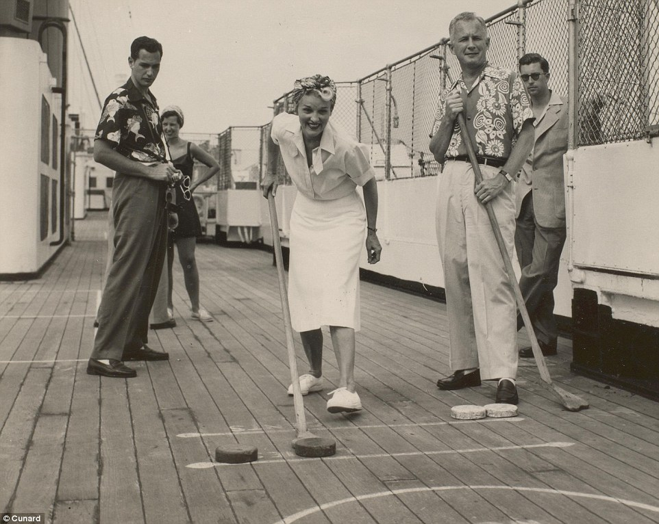
Rules of the Game
Five More Techniques from
Quite Inventive Designers
Your host
with
Richard Rouse III
Liz England
George Fan
Lee Perry
Michael de Plater
Emily Short
@richardrouseiii
@lizardengland
@TheGeorgeFan
@MrLeePerry
@emshort
Notes:
Welcome to the Rules of the Game session for 2016, I’m Richard and I’ll be your host.

Slide 2
Where do you get your ideas?
Notes:
Isn't this the question every writer dreads?
As if there's some magical process to it.
Anyone who's been working in a creative field, like writing, like games, knows that ideas are actually a dime a dozen. Ideas are cheap, implementation is hard.
But don't get me wrong, good ideas do help.

Slide 3
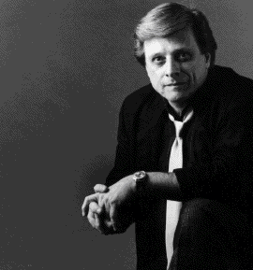
“Schenectady.”
– Harlan Ellison
Notes:
So writers have come up with pithy answers…

Slide 4
“From the idea-of-the-month club.”
– Neil Gaiman

Slide 5
“I make them up. Out of my head.”
– Neil Gaiman

Slide 6
Where do you get your game ideas?

Slide 7
How do you make your games fun?
Notes:
Protip for those of you maybe trying to get into games – avoid the word fun. Game designers don’t like it, because it’s too broad, too amorphous,
Of course we want people to have fun, but it’s not a useful descriptor.

Slide 8
How do you make your games work?
games
Notes:
I think a far more interesting question to ask designers is this…
Because it’s going from the idea to the working game that’s the hard part.

Slide 9
How do you make your games work?
prototypes

Slide 10
How do you make your games work?
systems

Slide 11
How do you make your games work?
enemies

Slide 12
How do you make your games work?
teams

Slide 13
Rules of the Game
Five More Techniques from
Quite Inventive Designers
Your host
with
Richard Rouse III
Liz England
George Fan
Lee Perry
Michael de Plater
Emily Short
@richardrouseiii
@lizardengland
@TheGeorgeFan
@MrLeePerry
@emshort
Notes:
Welcome to the Rules of the Game session for 2016,
I’m Richard and I’ll be your host.
I am the director/designer/writer at Paranoid Productions
where we are working on the action-infiltration game with the shifting narrative called The Church in the Darkness
Our format is simple – five designers get 10 minutes each to talk about a game design rule that is personal to them.

Slide 14
Rules of the Game 2015
Laralyn McWilliams
@laralyn
Chris Avellone
@ChrisAvellone
Dan Teasdale
@deliciousbees
Kim McAuliffe
@EnameledKoi
Nels Anderson
@nelsormensch
“Make Emotional Connections”
“Look for the Silver Lining”
“Chunk in Threes”
“Fight for the Little Things”
“Don’t Try to Evaluate Your Own Game*”
* But Only You Know What It Should Be
Search “Five Rules” on GDCVault.com
Notes:
So last year we held the first edition of this session
We invited 5 accomplished designers to share one of the “rules” they work with and go into detail about it for 10 minutes.
Last year’s talk is up free on the GDC Vault, I encourage you to go see it!
That session went well, and I thought, hey, we should do this again, and here we are. So I recruited five new designers who I thought did great work and could talk about one of the rules behind that good work.

Slide 15
Game design rules are personal, not universal.
Notes:
And as I said last year, game design rules are personal, not universal.
Just because you hear a rule here today doesn’t mean it is the final word on a subject.
I find the rules we get out of this session fascinating because of what they tell us about their creators.

Slide 16
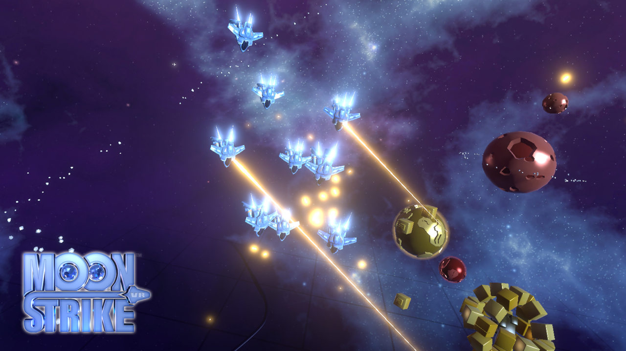
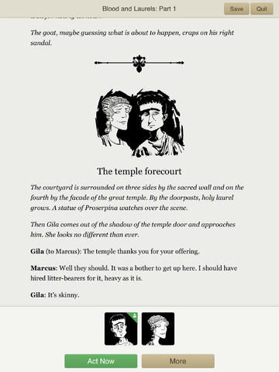
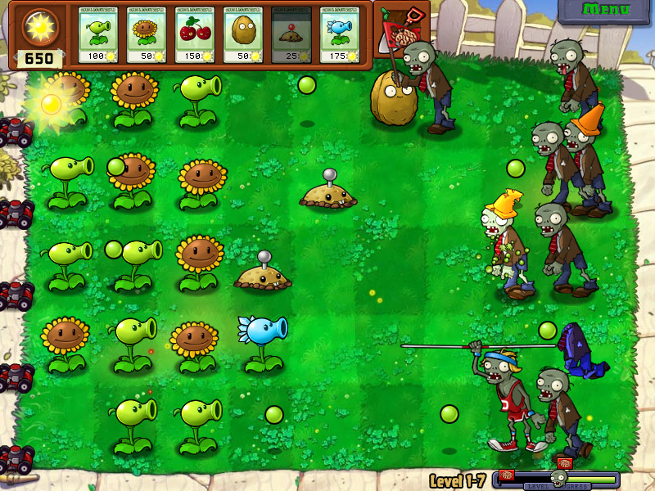
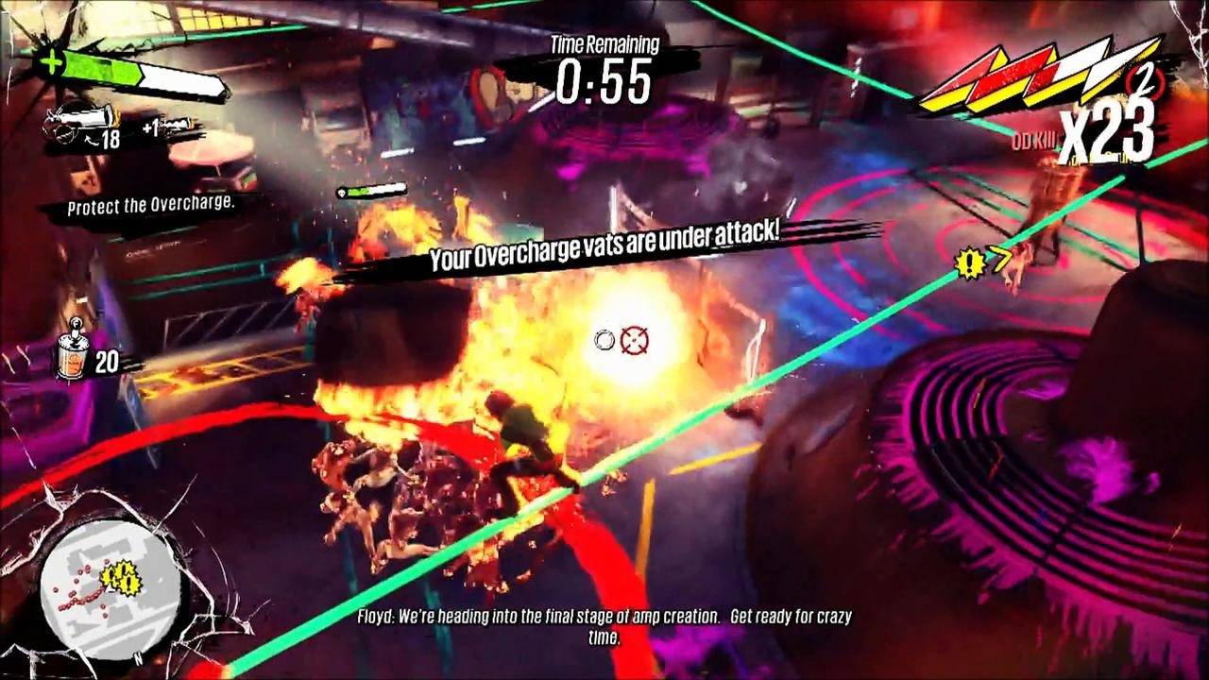
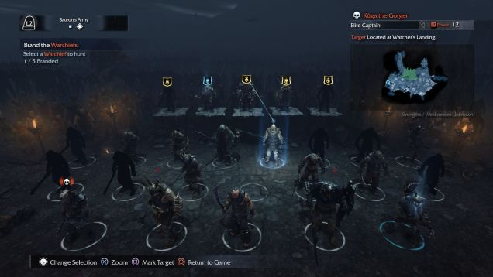
Notes:
I want to know what rules the developers behind some of these fantastic games had going in their mind when they made them
Not so that I can copy them, but so that I can think of what my own versions of these rules may be.

Slide 17
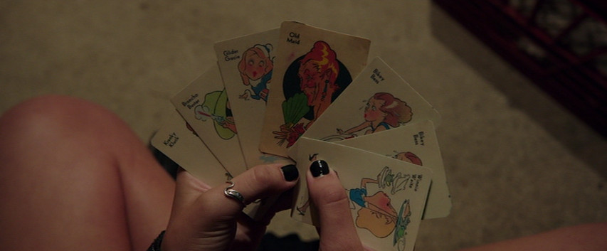
Notes:
I like to think of game design rules as a deck of cards that we as designers can choose to play when the time is right.
I’ve been working as a game designer for quite a while, so naturally I have my own deck of these rules
And sometimes I have rules specific to a project…

Slide 18
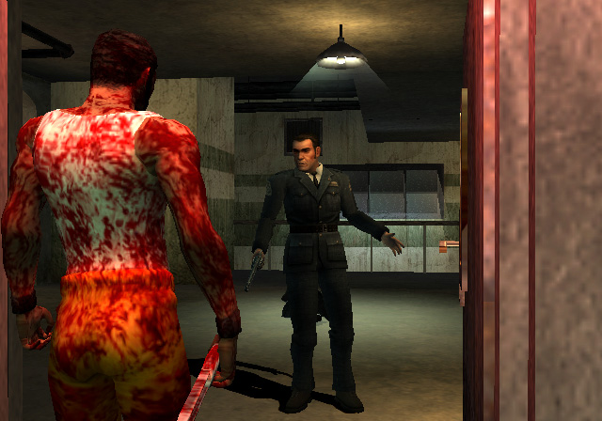
Consistent, rules-based, systemic world
Player makes a permanent impact
Player’s gameplay affects the narrative past and future.
Authentic to historical events (manifested in horrific creatures)
No easy answers.
“Your Game is Too Hard”
Notes:
For example, the rules I used on The Suffering project looked something like this.

Slide 19
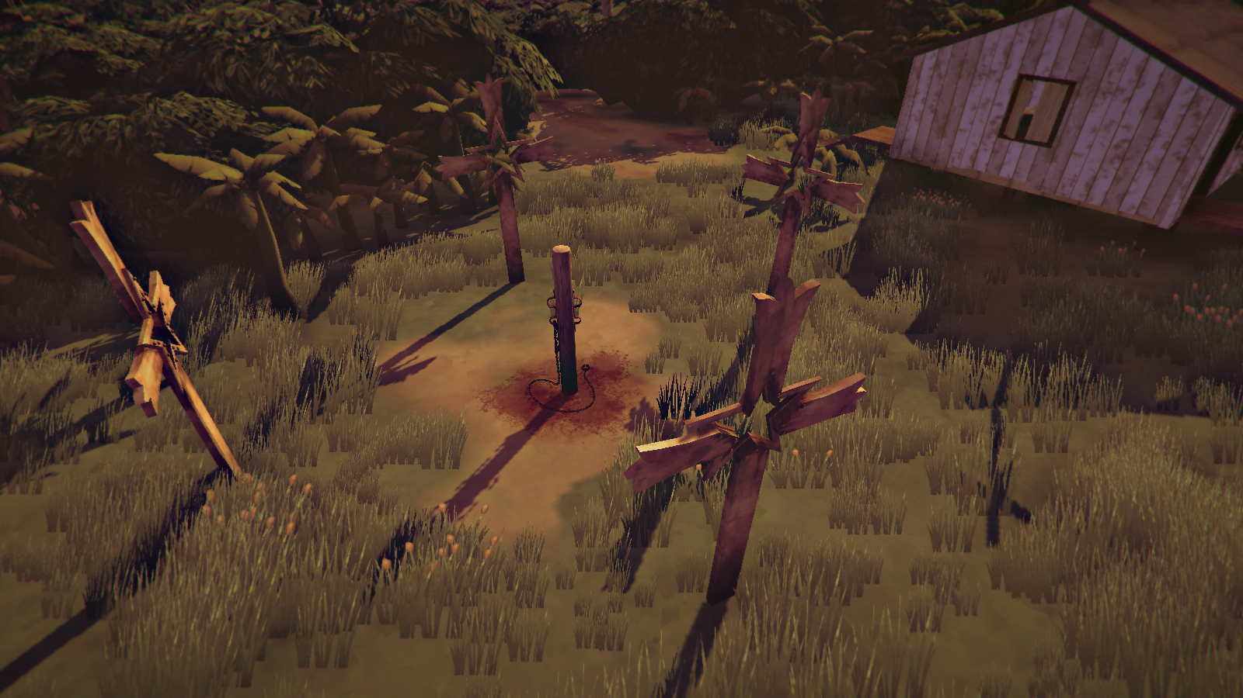
Consistent, rules-based, systemic world
Player makes a permanent impact
Player’s gameplay affects the narrative past and future
Authentic to historical events (manifested in horrific creatures)
No easy answers
“Your Game is Too Hard”
“Your game should be hard enough”
Shifting narrative & gameplay makes each playthrough unique
Notes:
Now for the Church in the Darkness, a top-down action infiltration game set inside a religious cult…
Some of these rules changed, because of the game.
Some rules I realized were wrong and I changed them.
I used to think that all games were too hard, because of a team’s necessary tendency to do that, but I realized you can overdo that – the Suffering turned out a bit too easy.
And of course, a new project probably brings new rules with it, that I may or may not continue to use in the future.

Slide 20
Nothing is Absolute
Constant Compromise
Notes:
People tend to object to defining rules because there is a possibility for these things to be mis-interpreted.
So I should say, of course, that in the craft of game design nothing is absolute
And working with a team you need to be thinking of constant compromise.

Slide 21
Notes:
BUT WHEN YOU ARE floating out to sea, into shark-infested waters…
I find that a strong personal goal or rule for yourself or your project can be that tool that pulls you out of shark territory and brings you back to the calm waters.

Slide 22
Notes:
So coming up…
A little later on, Emily Short is going to tell us how she tests her game before it's ready for testing
George Fan is going to tell us about how your enemies are not as different as you think they are
Liz England is going to tell us who you should make your design documents for.
Michael de Plater is going to tell us how systems can bring human stories

Slide 23
LEE
PERRY
Moonstrike VR, Lili, Gears of War 1-3
Designer – Big Dorks Entertainment
@MrLeePerry
Notes:
But first! Lee Perry - Lee Perry is an experienced game designer, having worked on….
And he's going to tell us how everything you know is wrong about when to polish (and when to add pizazz to) your game.

Slide 24
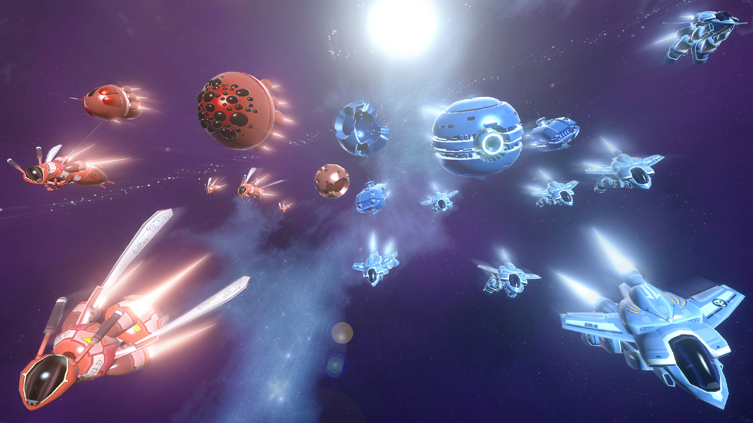

Slide 25
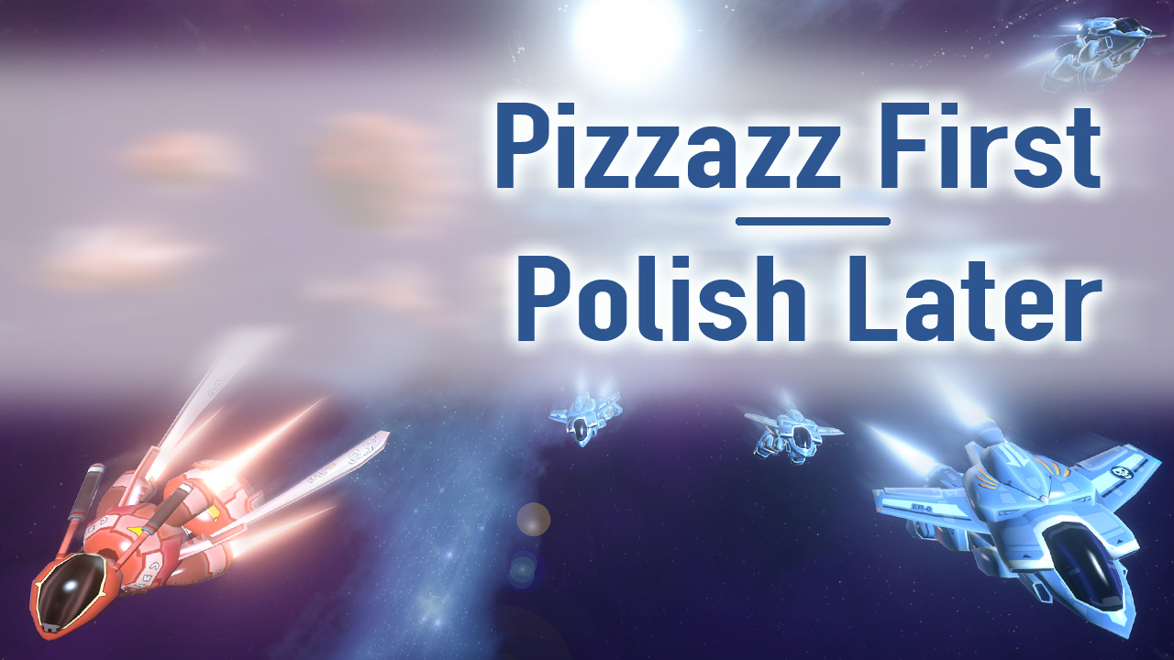
Lee Perry - Big Dorks Entertainment

Slide 26
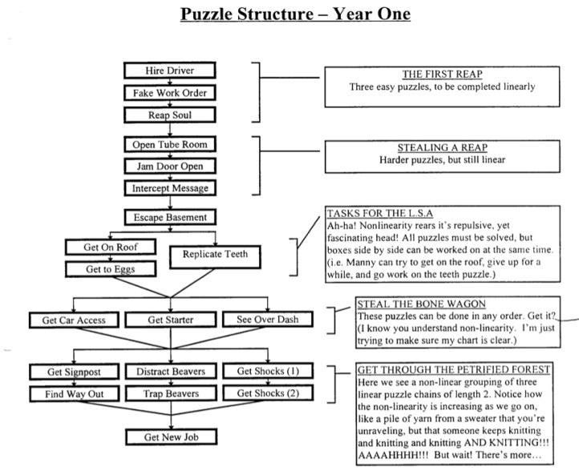
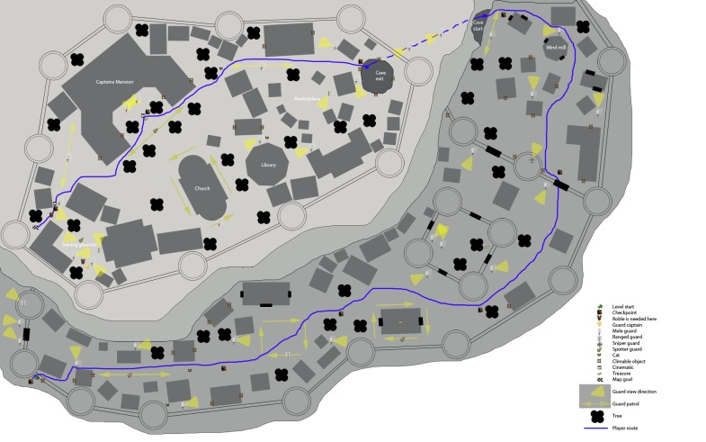
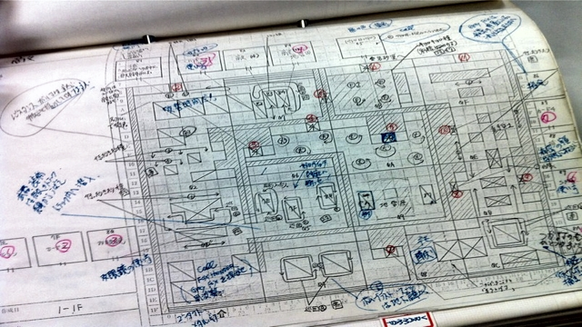
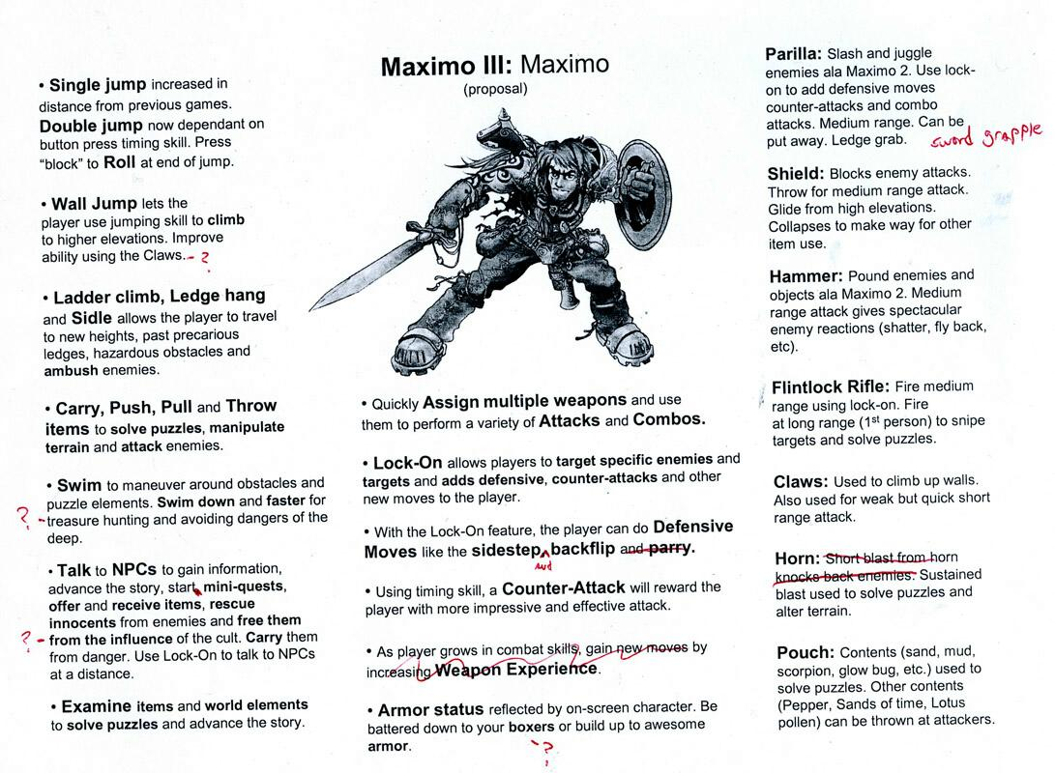
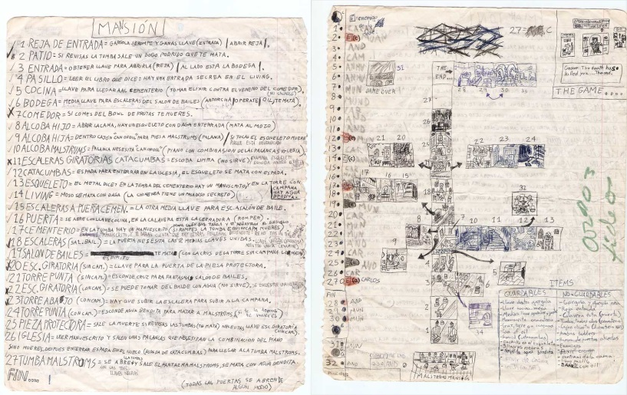
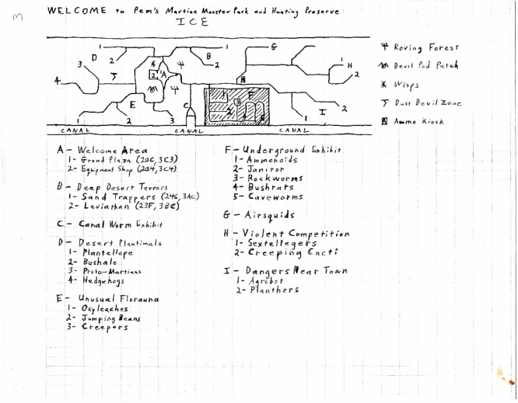
In the beginning…
Notes:
Starting out, like many, used to think games were about:
High concepts
Settings
Themes
THE CLASSIC BIG IDEAS!!!
MAPS!
BIOS!
At some point I like to think most designers “level up” and realize that game design isn’t *JUST* about the big concept…

Slide 27
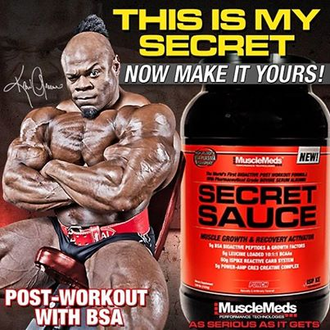
Secret Sauce?
Notes:
Great games have some secret sauce!

Slide 28
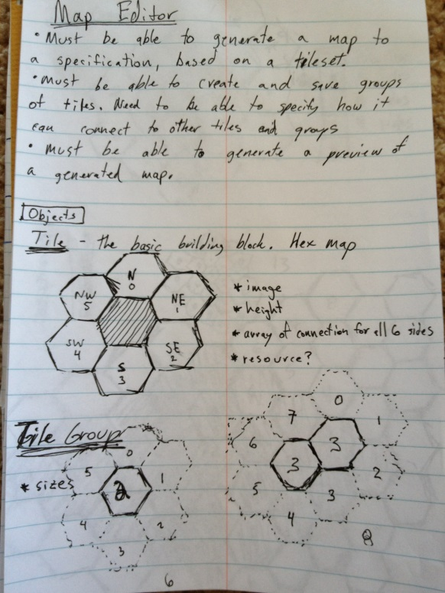
Secret Sauce?
Notes:
NOT JUST ABOUT THIS…

Slide 29
Player Feedback
Notes:
IT’S ALSO ABOUT THIS

Slide 30
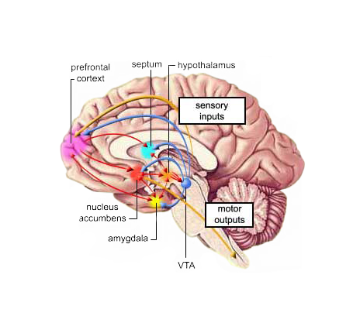
Player Feedback
Notes:
AND THIS Interacting with the game, and having a really satisfying response!
MOST devs understand the importance of great player feedback
It’s one NOT SO SECRET SAUCE that gives a game a sense of “character” and “soul”.

Slide 31
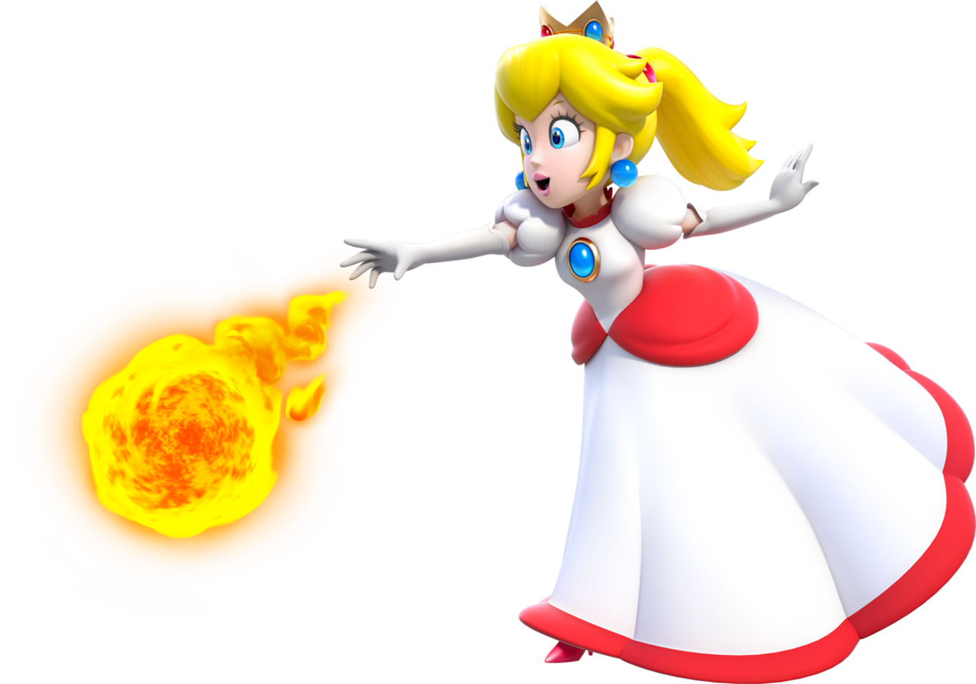
Player Feedback
Notes:
It’s about the joy of Mario jumps! Fireballs! Bashing a block!

Slide 32
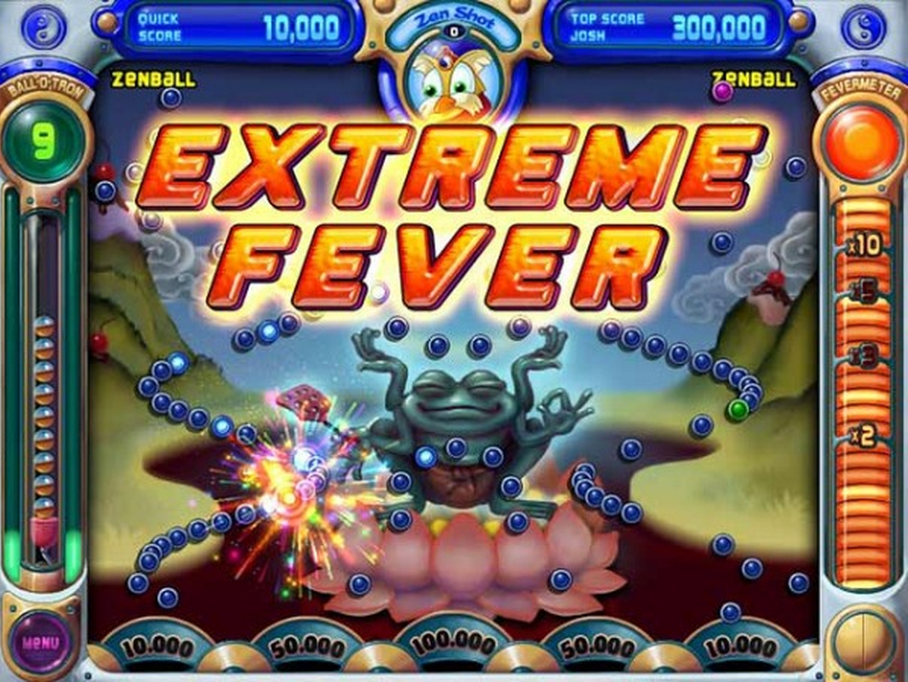
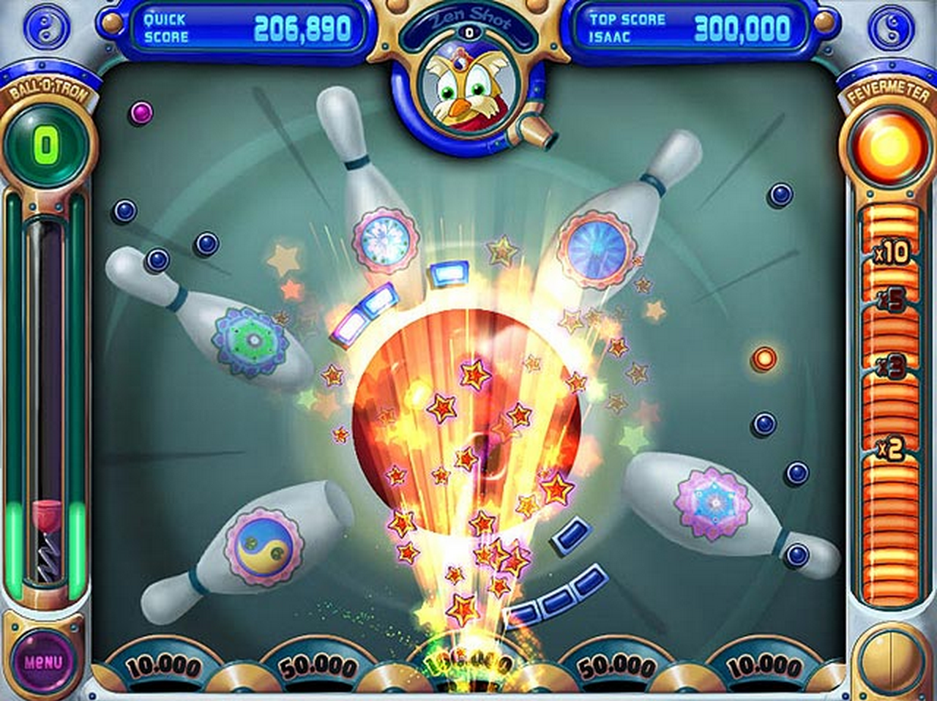
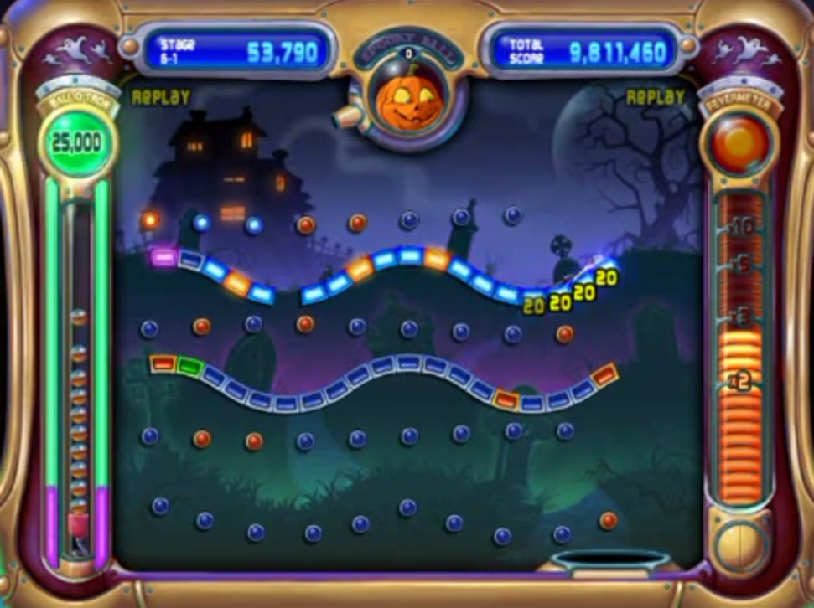
Player Feedback
Notes:
But PopCap is kind of among the Gods of Mt Olympus when it comes to making something *FEEL* awesome with amazing feedback. 1) They made the ball sound as it hits the pegs pitch shift up in this “ding diiing diiiiing” fashion. 2) Explosive Baskets! 3) End of level there’s that glorious slow motion effect and then the utter insanity of blaring “ode to joy” while fireworks start blasting.
Peggle is a master class in itself.

Slide 33
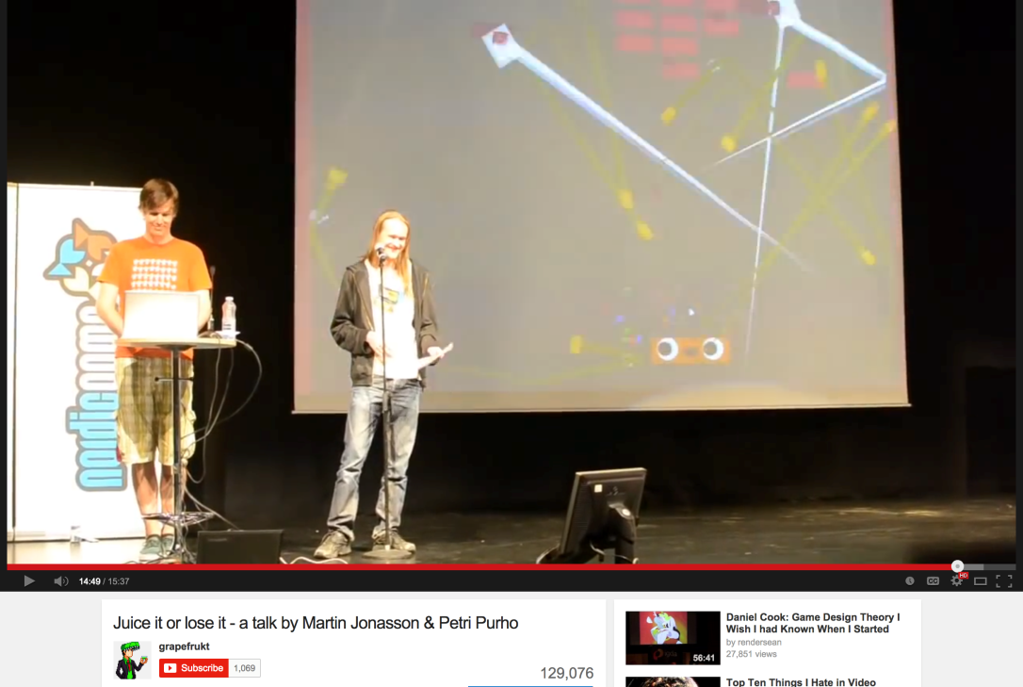
Player Feedback - Resources
“Juice it or lose it”
(Grapefrukt)
by Martin Jonasson
& Petri Purho
Notes:
Martin Jonasson and Petri Purho have an amazing video on YouTube where they take this very sterile Breakout clone and slowly add more and more feedback elements to it until it’s this insane experience. Their enthusiasm is pretty infectious, I definitely recommend watching it.

Slide 34
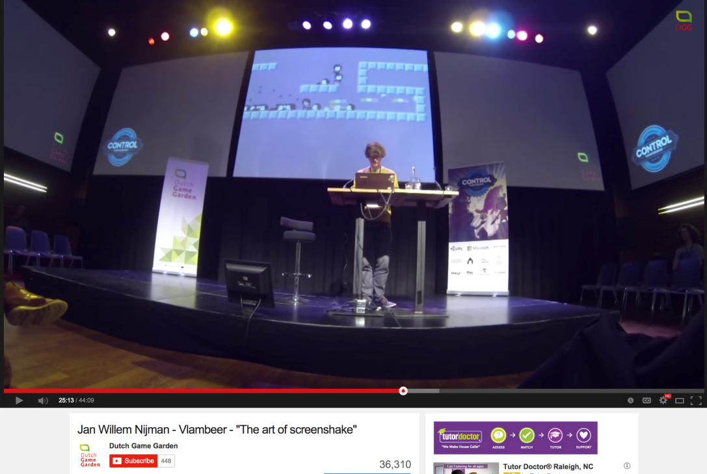
Player Feedback - Resources
“The art of Screenshake”
(Vlambeer)
by Jan Willem Nijman
Notes:
One other excellent speech was Vlambeer’s “The art of screenshake”, where again he starts with a rather sterile platformer and using primarily different types of screenshakes makes the game feel like this fantastic experience. Again, definitely time well spent checking this out.

Slide 35
Polish-o-meter
Polish level
Production Cycle
Notes:
IS FEEDBACK PART OF THE “POLISH STAGE?”

Slide 36
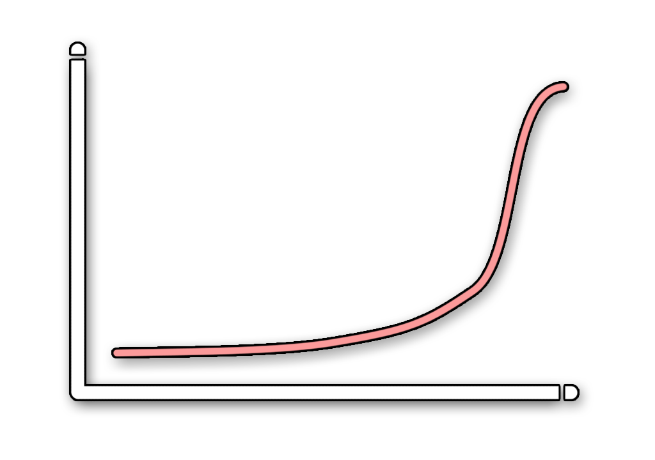
Polish-o-meter
Polish level
Production Cycle
Notes:
To me though, I still thou
Problem is, we all know things get cut at the end of a game.
It’s hard to tell publishers or partners that the game needs to wait while you “add the fun” at then end. ght polish simply needed to come online at SOME point before you shipped.

Slide 37
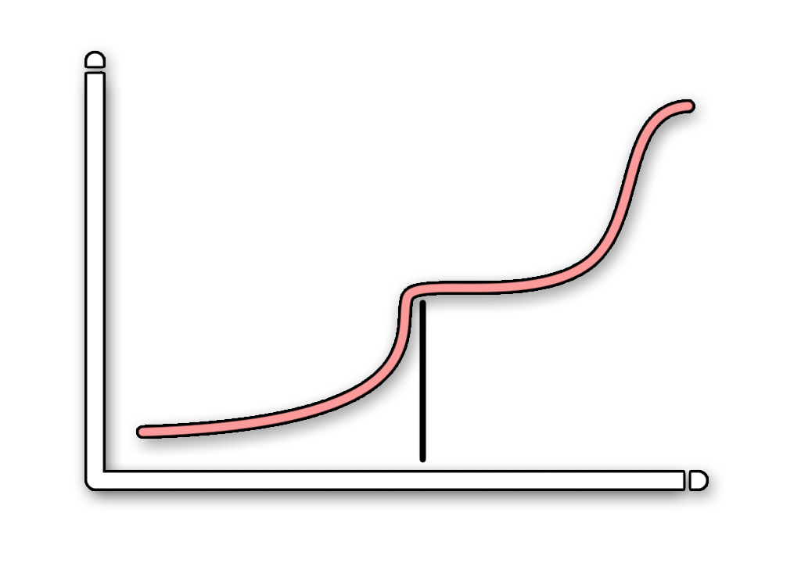
Polish-o-meter
Polish level
Production Cycle
Notes:
Or sometimes a key demo or press push would mean we bumped it up earlier. The BIGGER issue is that it’s still not taking real advantage of what great player feedback has to offer.

Slide 38
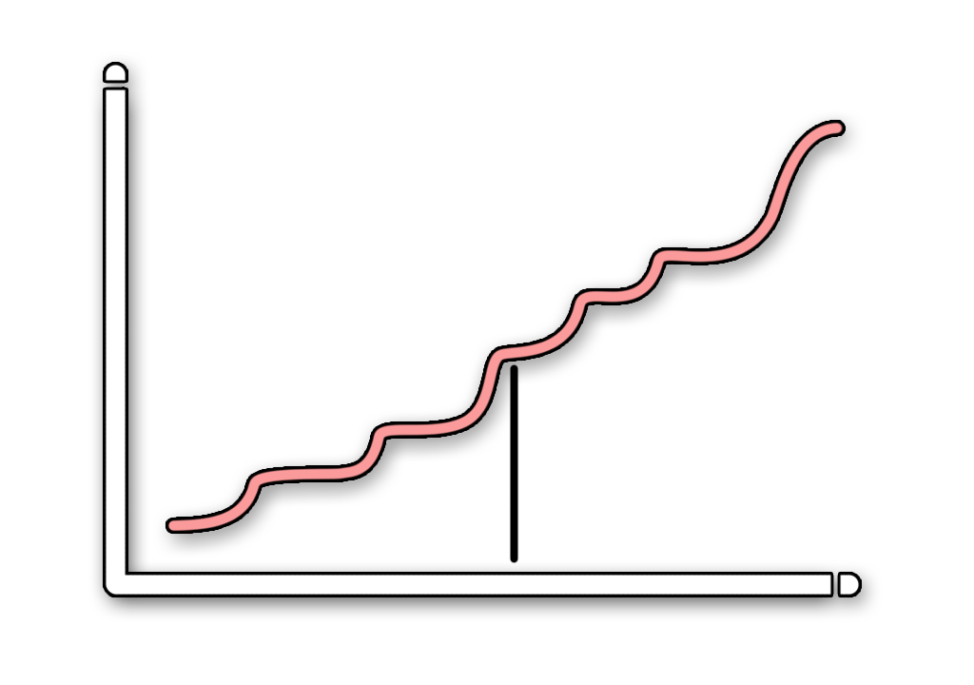
Polish-o-meter
Polish level
Production Cycle
Notes:
During Gears of War 1, I made a TON of our prototypes for creatures, weapons, etc.
and the project looked more like this!
Why?
A constant pattern of pitching and debating… But once we had a fun prototype everyone would get on board.

Slide 39
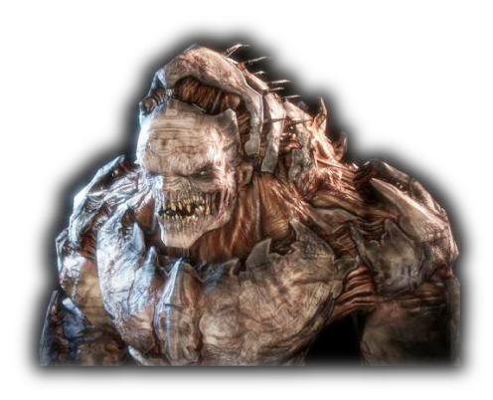
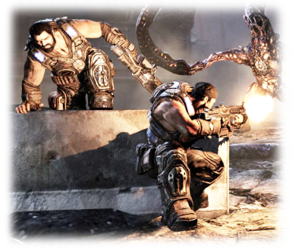
Polish-o-meter
Notes:
Saw it with the cover system early on. Super debated, some HATED the idea
Then we added all kinds of awesome to it… SOLD!
*NOW FLIP THROUGH OTHER EXAMPLES!*
With the chainsaw on the lancer, having a shotgun at all, creatures, boss fights… you name it. We would have debates, until someone too a moment to make them “feel” great, and it suddenly became “real”.

Slide 40
Polish-o-meter
Polish level
Production Cycle
Notes:
Internal salesmanship.
Adding polish was KEY, not to the player, but to the TEAM working on the game!
(publishers too!)
This is a dev tool!

Slide 41
“SOLO” Polish-o-meter
Polish level
Production Cycle
Notes:
Two years ago, started making games on my own.
AHHH! I didn’t need to sell and pitch to anyone!
Soooo…

Slide 42
“SOLO” Polish-o-meter
???
Polish level
Production Cycle
Notes:
…what does it all mean now? When do I get all juicy?!
Just SOME time before I shipped? Revert to old snakey here?
One problem for tiny indie projects… CRIPPLING SELF DOUBT! Turns out: Feedback isn’t JUST for players!
Feedback isn’t JUST for your team! Feedback is for YOU yourself!
It’s an amazing motivational tool!

Slide 43
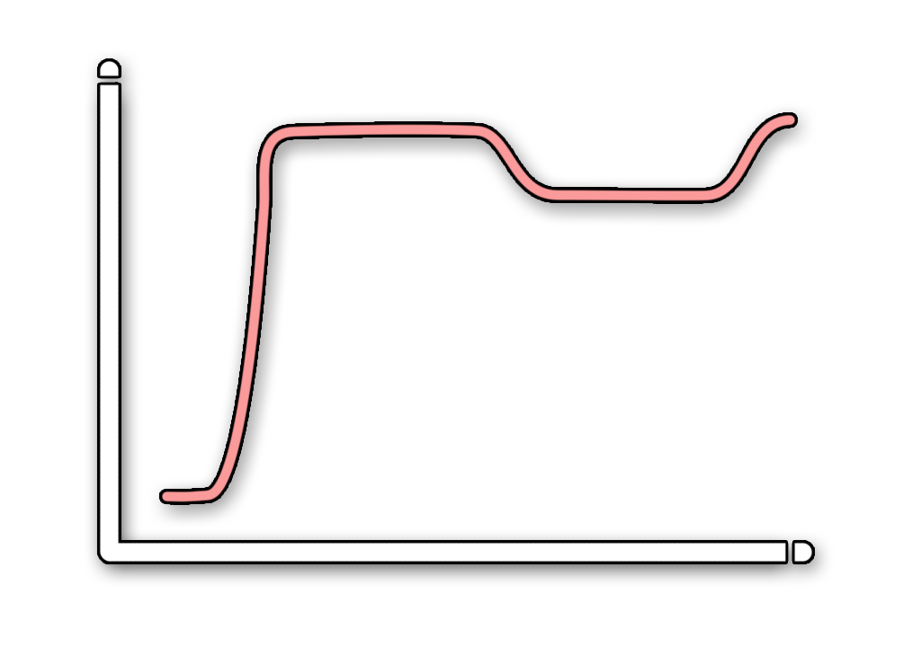
Polish-o-meter
INSANE!
Polish level
Production Cycle
Notes:
IN AN IDEAL MAGICAL WORLD, WE WOULD HAVE THIS!
How awesome would it be to have all this polish UP FRONT?!
How cool to know your game’s soul like that, so early on?!
INSANE!
THAT’S INSANE!!! You can’t just start off polishing step 1!
You’re right. We have to detach our concept of “feedback” from “polish”…

Slide 44
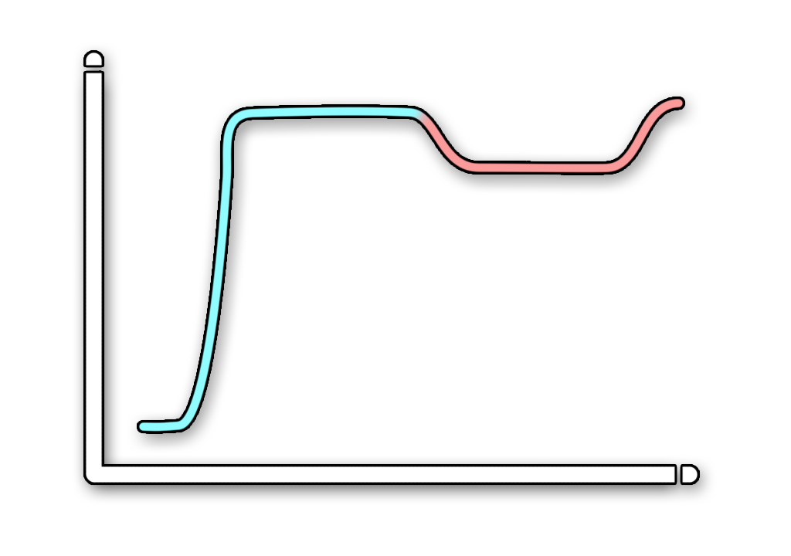
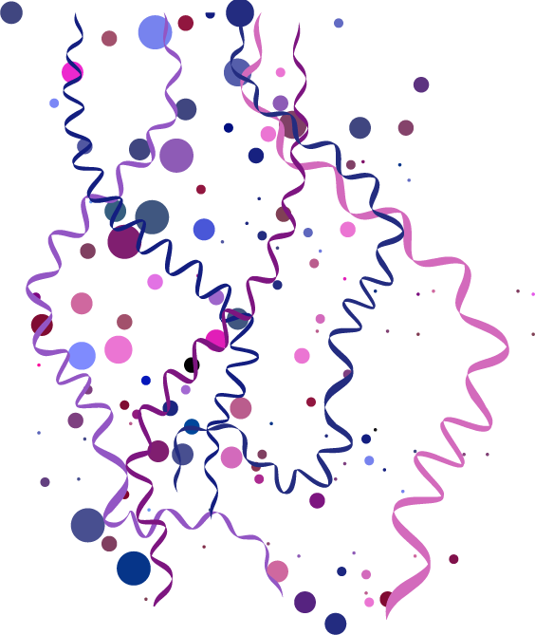
PIZZAZZ -o-meter
Polish level
Production Cycle
Notes:
It’s NOT not feedback!
It’s definitely not POLISH!
It’s ***PIZZAZZ*** instead! Weeeee! WHAT?! You can’t just rename something and make it work?!
LEE!!! How is “Pizazz” different than “polish” or “feedback” or “JUICE”?! Simple… It can be throw away, you’re not super attached to it. It’s punchy punchy placeholders.
Early on, is when you MOST need joy to manifest in your game! You MOST need to see the promise!
You MOST need that feeling like you’re really “on to something”! Later on, replace this stuff.
But, early on they’re the scaffolding of “fun” for your game.

Slide 45
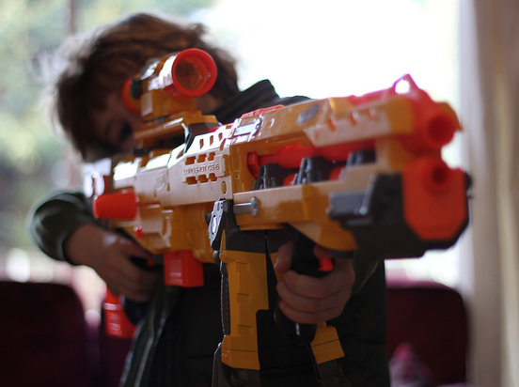
PIZZAZZ
Notes:
What is Pizazz!?
Pizzazz is our child level imaginations!
“WOOOOOOOOOOOOOOOOOOOOOOSH! AKAKAKKAKAKAKAKAKKA!”
“BASH ABASHABASHHHH!” WEEE OOOOOOWEEEEOOOOO!”
“PBUBUBUBUBBUBUBUBUBU! RWARRRRRRRRRRR! KKUKUKUKUKUKUKU! PEOOOO! FOOOOOM! BOOOSHH!HH!!!!”
The sooner your project can tap into at least SOME of that childlike joy from playing with a toy, the better you’re going to feel about your project as you progress. CONCEPT ARTISTS CONSTANTLY DO THIS!

Slide 46
Easy Pizzazz
Particle libraries!
Punchy sounds!
Screen shakes!
Dynamic lights!
Music!
Post Processing!
Camera moves!
Physics!
Notes:
There are a handful of generally accepted player feedback techniques that work great also as Pizzazz because they’re generally very simple to incorporate
Sounds - completely over the top is fine!
Particles – huge cheap libraries to drop in everywhere
Screen Shake – Everything!
Dynamic Lights - you might not be able to ship with some of these, but tying a crazy overbright light source to something can immediately make something feel intense and powerful.
Music – No sound guy? Go slap in anything you can get. Try soundrangers or stock music sites. Post Processing – bloom, blur, whatever!
Physics – People love physics reactions, they’re like free cool behaviors!

Slide 47
Early Dev Benefits
Nail down a “core loop”
Emergent “rabbit holes”
Encourages you to show your game
Confidence is fuel!
Notes:
EVEN FOR SOLO GAMES… BENEFITS FOR EARLY START ON THIS STUFF!
Lets you get a better establish your “30 seconds of fun” that you’re often trying to build the rest of the game around.
Unexpected aspects of your game can become really key features!
A game that has a lot of PIZZAZZ is one that you’re more likely to pass around and show people on short notice… you’ll get more feedback on it, and be more willing to take it out for a walk once in a while
The biggest benefit is one of confidence in your project. If you believe that when you hand the controls to another player, they’re going to truly enjoy it and see the potential, it colors EVERYTHING about that project. You get more excited about working on it, you get lost in your own game as you try out random builds, etc… it provides those moments that make many of us so excited to breath life into games in the first place.

Slide 48
VR Benefits
Helps train the player
“Known” techniques still work
Elevate your projects and pitches
Notes:
Working with VR lately, it has really became apparent how beneficial these techniques are.
Tutorials aren’t needed so much, good feedback can do the trick. “YES! Do more of that!”
SO many unknowns… But many old feedback techniques still work (not screen shakes ☺ )
The bar is relatively low right now. Adding feedback can make your project “a thing”

Slide 49
Example!
Notes:
Prepare yourself!!!
BEHOLD! VIRTUAL… VIRTUAL REALITY!

Slide 50
Notes:
1

Slide 51
Notes:
2

Slide 52
Notes:
3

Slide 53
Notes:
4

Slide 55
Early Results
In addition to the usual benefits
Support from Valve
Official demo for Oculus Touch
Attracted a dev partner
Several great articles
Notes:
BY DOING JUST A FEW THINGS LIKE THE HOOP…
In addition to the usual benefits
- Feeling more legit
Personal interest in playing the game
MORE FUN DEVELOPMENT
Etc…
Attention from Valve
- Early dev support
Official demo for Oculus Touch
- Oculus signed the project for a Touch Controller launch
Attracted a partner
- Programming /business partner sought me out
Several great articles
- Game informer, several VR publications

Slide 56
Soooooo?
You’re going to add feedback anyway (RIGHT?!)
Just frontload some!
Doesn’t have to be perfect!
It’ll help your whole process!
IT’S NOT POLISH, IT’S PIZZAZZ!
Notes:
You’re going to add feedback anyway
-UNLESS YOU’RE CRAZY!!!
Just frontload some!
- FOCUS ON YOUR CORE ACTIONS
- MAKE IT BIG
- ADD MORE THAN YOU THINK
It’ll help your whole process!

Slide 57
Thanks!
Lee Perry
@MrLeePerry
Notes:
Adios!

Slide 58
LEE
PERRY
Moonstrike VR, Lili, Gears of War 1-3
Designer – Big Dorks Entertainment
@MrLeePerry
Notes:
If anything, Lee’s talk reminds us of how political the act of being a game designer on a big team can be.
You have to be constantly selling your ideas, not only to your bosses/publishers, but also to the team itself.

Slide 59
EMILY
SHORT
Versu (including Blood & Laurels)
Sunless Sea, Galatea
Designer & Writer - Freelance
@emshort
Notes:
Next up, we have Emily Short!
Richard Intro for Emily
She’s going to tell us how she tests her game before she even has testers.

Slide 60
EMILY
SHORT
Versu (including Blood & Laurels)
Sunless Sea, Galatea
Designer & Writer - Freelance
@emshort
Notes:
I’m a freelance consultant in interactive narrative, which means that I spend a lot of time with different toolsets for writing and managing content and dialogue. Sometimes I build my own tools, sometimes I work with other people’s freeware tools, sometimes I work with proprietary tools that my client came up with. I’ve worked on a number of projects, including recently writing several of the island stories in Sunless Sea.
I’m here to argue for a pretty simple principle:

Slide 61
VISUALIZE
EARLY
Notes:
When you’re designing a new system, think about how you’re going to visualize its behavior.

Slide 62
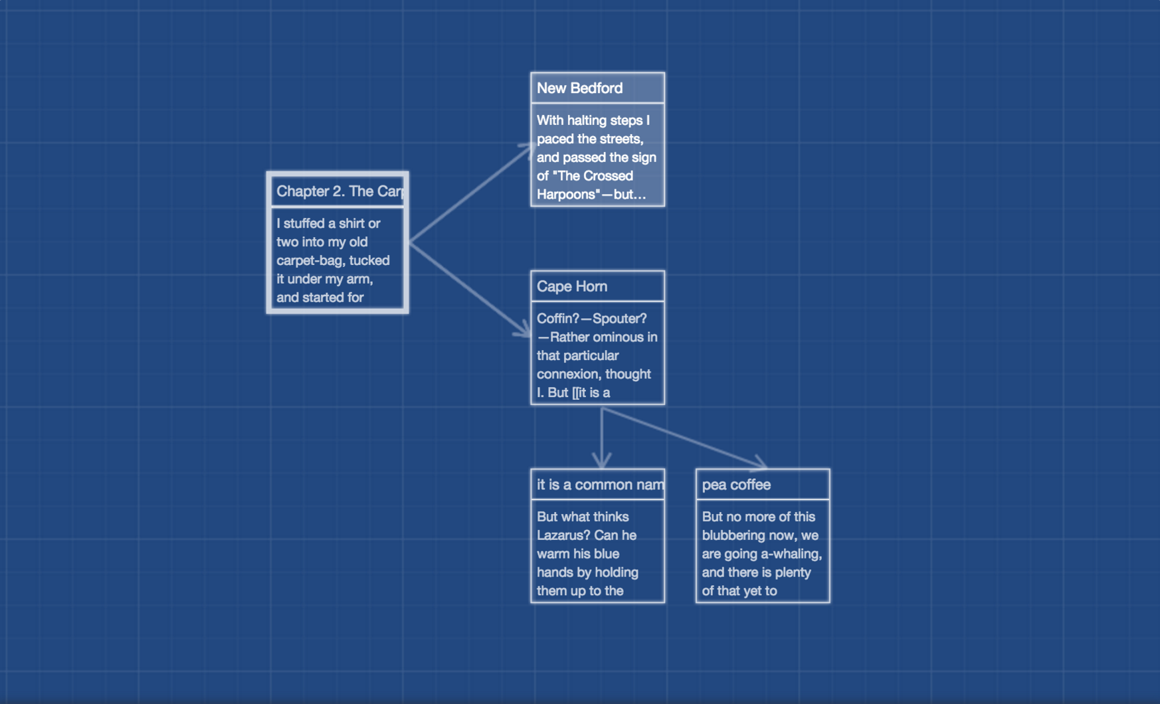
VISUALIZE
EARLY
Twine hypertext interface
Notes:
If you’re working on something with dialogue or narrative structure, that might mean visualizing how parts of the story or conversation feed into one another

Slide 63
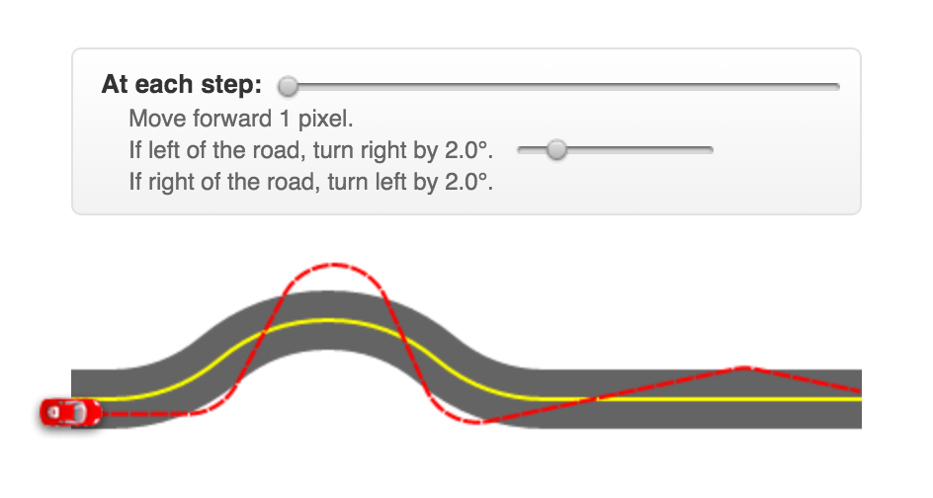
VISUALIZE
EARLY
Bret Victor, dynamic visualization
Notes:
If you’re working on dynamic system, that might mean heat maps. It might mean taking traces of many consecutive runs and laying them on top of one another. It might a dynamic visualization tool that projects movement in response to variables that you’re changing.

Slide 64
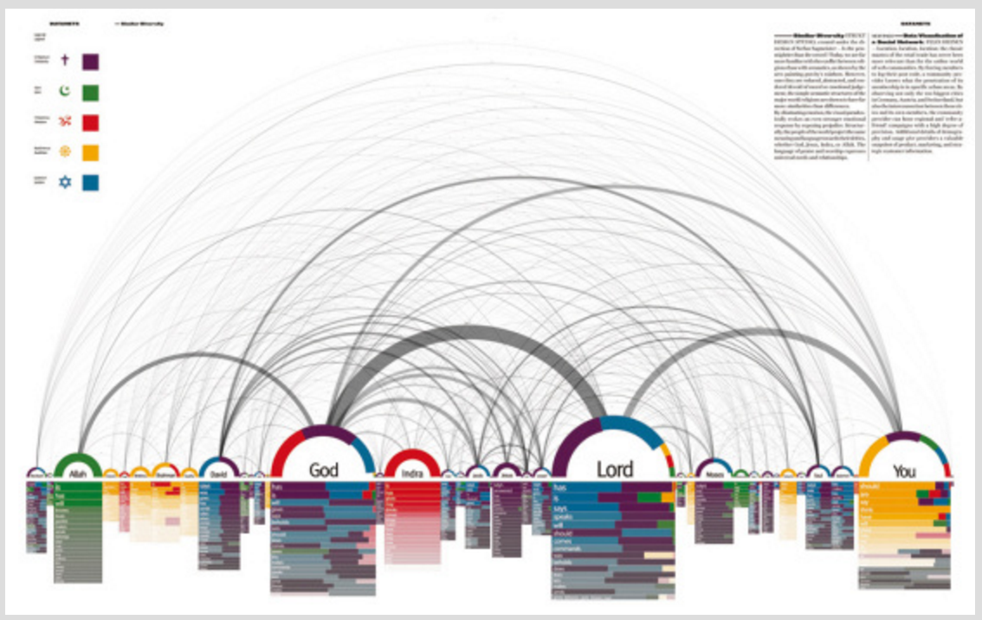
VISUALIZE
EARLY
Similar Diversity, on terms in religious texts - Processing.org
Notes:
If you’re building a procedural system that uses lots of content data, it might mean coming up with ways to picture how much data you have, what categories it breaks into, and how you’ll know when you have enough – here’s an example that analyzed the words in English translations of major religious texts and represents how often particular terms appear in each text.
So I’d like to take us through how I’ve used early visualization in several of my own projects, and then expand to talk about how the same approach might apply to other kinds of work besides narrative-focused projects.

Slide 65
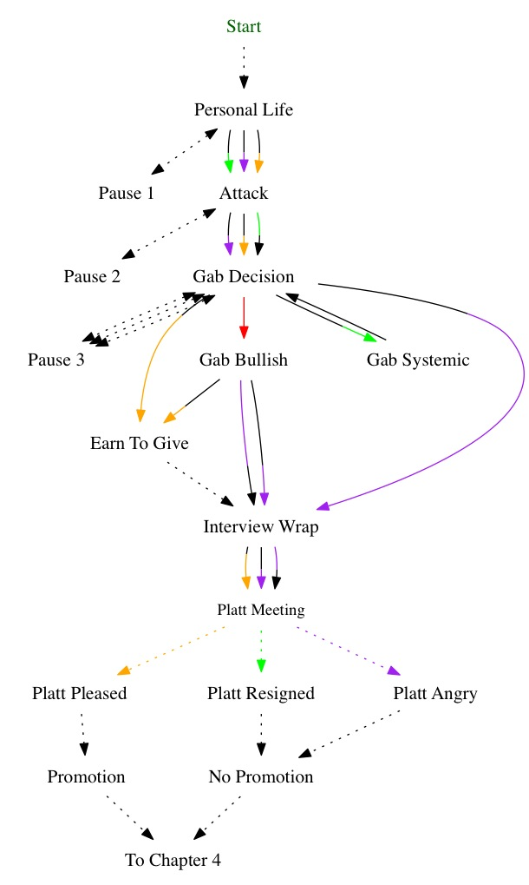
Platinum Package
(in progress)
Notes:
Here’s an in-progress visualization of a chapter in Platinum Package, a story I’m writing for Choice of Games’ line of branching novels. It may look like it’s a design document of some kind, but this is actually the result of running a Python script against the code for this story and automatically generating a dot format file that can be read into GraphViz. The visualization shows us the structure of part of one chapter.

Slide 66
Notes:
The visualization distinguishes player choices, which are represented by solid lines, from automatic transitions, which are dotted lines. I can immediately see that I have a mix of player choice and consequence, with the consequences clustered at the end of the chapter, which is what I want.

Slide 67
Notes:
Meanwhile the colors of the lines show what kinds of stat changes are happening when the player makes these decisions – each color corresponds to a different stat that could be going up or down.
Transitions in red are ones that have no stat effects. When those are missing, that’s a failure state that I need to be aware of.

Slide 68
Platinum Package
(in progress)
Notes:
This chart keeps up with changes that I’ve made to the story, so unlike a hand-generated design document, it doesn’t go out of date. That’s important, because I’m responding to feedback from my editor as the story progresses, and over these iterations the game is diverging from that original document. I could do meticulous upkeep on that document, or I could just have a way of seeing directly into the code.

Slide 69
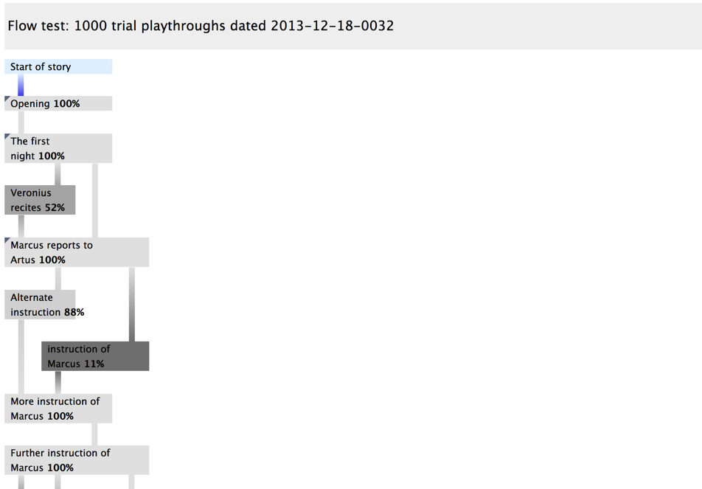
Notes:
Now here’s a case where the visualization I’m doing is further from a spec document and closer to a playtest report.
Versu is a project I worked on for several years that involved characters with an AI-driven approach to social interaction. That meant that there was an authored structure of a number of different scenes, but within each scene what happened was highly dynamic, depending on the moods and relationships of the characters. From a QA perspective, this meant we needed to go well beyond just having playtesters play the game a number of times. Instead, we would run thousands of trial playthroughs with an additional AI agent making the player’s choices randomly.
This chart shows the way we then visualized the resulting information. This is just the beginning of the chart – it actually continues for a bunch more scenes. But even so it may be tough to read on this slide, so let’s zoom in…

Slide 70
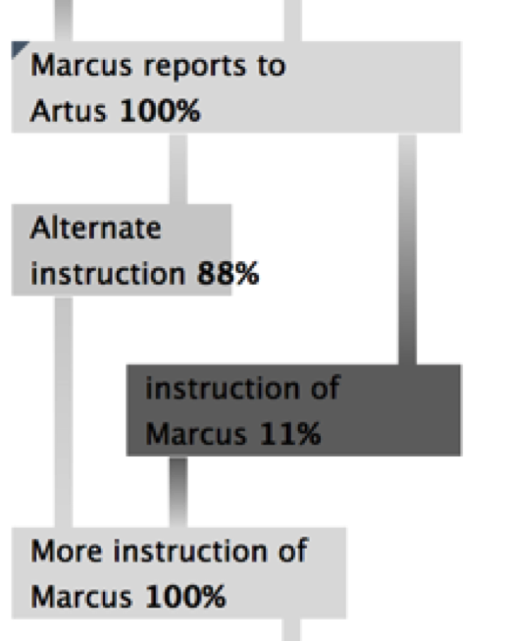
Notes:
So here we’re seeing just a few scenes of the game.
The first scene can end in one of two ways. Percentages indicate how many times the random player reaches each of the optional scenes. Scenes the AI reaches frequently are light grey; those it reaches more seldom are darker grey. Here we’re seeing that the AI reaches the “alternate” scene 88% of the time and the “instruction” scene 11% of the time.
If there’s a scene that the AI never reaches, that gets colored in red, to indicate that there is probably an implementation problem preventing access. Again, the visualization is designed to call out problem states.
In fact in this case because I had some help from the tool designer, we were able to build a visualization tool that was itself dynamic. So if I looked at one of those story nodes and wanted more information about what was happening during that node, I could click and open it up....

Slide 71
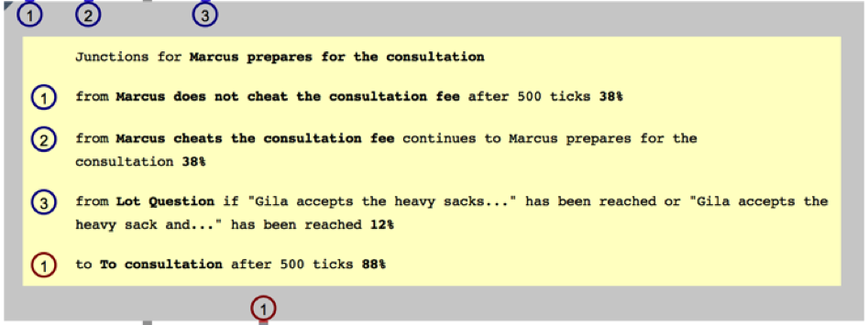
Notes:
And now I can see all the possible ways to transition into that scene and what the percentages are -- what percentage of the time this scene is reached from each of the nodes that could lead into it, and where the simulation usually goes next.

Slide 72
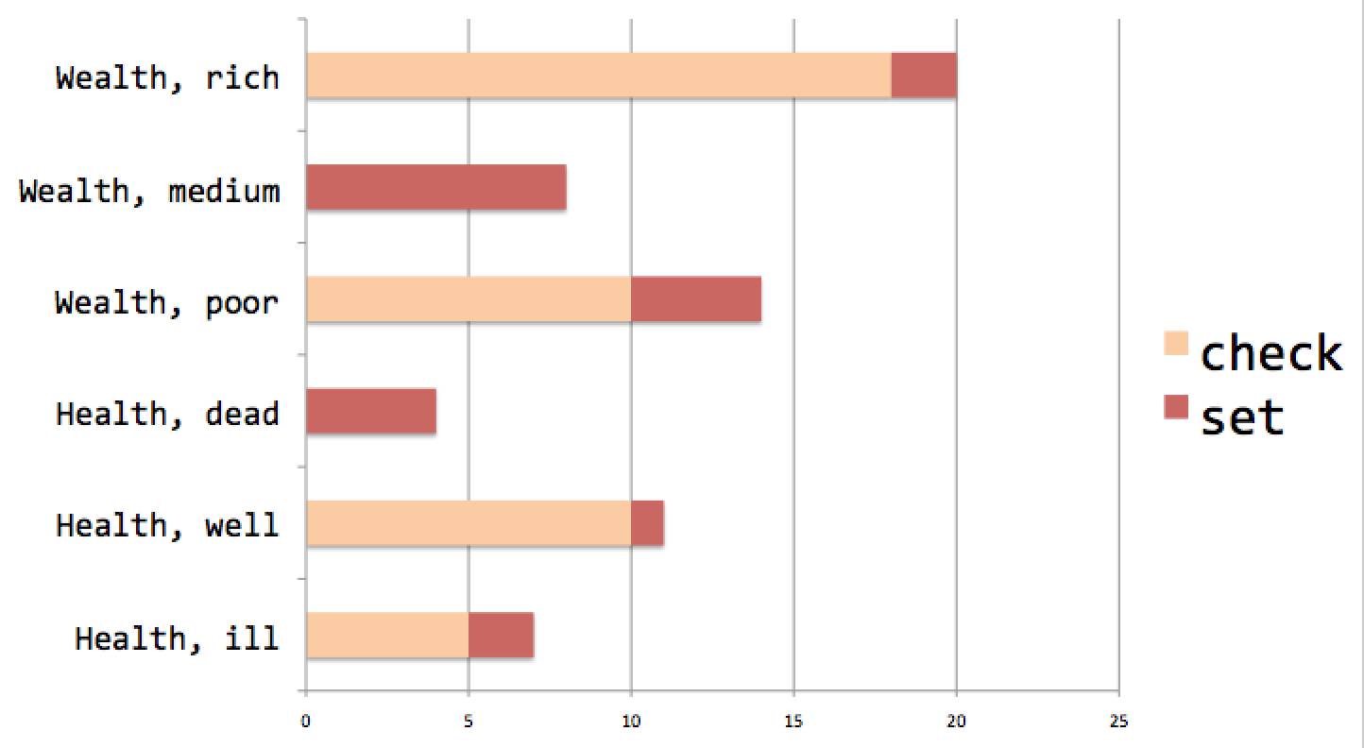
Notes:
Finally, I think it’s important to make the point here that your visualization doesn’t have to be attractive. I started the slide show with a bunch of pictures by people who are much better at visualization than I am, but it doesn’t have to be like that to be functional.
(If this picture is unsexy…)

Slide 73
Yes, sometimes I’m just using Excel
Notes:
If this picture is unsexy, that’s on purpose – it still represents something very useful.
This is a simplified version of how I looked into an experimental procedural narrative system that used a lot of event data. We had written a bunch of events that could be selected to occur next depending on whether the protagonist had certain status features. And, of course, an event could also change the protagonist’s status.
Running a simple script to count checking and setting instances for each quality and then charting the result in Excel helped get a visual sense of what was happening. For instance, in this representation, the wealth = rich attribute is being checked frequently but set infrequently, which is a warning that the system contains a lot of data that might rarely have a chance to fire.

Slide 74
Even conditional cell formatting counts as visualization
Notes:
Another question I had about this data set was how specialized the events were. An event could be checking multiple prerequisite qualities at a time. To get a sense of whether I was getting good coverage for all the values of qualities, I threw some count data into a conditionally-formatted Excel sheet.
For instance, this would tell me quickly that I’d created a lot of events specific to being poor and sick, say, or rich and healthy, but no events tied to being well and medium-wealthy.
Obviously with the real data there are many more entries to the sheet, but dead zones are instantly visible.

Slide 75
Visualization is good for you
Notes:
Now it might seem like this is a really really open-ended piece of advice that would work out wildly differently for different kinds of projects. And it might also seem like I’m asking you to gain some new expertise that isn’t necessarily in your wheelhouse as a designer.
I find that even asking myself the question, “what would a picture of this look like?” gives me a new angle on thinking about the quality of that design. A good visualization puts emphasis – like color or size – on things that are wrong or important. So what kind of information about your system is important? And what can go wrong?
If you have a system with a large amount of data, thinking about visualizing that data means you’re going to have to think about things like data types, what might characterize bad or good data, how much data you need, and whether you have adequate coverage of different aspects of your game world. And if you’re not a programmer but you have one handy, you might want to talk to them at this stage about how they’d approach this.

Slide 76
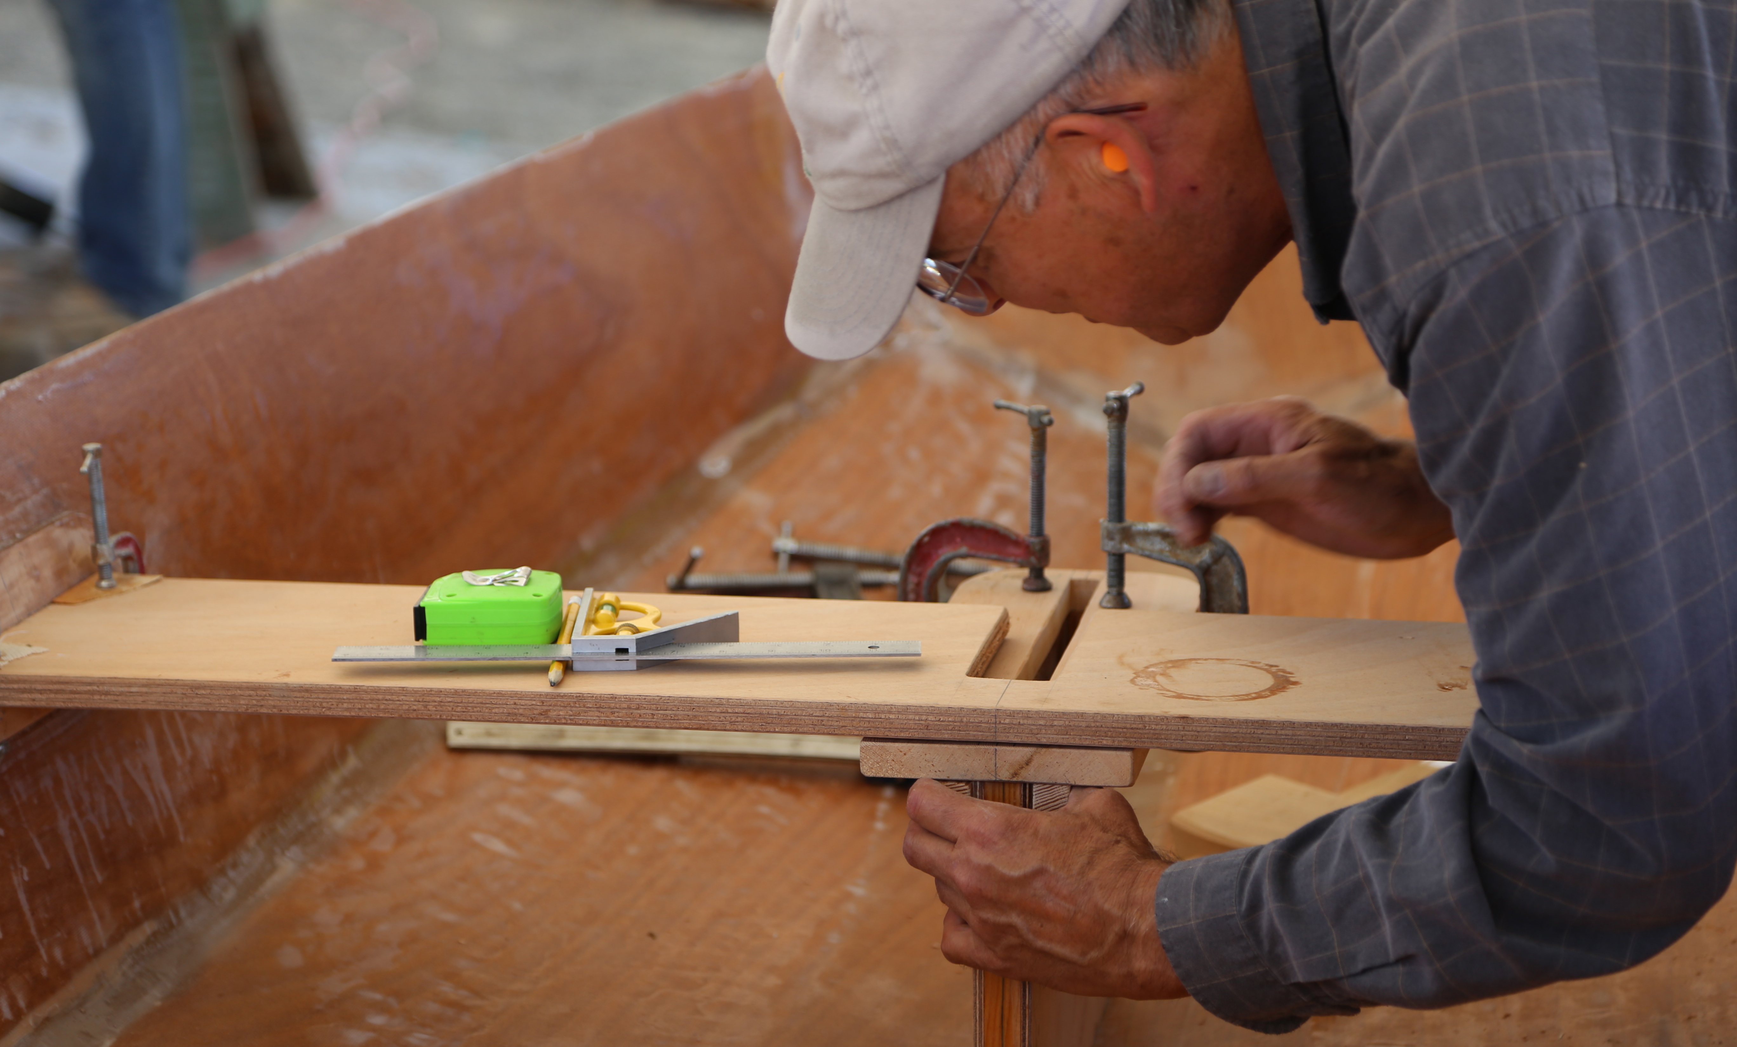
You’ll get better tools, too…
Notes:
Two: the sooner you have these ideas, the sooner you can build them into your tools. Or specify them so that your tool programmers can start building them into your tools.
No, you’re not going to anticipate everything that could possibly happen as the system evolves. But one of the useful things about a visualization is that it helps you instantly recognize issues in whatever you’ve just built. Anything you can do that highlights content problems *while they’re being generated* will save you huge amounts of time later catching and debugging them.
Conversely, anything that makes content creators feel *confident* about what they’ve built while they’re building it leads to faster, better content.
Here is how to make Future You really really hate Current You:

Slide 77
“We’ll just rely on the content creators to make sure this data is formated correctly.”
Notes:
Your content team may be geniuses and they may be really detail oriented people, (but you want as many ways as you can to find their mistakes anyway.)

Slide 78
Notes:
(but you want as many ways as you can to find their mistakes anyway.) We all know why spellcheckers are useful. Putting in more visualization options gives you more corrective tools.

Slide 79
Noah Falstein,
Puzzle Dependency Diagrams
Notes:
I’m not by any means the first person to stand up here and talk about how to visualize particular aspects of what you might be building as a designer. Here’s Noah Falstein talking at the narrative summit a couple of years ago about puzzle dependency graphs to manage a puzzle based game >>

Slide 80
Alex Champandard,
Believable Tactics for Squad AI
Notes:
Here’s a great talk from Alex Champandard at the 2012 AI summit which includes some discussion of how to visualize the behavior of squad AI

Slide 81
Graham/Dawe/Schwab, AI Pr0n: Maximum Exposure of Your Debug Info
Notes:
…and here’s a whole panel from the AI Summit in 2011 – Rez Graham, Michael Dawe, and Brian Schwab talking about visualizing expected AI behavior.

Slide 82
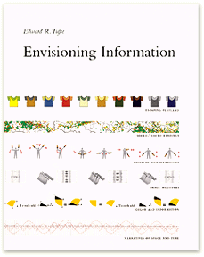
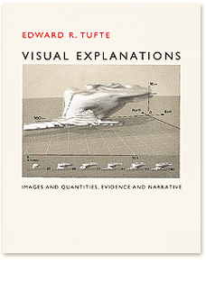
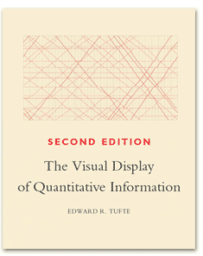
Edward Tufte
Notes:
Outside of GDC talks, you might also want to get some visualization ideas from Edward Tufte’s books.

Slide 83
Bret Victor, worrydream.com
Notes:
Or from Bret Victor’s website…

Slide 84
VISUALIZE
categories
Notes:
Whatever you’re trying to do, thinking about the visualization from the beginning does some useful things for your design process.
Visualization forces you to think about categories. What are the components of your system and how do they relate?

Slide 85
VISUALIZE
failure conditions
Notes:
Visualization forces you to consider failure conditions so that you can draw visual attention to them.

Slide 86
VISUALIZE
content coverage
Notes:
Visualization also forces you to think about what success will look like. What is a finished system? How do you know when you have enough content and in the right places?
(And if you visualize early, you can either build)

Slide 87
VISUALIZE
EARLY
Notes:
And if you visualize early, you can either build – or better yet, make your tools programmer build – a better tool that will find your bugs faster and streamline your workflow.

Slide 88
EMILY
SHORT
Blood & Laurels, Versu,
Sunless Sea, Galatea
Designer & Writer - Freelance
@emshort
Notes:
Thank you Emily!
Of course, as you may know, we as designers love to say “But it’s not ready for testing!”
I think Emily has provided us with one more reason that we can’t use that excuse any more.

Slide 89
GEORGE
FAN
Plants vs. Zombies, Insaniquarium
Game Designer - Independent
@TheGeorgeFan
Notes:
Next up we have George fan, who has been developing games for many years, one of his earlier titles being Insaniquarium, nominated for game design in the early days of the IGF
But you probably know him for a little game he made called Plants vs. Zombies.
George will be telling us how your enemies aren’t as different as you think they are.
Fun fact about George, when you want to find a picture of him on the internet, you end up getting a bunch of pictures like this…

Slide 90
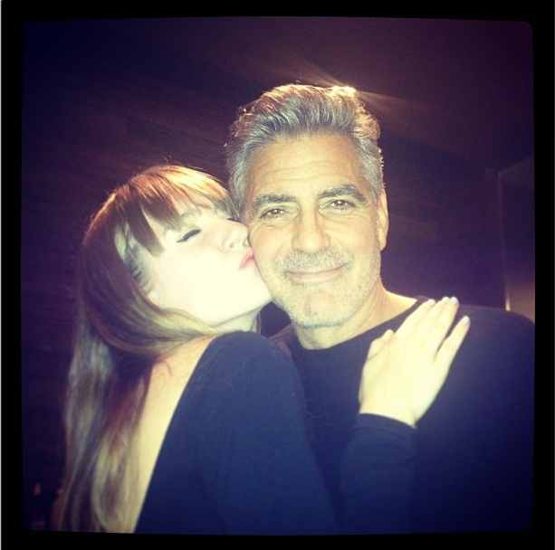

Slide 91
GEORGE
FAN
Plants vs. Zombies, Insaniquarium
Game Designer - Independent
@TheGeorgeFan
Notes:
That’s OK George, you’re the only George *I’m* a fan of.
George Fan!

Slide 92
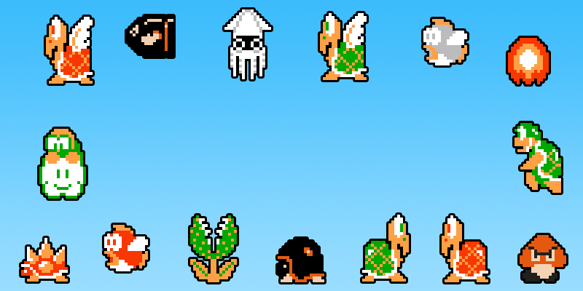
Make Your Enemies
Actually Different!
George Fan (@thegeorgefan)
Notes:
All right! Time to talk about *my* rule, which is: Make Your Enemies *Actually* Different.

Slide 93
Notes:
First, let’s zoom in to this word “Actually”. What do I mean by that?

Slide 94
Make it so each new enemy is
tackled in a different way
George Fan (@thegeorgefan)
Notes:
In this case I mean making it so each new enemy is tackled in a different way.
Think of some of the games you’ve played where the enemy design was exceptional. I bet in each case, there was a high density of.. enemies that you had to use different methods to defeat.
The reason I have Super Mario in this slide here is cause it did such a great job of meeting this criteria. Take note of the feeling you have right now looking at this set of bad guys, remembering all the different ways you defeated them. If you’re ever unsure about enemy design, I recommend analyzing how the first Super Mario did things as a clean example of enemy design done right.

Slide 95
Notes:
Sometimes we set out to make a game with a lot of enemy variety. On the surface, they look different enough and seem to do different things.

Slide 96
Notes:
But to the player, fighting enemies gets monotonous, and each new encounter doesn’t bring enough uniqueness to the table.

Slide 97
Notes:
We’re left with a game that feels like you just fought a bunch of the same thing. Today I wanna teach you how to avoid that.

Slide 98
Player Brain-O-Vision
TM
Notes:
To help us along, I’m gonna introduce a tool called Player Brain-O-Vision. It’s a way for us remember to get into the player’s brain, as this *is* the most important perspective.

Slide 99
Our player
Notes:
So let’s meet our player.

Slide 100
Our player has a brain
Notes:
Naturally, our player has a brain.

Slide 101
?
Notes:
Let’s try using Player Brain-O-Vision and imagine what this guy is thinking. Let’s try to “see” what his brain sees.
Based on this guy’s expression? I think.. He’s playing..

Slide 102
Player Brain-O-Vision
TM
Notes:
Bill & Ted’s Excellent Video Game Adventure.

Slide 103
Making Enemies Actually Different:
DON’T DO’s
Notes:
So let’s get into this. We’ll start with some DON’T DO’s. Things you don’t wanna do when your goal is to make your enemies *actually* different.

Slide 104
Don’t Do:
Different Look, Same Function
Notes:
The first pitfall happens when we have two enemies that are identical, and think

Slide 105
Don’t Do:
Different Look, Same Function
Notes:
“Oh, we’ll just change the look of one of em, that’ll be enough” <buzzer sound> Do this over and over again and you’ll have the most boring game of all time.

Slide 106
Don’t Do:
Different Look, Same Function
Notes:
The problem here is the two enemies are still doing the same thing. The player doesn’t handle the skeleton any different than the mummy..

Slide 107
Player Brain-O-Vision
TM
->
Notes:
so they’ll store both of these in their brain, occupying the same space. Our brains tend to clump things together in order to keep up with all the information we need to process.
The player’s goal is to beat the game. To that extent, the player doesn’t care that the mummy *looks* different from the skeleton. In its efficiency, the brain will squeeze these two together into just one enemy. This is what we want to avoid, as we’re not adding to true enemy variety here.

Slide 108
Don’t Do:
Just Palette Swap It
Notes:
Even lazier than just changing the look is just changing one color to another.
I certainly didn’t think of this grey fish from Super Mario as a brand new enemy type. I’ll cut them some slack though cause they were up against some extreme memory limitations at the time. But nowadays, color shifts just don’t pass for “brand new enemies” anymore.

Slide 109
I don’t want to play this game
Notes:
An abundance of em can often make your game feel cheap, and most of the time you’re better off with just 1 solid enemy instead of 2 palette swapped enemies.

Slide 110
Don’t Do:
Small changes in hp, damage, speed
500 hp
510 hp
Notes:
One more thing is.. to not think of small changes in hp, damage, and speed as brand new enemies.
A little bit of this is ok, but if every bad guy in your game can be defined as just some degree of these three variables, then you’ve done something wrong.

Slide 111
Player Brain-O-Vision
TM
->
~500 hp
500 hp
510 hp
Notes:
The difference between 500 and 510 is small enough that once again, the player’s brain will meld the these two together into just one bad guy with about 500 hp.

Slide 112
That’s it for
DON’T DO’s…
Notes:
All right, now that we’ve covered some Don’t Do’s…

Slide 113
Now time for some
DO DO’s
Notes:
It’s time to take a look at some DO DO’s. I’ve got a big DO DO for you to take a look at..

Slide 114
Attributes of
Differentiation
Notes:
And I’m gonna call it “Attributes of Differentiation”. Basically, these are qualities enemies might have.. that would make em play differently than others. You can think of em as sort of avenues to explore while you’re trying to make your enemies actually different. In this section of the talk, I’ll provide you with some examples of attributes I find myself using again and again.

Slide 115
Attribute #1:
Movement
Notes:
The first one of these is movement. We can often make the player handle the enemy differently by simply introducing a new movement pattern. In Super Mario, these enemies all have distinct styles of movement, and the player needs to account for each one differently.

Slide 116
Notes:
But be careful you don’t spend time making things have special movement.. when in the end.. it gets handled by the player just like something else. In this hypothetical game, we’ve designed two enemies, a bird that moves in a zig-zag and a bat that moves in a sine wave.

Slide 117
Player Brain-O-Vision
TM
->
Notes:
There might cases where this difference *is* significant, but for the most part I see players handling these two movement patterns in the same way. Again, not good if our goal is to make enemies *actually* different. Stuff like this can be found through playtesting, but using Player Brain-O-Vision we can often catch it earlier.

Slide 118
Attribute #2: Priority
Notes:
Another attribute I like to consider is priority, meaning, when seeing lots of enemies on screen, which order to defeat them in? How urgently do I need to defeat this enemy relative to others? An example of a high-priority enemy is the generator from Gauntlet. It doesn’t matter how many ghosts you kill, if you don’t kill the bone piles first, they’ll keep spawning more ghosts.

Slide 119
High Priority
Notes:
The UFO from Space Invaders is an interesting case. You prioritize it not because it’s threatening, but because it’s worth a bunch of points and only on screen for a short time.

Slide 120
Notes:
Let’s think about priority some more. Suppose we have a group of basic grunts.

Slide 121
Notes:
Now, let’s add a healer to that group. If we try killing the grunts first, it’ll take a long time cause the healer will keep em healed.

Slide 122
Notes:
So the correct play is to focus on killing the healer first, and then take care of the grunts after the healer’s been dealt with.

Slide 123
Notes:
But what about this?

Slide 124
Notes:
Let’s *instead* add a high damage archer to the group..

Slide 125
Notes:
In this case, the *archer* becomes our number one priority because it’s the more threatening unit. Again, it makes more sense to prioritize killing the archer over the grunts. Now, as long as our weird hypothetical game only presented you units in these two formations of..

Slide 126
Notes:
Healers and grunts..

Slide 127
Notes:
and Archers and grunts..

Slide 128
=
Notes:
The healer and archer would be seen as exactly the same unit in terms of priority, even though they perform vastly different roles. Just something to keep in mind.

Slide 129
“Deal with me first”
Notes:
Fact is, a lot of enemies we design tend to fall into this high priority, “Deal with me first” category

Slide 130
“Deal with me last”
->
->
Notes:
That’s why it’s good to explore the other end of the spectrum and design enemies that are best dealt with last. Both of these guys get mad and become more deadly after you damage em, so it’s best to ignore em if you have other enemies to deal with.

Slide 131
“Deal with me last”
High HP
Low Damage
Notes:
Enemies that have lots of hp but do low amounts of damage also fit into this “Deal with me last” category.

Slide 132
Attribute #3:
Timing
Notes:
Another attribute we can consider is timing. It often involves having an enemy that’s more dangerous during certain times, or likewise more vulnerable during certain times.
A prime example of this is the Piranha Plant from Super Mario. It’s safe to pass while it’s retracted into the pipe, but dangerous otherwise.

Slide 133
Notes:
The lava bubble is another bad guy from Super Mario that hops in and out of the lava and requires timing to avoid.

Slide 134
=
Notes:
If we’re observant and we use Player Brain-O-Vision, we might discover some similarities between these two units. I initially didn’t think of these as being very similar, but in researching this talk I realized they’re both timing-based enemies with up-and-down movement. The only differences are the lava bubble is immune to Mario’s fireball, and only found in lava. If this were our own game, it would then be up to us to decide if these small differences were enough.

Slide 135
Attribute #4:
Range
Notes:
On to the next attribute. When most of the enemies in your game do close-ranged attacks, you can shake things up by offering some enemies that are long-ranged.
The catapult zombie and hammer brothers are examples of long-ranged enemies in games where most of the enemies are close-ranged.

Slide 136
Notes:
Likewise, if most enemies in your game are long-ranged, consider throwing in a close ranged enemy just to liven things up. A lot of these attributes come down to.. being observant of what happens often in your game.. and designing things to disrupt that.

Slide 137
Attribute #5:
Enemy-Counters-Player
Notes:
Which brings us to our next attribute. A good way of coming up with new enemies.. is to think about what actions the player does most often in your game, then come up with an enemy that counters that action to shake things up.

Slide 138
Counters stomp
Counters fireball
Notes:
In Super Mario, the most common action used to defeat enemies is to stomp on em. So halfway through the game, the Spiny enemy is introduced, which you obviously can’t stomp on. Along the same lines, the buzzy beetle is immune to fireballs, another common action of Mario’s. Both enemies do their job of keeping Mario on his toes and not letting him perform just the same actions over and over.

Slide 139
Notes:
In Plants vs Zombies, I had the early issue of Wall-nuts being really good, and noticed players falling into a rut of using wall-nuts to solve everything. So I designed these Pole-Vaulting zombies that would leap over the first plant they ran into, thus making wall-nuts a little less universally good and mixing things up for the player.

Slide 140
Think about what your players do
often, then come up with ways
for your enemies to disrupt that.
Notes:
A good exercise is to think about what your players do often, then come up with ways for your enemies to disrupt that.

Slide 141
Notes:
For example if you notice in your game your players are just constantly spamming AOE attacks, you could design a unit that counters AOE. These eggs, when damaged,

Slide 142
Notes:
release extremely powerful demons, punishing the player who just goes around AOE attacking everything willy-nilly. Unleashing all the demons at once is a bad move as the demons become too overwhelming for the player to deal with.

Slide 143
Notes:
Instead, the correct play is to break the eggs one at a time, dealing with each demon individually before breaking the next egg. With this one enemy type, we’ve added a nice beat to our game where players play more carefully for a bit, and then they go back to constantly spamming AOE.

Slide 144
Notes:
In PvZ, I knew players had gotten used to zombies coming in from the right side of the screen,

Slide 145
Notes:
So I threw em a curveball and introduced the Digger Zombie, which surprise-attacks your plants from the left!

Slide 146
Attribute #6:
Player Counters Enemy
Notes:
On the flip side, we can also design enemies by giving em a weakness, then offering a power to the player that exploits that weakness

Slide 147
Feels good to defeat enemies you
couldn’t before
->
Notes:
It often feels satisfying to face down an enemy that’s tough to deal with initially, but then you’re given a power that helps you defeat it with ease.

Slide 148
Attribute #7: Attention
(telegraphed attacks)
Notes:
Finally, we have the attribute of player attention, which mostly comes in the form of telegraphed attacks. This involves designing enemies whose attacks deal a ton of damage if not avoided, but give you ample warning.. so you have the opportunity to avoid them. How they function in groups of enemies is to demand your attention for some amount of time.
An example of this is from Super Mario 3, where this sledge brother will jump up into the air, forecasting a ground slam. If you’re still on the ground when they slam into it, you’ll be stunned for some time. This forces you to pay attention and react by jumping.

Slide 149
To recap…
Notes:
Ok, to sum things up, here’s an effective way to make your enemies *actually* different.

Slide 150
To recap…
1. Use Attributes of Differentiation
Notes:
First, try to design each new enemy with an Attribute of Differentiation in mind.

Slide 151
To recap…
1. Use Attributes of Differentiation
a) Movement b) Priority
c) Timing d) Range
e) Player-Counters-Enemy
f) Enemy-Counters-Player
g) Attention (Telegraphed Attacks)
Notes:
I’ve given you some examples of attributes you can explore.

Slide 152
To recap…
1. Use Attributes of Differentiation
a) Movement b) Priority
c) Timing d) Range
e) Player-Counters-Enemy
f) Enemy-Counters-Player
g) Attention (Telegraphed Attacks)
2. Then use Player Brain-O-Vision
Notes:
Once you’ve done that, pass the enemy through Player Brain-O-Vision.. to see if it *actually* makes the player DO something different.

Slide 153
To recap…
1. Use Attributes of Differentiation
a) Movement b) Priority
c) Timing d) Range
e) Player-Counters-Enemy
f) Enemy-Counters-Player
g) Attention (Telegraphed Attacks)
2. Then use Player Brain-O-Vision
3. Your enemies are now awesome!
Notes:
Do this, and your enemies will be awesome. I’m looking forward to playing your upcoming games with truly diverse sets enemies.

Slide 154
Thanks!
@thegeorgefan
georgefan@gmail.com
Notes:
If you wanna talk some more about this, my info’s right here. I’ll be coming out with a game later this year that has its own share of enemies that’re *actually* different. Follow me on twitter for more updates on that.
All right, thanks!

Slide 155
GEORGE
FAN
Plants vs. Zombies, Insaniquarium
Game Designer - Independent
@TheGeorgeFan
Notes:
Thank you George!
I feel like right now people in the audience have cracked open their lap tops are ripping out their palette swapping code

Slide 156
LIZ
ENGLAND
Sunset Overdrive, Resistance 3, Scribblenauts
Designer – Ubisoft Toronto
@lizardengland
Notes:
Next up, we have Liz England!
She’s a game design veteran having worked on everything to Scribblenauts to Resistance to…
Sunset Overdrive – a game we both worked on but as is the case in modern development, we didn’t meet until this week
Now, for another modern reality, if you’ve been doing game design in a big team for a while, you’ll know that no one reads your precious game design documents.
Well, good news, Liz has the solution!

Slide 157
Notes:
Today I'll share a trick - more like a philosophy - with you that I call "Make actionable documentation".
This talk is kind of specific and more advanced. It assumes you already know many of the trials and tribulations of making good design documentation.
(Will replace this pic with one of GDDs around the office)

Slide 158
PRIOR GDC TALKS ON DOCUMENTATION:
How to Write Great Design Documents by Damion Schubert
One Page Designs by Stone Librande
'Nuff Said: Comics as Design Documentation by Matthew Derby
Notes:
For some further reading I recommend this prior GDC talks on design docs because I'll be spending my 10 minutes on a specific subtopic.

Slide 159
thesis!
MAKE
ACTIONABLE
DOCUMENTATION
Notes:
For some further reading I recommend this prior GDC talks on design docs because I'll be spending my 10 minutes on a specific subtopic.

Slide 160
MAKE DOCUMENTATION
Notes:
For some further reading I recommend this prior GDC talks on design docs because I'll be spending my 10 minutes on a specific subtopic.

Slide 161
MAKE DOCUMENTATION
THAT PEOPLE CAN ACT ON
Notes:
For some further reading I recommend this prior GDC talks on design docs because I'll be spending my 10 minutes on a specific subtopic.

Slide 162
MAKE DOCUMENTATION
THAT PEOPLE CAN ACT ON
Notes:
For some further reading I recommend this prior GDC talks on design docs because I'll be spending my 10 minutes on a specific subtopic.

Slide 163
MAKE DOCUMENTATION
THAT PEOPLE CAN ACT ON
Notes:
For some further reading I recommend this prior GDC talks on design docs because I'll be spending my 10 minutes on a specific subtopic.

Slide 164
MAKE DOCUMENTATION
THAT PEOPLE CAN ACT ON
for people
not features!
Notes:
For some further reading I recommend this prior GDC talks on design docs because I'll be spending my 10 minutes on a specific subtopic.

Slide 165
“WHO IS THIS DOCUMENT FOR?”
Notes:
Instead of asking "what feature am I documenting?" ask yourself this: "Who is this document for?" A game can't read your documentation, it doesn't care if you document it or not. People can read it. People care. So write docs for people, not for games. If you can design a game for players, you can design documentation for readers.

Slide 166
DOCUMENTS FOR PEOPLE:
Notes:
When I talk about people I'm obviously talking about members of your team. When you spec out a system, don't make a doc for the entire team. Make a document for an artist, or for designers, or for programmers.

Slide 167
DOCUMENTS FOR PEOPLE:
whole team leads & CD designers programmers artists audio team project managers testers etc…
Notes:
When I talk about people I'm obviously talking about members of your team. When you spec out a system, don't make a doc for the entire team. Make a document for an artist, or for designers, or for programmers.

Slide 168
DOCUMENTS FOR PEOPLE:
whole team leads & CD designers programmers artists audio team project managers testers etc…
whole team? …all programmers? …all AI programmers? …that one guy Adam!
Notes:
I encourage you to get more specific, though. I try to write my documentation for an INDIVIDUAL as often as possible. So that means you make documentation for Adam the AI Programmer and ideally you sit down and talk to him about what he wants to see in that doc. Different people work differently, so some people want extensive use cases, others want flowcharts, and others might work best if you kind of narrate what the player is doing.
The important thing here is: the needs of the reader are most important. It doesn't matter whether you detail everything out, but rather you detail what your reader needs to know.
SUBJECTIVELY describe the system instead of OBJECTIVELY describing it

Slide 169
“WHAT DO I WANT THEM TO DO WITH IT?”
Notes:
The next question I ask myself is, "What do I expect them to do with this?" Well what do you expect them to do? You expect them to read it, right? Wrong! Documentation needs to be USED somehow, not just read. It needs to serve a purpose.

Slide 170
MAKE DOCUMENTATION
THAT PEOPLE CAN ACT ON
Notes:
So my second rule is "Make documentation with a purpose".

Slide 171
MAKE DOCUMENTATION
THAT PEOPLE CAN ACT ON
with an
explicit purpose
Notes:
So my second rule is "Make documentation with a purpose".

Slide 172
USE YOUR VERBS
Notes:
Game designers like to talk about verbs (I know I do) like run, jump, shoot, interact, etc. I like to try applying those verbs to my documentation. This is just identifying what action you want people to take when they read it.

Slide 173
USE YOUR VERBS
to read to inform to approve to implement
to track to debug to follow along
Notes:
Maybe you are writing a doc for someone to implement a system for you, which requires a large amount of detail. Or this doc is a blueprint that tells fellow designers how to implement something according to a set of guidelines. Maybe it's just a high level spec for a system that you need to shop around to the leads and creative director for approval. Maybe it's a big poster meant to inform the rest of the team and get everyone on the same page.
The important lesson here is that form will follow function.

Slide 174
MAKE
ACTIONABLE
DOCUMENTATION

Slide 175
MAKE
ACTIONABLE
DOCUMENTATION

Slide 176
PRACTICAL CONSIDERATIONS
Notes:
As a summary, some of the practical implications of writing documents for people with a purpose is:
I write docs when they are needed, and not before. I try not to anticipate what documents we’ll need.
Each doc tends to be smaller and more concise, with its own specified level of detail. That also means a single feature may have multiple documents for it with some, but not tons, of overlap.
Actionable docs require different styles of documents for different needs. I find word docs are still the most common, but least effect, way of sharing information. Don’t be afraid to use infographics or flowcharts or excel files, and keep in mind the level fo detail you actually need and don’t try to be everything for everyone.
It’s also okay to not keep docs up to date if they’ve served their purpose. Sometimes the purpose in ongoing throughout development, and other times we should be comfortable with abandoning documentation.
Lastly, ‘actionable’ documentation (and I’ll get into examples in a moment) doesn’t have to replace every document you make. It replaces about half of my documentation, and the other half still tend to follow more traditional standards.

Slide 177
PRACTICAL CONSIDERATIONS
Different Styles for Different Needs (infographics, charts, flowcharts, word)
Notes:
As a summary, some of the practical implications of writing documents for people with a purpose is:
I write docs when they are needed, and not before. I try not to anticipate what documents we’ll need.
Each doc tends to be smaller and more concise, with its own specified level of detail. That also means a single feature may have multiple documents for it with some, but not tons, of overlap.
Actionable docs require different styles of documents for different needs. I find word docs are still the most common, but least effect, way of sharing information. Don’t be afraid to use infographics or flowcharts or excel files, and keep in mind the level fo detail you actually need and don’t try to be everything for everyone.
It’s also okay to not keep docs up to date if they’ve served their purpose. Sometimes the purpose in ongoing throughout development, and other times we should be comfortable with abandoning documentation.
Lastly, ‘actionable’ documentation (and I’ll get into examples in a moment) doesn’t have to replace every document you make. It replaces about half of my documentation, and the other half still tend to follow more traditional standards.

Slide 178
PRACTICAL CONSIDERATIONS
Different Styles for Different Needs (infographics, charts, flowcharts, word)
Smaller, More Concise Docs …but one feature means many documents
Notes:
As a summary, some of the practical implications of writing documents for people with a purpose is:
I write docs when they are needed, and not before. I try not to anticipate what documents we’ll need.
Each doc tends to be smaller and more concise, with its own specified level of detail. That also means a single feature may have multiple documents for it with some, but not tons, of overlap.
Actionable docs require different styles of documents for different needs. I find word docs are still the most common, but least effect, way of sharing information. Don’t be afraid to use infographics or flowcharts or excel files, and keep in mind the level fo detail you actually need and don’t try to be everything for everyone.
It’s also okay to not keep docs up to date if they’ve served their purpose. Sometimes the purpose in ongoing throughout development, and other times we should be comfortable with abandoning documentation.
Lastly, ‘actionable’ documentation (and I’ll get into examples in a moment) doesn’t have to replace every document you make. It replaces about half of my documentation, and the other half still tend to follow more traditional standards.

Slide 179
Notes:
Let’s compare that to another visual document that has very few words.
This is a map of Sunset Overdrive we used throughout production. It’s visual, but relatively easy to keep up to date, and almost everyone on the team used it to keep track of the state of the city. Being used a lot, that meant there was high demand to keep it up to date – which led to the doc’s form (photoshop file, not as pretty, rough around the edges).
The downside is that it requires some memorization of in-house terminology, so when new people rolled onto the team they needed to be brought up to speed on color coding or what “C2” or “Q3” meant. But that was not the intended reader for this document.

Slide 180
…for the team to track…
Notes:
Let’s compare that to another visual document that has very few words.
This is a map of Sunset Overdrive we used throughout production. It’s visual, but relatively easy to keep up to date, and almost everyone on the team used it to keep track of the state of the city. Being used a lot, that meant there was high demand to keep it up to date – which led to the doc’s form (photoshop file, not as pretty, rough around the edges).
The downside is that it requires some memorization of in-house terminology, so when new people rolled onto the team they needed to be brought up to speed on color coding or what “C2” or “Q3” meant. But that was not the intended reader for this document.

Slide 181
Notes:
I want to compare that to another map, though. One of the side effects of actionable documentation is that you often need multiple docs for one feature.
This map is a literal poster printout of the prior map with post-it notes. It was used by the challenge and quest team to help identify where to populate the game with content. This came about because sitting in a meeting trying to edit a photoshop file on a computer was really awkward compared to piling around a real life map and just moving post-it notes around.
(I promise to take a higher quality photo for final draft)

Slide 182
…for quest designers to plan…
Notes:
I want to compare that to another map, though. One of the side effects of actionable documentation is that you often need multiple docs for one feature.
This map is a literal poster printout of the prior map with post-it notes. It was used by the challenge and quest team to help identify where to populate the game with content. This came about because sitting in a meeting trying to edit a photoshop file on a computer was really awkward compared to piling around a real life map and just moving post-it notes around.
(I promise to take a higher quality photo for final draft)

Slide 183
Notes:
How content unlocks over time. Tons of information, not many words. Giant flowchart image was much more successful than excel tracker. This doc was written in a way that meant everyone on the team could use it to find in-game content and grok our rollout plan.

Slide 184
…for QA to debug…
Notes:
How content unlocks over time. Tons of information, not many words. Giant flowchart image was much more successful than excel tracker. This doc was written in a way that meant everyone on the team could use it to find in-game content and grok our rollout plan.

Slide 185
Notes:
Here’s another compare and contrast.
This is the mission flow when a player accepts a mission, and what happens when they fail, or die and respawn, or quit the game, or change to a quest, and so on. This annotated flowchart worked great for the programmer working on that system.
However, when I handed it to the mission designers to implement, their eyes just glazed over. As a result…

Slide 186
…for programmers to implement…
Notes:
Here’s another compare and contrast.
This is the mission flow when a player accepts a mission, and what happens when they fail, or die and respawn, or quit the game, or change to a quest, and so on. This annotated flowchart worked great for the programmer working on that system.
However, when I handed it to the mission designers to implement, their eyes just glazed over. As a result…

Slide 187
Notes:
I made this document. It still tells the reader about how a mission flows, but it has much less level of detail and uses explicit examples from within the game. In this case, designers can look at examples and make intuitive leaps about how that affects their mission structure, without being bogged down with details they don’t really need.

Slide 188
…for designers to plan out…
Notes:
I made this document. It still tells the reader about how a mission flows, but it has much less level of detail and uses explicit examples from within the game. In this case, designers can look at examples and make intuitive leaps about how that affects their mission structure, without being bogged down with details they don’t really need.

Slide 189
PRACTICAL CONSIDERATIONS
It’s Okay to Not Update Docs if they’ve served their purpose, retire them
Notes:
As a summary, some of the practical implications of writing documents for people with a purpose is:
I write docs when they are needed, and not before. I try not to anticipate what documents we’ll need.
Each doc tends to be smaller and more concise, with its own specified level of detail. That also means a single feature may have multiple documents for it with some, but not tons, of overlap.
Actionable docs require different styles of documents for different needs. I find word docs are still the most common, but least effect, way of sharing information. Don’t be afraid to use infographics or flowcharts or excel files, and keep in mind the level fo detail you actually need and don’t try to be everything for everyone.
It’s also okay to not keep docs up to date if they’ve served their purpose. Sometimes the purpose in ongoing throughout development, and other times we should be comfortable with abandoning documentation.
Lastly, ‘actionable’ documentation (and I’ll get into examples in a moment) doesn’t have to replace every document you make. It replaces about half of my documentation, and the other half still tend to follow more traditional standards.

Slide 190
PRACTICAL CONSIDERATIONS
It’s Okay to Not Update Docs if they’ve served their purpose, retire them
The game is its own best documentation once you get to a certain point in development
Notes:
As a summary, some of the practical implications of writing documents for people with a purpose is:
I write docs when they are needed, and not before. I try not to anticipate what documents we’ll need.
Each doc tends to be smaller and more concise, with its own specified level of detail. That also means a single feature may have multiple documents for it with some, but not tons, of overlap.
Actionable docs require different styles of documents for different needs. I find word docs are still the most common, but least effect, way of sharing information. Don’t be afraid to use infographics or flowcharts or excel files, and keep in mind the level fo detail you actually need and don’t try to be everything for everyone.
It’s also okay to not keep docs up to date if they’ve served their purpose. Sometimes the purpose in ongoing throughout development, and other times we should be comfortable with abandoning documentation.
Lastly, ‘actionable’ documentation (and I’ll get into examples in a moment) doesn’t have to replace every document you make. It replaces about half of my documentation, and the other half still tend to follow more traditional standards.

Slide 191
Notes:
This is a visual design document early on Sunset Overdrive. It worked exceptionally well to inform the whole team about the traversal system we had planned for the game. It has a lot level of detail and a lot of visuals, and shows the promise of traversal. There’s very little text.
There’s no way you can implement off of this document. Visual docs also look great but are practically impossible to keep up to date. But that’s okay! If you’re making actionable docs – for people and with a purpose – then when it fulfills that purpose, don’t be afraid to retire the doc and archive it. You do not need to try to keep every doc up to date.

Slide 192
…for the team to update them
Notes:
This is a visual design document early on Sunset Overdrive. It worked exceptionally well to inform the whole team about the traversal system we had planned for the game. It has a lot level of detail and a lot of visuals, and shows the promise of traversal. There’s very little text.
There’s no way you can implement off of this document. Visual docs also look great but are practically impossible to keep up to date. But that’s okay! If you’re making actionable docs – for people and with a purpose – then when it fulfills that purpose, don’t be afraid to retire the doc and archive it. You do not need to try to keep every doc up to date.

Slide 193
The game is its own documentation.
Notes:
…but sometimes it does! In the case of our vanity system, by the end of the project we did not have a holistic doc that explained vanity to the whole team. People who worked directly on it had their own documentation.
With a system like player vanity, which had little affect on your work if you weren’t on the system directly, we found that just pointing to other games, or to the initial preproduction proposal, or just letting people use the vanity closet that existed in game was enough to communicate the system to the team.
The game itself was better documentation than anything we would’ve written. A doc here would have been wasted time.

Slide 194
PRACTICAL CONSIDERATIONS
Write Docs When Needed, Not Before don’t write for an audience that doesn’t exist yet
Notes:
As a summary, some of the practical implications of writing documents for people with a purpose is:
I write docs when they are needed, and not before. I try not to anticipate what documents we’ll need.
Each doc tends to be smaller and more concise, with its own specified level of detail. That also means a single feature may have multiple documents for it with some, but not tons, of overlap.
Actionable docs require different styles of documents for different needs. I find word docs are still the most common, but least effect, way of sharing information. Don’t be afraid to use infographics or flowcharts or excel files, and keep in mind the level fo detail you actually need and don’t try to be everything for everyone.
It’s also okay to not keep docs up to date if they’ve served their purpose. Sometimes the purpose in ongoing throughout development, and other times we should be comfortable with abandoning documentation.
Lastly, ‘actionable’ documentation (and I’ll get into examples in a moment) doesn’t have to replace every document you make. It replaces about half of my documentation, and the other half still tend to follow more traditional standards.

Slide 195
PRACTICAL CONSIDERATIONS
Write Docs When Needed, Not Before don’t write for an audience that doesn’t exist yet
Suddenly, Documentation! requires a fast turn-around
Notes:
As a summary, some of the practical implications of writing documents for people with a purpose is:
I write docs when they are needed, and not before. I try not to anticipate what documents we’ll need.
Each doc tends to be smaller and more concise, with its own specified level of detail. That also means a single feature may have multiple documents for it with some, but not tons, of overlap.
Actionable docs require different styles of documents for different needs. I find word docs are still the most common, but least effect, way of sharing information. Don’t be afraid to use infographics or flowcharts or excel files, and keep in mind the level fo detail you actually need and don’t try to be everything for everyone.
It’s also okay to not keep docs up to date if they’ve served their purpose. Sometimes the purpose in ongoing throughout development, and other times we should be comfortable with abandoning documentation.
Lastly, ‘actionable’ documentation (and I’ll get into examples in a moment) doesn’t have to replace every document you make. It replaces about half of my documentation, and the other half still tend to follow more traditional standards.

Slide 196
PRACTICAL CONSIDERATIONS
Write Docs When Needed, Not Before don’t write for an audience that doesn’t exist yet
Suddenly, Documentation! requires a fast turn-around
Runs Counter to the Plan-It-Out-First Mentality but remember that YOU can be your own reader
Notes:
As a summary, some of the practical implications of writing documents for people with a purpose is:
I write docs when they are needed, and not before. I try not to anticipate what documents we’ll need.
Each doc tends to be smaller and more concise, with its own specified level of detail. That also means a single feature may have multiple documents for it with some, but not tons, of overlap.
Actionable docs require different styles of documents for different needs. I find word docs are still the most common, but least effect, way of sharing information. Don’t be afraid to use infographics or flowcharts or excel files, and keep in mind the level fo detail you actually need and don’t try to be everything for everyone.
It’s also okay to not keep docs up to date if they’ve served their purpose. Sometimes the purpose in ongoing throughout development, and other times we should be comfortable with abandoning documentation.
Lastly, ‘actionable’ documentation (and I’ll get into examples in a moment) doesn’t have to replace every document you make. It replaces about half of my documentation, and the other half still tend to follow more traditional standards.

Slide 197
PRACTICAL CONSIDERATIONS
Not an Excuse to Avoid Documentation more docs, not fewer!
Notes:
However there’s some caveats…
It really depends on the size and structure of the team. A team of two people probably already do something like this, and
It can be hard to get new people up to speed if you don’t have comprehensive documentation. However, comprehensive but totally out of date documentation is bad too, and that’s what we normally deal with.
Some people work best with planning every detail out first before you start implementing, but actionable documentation . On the flip side, don’t be afraid to write documentation for YOURSELF as the reader, so if planning on paper works great for you then keep doing it.
Suddenly, documentation! – if you want until someone asks for documentation, that might mean you have to drop everything and write it immediately.
Like I said, this means more docs and not less.
And it’s not an excuse to avoid documentation. This is simply an attempt to make less wasteful documentation.
So now I am going to dive into some practical examples of docs I think were exceptionally “actionable”. I’ve made most of these, but did

Slide 198
PRACTICAL CONSIDERATIONS
Not an Excuse to Avoid Documentation more docs, not fewer!
Doesn’t Replace Every Document but you can still try to make those more actionable
Notes:
However there’s some caveats…
It really depends on the size and structure of the team. A team of two people probably already do something like this, and
It can be hard to get new people up to speed if you don’t have comprehensive documentation. However, comprehensive but totally out of date documentation is bad too, and that’s what we normally deal with.
Some people work best with planning every detail out first before you start implementing, but actionable documentation . On the flip side, don’t be afraid to write documentation for YOURSELF as the reader, so if planning on paper works great for you then keep doing it.
Suddenly, documentation! – if you want until someone asks for documentation, that might mean you have to drop everything and write it immediately.
Like I said, this means more docs and not less.
And it’s not an excuse to avoid documentation. This is simply an attempt to make less wasteful documentation.
So now I am going to dive into some practical examples of docs I think were exceptionally “actionable”. I’ve made most of these, but did

Slide 199
Notes:
Now, sometimes you still need to spec out a large system on paper and that leads you to the infamous 20+ page design doc.
A trick I use to get those more usable is to try to keep one subject per page. This is what the design doc for the object editor in the third Scribblenauts looked like. Part of my approach is the idea that if someone needs to know about a specific part of the system, I could just send them THAT PAGE and nothing else in the doc to help inform them. In a way, each page in this doc is it’s own document.

Slide 200
PRACTICAL CONSIDERATIONS
Depends on Size/Structure of Team big or small? indie or AAA? local or distributed?
Notes:
However there’s some caveats…
It really depends on the size and structure of the team. A team of two people probably already do something like this, and
It can be hard to get new people up to speed if you don’t have comprehensive documentation. However, comprehensive but totally out of date documentation is bad too, and that’s what we normally deal with.
Some people work best with planning every detail out first before you start implementing, but actionable documentation . On the flip side, don’t be afraid to write documentation for YOURSELF as the reader, so if planning on paper works great for you then keep doing it.
Suddenly, documentation! – if you want until someone asks for documentation, that might mean you have to drop everything and write it immediately.
Like I said, this means more docs and not less.
And it’s not an excuse to avoid documentation. This is simply an attempt to make less wasteful documentation.
So now I am going to dive into some practical examples of docs I think were exceptionally “actionable”. I’ve made most of these, but did

Slide 201
PRACTICAL CONSIDERATIONS
Depends on Size/Structure of Team big or small? indie or AAA? local or distributed?
Difficult to Onboard New People Without Comprehensive Documentation but this is always a problem
Notes:
However there’s some caveats…
It really depends on the size and structure of the team. A team of two people probably already do something like this, and
It can be hard to get new people up to speed if you don’t have comprehensive documentation. However, comprehensive but totally out of date documentation is bad too, and that’s what we normally deal with.
Some people work best with planning every detail out first before you start implementing, but actionable documentation . On the flip side, don’t be afraid to write documentation for YOURSELF as the reader, so if planning on paper works great for you then keep doing it.
Suddenly, documentation! – if you want until someone asks for documentation, that might mean you have to drop everything and write it immediately.
Like I said, this means more docs and not less.
And it’s not an excuse to avoid documentation. This is simply an attempt to make less wasteful documentation.
So now I am going to dive into some practical examples of docs I think were exceptionally “actionable”. I’ve made most of these, but did

Slide 202
MAKE
ACTIONABLE
DOCUMENTATION
Notes:
So that brings me to the end of my talk on “Make Actionable Documentation”.

Slide 203
LIZ
ENGLAND
Sunset Overdrive, Resistance 3, Scribblenauts
Designer – Ubisoft Toronto
@lizardengland
Notes:
Thank you Liz!
The one type of document Liz didn’t go into is the one you write to impress the publisher.
Ah, to live in a world where those weren’t necessary.

Slide 204
MICHAEL
DE PLATER
Shadow of Mordor,
End War, Total War
VP of Design - Monolith
Notes:
And finally, our last speaker is here to end us on a subject dear to my heart.
Often we think about game systems as intuitive or sticky or challenging or good for flow.
But what about systems that produce humanity?
Our next speaker has worked on everything from sports games to Total War to 2014’s game of the year Shadow or Mordor…
Michael de Plater!

Slide 205
MAKE YOUR GAME TELL REAL-WORLD STORIES
Game Resume – since ‘95
EA Sports – Aussie & English
Total War - Shogun to Rome
Tom Clancy - EndWar & Ghost Recon
Shadow of Mordor – The Nemesis System
Notes:
Todays talk is going to be about what connects all of these games I’ve worked on over the last 20 years. They are all systems which produce stories.

Slide 206
SPORTS & WAR & PERSONAL RIVALRIES
Story Systems
Conflict
Time
Social Structures
Notes:
These three may seem very different genres, but the underlying designs have a lot in common in terms of how they handle conflict, drama, time and the nesting of the personal within the epic.
There’s a reason they all have Movie Genres and TV Tropes pages

Slide 207
SPORT SEASONS
The Sports Season as Interactive Narrative
Time always moves forward
Failure creates drama
Escalation to a dramatic climax
Neither linear or branching narrative
Notes:
Sports Seasons ARE Game Design – and you can see examples of different Designs across different Sports and Cultures.
Including of course E-Sports
Confession and Caveat – I don’t really like Sports. I’ve always just looking at them from the perspective of a Game Designer.

Slide 208
SPORT SYSTEMS
Sports Systems dynamically generate Personal Narratives
Champions
Heroes & Villains
Underdogs
Grudges & Revenge
Rematches
Within a structure of Epic Conflict
Notes:
As well as high level narrative structures Sports System Design also generates personal / individual stories implicitly through the structure of its design - Daily.
[Will update this to the most recent Sports News]
Heroes and Villains emerge implicitly out of the Design of Winners, Losers, Statistics, Injuries, Grudges

Slide 209
CREATING STORIES FROM DATA
Sports Systems even generate narratives from Statistical Analysis
Notes:
Statistics can create Stories within the System as well as Meta-Narratives outside of the Game – via commentators and players.
People may follow these stories without even particularly caring for the sports or even watching them.

Slide 210
WAR STORIES
War Shares many of the same dramatic structures
Conflict
Escalation
Personal within Epic
Social Structures
Notes:
War scenarios are similar to sports in many structural ways.
Time always moves forward to create dramatic situations – no “restarting” the moment something goes wrong.
Just as you may lose the play but win the game, you may lose the battles but winning the war, escalating towards an inevitable climax

Slide 211
WAR STORIES
Death & Drama
Inheritance – Traits in Rome: Total War
Notes:
Specific example of embracing Failure but moving forward – in Rome: Total War characters would die (similar to injuries in Sports) but leave heirs who would inherit Traits.
Creates strong attachment to characters and emergent drama.
And incidentally, looking forward, the Nemesis System deals with this in a different way through Cheating Death and Scars – literally writing stories on the flesh of the characters.

Slide 212
WAR STORIES
Civil Wars in Rome: Total War
- Balancing as a Story Mechanic
Notes:
Often in Strategy Games the late game is dull because beyond a tipping point you know who’s going to win and the rest is mopping up
We dealt with this in Rome: Total War with the Civil War Mechanic – once the Roman Faction is close to winning it splits up and becomes multiple factions – generating drama and a climatic end game.
And this system was derived from the real world reference.

Slide 213
THE NEMESIS SYSTEM
This time it’s Personal
Conflict
Time moves forward
Embracing failure as drama
Social Structures
Notes:
Though it may be not obvious at first, I hope see now how this built to Shadow or Mordor’s Nemesis System.
Same ingredients as Sports and War – but focused on the Personal, which is appropriate for an Action Game. The ideas are similar but the scale is different.
Once again there is an emergent procedural narrative that’s neither linear nor branching. Player has tremendous choice and personal investment in a story that is “theirs” yet we’re not building bespoke “branches”.

Slide 214
THE NEMESIS SYSTEM
Social Systems & Hierarchies as Story Mechanics
Notes:
Humans are hard-wired to understand shifting social structures and hierarchies – a great deal of human storytelling and drama is based on this model. Makes it a great mechanic for generating stories.
The Nemesis System enabled Players to intervene in a Social Hierarchy through Death (their own death moved up their enemies), Revenge and ultimately Domination and Power – players loved being able to mess with social structures.

Slide 215
THE NEMESIS SYSTEM
Death & Memory
The world exists without the player
The Player is at the center of the world
Notes:
Balancing two superficially conflicting ideas is key
Note this is very similar to Play by Play Commentary in Sports Games – but again the difference / emphasis is on making it Personal and embedding it into the dynamic narrative.

Slide 216
UNLIMITED STORIES
Social & Multiplayer
- Narrative synergy between game and meta-game
Notes:
I spoke about my experience across 3 genres – Sports, Wargames and Action-Adventure.
But these ideas can be applied across many genres yet explored.
For instance, think about how all of these ideas are implicit to Multiplayer Experiences and there are huge opportunities to narrativise those systems – like the fertile grounds of Minecraft & Day-Z – where the stories could be made strong while still keeping the game systems-driven and open-ended.

Slide 217
REFERENCES
Highly recommended for thinking about Stories as Systems
Playing at the World – The History of D&D
Play Unsafe – Improve Techniques in Role Playing
Glued to Games – Player Engagement through Needs Satisfaction

Slide 218
MAKE YOUR GAME TELL REAL-WORLD STORIES
Michael de Plater
www.lith.com
Monolith is hiring!
Notes:
Thanks

Slide 219
MICHAEL
DE PLATER
Shadow of Mordor,
End War, Total War
VP of Design - Monolith
Notes:
Thank you Mike!

Slide 220
Notes:
That’s our final session – now that we’ve seen all these, think about how you may want to add these rules to your own deck of design rules
Like building your own personal Magic deck, the cards you choose to use will effect how you develop games.
Different decks will work better or worse in different situations.
But most important is that your deck of game design rules feels good to you and is one that you enjoy developing with.

Slide 221
Rules of the Game
With your host Richard Rouse III @richardrouseiii
Lee Perry
@MrLeePerry
Emily Short
@emshort
George Fan
@TheGeorgeFan
Liz England
@lizardengland
Michael de Plater
“Pizzazz First, Polish Later”
“Visualize Early”
“Make Your Enemies Actually Different!”
“Make Actionable Documentation”
“Make Your Game Tell Real-World Stories”
Slides at: www.paranoidproductions.com
Notes:
That’s a wrap!
Slides are up right now on my web site if you want to go check them out – in the writings section!
We’re not going to do Q&A but we’ll be hanging around up here for as long as they’ll let us if you want to come ask us some questions.
Please remember to fill out your surveys. The comments are really useful for helping us know how we did and what you’d like to see in the future.
Thanks to all the speakers and thanks to everyone for coming!

